Slide 1




EURO-LABS
Basic Training School 2026
IFIN-HH, Bucharest-Magurele, Romania
11- 23 May 2026
Dr. Alexandra Spiridon – Org. Com. chair
https://indico.nipne.ro/event/429/overview

Slide 2
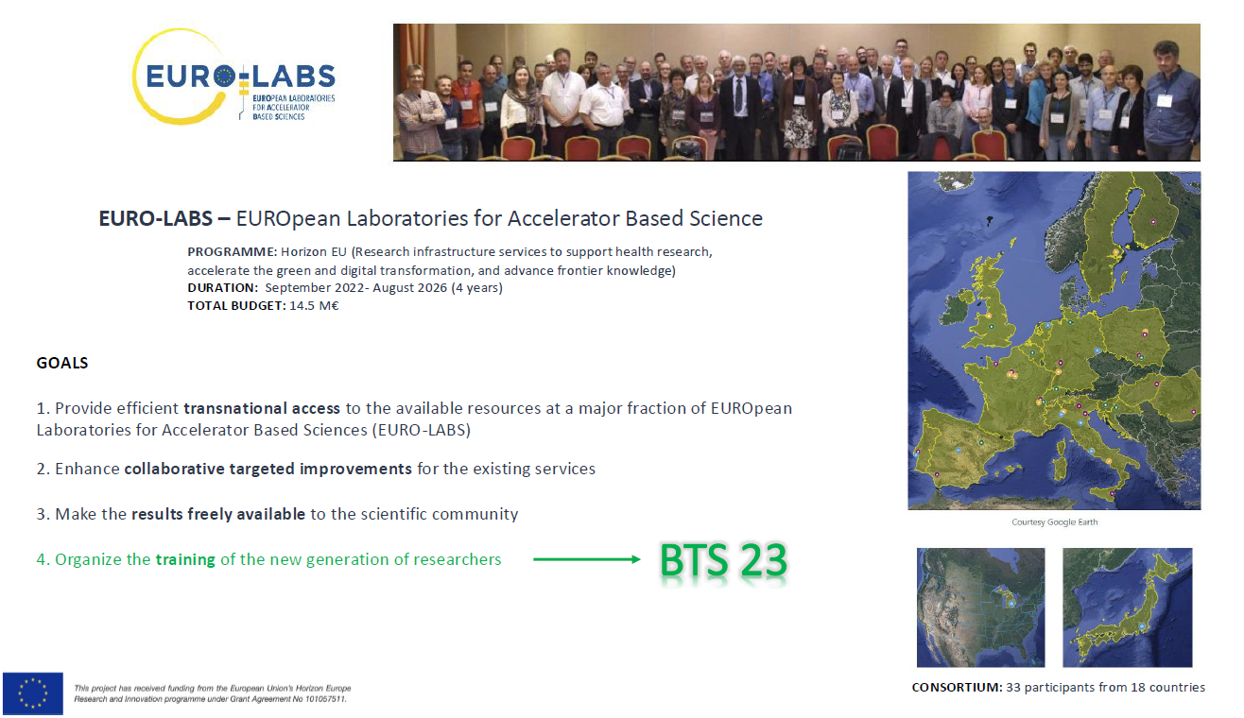
BTS26

Slide 3
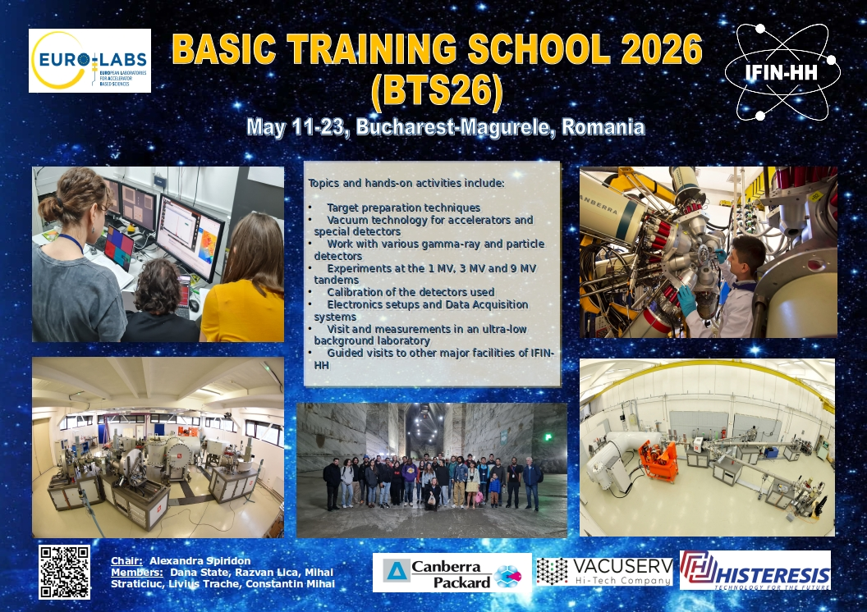

Slide 4
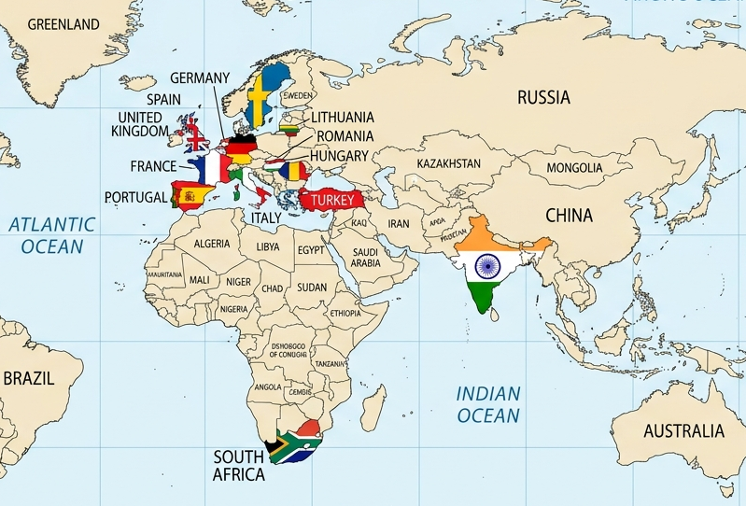
25 participants from 15 countries
Germany (1)
Portugal (1)
Spain (4)
Romania (5)
Turkey (1)
South Africa (2)
Italy (2)
India (1)
Hungary (1)
United Kingdom (3)
Sweden (1)
Lithuania (1)
Greece (1)
Netherlands (1)
France (1)

Slide 5
Useful details
While on the premises, including dormitory, please respect all common-sense rules and the rules of IFIN-HH regarding work safety and radiation protection
Today we start with a Welcome by institute’s Management
Followed by the mandatory – by law – work safety and radiation protection instructions – pay attention
Will proceed by the poster session (one floor above): each will install her/his poster and will be allocated 5 min to explain it to your colleagues
  Before the end of the day, you’ll receive the money for your subsistence support as per EURO-LABS rules
  Be careful with your trip from/to the dormitory; you need ID to re-enter IFIN-HH each morning and make sure you are in time
  Lunch at one of either two buffets: one close to the IFIN-HH gate, another at ELI-NP
  You manage yourselves the breakfasts and dinners – care for keeping the kitchen clean
You are split in 4 working groups of 6 students each and will follow the program posted on the indico website
As per our aim, this is going to be a hands-on event, support will be available. Ask questions!
Will work mostly at the 3 accelerators; visits are scheduled to the other large installations of IFIN-HH

Slide 6
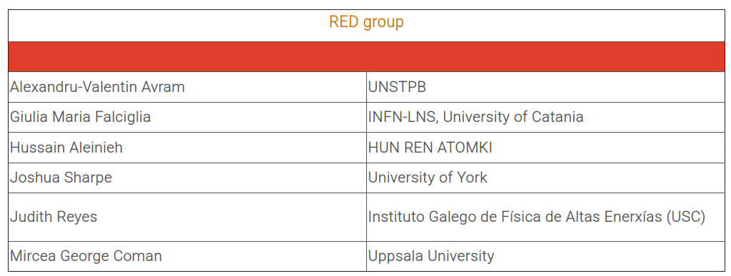
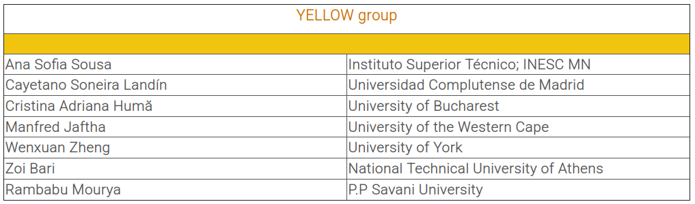
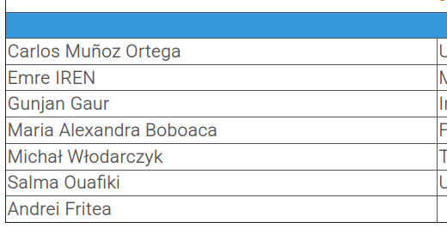
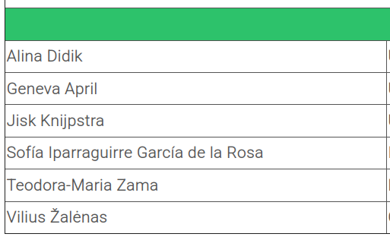
Participants have been split into 4 groups:
(the groups have been posted on indico as well, and are color coded with your lanyards)

Slide 7
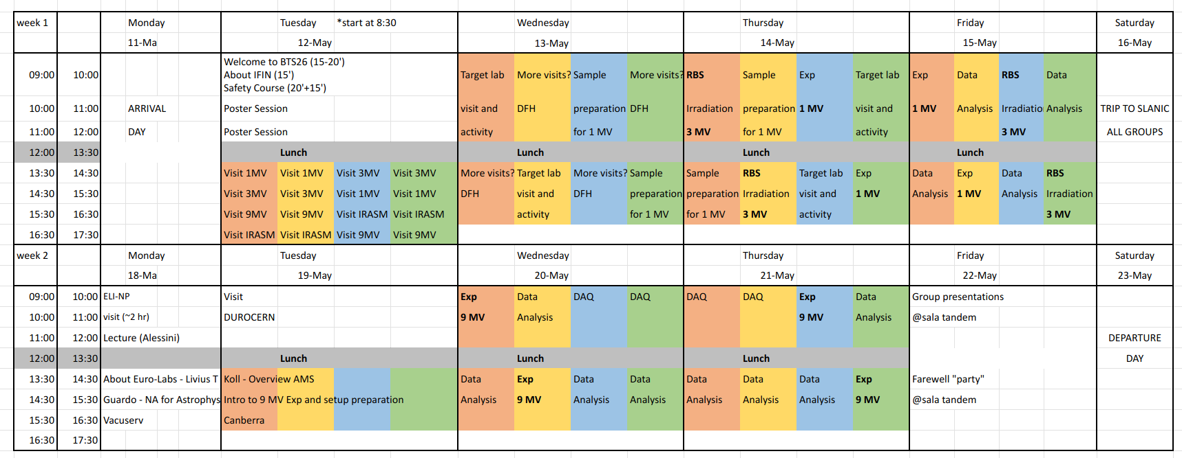
Timetable on indico: https://indico.nipne.ro/event/429/timetable/
(*check it regularly, as changes will be updated there)
(*currently, only the first week is uploaded as we’re still finalizing some details for the second week)

Slide 8
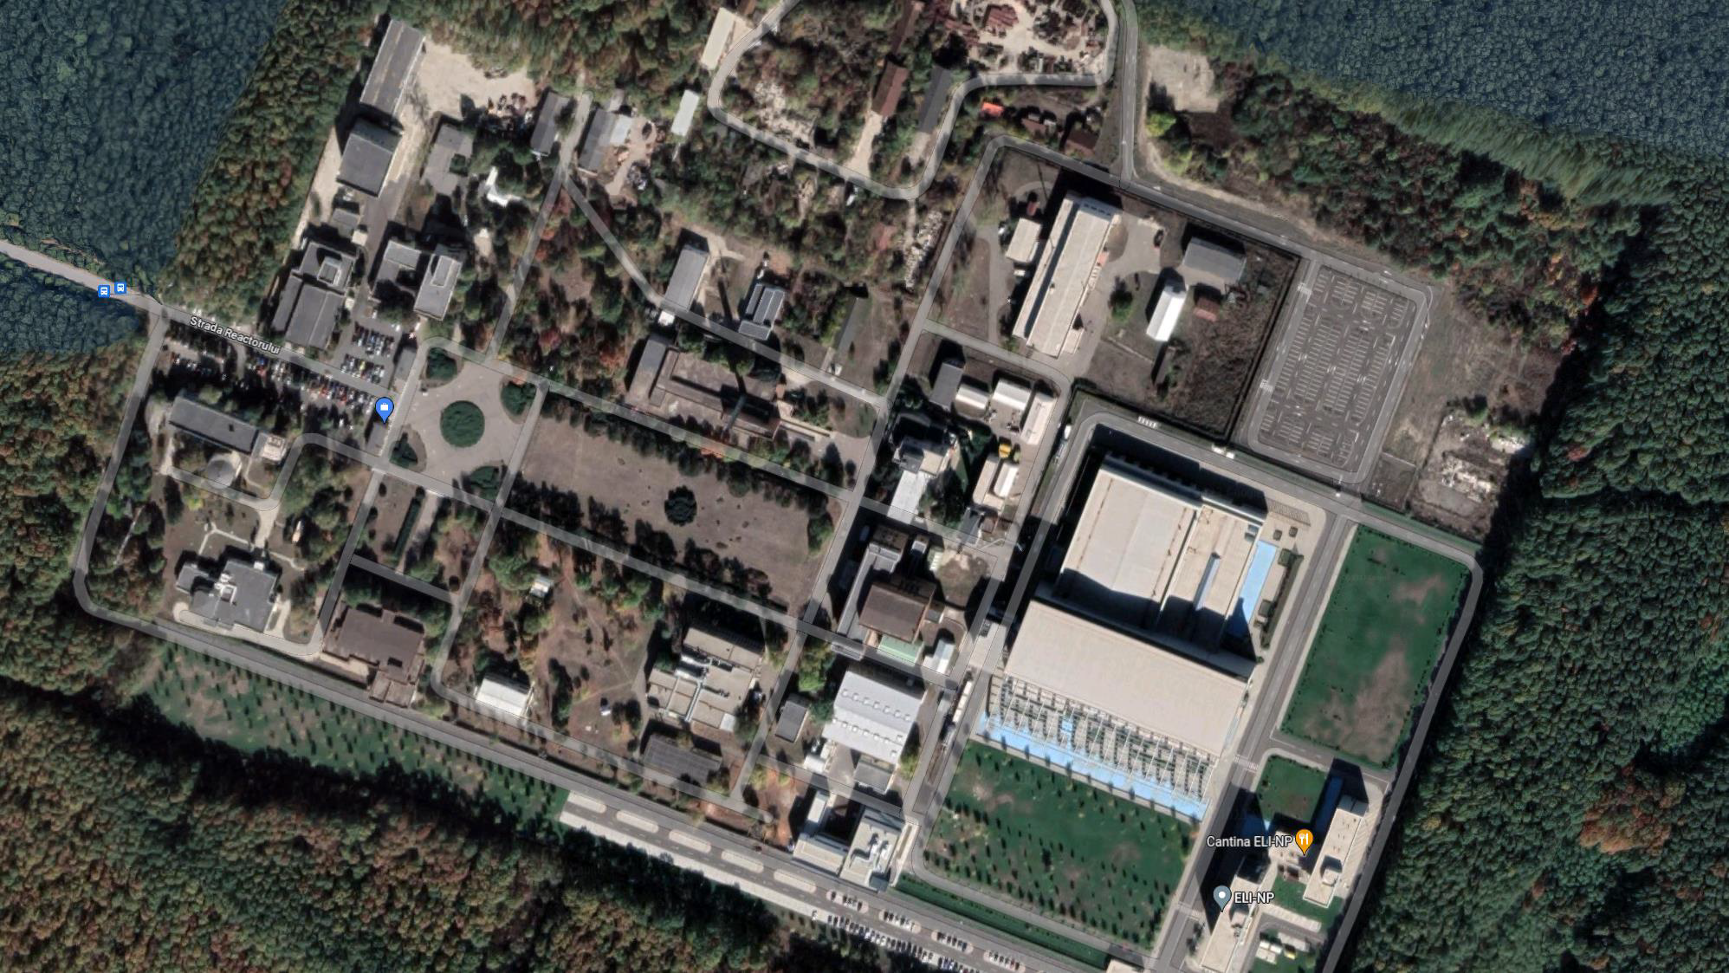
Multipurpose Irradiator Facility
(IRASM)
Hadron Physics Department
(DFH)
Extreme Light Infrastructure – Nuclear Physics
(ELI-NP)
IFIN-HH Cafeteria
1 MV Tandetron (ROAMS)
Department of Applied Nuclear Physics (DFNA)
ELI-NP Cafeteria
9 MV Tandem and 3 MV Tandetron Accelerators
Department of Nuclear Physics (DFN)
Department of Applied Nuclear Physics (DFNA)

Slide 9
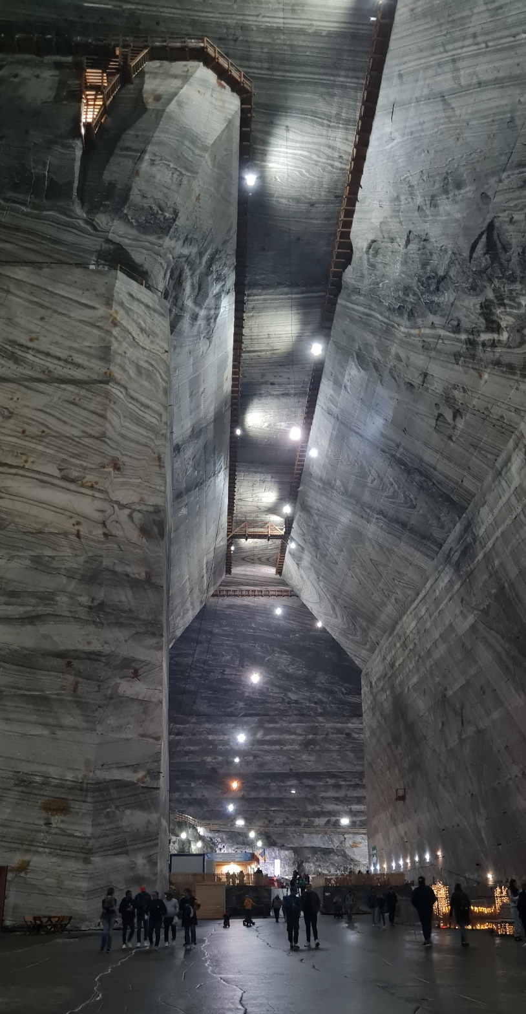
Saturday, 17 May
Visit to Slanic Salt Mine and the μBq laboratory
Dress warmly!!!
Bring a light jacket or at least a hoodie
We will depart early, likely ~7 a.m.
Final details will be communicated to you on Thursday

Slide 10
Few reminders
You must be accompanied by an IFIN-HH employee at all times inside the institute
In order to process your meal stipend / daily allowance, we need daily signatures from you to confirm your presence
For travel reimbursement (EU participants), please send/give us the necessary documents by Friday, 15 May
At the end of BTS26, on Friday May 22nd, a report will be presented by each team (2-3 speakers) with a summary of all the activities, your results and your personal feedback.
An anonymous survey will also be sent to each participant to review their experience at BTS26, helping EURO-LABS improve the future editions.

Slide 11
Useful to know/meet
Here are those that can assist and help you throughout your stay:
  Alex Spiridon
  Dana State
  Mihai Straticiuc
  Razvan Lica
  Andrei Turturica
  Ana Maria Stefanescu
  Decebal Iancu
  Ion Burducea
  Radu Andrei

Slide 12






