Slide 1
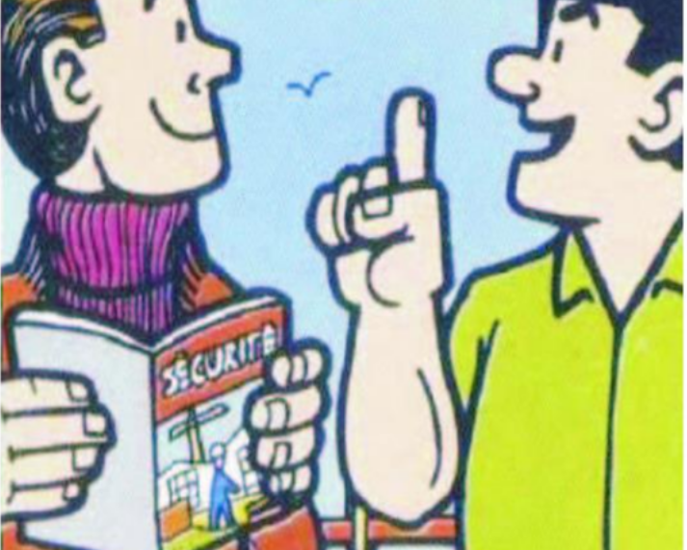




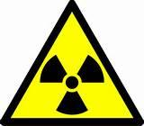


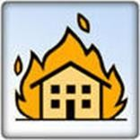

 | Horia Hulubei National Institute for R&D in Physics and Nuclear Engineering IFIN-HH 30 Reactorului St., Bucharest-Magurele, jud. Ilfov, P.O.B. MG-6, RO-077125, ROMANIA tel.: (+4) 021 404 2301, fax.: (+4) 021 457 4440 www.nipne.ro secretar@ifin.nipne.ro
 | 🡂 | 🡂🡂🡂 This guide contains general aspects on safety physical protection and emergency situations th your entire activity |  | and health at work, radiological safety, at you must know and comply with during in IFIN-HH.

Slide 2

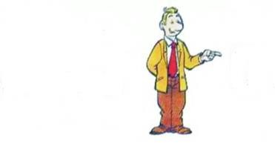
Welcome to IFIN-HH!
This guide:
Is intended for all categories of employees working in IFIN-HH;
Is used for the general – introductory training performed when you came to IFIN-HH, in accordance with the provisions of procedures code PO-IFIN-87 and code PO-IFIN-88, review in force, as well as periodical training performed according to the legal requirements.
Contains general information on safety and health at work, radiological safety, physical protection and emergency situations regulations (prevention
and fire extinction and civil protection) that must be known and observed and cognition will allow you to be more receptive in what regards your safety.
The risks specific to the working place shall be introduced to you by the head of the entity where you work, during the working place training.
Because everyone’s health and safety is an unconditional priority, IFIN-HH uses all means necessary to protect you.
OBJECTIV:
0 ACCIDENTS
This objective can be met by applying the safety managerial policy of IFIN-HH and by involving the entire personnel we shall be able to maintain in IFIN-HH the best safety conditions for the employees, collaborators, contractors, visitors and protect the environment.
1

Slide 3
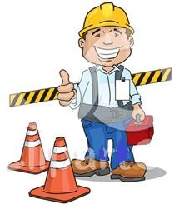
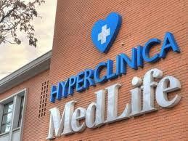
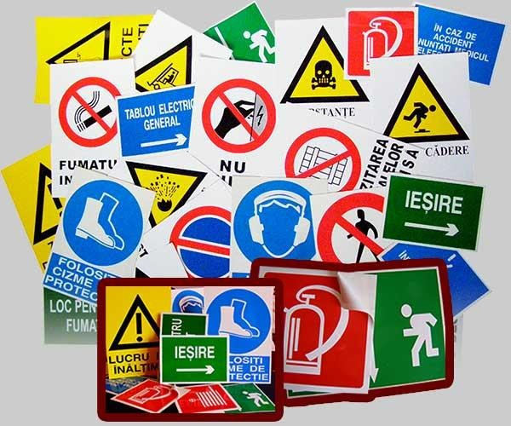
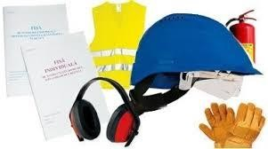
GENERAL RULES FOR SAFETY AND HEALTH AT WORK The main reference documents applicable: Law no. 319/2006 on safety and health at work, as further amended and supplemented. Government Decision no.1425/2006 for the approval of the Methodological Norms for implementing the provisions of Law of Safety and health at work no.319/2006, as further amended and supplemented. Government Decision no.355/2007 on the surveillance of employees’ health, as further amended and supplemented.
The employees’ health is monitored according to the legislation in force. Your participation in the periodical monitoring of health is mandatory. The occupational health services are provided by MEDLIFE clinic. All employees benefit from a standard occupational health subscription covered by IFIN-HH which, optionally and for a fee, can extend to more clinical investigations.
Observe all signs of work safety that you encounter at the working place and while moving inside IFIN-HH!
Wear the personal protective equipment given to you in order to avoid the occurrence of accidents, where necessary. Use correctly the work equipment supplied. Observe the work and safety and health at work instructions that apply to your working place. Signal any dangerous situation to your superior in order to take the necessary measures.
2

Slide 4

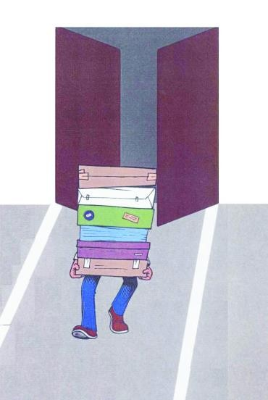
The normal access hours in IFIN-HH are from 6³⁰ AM to 7 PM, during business days. During non-business days and during business days from 7 PM to 6³⁰ AM, the access shall be allowed only with your superior’s approval and only if in the building there are at least two people. The access with personal car inside the institute is not allowed. IFIN-HH has parking spaces outside the main access gates | Rules of access and mobility in IFIN-HH Access in IFIN-HH Group I is done through the access control point equipped with radiometric portals, based on access cards, by observing the provisions of the applicable procedures and regulations in force, namely: Procedure code PO-IFIN-110 Procedure code PO-IFIN-112 Procedures specific to each department Internal Regulation of IFIN-HH The access in IFIN-HH buildings from Group II is done based on the access cards. You are bound to know the content of the above documents. They can be consulted on the intranet network of IFIN-HH.
Do not block the access routes!
3

Slide 5
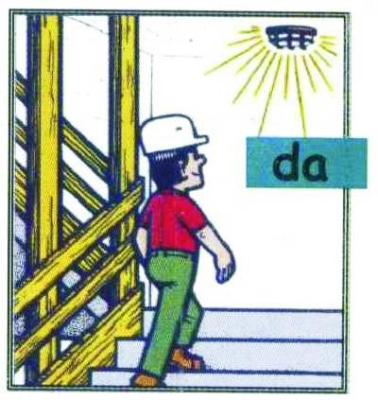
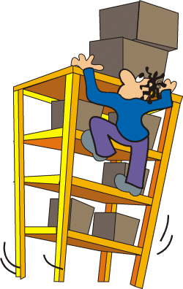


Make sure the access areas inside the buildings are properly lighted and secured. Railings are only meant to help you ascend and descend. Do not bend over the railings and do not climb on them. Fall hazard!
When you take an object at height, you must use a safe ladder. It is forbidden to improvise footbridges made of chairs, boxes, drawers, placed one on top of the other, because they are not steady and they can overturn.
Observe the traffic rules on public roads and the additional rules with IFIN-HH buses, on the route declared from home to the working place and from the working place to home!
4

Slide 6
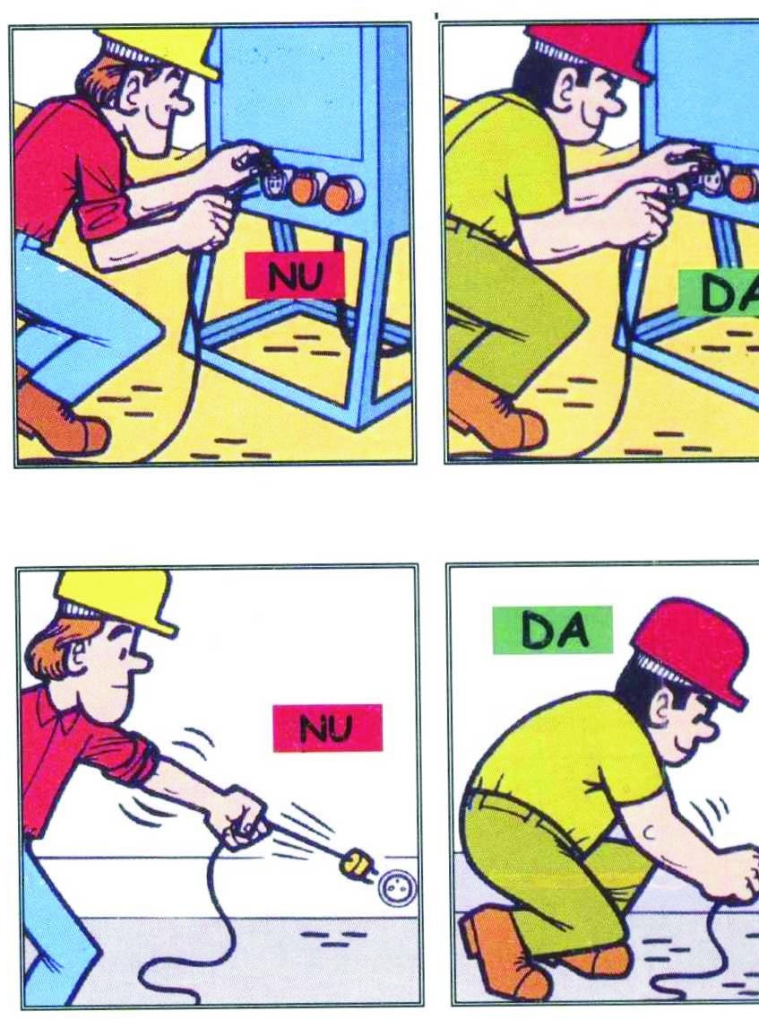
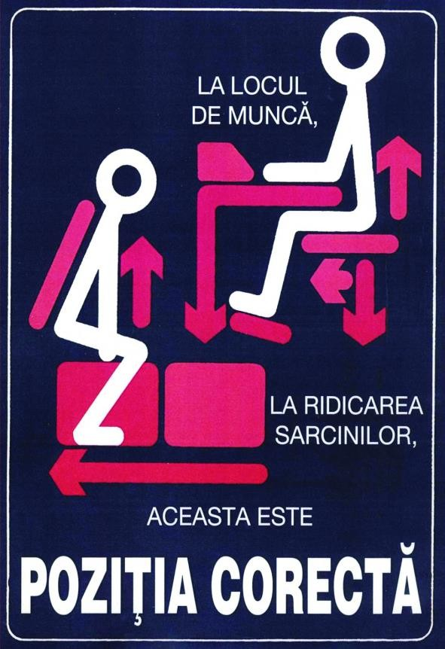
Do not intervene on the electrical installations and do not use improvisations!
It is forbidden to use of damaged sockets, broken cables, with deteriorated insulation or without plugs or without grounding. In order to avoid short-circuits in case of accidental floods, it is forbidden to place electrical equipment (computers, printers, multiple sockets, UPS non- interruptible sources etc.) on the floor. Do not use the same socket for more electrical devices at the same time, using power strips. It is forbidden to intervene on the installations, devices or electrical panel. Any malfunction shall be signalled to your superiors for remedy purposes. When you disconnect, do not pull the wire.
Observe the correct position if you have a mainly fixed working place. Also, pay attention to the position you have when you lift weights. At the working place, this is the correct position when you lift weights. Lift the weight by using the leg strength and keeping your back straight, in order to avoid body distortions!
5

Slide 7
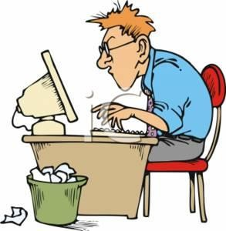
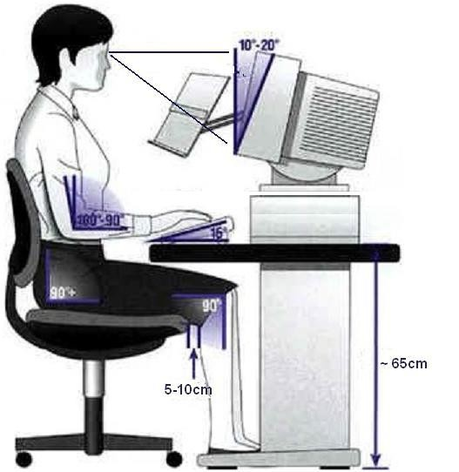
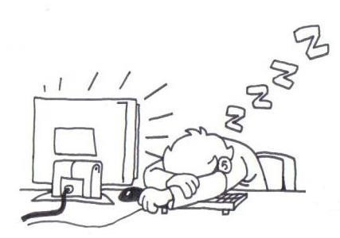
 | Use the computer safely!
The correct position at the office: Keep you back and shoulders straight; all three curves of your back should rest against the back of the chair; For a more comfortable position, you may use special cushions to maintain your back and posterior in a correct position; Try to distribute your weight correctly, on both hips; Keep your knees bended in a correct angle – the knees should be at the same level with the hips or little higher; Don’t keep your legs crossed – blood circulation will be hampered; Don’t sit in the same position for more than 40 minutes; Keep your feet on the floor; When you sit on a mobile chair, don’t turn from the waist, but try to turn with the entire body.
YES | NO
6

Slide 8
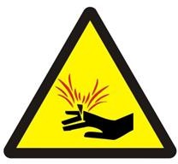
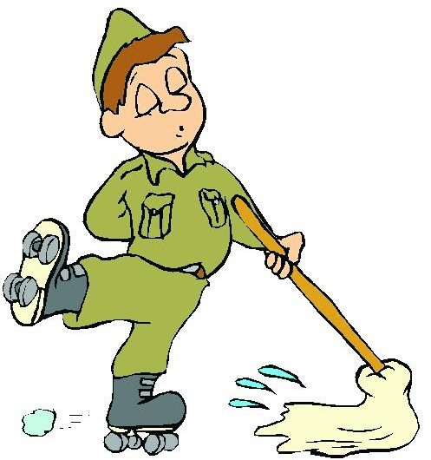


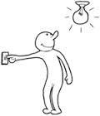
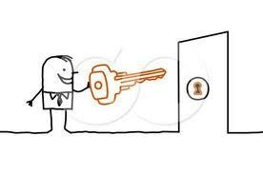
Be careful when you handle sharp objects!
When using a knife or a cutter, you must keep your fingers as far from the blade’s edge as possible.
Pay attention when filing in folders with mechanical fasteners.
Sharp and blunt objects (pencils, cutters, blades etc.) must be places in separate compartments of drawers.
In case of cutting or wounding, use the first aid kit or ask for specialised intervention.
  Give proper attention to tidiness and cleanliness at the working place.
  By always keeping the working place clean, you will avoid unwanted accidents.
Remember that a clean and organised institution also means safety!
When finishing the working hours, before you leave the office, you must:
  Pull all power strips from the socket;
  Check all water taps;
  Turn off all air conditioners and computers;
  Turn off the light;
  Lock the door.
Also observe all rules specific to the working place, where necessary.
General rules when finishing the
working hours
CAUTION!
You are not allowed to stay after the normal working hours unless you have your direct superior’s approval, minimum
2 persons.
7

Slide 9
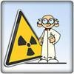
GENERAL RULES OF
RADIOLOGICAL SAFETY
Main reference documents applicable:
Law 111/1996, republished, on the safe performance, regulation, authorisation and control of nuclear activities, as further amended and supplemented.
Fundamental norms of radiological safety approved by CNCAN Order no.14, of January 24th, 2000 and
published in the Romanian Official Gazette no.404
₂₉th
encore, of August 2000, available for
consultation on www.cncan.ro.
Other CNCAN Norms applicable and specific radiation protection procedures at the level of IFIN-HH and departments level as well.
The intervention plan in cases of radiological emergency on IFIN-HH premises Group I, review in force.
The specific of our activity involves an inherent radiological risk in certain departments. Therefore, through adequate policies, technical and organisational measures and periodical trainings, we always take care that our activity is performed under high safety conditions. Also:
We observe strictly the legal and regulatory requirements on radiological safety, safety and health at work, emergency situations, physical protection and environment;
We provide permanently the dosimetric monitoring of the entire personnel;
The spaces where we work are separated into controlled areas and supervised areas, areas where strict measures are imposed for the prevention, control of exposure and diminution of radiological risks;
Each employee, visitor, external collaborator or contractor is informed and trained on the risks of the activity in controlled and supervised areas as well as the protection and prevention measures.
All activities performed in radiological areas have procedures defined and the measures for the optimisation of radiation protection and the implementation of ALARA principle (As Low As Reasonably Achievable) are permanently updated and continuously improved.

Slide 10
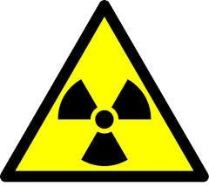
Radiation protection means provided
in IFIN-HH
In order to provide radiological safety to the professionally exposed personnel, to the population and the environment, IFIN-HH:
Performs all activities that involve radiological risks within the limits and conditions of the permits issued by the National Committee for the Nuclear Activities Control (CNCAN) which represents the national authority in the field of regulation, authorisation and control of nuclear activities in Romania;
Provides the periodical medical supervision of the entire personnel;
Provides a wide range of personal equipment for protection against ionising
radiations and also collective equipment for radiation protection and equipment for radiation monitoring. Also, you can find the necessary equipment to provide radiological safety against normal and potential exposure (gate, locker, healthcare point, decontamination options, radiation protection means, dosimetric devices, safety systems, etc.);
Permanently provides both the monitoring of the work environment and the monitoring of radioactivity in the environment;
Has laboratories notified by CNCAN for personal dosimetric monitoring
activities of external exposure and internal contamination of the personnel, with dosimetric film, thermo-luminescent dosimeter and human body counter, estimating the dose equivalent and actual doses;
Provides the safe management of institutional radioactive waste resulting from the activities performs in accordance with the regulatory requirements;
Provides the proper training of professionally exposed personnel, in the field of
radiological safety and maintains the level of training and technical competence of the entire personnel, through both adequate training programs organised at department and institute level and permanent participation in CNCAN authorized courses, international conferences, workshops, seminars, etc.;
Classifies working places depending on the radiological risk, according to the specific criteria established by CNCAN;
Performs the classification on categories of radiological risk of professionally
exposed persons, in accordance with the legal and regulatory requirements applicable;
has implemented control and surveillance measures adapted to different areas
and work conditions, including the ones of personal surveillance, when required;
monitors the exposure to radiation in case of accidental and emergency exposure;
in case of contamination, it has the procedures and necessary infrastructure for decontamination.

Slide 11

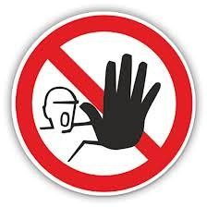
Also, IFIN-HH uses, in the practises involving radiological risks, only personnel who have practice permits valid for that activity, classified on three levels:
level 1 – for workers in the radiological field;
level 2 – for those in charge with radiological safety and persons leading activities with radiation sources;
level 3 – for experts certified in radiological protection.
IFIN-HH is constantly preoccupied with radiation protection optimisation, which relies on the following prevention means:
time (reducing the exposure period);
distance (increasing the distance between the worker and the radiation source);
protection (using protection barriers, such as lead or concrete shields
between the workers and the radiation source. The type of protection is chosen and used depending on the type of radiations and energy.)
Thus, all activities involving work with radiations and radioactive materials is done based on defined procedures, in accordance with the limits and conditions set in the permits issued by CNCAN, by the personnel with technical competencies and with equipment and installations that have radiological safety permits.
Access in the areas controlled from a radiological safety point of view is done based on the access procedures specific to the area and with the approval of the head of that entity.
Access in areas in which you are not authorised is forbidden!

Slide 12
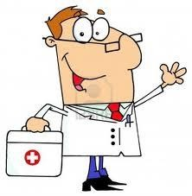
Obligations of professionally exposed persons
not to expose themselves and others to radiations over the reasonable values necessary for the performance of work tasks; not to use radiation sources or nuclear installations for purposes other than those they have been created and certified for, or for works other than those resulted from the work tasks; to wear the personal protection equipment and the personal monitoring means; to inform immediately the person in charge with radiological safety in the department where he/she works, about any malfunction observed in the personal protection equipment, in the collective protection equipment or in the warning system; to hand over, immediately after use, at the place of storage, the personal protection equipment and the personal monitoring means; to comply with the work instructions and with the indications of the person in charge with radiological safety for the controlled or supervised area; to come at the medical examinations or tests requested by the competent physician and to give all details related to the status of his/her health requested by the competent physician; to immediately notify, also in writing, the person in charge with radiological safety or the management of the department, every time he/she has solid reasons to believe that he/she or somebody else suffered an overexposure or a special event occurred such as the loss/theft of a radiation source, radioactive material leakage, malfunctions that endanger the safety of radiation sources, nuclear installations or the integrity of the protection means; to participate in the intervention exercises in cases of radiological emergencies and at sessions for testing knowledge in the field of radiological safety; in order to protect the contamination checking equipment, at the entry/exit in/from the controlled radiological areas, it is that women avoid wearing shoes with sharp heels.
In case of contamination, you must go through the decontamination procedures in accordance with IFIN-HH regulatory requirements and procedures in force. | Immediate measures in case of radiological emergency limiting the movement of persons that are not involved in the intervention or limiting the shifting between the buildings, by signalling/marking the areas/the forbidden access points; closing the windows, windows and air ducts; shutting down the ventilation systems; sheltering and/or evacuating the personnel; offering first aid.

Slide 13
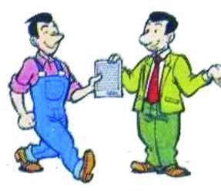
GENERAL RULES FOR
EMERGENCY SITUATIONS
Main reference documents applicable: Law no. 307/2006 on defence against fire, as further amended and supplemented. Law no. 481/2004 on civil protection, republished in Official Gazette no. 554/22.07.2008 as further amended and supplemented. Order of the Minister of Administration and Interior no. 712/2005 supplemented and amended with OMAI 786/2005. Order of the Minister of Administration and Interior no. 163 of 28th of February 2007 for the approval of General Norms of defence against fire, Published in OG no. 216 of 29th of March 2007.
Through a series of specific activities, we provide permanent prevention and reduction of emergency situation risks occurrence (fires) and we inform on the way one should act in case of calamities (floods, earthquakes, extreme temperatures and/or weather events, etc.) in order to evacuate, rescue and protect the persons, the material assets and the environment. Now, the activity of intervention in case of emergency is organised in every IFIN-HH building. Also, each building has a material basis for emergency situations and necessary specific documents (evacuation plans, response plans, procedures, etc.). By periodic trainings, you will acquire knowledge on: Normative acts which regulate the management of emergency situations, the activity of defence against fire and the activity of civil protection; General and specific obligations of each employee category; Conditions that cause or favour the occurrence of technological accidents and damages and potential and specific causes (risks) of fire and/or explosion, norms, rules and their prevention measures; Description, operation, maintenance and the way of using installations and protection systems designed for the prevention of technological damages and fire. Also, through the organisation and performance of exercises and applications, you will become familiar with how to act and the response capacity in case an emergency situation occurs.

Slide 14
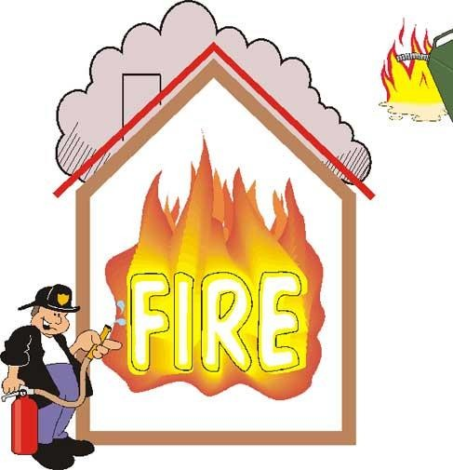
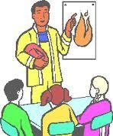
In IFIN-HH the material basis for intervention in case of emergencies (fire prevention and extinction) mainly consisting in:
Civil protection shelter (DFVM ground floor);
Prevention and Fire Extinction pickets;
Extinguishers;
Internal and external hydrants;
Pools with water reserve for intervention in case of fire;
Passive and active alarm systems;
Protection equipment;
Signalling indicators;
Medical kits;
Communication and radio communication systems.
Observe all signalling indicators that you encounter at the working place and while moving inside IFIN-HH!
Specific rules and measures for defence against fire
people escape routes and access routes to the means of intervention
against fire are permanently kept free;
it is forbidden to place on the
it is forbidden to block access, evacuation and intervention routes with materials that reduce the width or height of the established circulation free area or with materials that constitute fire or explosion hazard, as well as performing their modification, thus worsening the initial situation;
electrical appliances pots and vases or
other vessels containing liquids that may accidentally spill and cause short circuits followed by fire;

Slide 15
in the rooms where there is work equipment, one shall make sure that the following rules and fire prevention and extinction measures are observed:
  limiting the combustible materials and promptly removing possible fire sources;
  it is forbidden to store flammable liquids in other places than those authorised;
  the good functioning of the electrical equipment shall be controlled and ensured, no improvisations being allowed.
Mainly, it is forbidden to:
connect consumers who exceed the nominal power of circuits;
subject electrical connections to tensile stresses;
leave electrical conductor’s ends uninsulated, in case of partial dismantling of an installation;
use temporary connections by introducing electrical conductors, without plug, directly into the sockets;
use mobile (portable) lamps, powered by improvised and/or used cords;
use improvised light filters (lampshades) of cardboard, paper or other combustible materials for luminaires;
place combustible materials (cloths, papers, plastic sheets, wood etc.) on the electrical engines;
use unapproved radiators and electrical heaters or in other places than those established in the technical instructions or agreements;
introduce objects of any type inside panels, niches or electrical panels;
hang niches or pictures of objects any type by the panels;
deposit combustible objects and/or materials in the general electrical distribution panels.

Slide 16
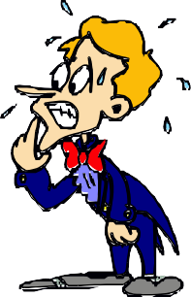
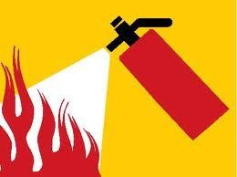
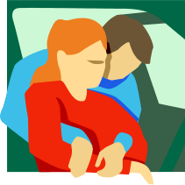

Behaviour in case of emergency
Keep calm!
If needed, use first intervention means located in the building.
In case of emergencies, calmly leave the room following the evacuation route.
Do not take with you umbrellas, luggage, large and heavy packages.
Save those who are in danger.
You must behave in such way as not to create alarm and panic attacks in the halls and especially on the stairs.
Walk calmly towards the emergency exit accompanied by the person appointed.
Go to the gathering place established
accordingly.
It is recommended that women wearing
high heel shoes take them off before descending the stairs.
Follow exactly the instructions sent by the public alarm system in case of emergency,
and marked
the acoustic alarm signals and the corresponding markings. Do not take any initiative on your own. You risk unnecessary exposure to hazards.
For events that you cannot solve by yourself, according to Intervention plans in case of emergency, call 112.
If smoke goes inside, in order to protect the airway, cover your nose and mouth with a wet handkerchief.

Slide 17
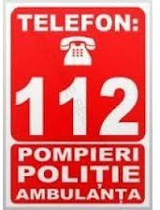
The use of call to 112 In IFIN-HH, only persons authorised through the alarm scheme in case of emergencies can call 112, according to the Intervention Plans in force.
Thank you for your time!

