Slide 1
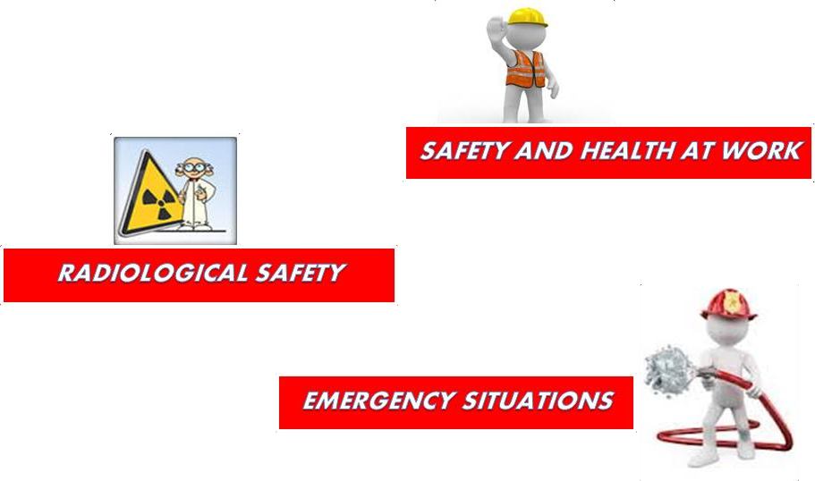
Horia Hulubei National Institute
for R&D in Physics and Nuclear Engineering
IFIN-HH
30 Reactorului St., Bucharest-Magurele, jud. Ilfov, P.O.B. MG-6, RO-077125, ROMANIA tel.: (+4) 021 404 2301, fax.: (+4) 021 457 4440
secretar@ifin.nipne.ro
www.ifin.ro
🡂🡂🡂🡂
This guide contains general safety and health at work, radiological safety, physical protection and emergency situation aspects that you must know and observe during your entire visit in IFIN-HH.

Slide 2

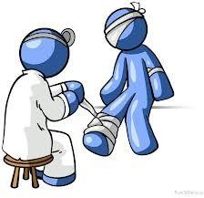
Welcome to
IFIN-HH!
This guide:
is intended for all visitors (organised groups of gymnasium, high-school, university students, delegates, other people);
is used for the training performed when you came to IFIN-HH, in accordance with the provisions of procedures code PO-IFIN-87 and code PO-IFIN-88 and the Access rules for organised groups code R-IFIN-24, review in force;
contains general information on safety and health at work, radiological safety, physical protection and emergency situations regulations (prevention and fire extinction and civil protection) that must be known and observed and their cognition will allow you to be more receptive in what regards your safety.
If you are to visit certain departments where there are specific risks, they will be presented to you immediately after entering the building by the head of that entity.
Because everyone’s health and safety is an unconditional priority, IFIN-HH uses all means necessary to protect you.
OBJECTIV:
0 ACCIDENTS
This objective can be met by applying the safety managerial policy of IFIN-HH and by involving the entire personnel we shall be able to maintain in IFIN-HH the best safety conditions for the employees, collaborators, contractors, visitors and protect the environment.

Slide 3

SAFETY MEASURES PROVIDED BY IFIN-HH
 | Access in IFIN-HH Group I is done through the access control point equipped with radiometric portals, based on access cards, by observing the provisions of the applicable procedures and regulations in force. Access in departments performing radiological risk activities is monitored from a radiological point of view with fix and mobile equipment designed to provide radiation protection.
The specific of our activity involves an inherent radiological risk in certain departments. Therefore, through adequate policies, technical and organisational measures and periodical trainings, we always take care that our activity is performed under high safety conditions. IFIN-HH is concerned with your safety and therefore: observes strictly the legal and regulatory requirements on radiological safety, safety and health at work, emergency situations, physical protection and environment; performs all activities that involve radiological risks within the limits and conditions of the permits issued by the National Committee for the Nuclear Activities Control (CNCAN) which represents the national authority in the field of regulation, authorisation and control of nuclear activities in Romania; provides radiological safety monitoring during the entire visit, by offering you direct reading electronic personal dosimeters; provides accompanying personnel during the entire visit, who will guide you only on the route and locations formerly established and approved for visiting by the institute’s management; limits your access in radiological risk work areas; provides a wide range of personal equipment for protection against ionising radiations and also collective equipment for radiation protection and equipment for radiation monitoring; offers you personal protection equipment, when required;

Slide 4

you can find the necessary equipment to provide radiological safety against normal and potential exposure (gate, locker, healthcare point, decontamination options, radiation protection means, dosimetric devices, safety systems, etc.);
informs you during training before the visit on IFIN-HH specific activities and the risks on radiological safety and safety and health at work, as well as the prevention and protection measures and activities at IFIN-HH level, in general;
permanently provides both the monitoring of the work environment and the monitoring of radioactivity in the environment;
provide permanently the dosimetric monitoring of the entire personnel;
has laboratories notified by CNCAN for personal dosimetric monitoring activities of external exposure and internal contamination of the personnel, with dosimetric film, thermo-luminescent dosimeter and human body counter, estimating the dose equivalent and actual doses;
provides the safe management of institutional radioactive waste resulting from the activities performed in accordance with the regulatory requirements;
provides the proper training of professionally exposed personnel, in the field of radiological safety and maintains the level of training and technical competence of the entire personnel, through both adequate training programs organised at department and institute level and permanent participation in CNCAN authorized courses, international conferences, workshops, seminars, etc.;
classifies working places depending on the radiological risk, according to the specific criteria established by CNCAN;
performs the classification on categories of radiological risk of professionally exposed persons, in accordance with the legal and regulatory requirements applicable;
monitors the exposure to radiation in case of accidental and emergency exposure;
in case of contamination, it has the procedures and necessary infrastructure for decontamination.

Slide 5

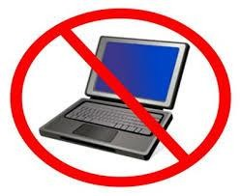
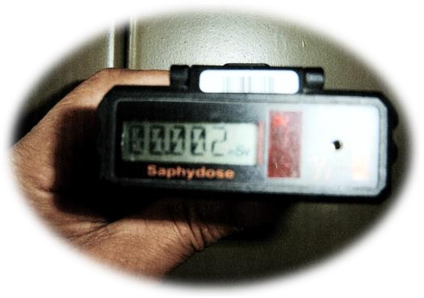
GENERAL RULES FOR VISITORS
ORGANISED GYMNASIUM OR HIGH SCHOOL STUDENT GROUPS
WHEN ENTERING IFIN-HH
The normal access hours in IFIN-HH for persons outside the institute are from 8 AM to 4:30 PM, during business days.
Access during the non-working hours IS NOT ALLOWED.
Accompanying teachers must submit ID/passport when entering the institute and “Students’ access request” approved, in order to get the visitor’s card and the dosimeter.
The access with personal car is not allowed.
Participate in the training performed before access and sign the training sheet.
If you have personal objects on you (e.g. laptop, tablets, cameras, luggage) they will be handed to the officer at the access control point when entering the institute and they will be given back to you at the end of the visit.
Personal electronic dosimeters with alarm threshold and with direct reading that you receive when entering IFIN-HH, will be given to you by the dosimetry specialist present at the access control point.
Dosimeter’s indications are read and recorded both when you enter and when you exit the institute.
The annual dose limit for visitors is 1 mSv/an

Slide 6



STUDENTS, DELEGATES, OTHER PERSONS
WHEN ENTERING IFIN-HH
The normal access hours in IFIN-HH for persons outside the institute are from 8 AM to 4:30 PM, during business days. Access during the non-working hours IS NOT ALLOWED. Submit ID/passport when entering the institute in order to get the visitor’s card. The access with personal car is not allowed. Participate in the training performed before access and sign the training sheet. If you have personal objects on you (e.g. laptop, tablets, cameras, luggage) that you did not declare to be written on the gate ticket, please inform the accompanying person about it. Otherwise, the objects in question will be kept by the petty officer at the access gate and they will be given back to you when you exit the institute.
DURING THE VISIT IN IFIN-HH
 | During the entire visit period, wear the direct reading personal electronic dosimeters received when you entered IFIN-HH or other departments. Wear the visitor’s card received at the entry so that is visible. Wear the personal protection equipment given to you in order to avoid accidents’ occurrence, where needed. Do not deviate from the established route and follow all instructions of the person who accompanies you.

Slide 7


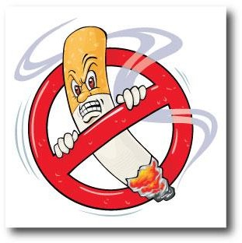

 |  | Do not approach more than you should the installations and equipment under operation. It is forbidden to block the alleys, corridors and access routes. Do not bend over the railings and do not stand on them. Observe all safety indicators that you encounter inside IFIN-HH. Signal any dangerous situation to the person who accompanies you.
Access in the areas controlled from the radiological safety point of view is done based on the access procedure specific to the areas and with the approval of the head of that entity. The access in areas that are not the object of your visit is forbidden.
 | Where you encounter the smoking interdiction sign, comply with it.
Inside IFIN-HH it is forbidden to take pictures or film without the prior approval of IFIN-HH’s management.

Slide 8

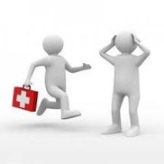

 | In case of an emergency situation: Follow exactly the instructions transmitted through the public alarm system in case of emergency, acoustic alarm and corresponding indicators. Do not take any kind of initiative on your own. You risk unnecessary exposure to hazards.
Although it is this unlikely, in case of contamination you are required to undergo the decontamination operations in accordance with IFIN-HH regulatory requirements and procedures in force.
AT THE END OF THE VISIT IN IFIN-HH
 |  | Give back the dosimeter received at the entrance. Give back the visitor’s card. Pick up the personal objects that you left at the access control point.
Thank you for your visit!

