Slide 1
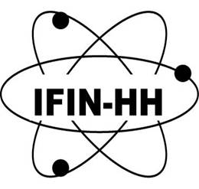
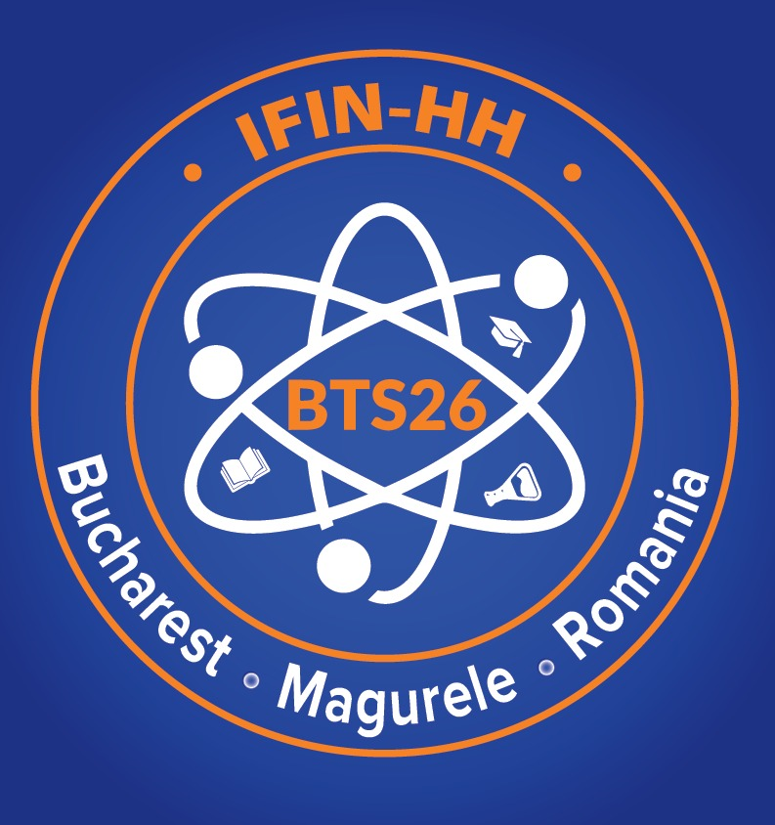

Nuclear Physics worldwide and EURO-LABS
Livius Trache
EURO-LABS’ Task leader, 5.4 “Training”
“a word on our sponsor”
for the Basic Training School 2026 - BTS26
IFIN-HH, Bucharest-Magurele, May 18th, 2026

Slide 2
What, why …?
- more of a “let us know the big environment, see what and why we do what we do!” and a short presentation of the EURO-LABS project
Purposes of Science Nuclear Physics:
- curiosity driven research – understanding nature, ourselves …
- use of knowledge to improve our life, our interaction with nature, with each-other, etc.
Nuclear and Particle Physics are about understanding the fundamentals of the Universe more than other branches of knowledge
EURO-LABS is an European RIA project

Slide 3
On Nuclear Physics
Nuclear and Particle Physics are about understanding the fundamentals of the Universe more than other branches of knowledge
Nucleus was discovered ~115 years ago (Rutherford et al. ) when NP started, and much progress since
Nuclei:
- are fundamentally quantum objects
- test 3 of 4 fundamental forces
- are made of fermions
- single particle and collective phenomena
Nuclear Physics has generated:
the “atomic bomb”
nuclear energy
nuclear medicine
“core of the matter and fuel of stars”
research and use involve(d) large facilities, generated large labs and work in large collectives
“internationalization” (globalization) of Science
pushed computers and communication technologies – large scale and fast
the internet (tcp-ip communications) and the www
“other applications” …

Slide 4
Nuclear physics research: what and how
Nuclear structure – goal: extend knowledge from the proton dripline to the neutron dripline
Nuclear reactions – from low energies to intermediate energies (notions evolving!)
Fundamental & exotic decays
Nuclear astrophysics
  Nuclear physics for astrophysics – nuclear data
  Nucleosynthesis
  Physics of dense, compact stellar objects
  Specific astronomical observations – elemental and isotopic abundances, X- and gamma-ray space telescopes, cosmochemistry (grains in meteorites)
  … multimessenger astronomy
Use of particle accelerators and large labs – increased energy and/or beam intensity
New RIB – radioactive ion beams facilities – large and small
Use of underground labs
Improvement of detectors – large arrays, new materials;
Improvement of data collection: electronics, communications, storage, speed …
Multidisciplinary approaches and topics

Slide 5
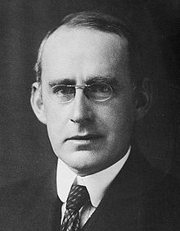
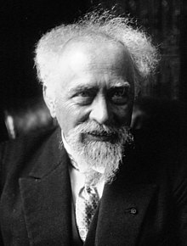

Introduction to NA
Stars’ energy is from nuclear reactions - most
The elements in our Universe were synthesized via nuclear reactions in two phases:
  Light elements up to ⁷Li in the process known as Big Bang Nucleosynthesis (BBN) or primordial nucleosynthesis
  Heavier elements in the Stellar Nucleosynthesis process.
In 1919, 1920 independently concluded:
“sub-atomic energy” reservoir - the only that could create the energy that we see from the stars.
Ideas developed over time
We have a paradigm verified by observations and by modeling about the origin of the chemical elements in the Universe.
The basic idea - firstly introduced by Alpher, Bethe and Gamow (1948, April 1): chain of nuclear reactions
  appropriate temperature;
  density conditions.
1920 Arthur Edington
1919 Jean Perrin
1926

Slide 6
“Nuclei: the core of the mater, the fuel of stars”
motto of the Division of Nuclear Physics of the American Physical Society at the beginning of IIIrd millennium

Slide 7
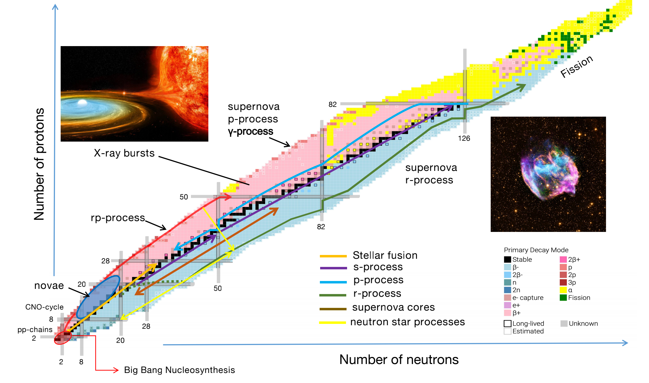
Nucleosynthesis processes on nuclide chart
H rich environements

Slide 8
Q: what and how?!
Nuclear Astrophysics (NA) is part in the science programs of all and each large nuclear physics institutes => it belongs to HIAF
… clearly stated as “… understanding of the origin of heavy elements in Universe”
NA includes (debatable!):
  Nuclear Physics for Astrophysics (NPA) – nuclear reaction data
  Star dynamics, including physics of dense, compact stellar objects
  Nucleosynthesis modelling
  Specific observations (elemental& isotopic spectroscopy, space X- & gamma-rays telescopes, cosmochemistry of meteorites, search in terrestrial deposits …)
  “multimessenger astronomy” … GCE …
What and how to address the event entitled: “The Frontier Nuclear Physics Symposium Related to HIAF”?
… given the huge mismatch between the energies of cosmic reactions (very small ~eV, keV/u) and those of HIAF (up to GeV/u)

Slide 9
Own “workshop”
Results and plans from own (recent) work:
Direct measurements at very low energies, with small tandetron accelerator, γ-ray detectors, prompt and deactivation , eventually in an ultra-low background lab in a salt mine
  Radiative alpha-capture on 64Zn, 58Ni
  (older) 13C+12C
Search for cosmogenic ²⁴⁴Pu in terrestrial deposits
Use of indirect methods with RIB in international collab
  Resonance search in beta-delayed proton emission (²³Al, ³¹Cl, ³⁵K) ²⁷P at Texas A&M University
  Nuclear and Coulomb breakup at intermediate energies, ⁹C with SAMURAI at RIKEN

Slide 10
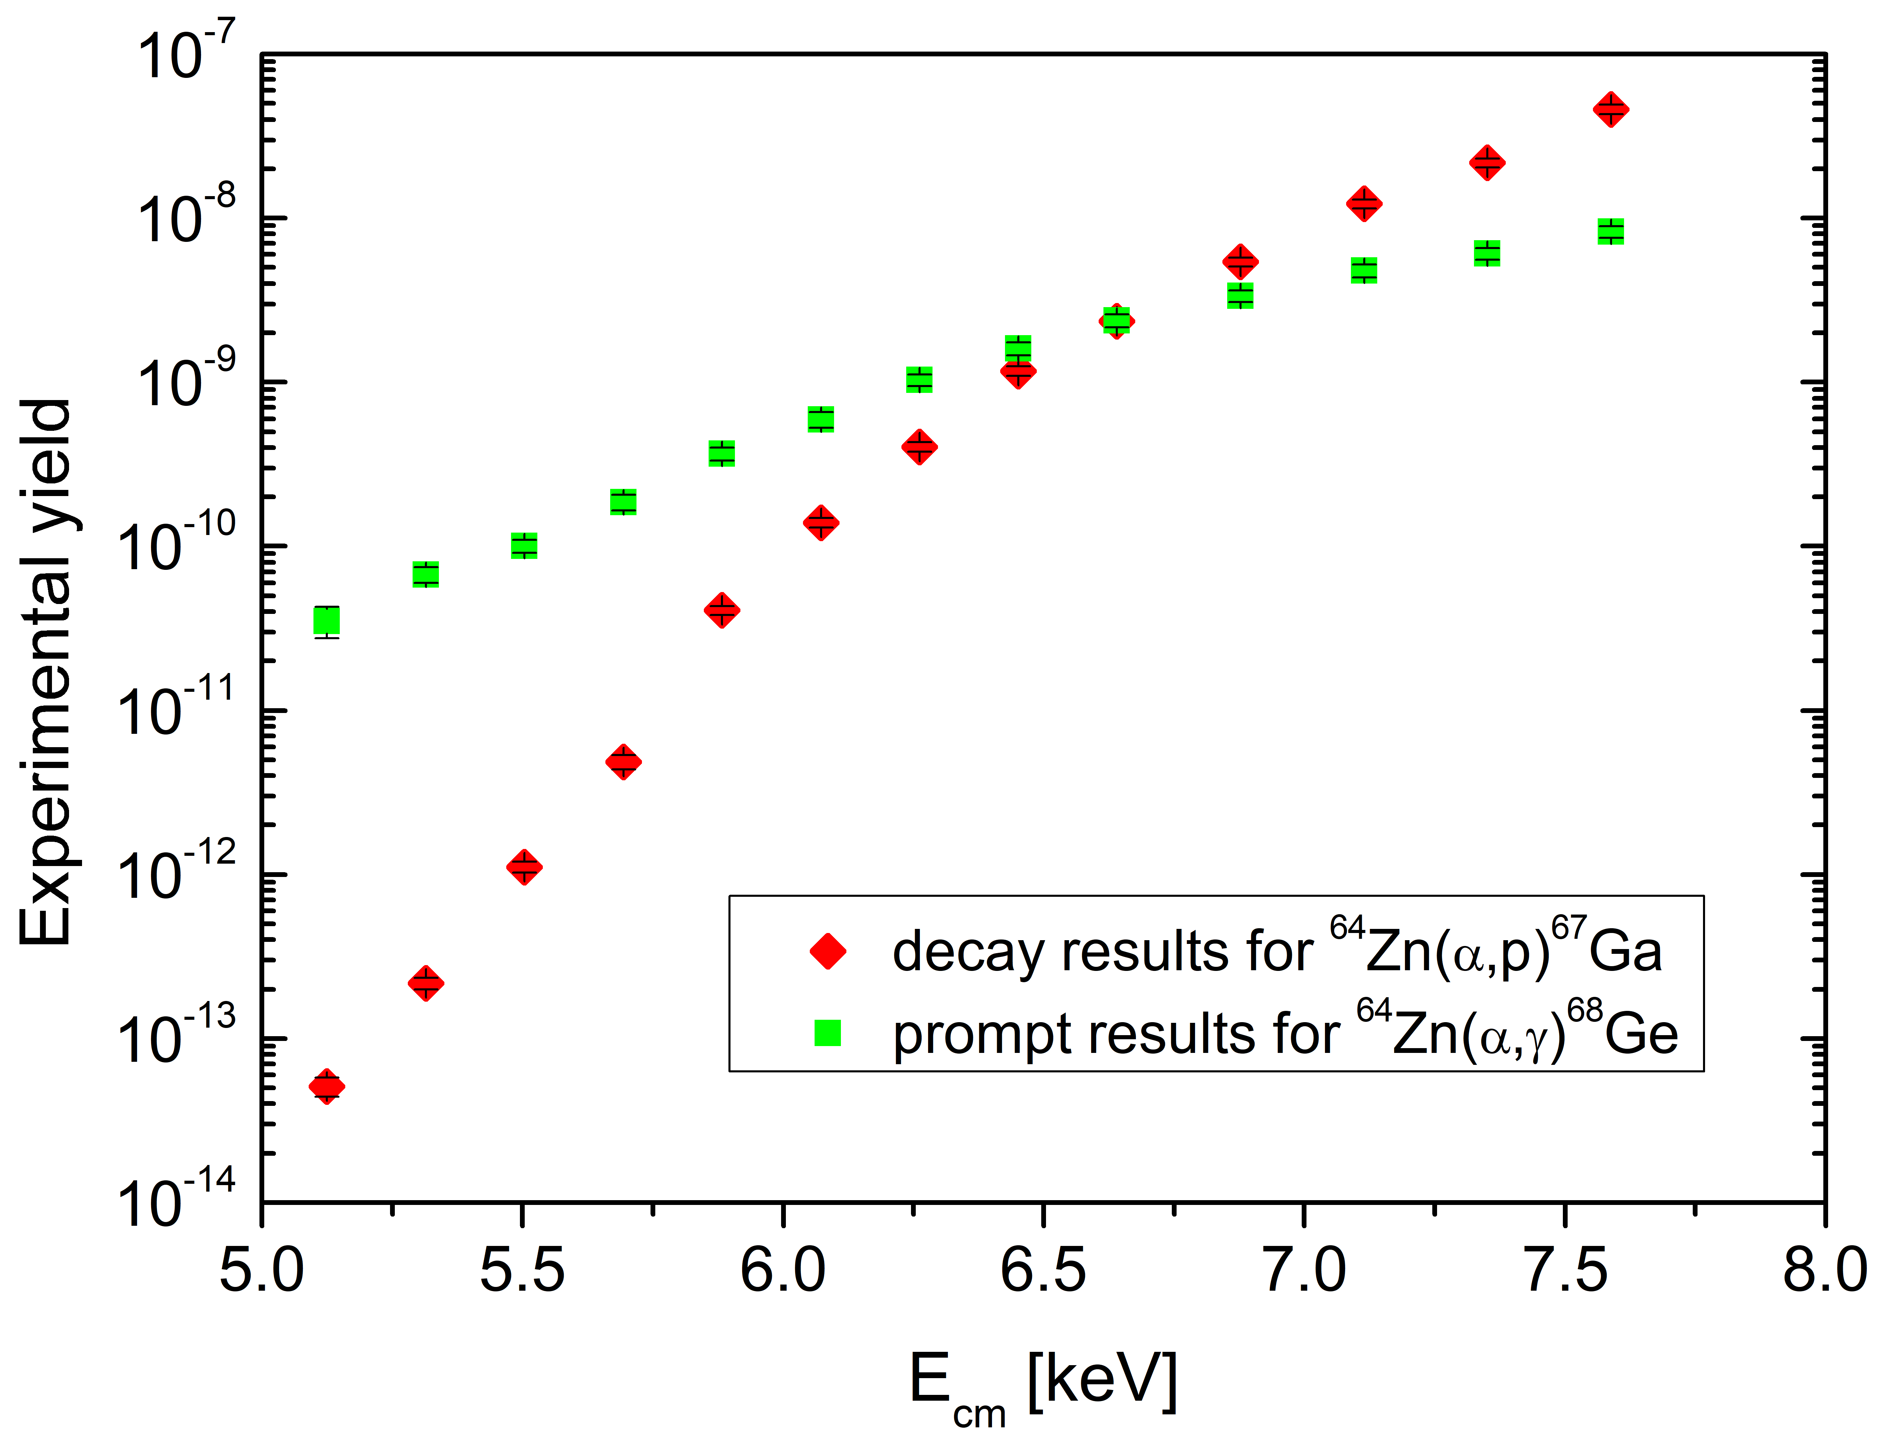
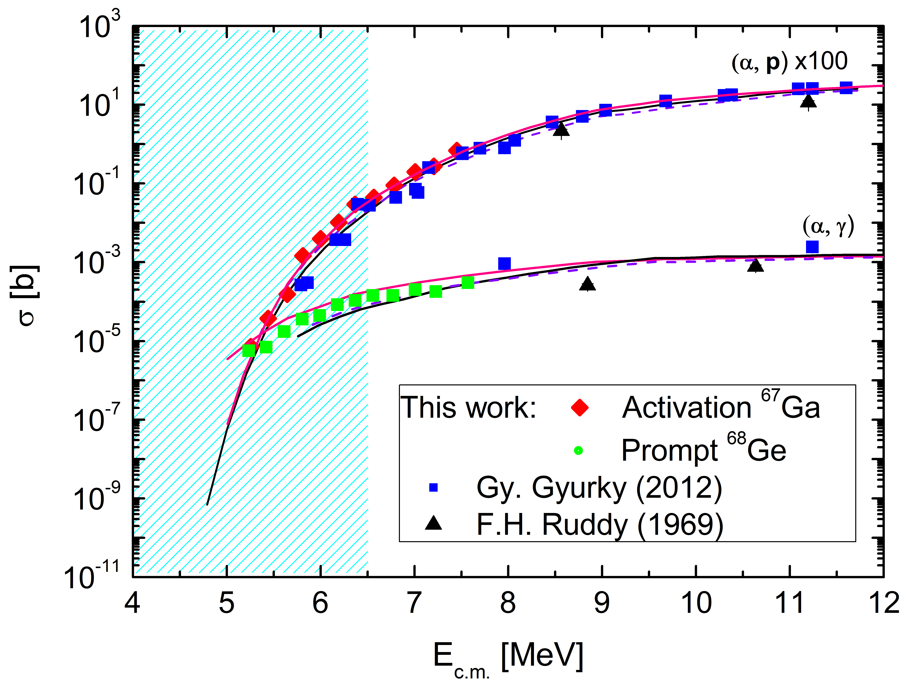
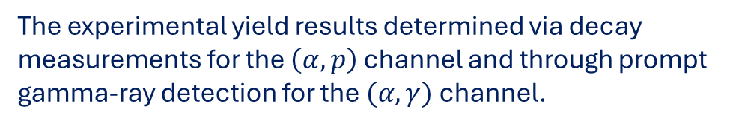
The α +⁶⁴Zn reaction
[mb]
The experimental cross sections. The data of this work - red rhombs and green squares. Previous exp. results - blue squares [15] and black triangles [16]. Statistical model calculations (curves) are taken from [17,18]. TALYS’s [19] default calculation is the pink line. The blue shaded box is the Gamow window at T = 2 GK
The experimental yield results determined via decay measurements for the $\left(α,p\right)$ channel and through prompt gamma-ray detection for the $(α, γ)$channel.

Slide 11
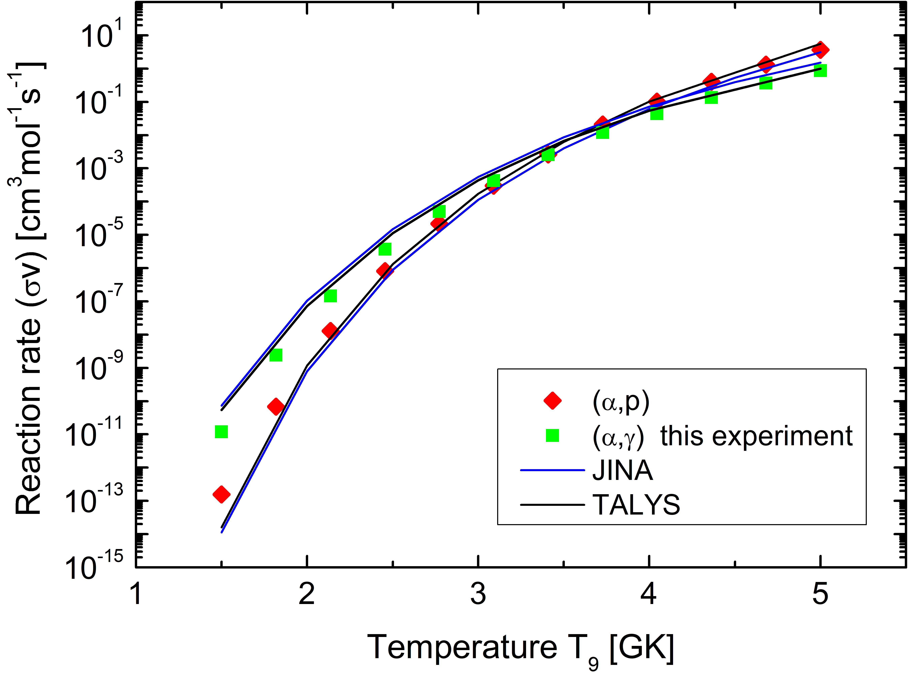
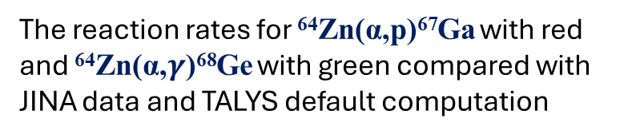
Reaction rates
$$N_{A}\left\langle σv\right\rangle =N_{A}{\left(\frac{8}{πμ}\right)}^{1/2}\frac{1}{{\left(kT\right)}^{3/2}}×\int_{0}^{∞}{S\left(E\right)\exp{ }\left(−\frac{E}{kT}−2πη\left(E\right)\right) dE}$$
The reaction rates for ⁶⁴Zn(α,p)⁶⁷Ga with red and ⁶⁴Zn(α,$γ$)⁶⁸Ge with green compared with JINA data and TALYS default computation
  Published recently: D. State et al., Eur. Phys. J. A (2026) 62:21 (https://doi.org/10.1140/epja/s10050-026-01786-8).

Slide 12
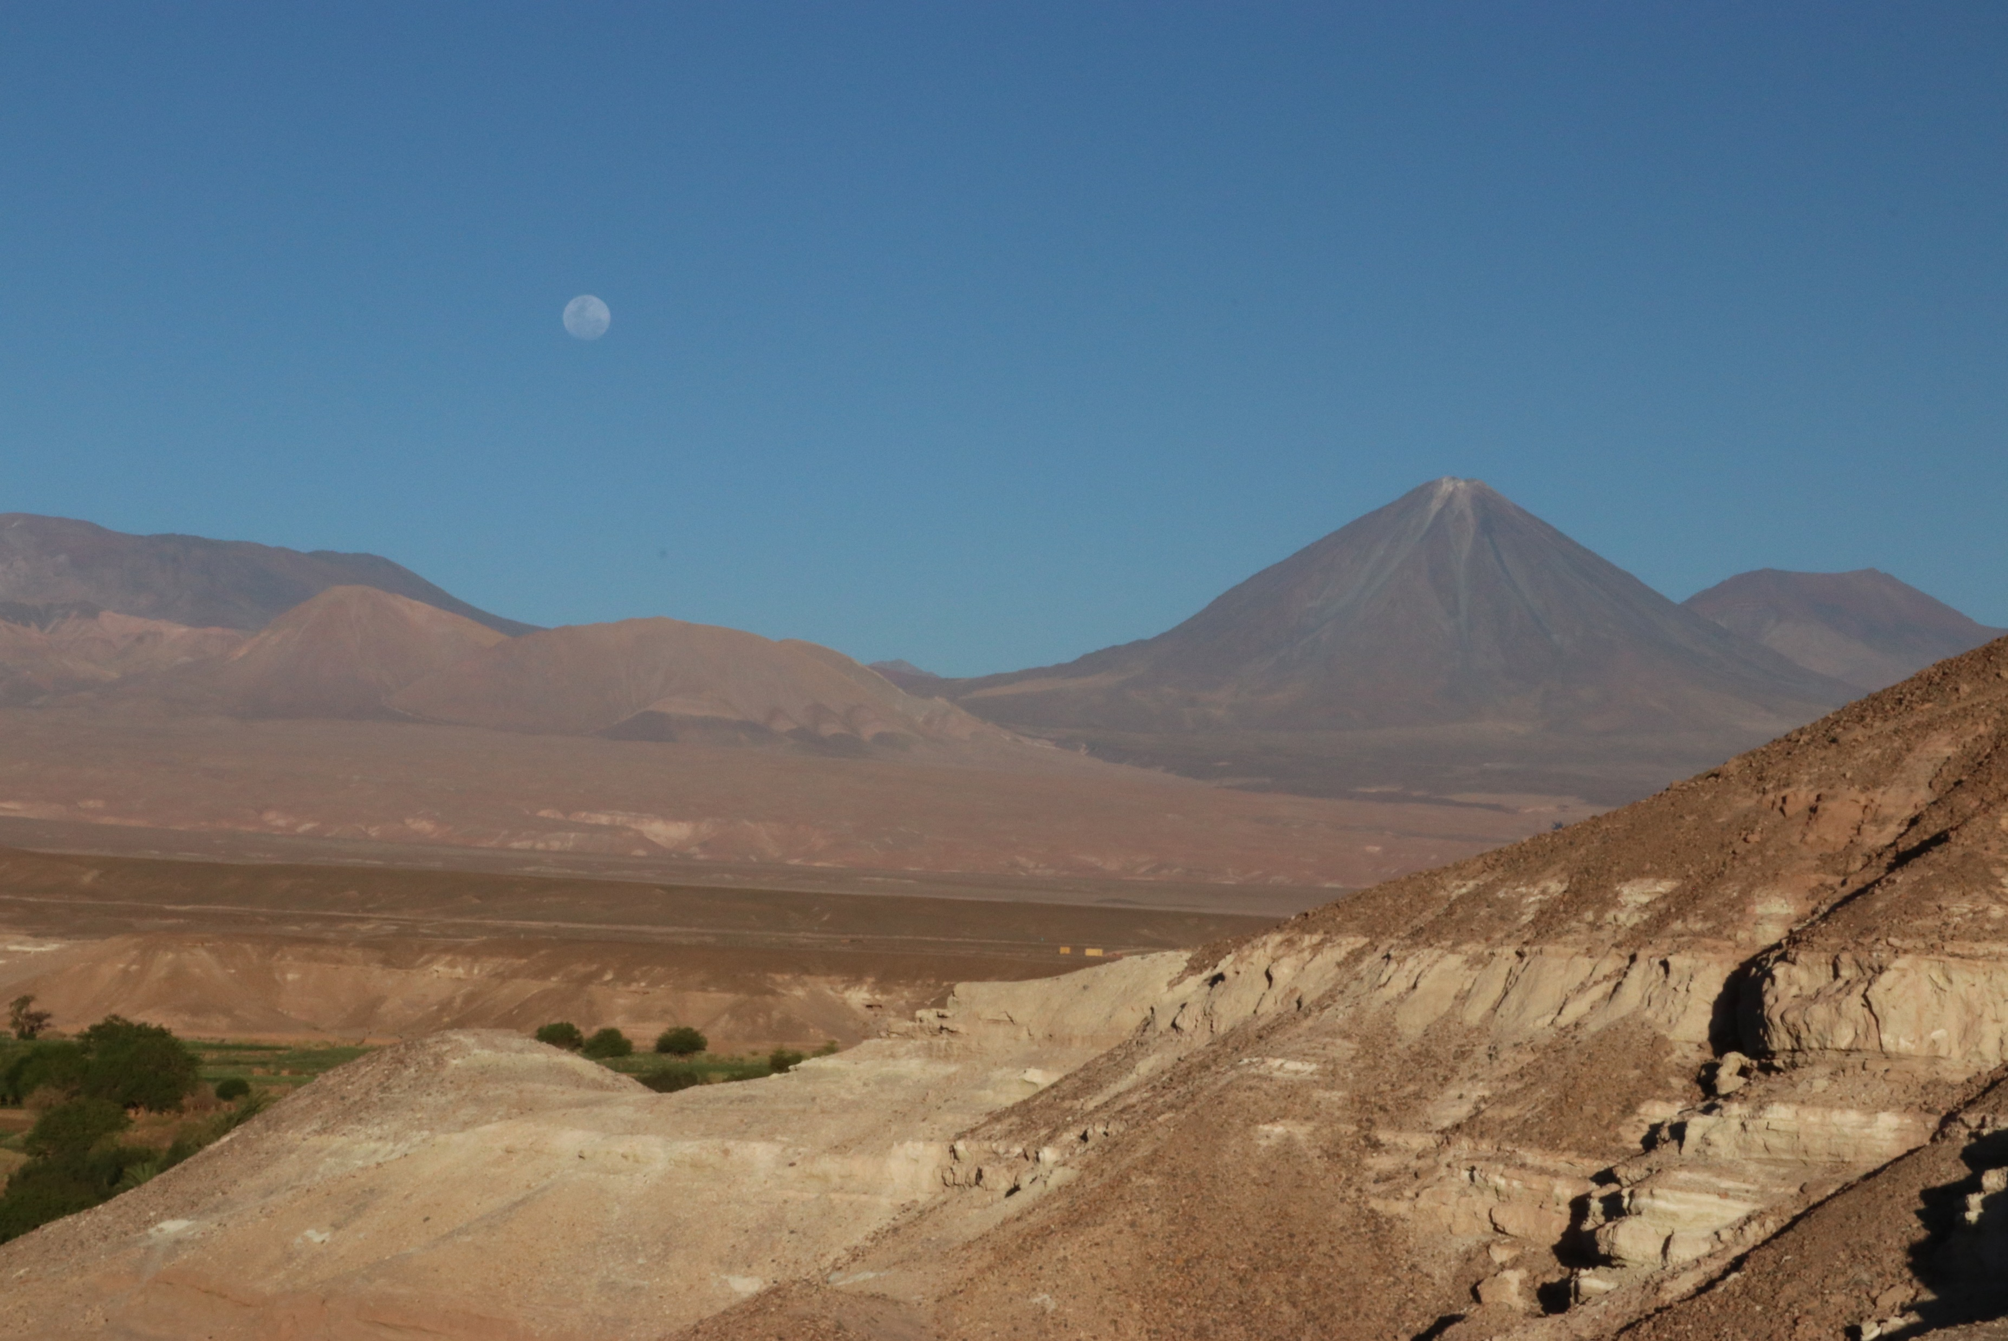
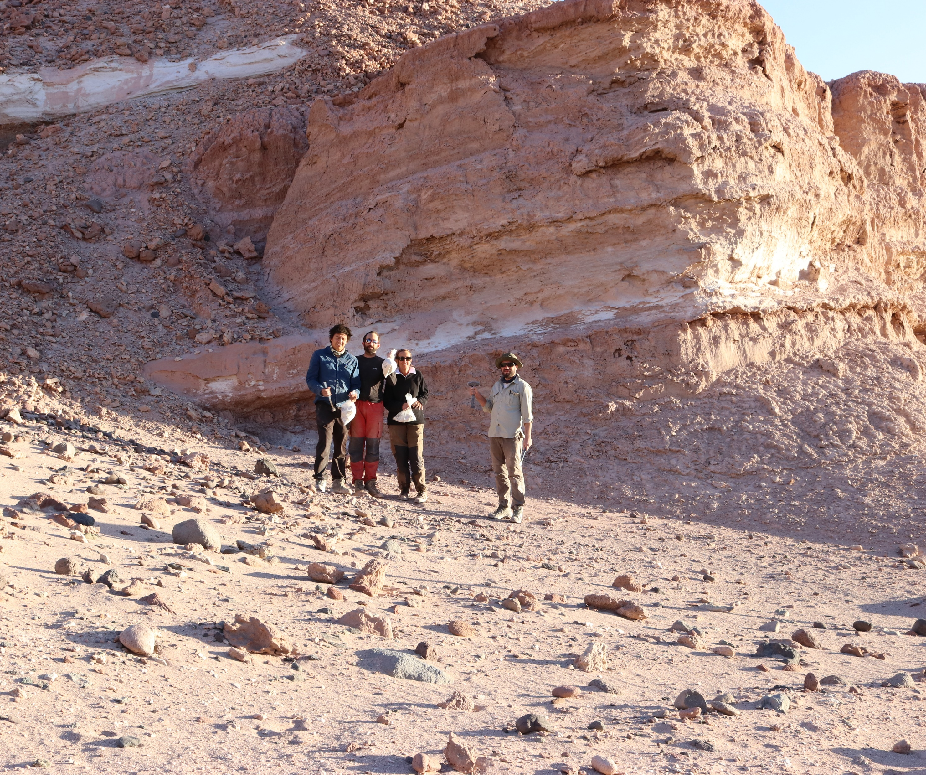
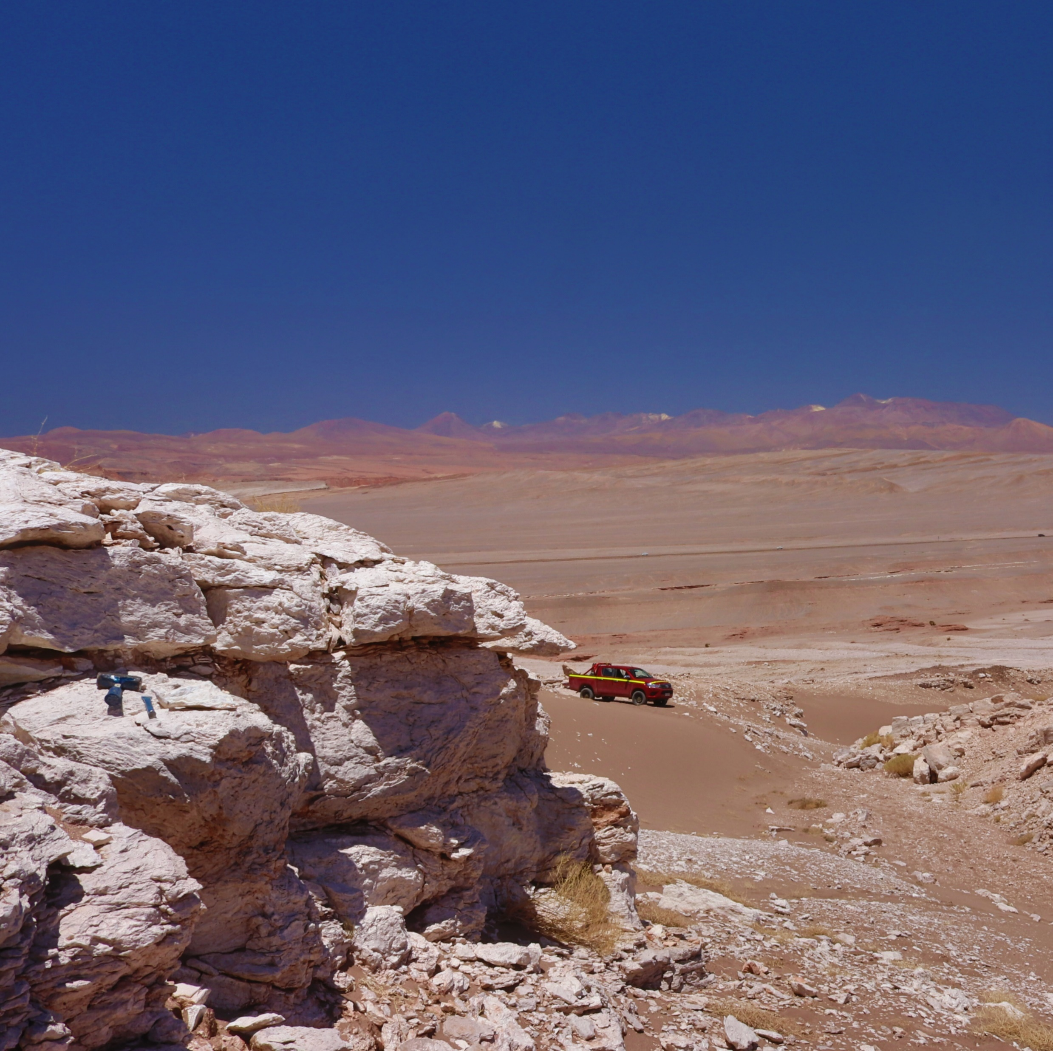
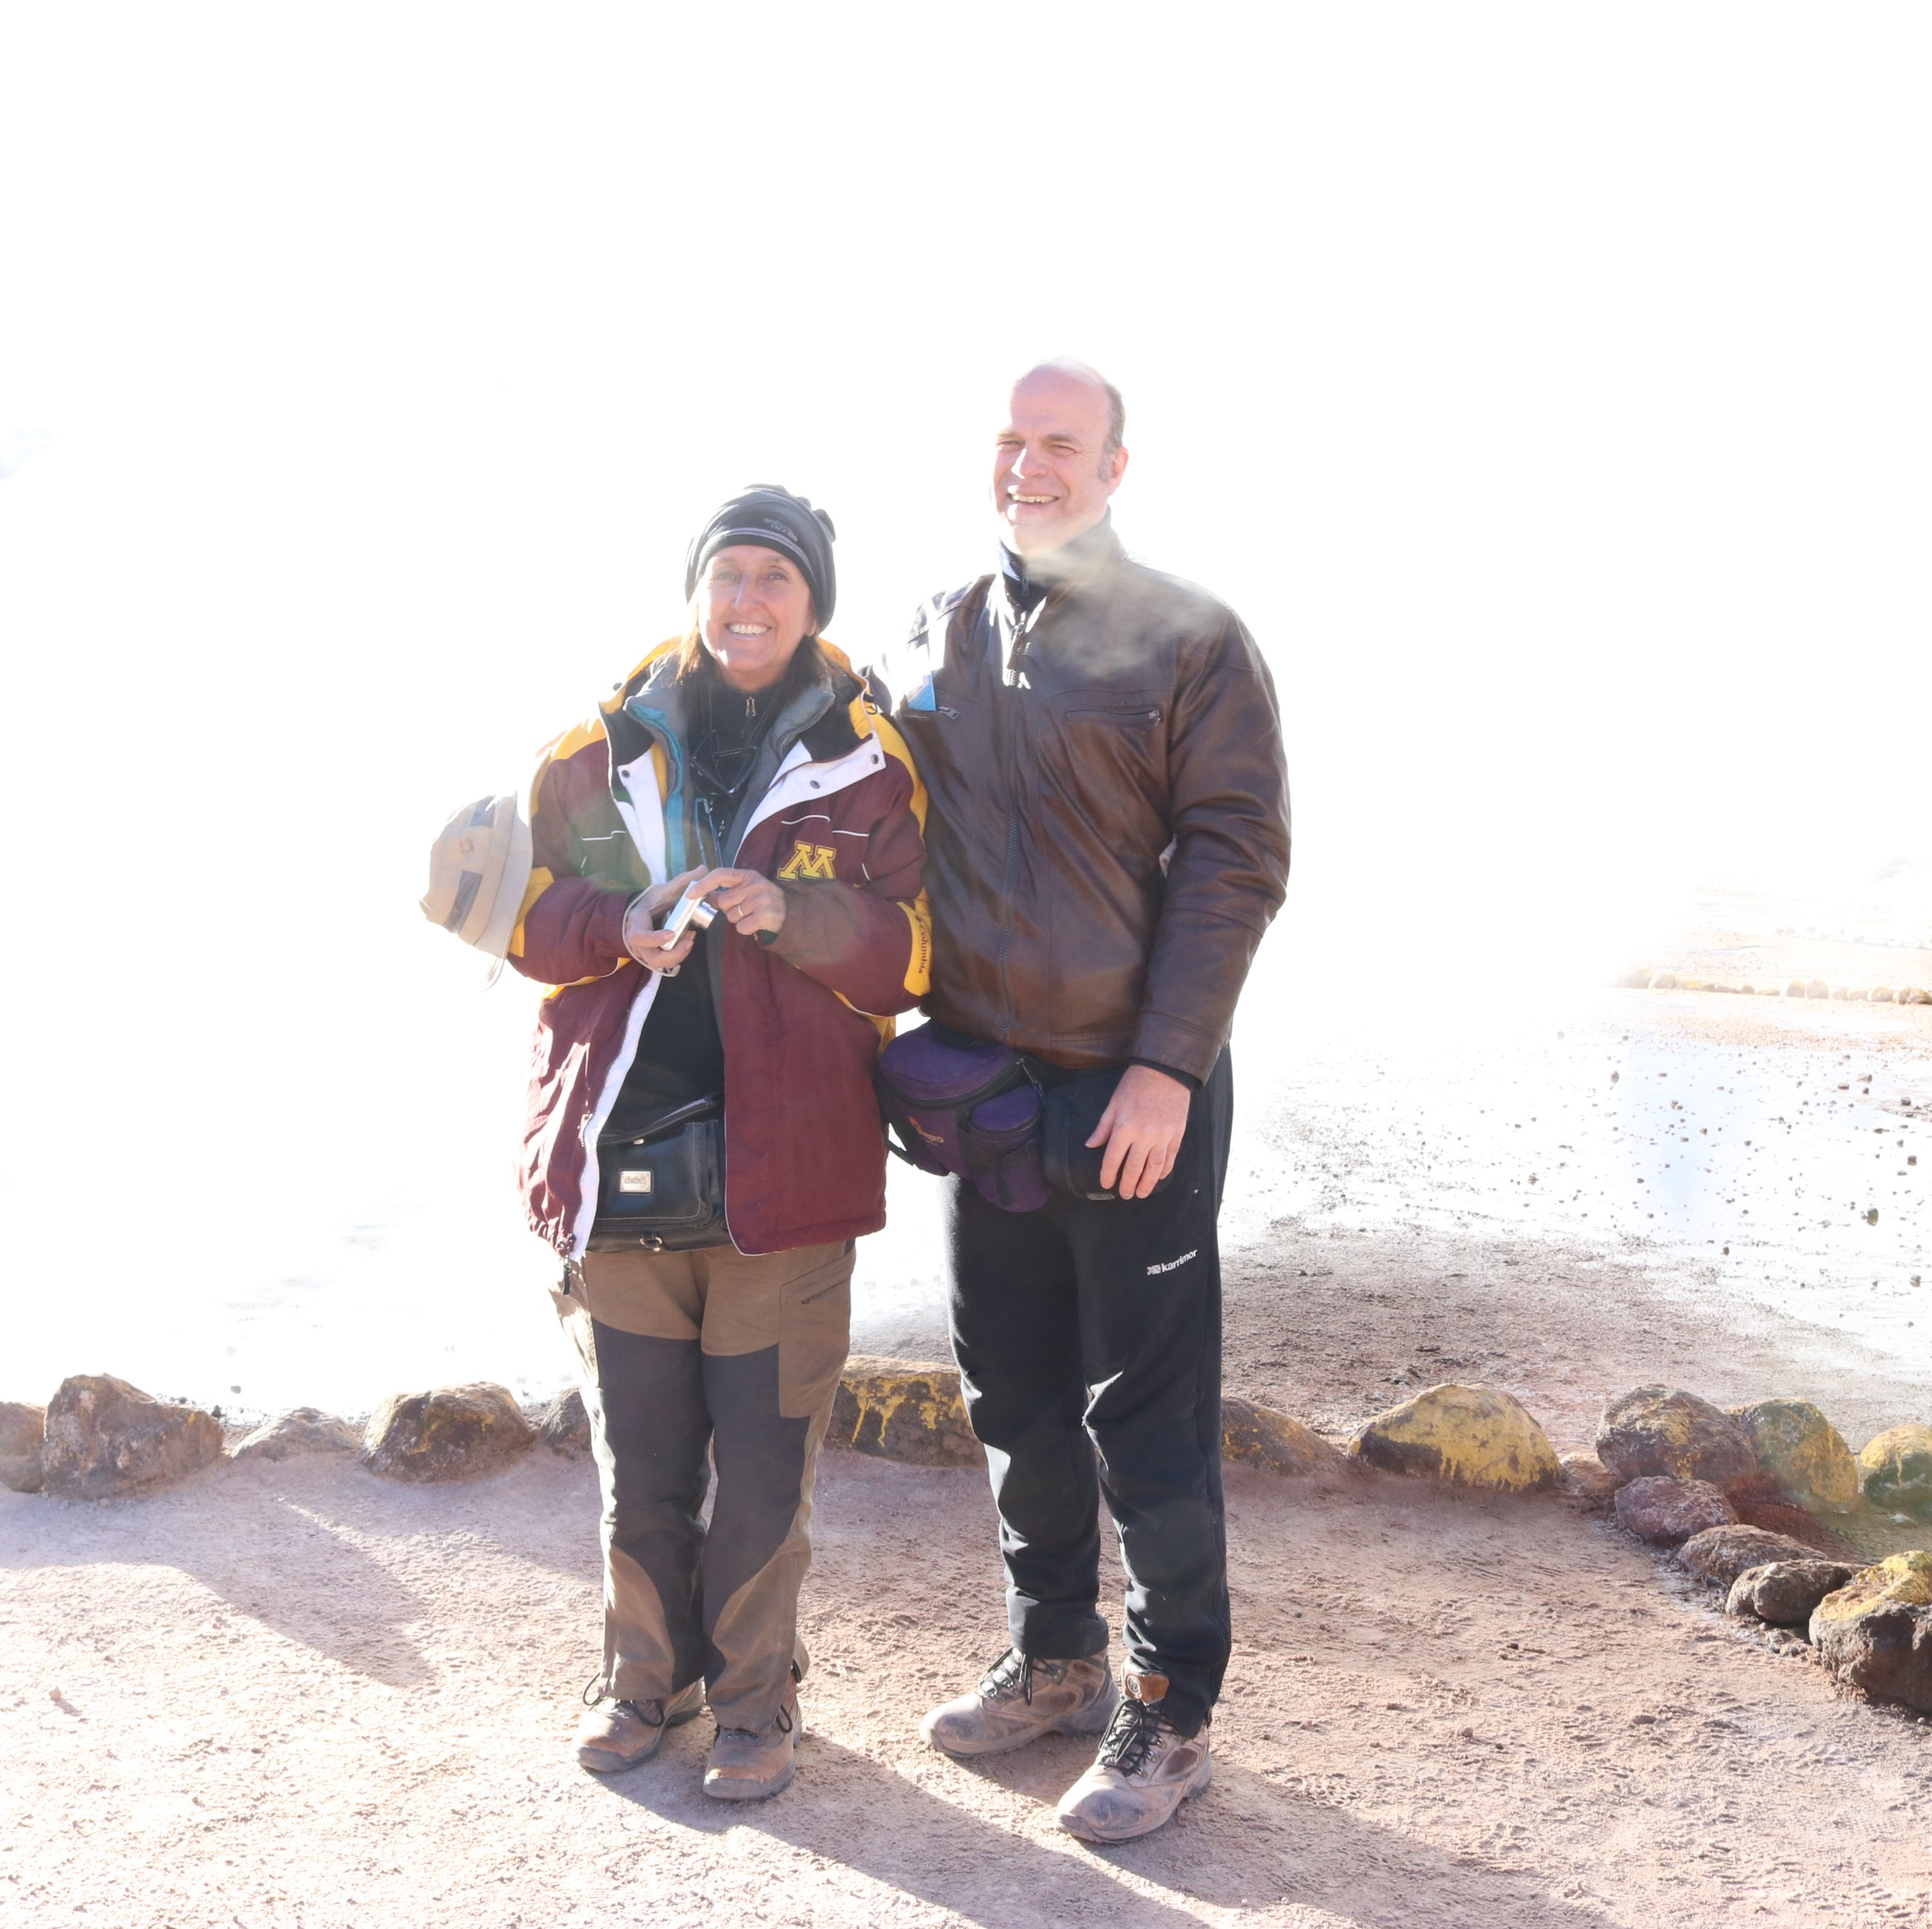
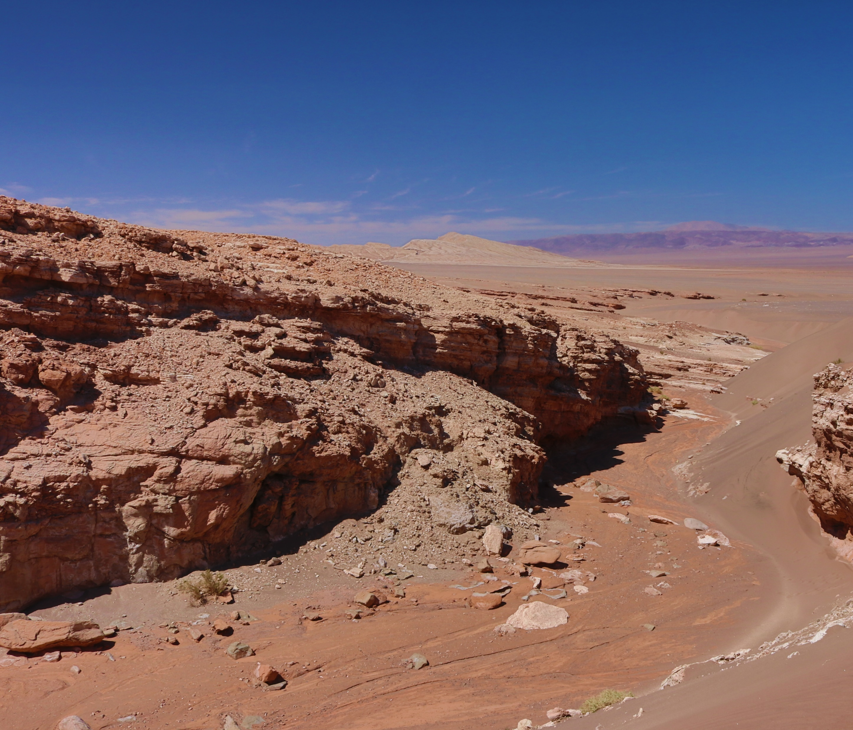
Samples. Microbialites
Chile, Atacama Desert, Vilama Formation

Slide 13
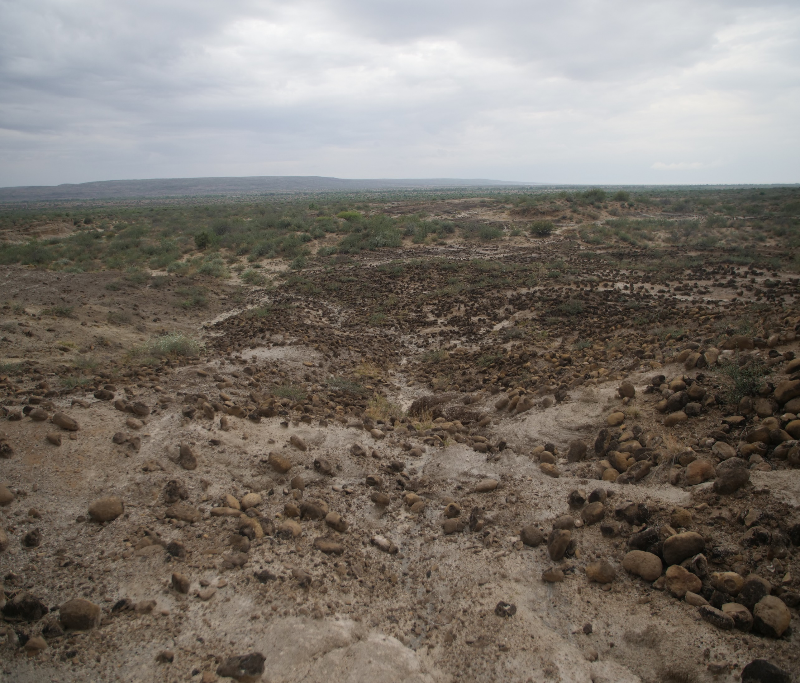

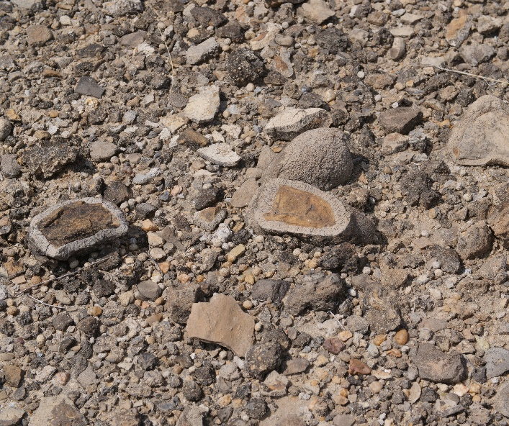
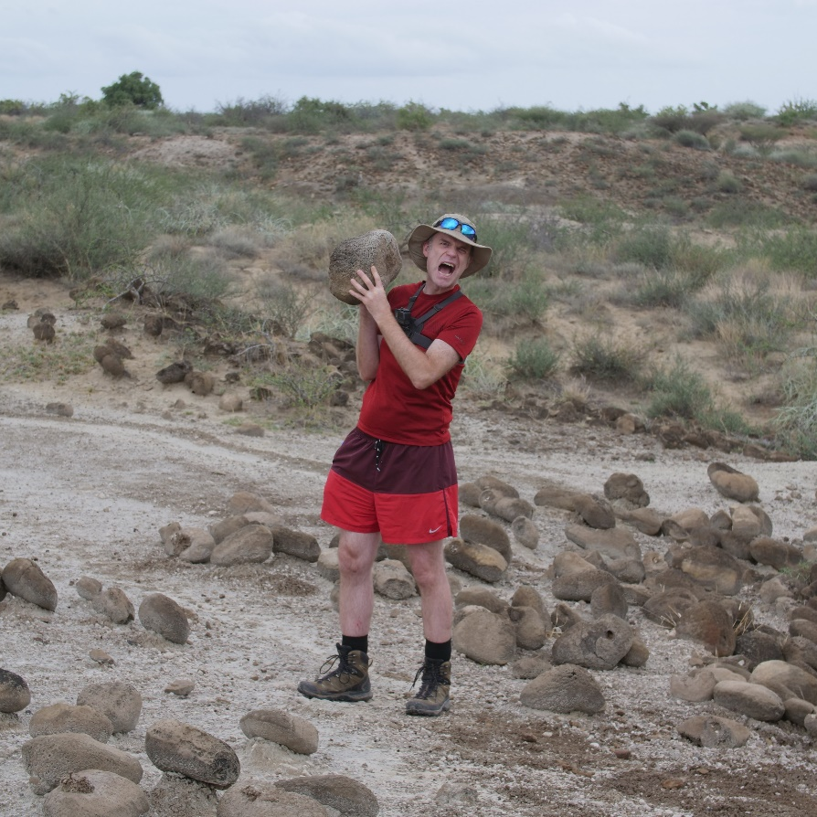
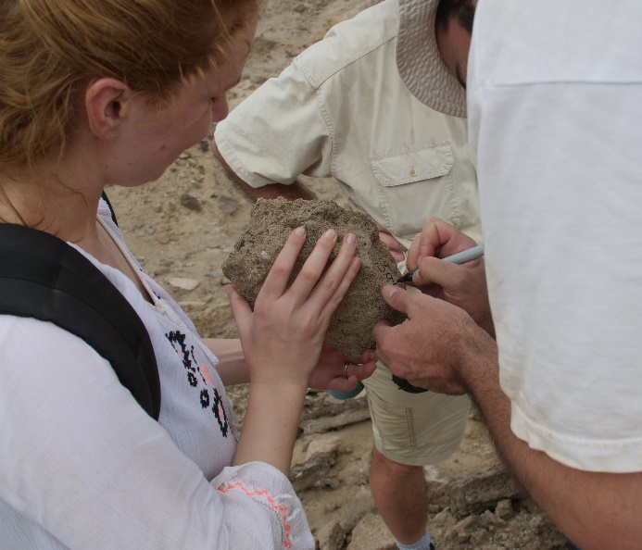
Search for cosmogenic ²⁴⁴Pu
Stromatolite @ AMS
In Kenya, Turkana Basin
Prof. Shawn Bishop TUM
Thesis, dr. Iuliana Stanciu
S. Bishop, I. Stanciu et al, Planetary Science J.,2025

Slide 14
Other NP topics
Evolution of nuclear structure
Driplines?!
New closed shells (new magic numbers) far from the stability valley
Shape variations, coexistence
Single particle vs collective structures
Reactions
Mechanisms and descriptions ?! Single step? CDCC …?
Weakly bound nuclei – halos, evolution toward driplines
Structure of deeply bound states, pairs, clusters … using inverse kinematics and high energies
4n state? 6n state?
Fundamental and exotic decays
Pure Fermi transitions (0+ -> 0+, pi – nu …) – to check the Standard Model
Proton emissions -1p, -2p, -3p …
Neutron emission near dripline

Slide 15
Beams
RIB - Radioactive (or Rare) Ion Beams
Forefront of nuclear physics research with accelerated RIBs since 1986
(discovery of ¹¹Li – first halo nucleus, I. Tanihata et al., at Berkley)
RIB production:
- by fragmentation of fast primary beams – followed by separation
- by ISOL techniques: primary beams produce radioactive species, separated and then reaccelerated
The newest built/planned facilities are RIB facilities
Stable beam facilities should be kept and improved for complementarity and not only …!

Slide 16
EURO-LABS formal identification
European project under European Union’s Horizon Europe program
Call HORIZON-INFRA-2021-SERV-01
Research infrastructure services to support health research, accelerate the green and digital transformation, and advance frontier knowledge (2021)
Inclusive access to the services provided by research infrastructures in the European Research Area is essential both for the quality of the research produced and for the training of researchers. Easy access to high-quality resources, based on clear conditions and with appropriate funding, is an important and attractive feature of the EU research and innovation system, allowing researchers to move within or from outside Europe to perform their research. An open landscape of RIs in Europe contributes to the circulation of skills and attraction of talents and promotes European cohesion.
(Follow-up to … ENSAR, ENSAR2, etc. …)
DURATION: September 2022- August 2026 (4 years)
TOTAL BUDGET: 14.5 M€
TOTAL EC CONTRIBUTION:14.2 M€
CONSORTIUM: 33 participants from 18 countries
PROJECT COORDINATOR: Paolo Giacomelli (INFN)
SCIENTIFIC COORDINATOR: Navin Alahari (GANIL)
Grant Agreement No 101057511 Web: https://web.infn.it/EURO-LABS/
The project brings together, for the first time, the three research communities of nuclear physics, accelerator and detector technologies for high energy physics, in a pioneering super-community of sub-atomic scientists.

Slide 17
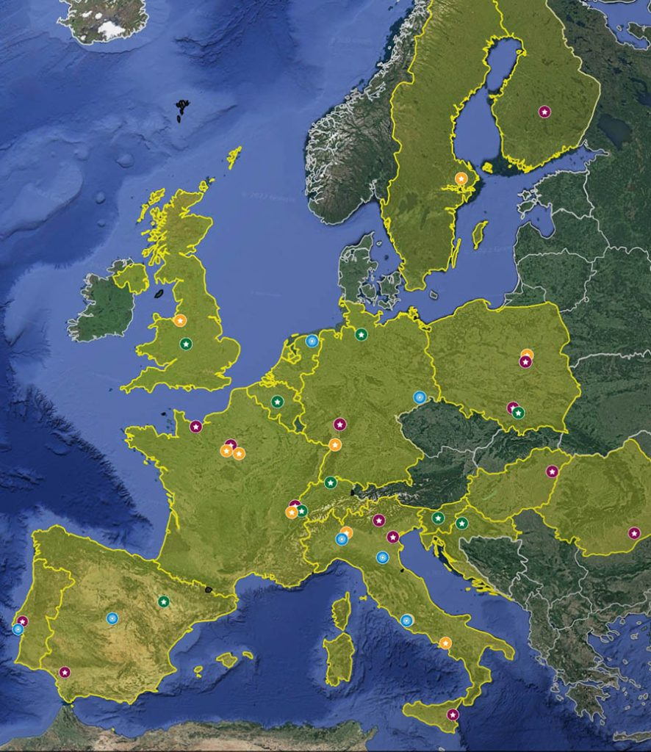
The EURO-LABS project
WHO IS INVOLVED
EURO-LABS is a network of 33 research and academic institutions from 18 countries (25 beneficiaries and 8 associated partners) from European and non-EU countries, involving 47 Research Infrastructures in the Nuclear physics, Accelerators and Detectors pillars. Within this large network, EURO-LABS will ensure diversity and actively support researchers from different nationalities, gender, age, grade, and variety of professional expertise.
AIMS OF EURO-LABS
Fostering the sharing of knowledge and technologies across scientific fields;
To create synergies and collaborations between the RIs of the Nuclear and High Energy communities;
Building up a super community of sub-atomic researchers and the associated technical staff;
Enhancing Europe’s potential for successfully facing the upcoming new challenges of the coming decades.
Task 5.4 Training - Enhance the competitiveness of our research infrastructure and its technical capabilities by training researcher and technical personnel both at the basic and advanced level providing hands-on courses in our facilities
(from https://web.infn.it/EURO-LABS/ )

Slide 18
EURO-LABS’ structure
EURO-LABS = EUROpean Laboratories for Accelerator Based Sciences
Nuclear and High Energy Physics – low and high-energy communities
“diverse approaches, wide range of energy scales … using cutting-edge technologies in accelerators, detectors and test facilities … for precise measurements, development of theoretical models “
Work Packages concentrating on TNA and JRA, Outreach and Training
  TNA – TransNational Access
  JRA – Joint Research Activities
  Outreach – to the communities and society at large and
  Training – we are training: Basic and Advanced
33 beneficiaries (= institutions) in 18 countries of Europe
(15+3)+ 14+ 11 facilities or installations in 12 countries
Enhance communication and synergies among the 3 communities …
“Special attention is paid to attracting new users’ communities, outside the nuclear and particle physics communities. This is very important to develop diverse skills of the next generation researchers, for the optimal exploitation of the substantial number of RIs for scientific and technological discoveries and beyond.”

Slide 19
EURO-LABS project
EURO-LABS supports access to European Research Infrastructures that are open access facilities – TA (TransNational Access)
  Need to get your ideas accepted by local PAC and build your group!
  Travel support
  Accommodation and subsistence support
Connects the European Nuclear Physics community, the HEP Accelerator and HEP Detectors communities on a 4 years, ~15M euro project
Training (task 5.4) has the purpose of increasing the efficiency of use of RI, of education and formation of new generations of nuclear scientists
  Basic Training Schools: 2023 @Bucharest; 2024 @ Warsaw; 2025 @Sevilla;
  2026 @Bucharest
  Advanced Training Schools on Operation of Accelerators: 2024 @CERN, 2024 @GSI/FAIR, 2025 @CERN

Slide 20
EURO-LABS TA facilities
complete list at https://web.infn.it/EURO-LABS/
https://web.infn.it/EURO-LABS/wp2-nuclear-physics-infrastructures/ 15+3 facilities
https://web.infn.it/EURO-LABS/wp3-ta-for-accelerators/ 14 installations
https://web.infn.it/EURO-LABS/wp4-ta-for-detectors/ 11 installations
Infrastructures videos https://mediawall.infn.it/view/?catName=euro-labs&lang=en_US
WP2 - Access to RI for Physics
GSI/FAIR
GANIL/Spiral2
ISOLDE at CERN, Geneve
SPES at LNLegnaro, Italy
LNS Catania, Italy
IFJ Krakow and Univ. Warsaw, Poland
Univ. of Jyvaskyla, Finland
CLEAR – CNA Sevilla, IST Lisbon & ATOMKI Debrecen (Cluster of Low Energy Accelerators for Research)
IFIN-HH Bucharest-Magurele

Slide 21
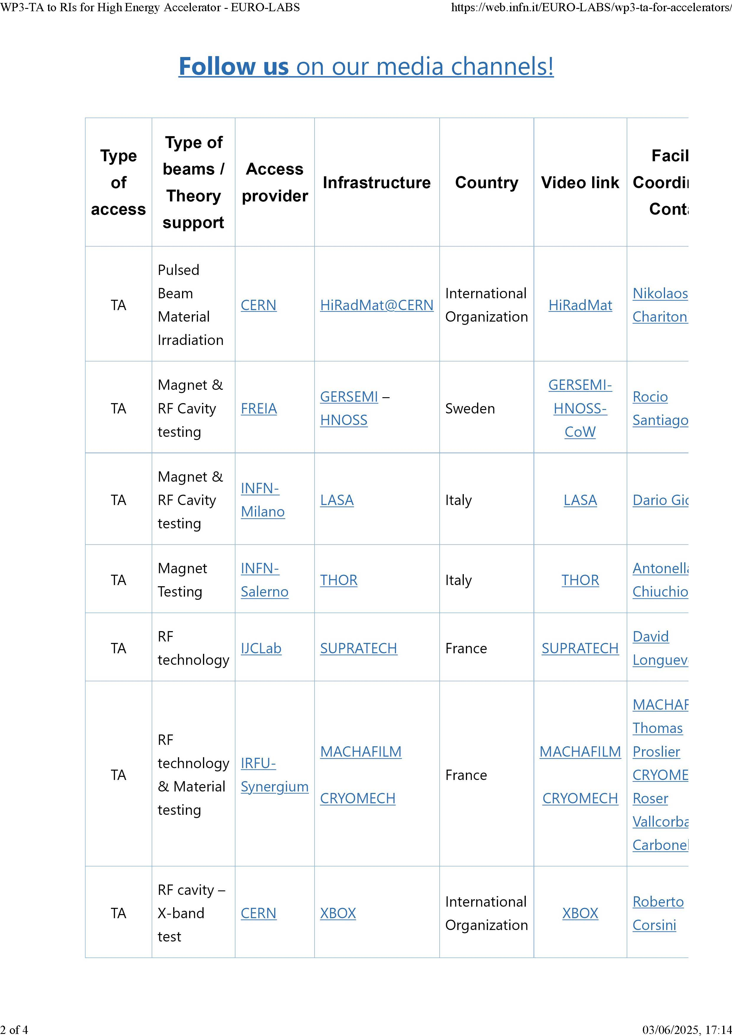
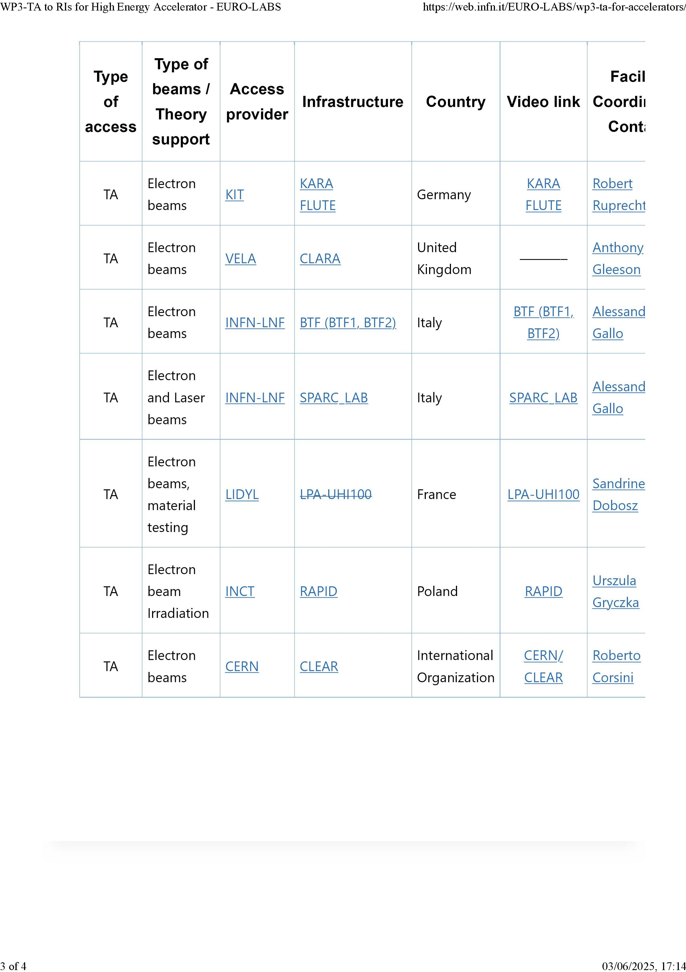
WP3: Access to RI for HEP Accelerators https://web.infn.it/EURO-LABS/wp3-ta-for-accelerators/

Slide 22
WP4: Access to RI for HEP Detectors
The typical detector R&D cycle consists of constructing a series of prototypes, testing them in high-energy particle beams, irradiating them and possibly evaluating their performance in special characterization facilities
This is followed by the division of WP4 into tasks:
  WP4.1 supplies the test beams in 3 RIs,
  WP4.2 offers detector characterization in 2 RIs and
  WP4.3 irradiation opportunities in 6 RIs.
The three RIs offering test beams in WP4.1 are:
  4.1.1: CERN PS and SPS test beams,
  4.1.2: DESY-II Test beam Facility,
  4.1.3: PSI PiM1 and UCN test beams

Slide 23
FAIR – “The Universe in the Lab”
FAIR Gmbh – a complex (and difficult) international enterprise
Countries: Roughly 3,000 scientists from more than 50 countries are already working on the planning of the experiment and accelerator facilities. This project is realized by shareholders from Finland, France, Germany, India, Poland, Romania, Russia, Slovenia and Sweden that have signed an international treaty, the FAIR Convention, which formally entered into force in March 2014. The UK joined in 2013 as its first associate member. In 2018 the Czech Republic joined as an aspirant partner. Further countries, like Italy, are in negotiations.
Investments: 3.3 billion euros
Accelerates: UNILAC + SIS18 + SIS100 all ions to energies up to GeV/nucleon (>99% c)
RIBs from fragmentation + …
The four scientific pillars of FAIR are:
  NUSTAR - Nuclear Structure, Astrophysics and Reactions,
  CBM - Compressed Baryonic Matter,
  APPA - Atomic, Plasma Physics and Applications,
  PANDA - antiProton ANnihilation at DArmstadt.

Slide 24
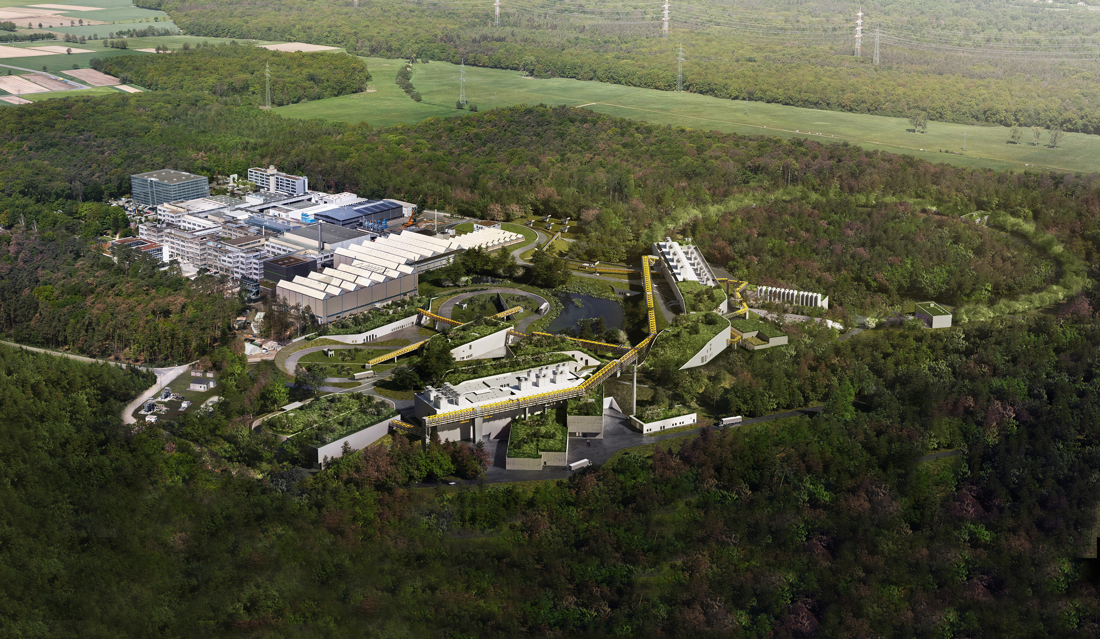
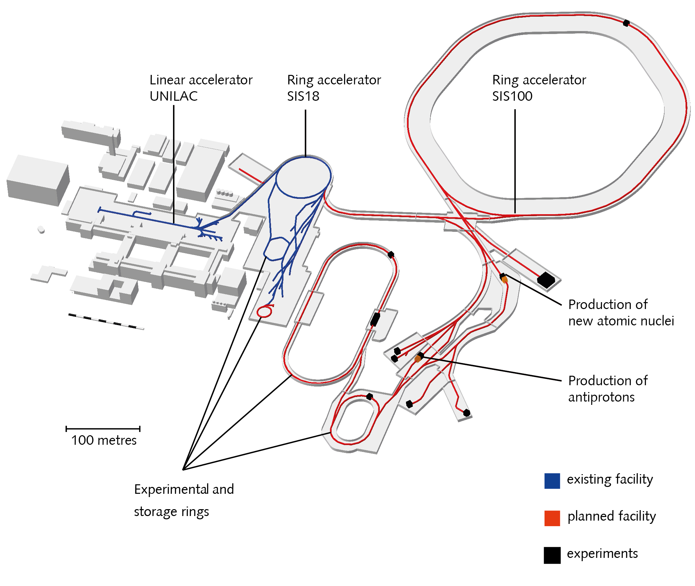
GSI/FAIR in Darmstadt

Slide 25
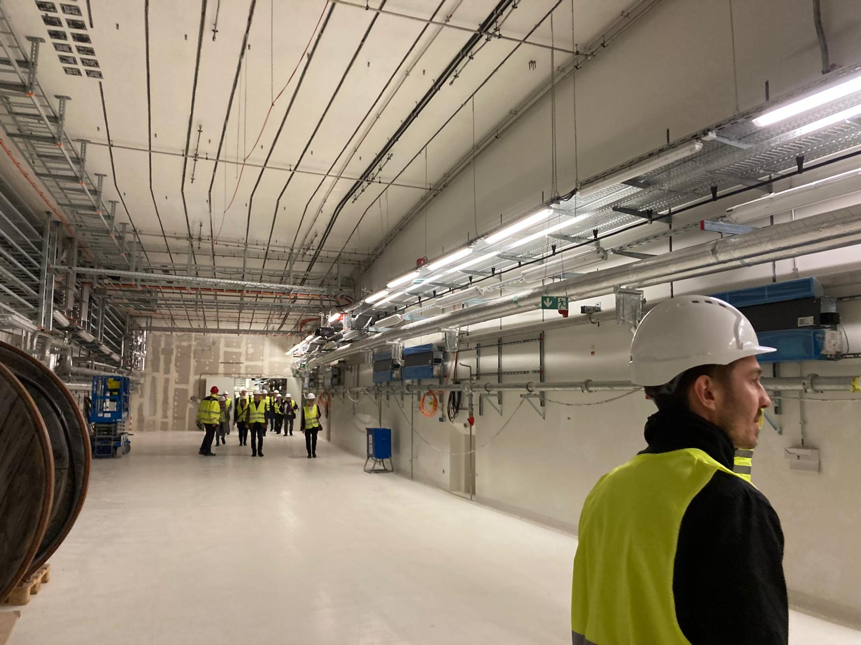
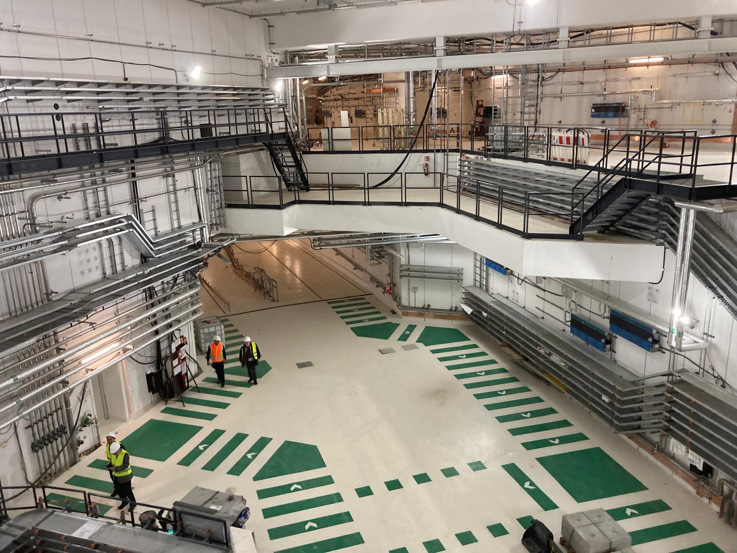
FAIR now (2025-2030) from “construction site”to “installation site”

Slide 26
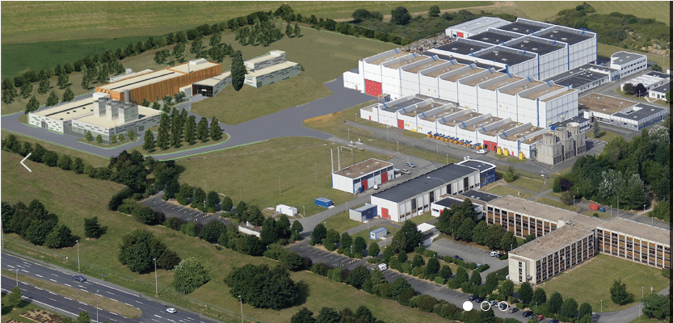
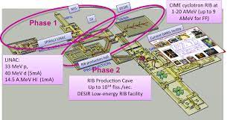
GANIL/Spiral2

Slide 27
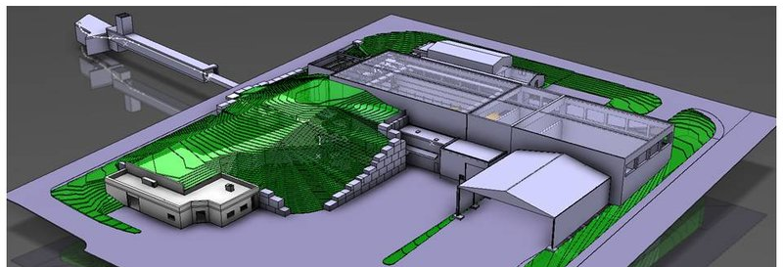


The ISOLDE-CERN Facility
- a brief overview -
from Razvan Lica @ CSSP23

Slide 28
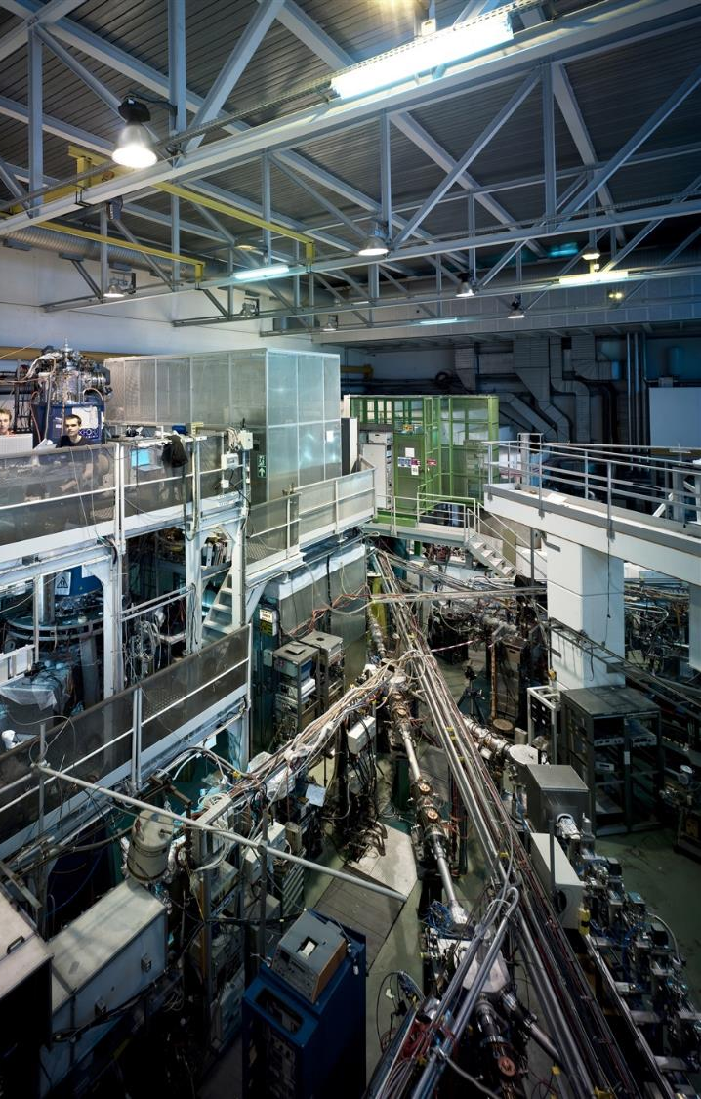

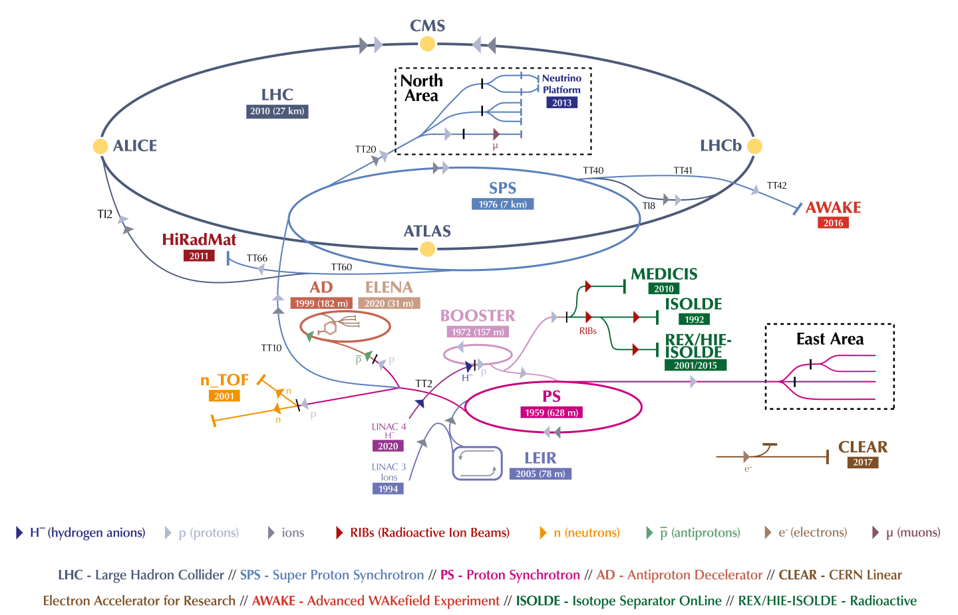
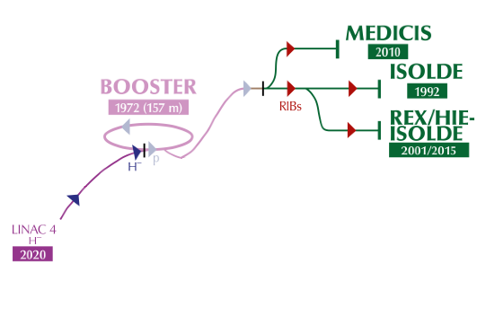
at CERN
ISOLDE = Isotope Separator OnLine
Produces Radioactive Ion Beams (RIB)
Approved by the CERN council in 1964
  Since 1967 supplied by the SC with 600 MeV protons
  Moved to the PSB in 1992 with 1.0 GeV protons (later 1.4 GeV)
RIBs are used for studies in:
  Nuclear physics
  Atomic physics
  Solid state physics
  Astrophysics
  Life sciences

Slide 29
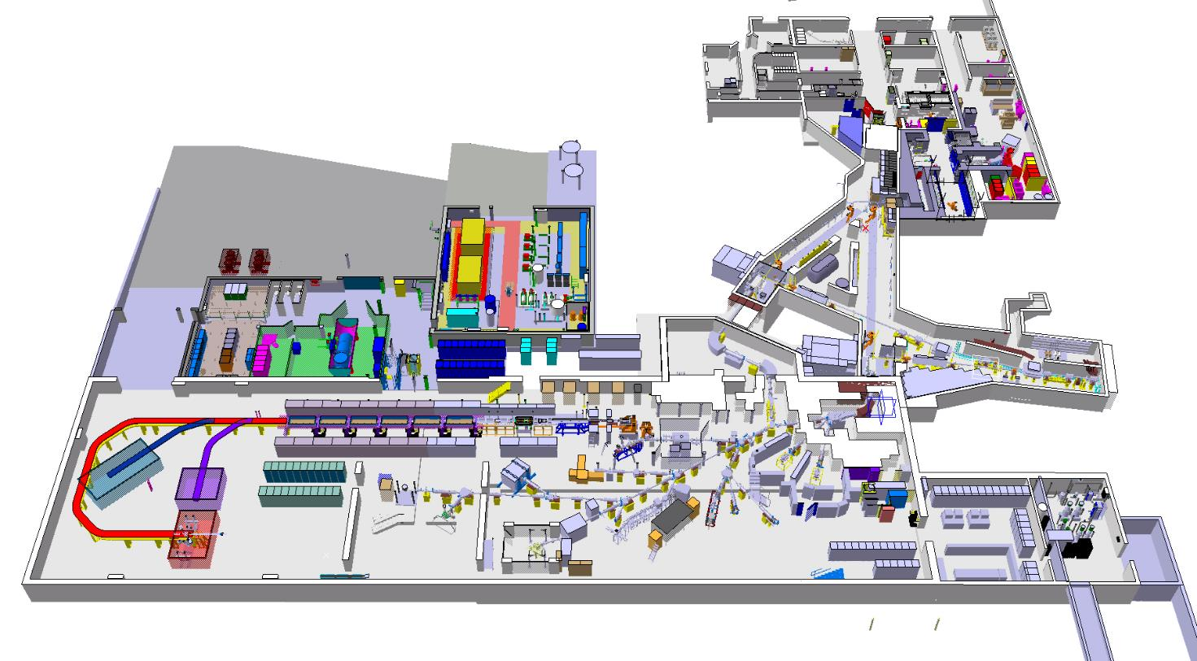




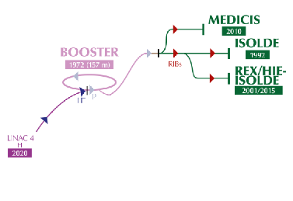

Facility
Protons (1.4 – 2.0 GeV, < 2µA)
Low energy RIBs (up to 60 keV)
Radioactive laboratory
Class A
MEDICIS
High energy RIBs (up to 10 MeV/u – A/q=4.5)
Pulsed protons (1.2 s)
1.4 GeV
3.3x10¹³ protons per pulse
HRS
High Resolution Separator
High Energy RIB
Target area
Low energy RIB
GPS
General Purpose Separator
*picture courtesy of M. Delonca

Slide 30
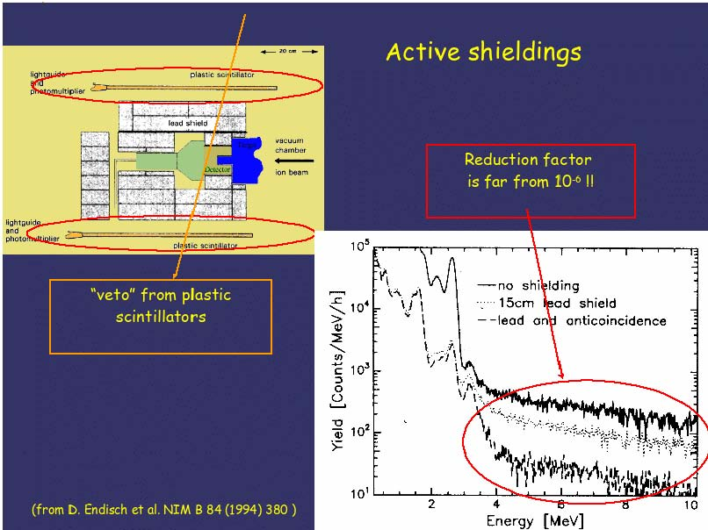
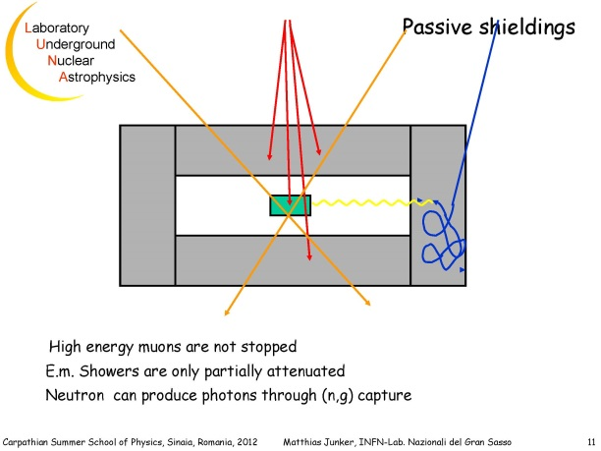
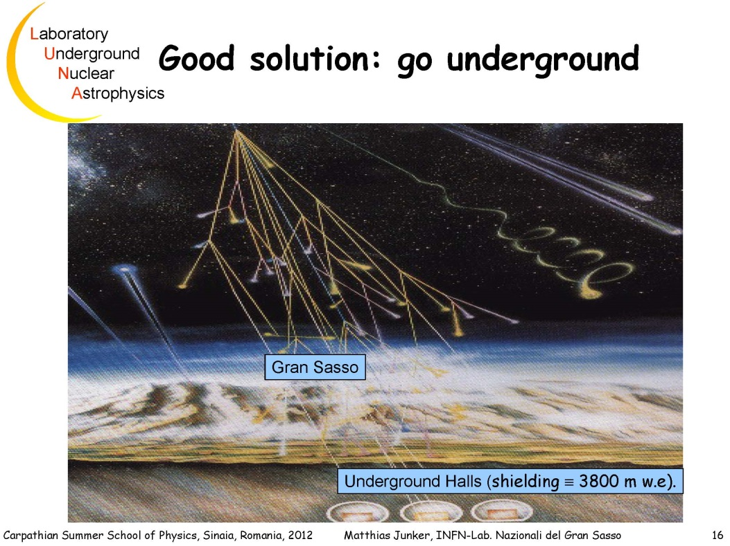
Nuclear Physics for Astrophysics - low energies, direct measurements
low cross sections →
measure longer?!
No, bc background issues!
Background from
  Cosmic rays
  Environment radioactivity
Solution: shielding
  Passive
  Active
  Underground
Low cross sections
  High current accelerators
  Targets …
Detect what?!

Slide 31
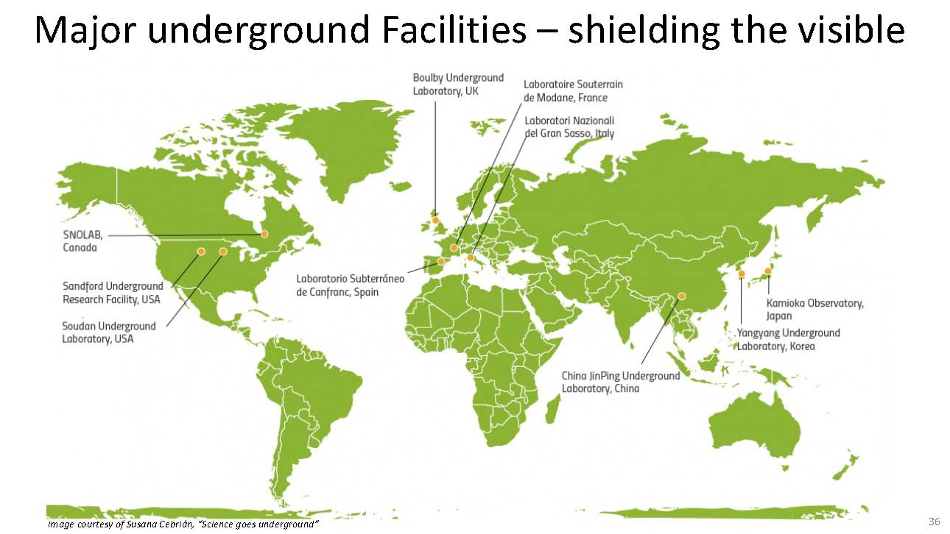

Slide 32
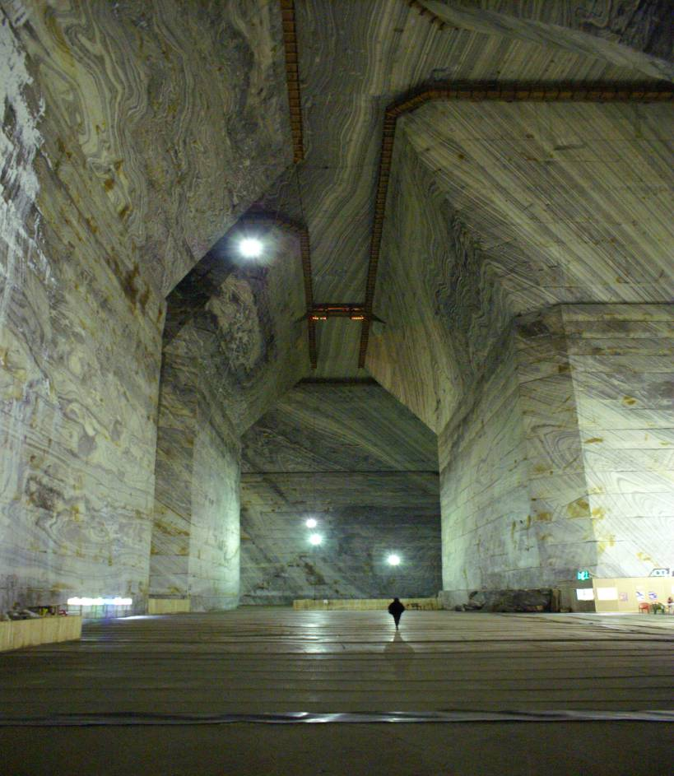
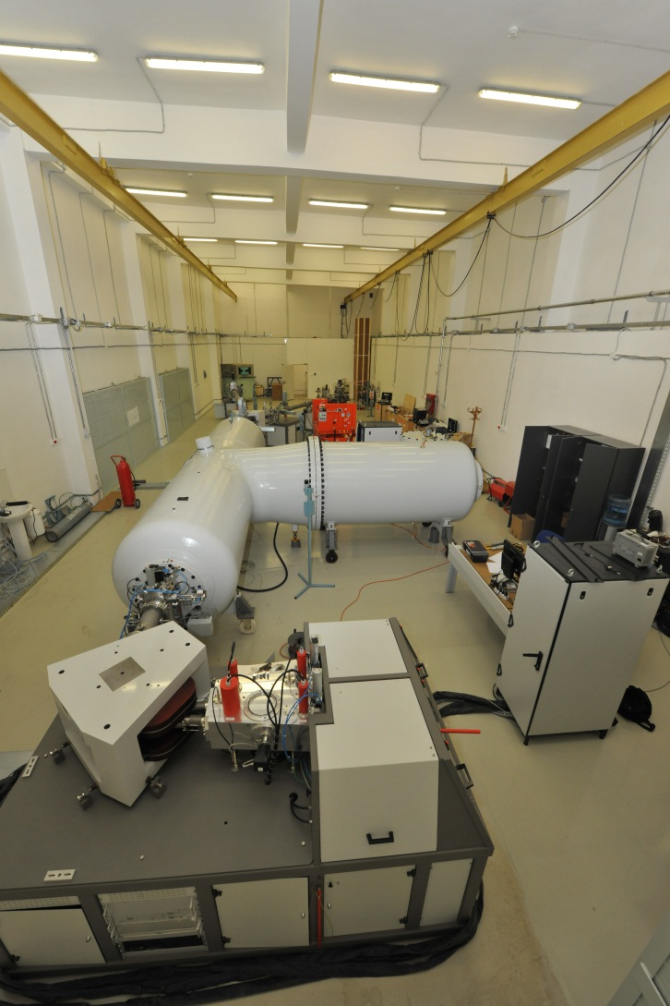
3MV tandetron in Bucharest - suitable for nuclear astrophysics: α and light ion beams & ultralow background lab in saltmine

Slide 33
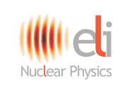
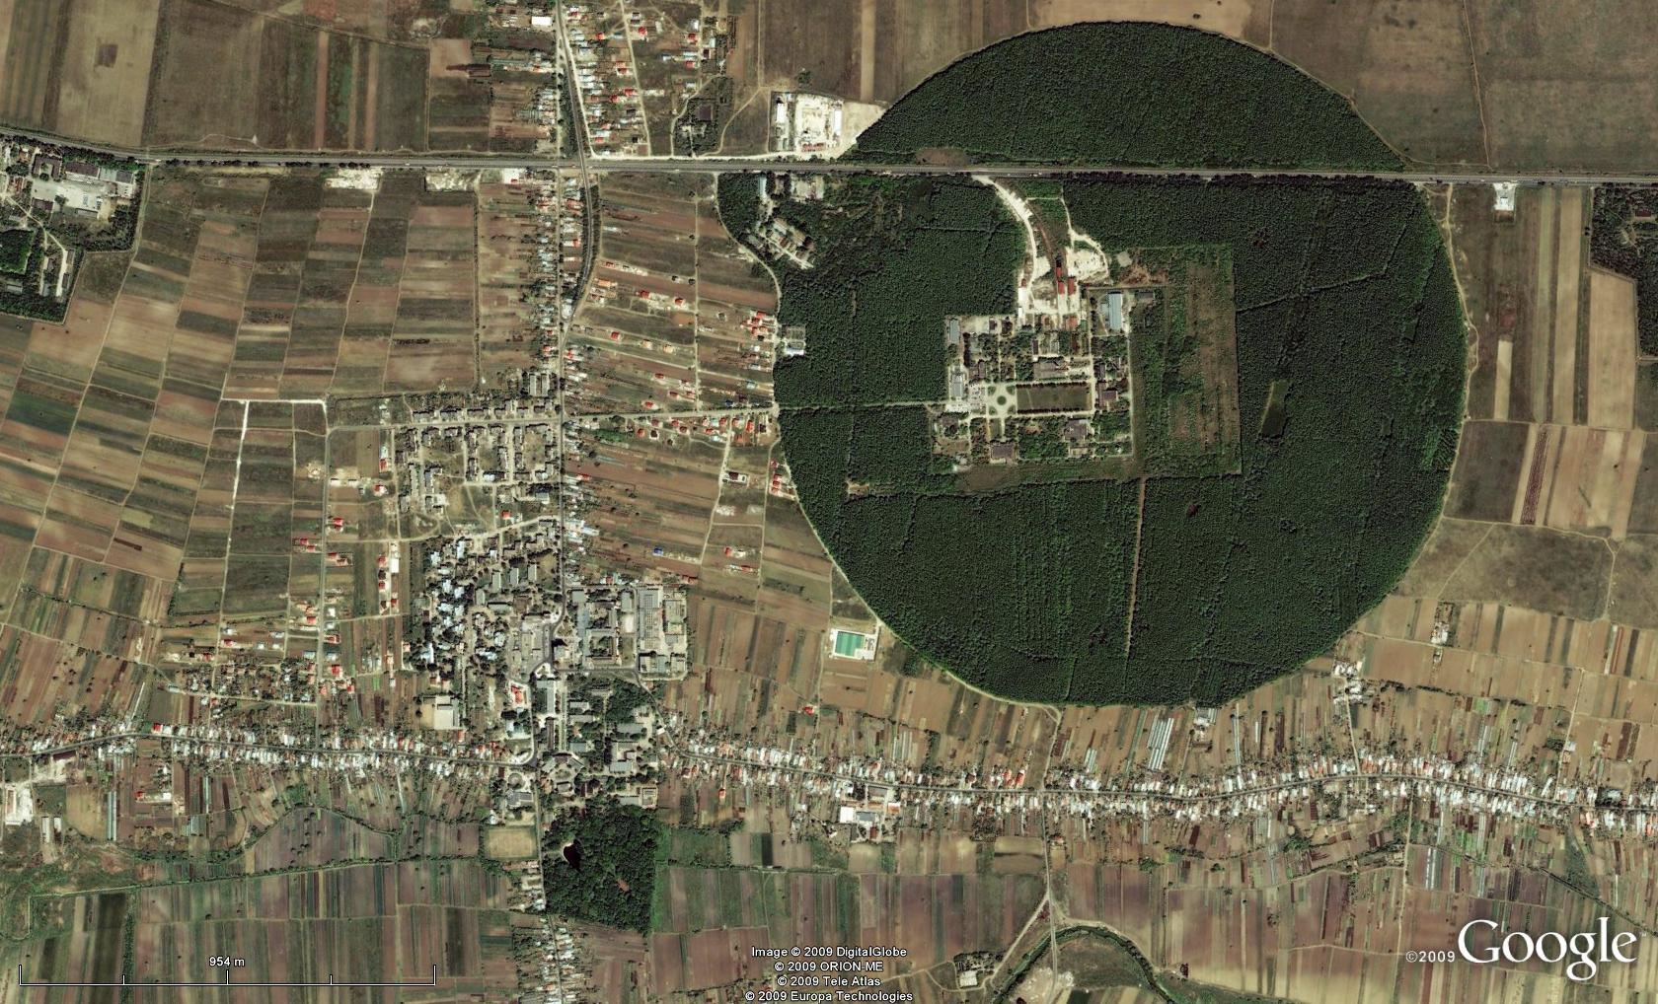
Bucharest-Magurele Physics Campus
National Physics Institutes
BUCHAREST
ring rail/road
ELI-NP
NUCLEAR
Tandem acc. Cyclotron
γ – Irradiator
Adv. Detectors
Life & Env.
Radioisotopes
Reactor (decomm.)
Waste Proc.
Faculty of Physics, UB
Lasers & Plasma
Optoelectronics
Material Physics
Earth Science
Space Science
Theoretical Physics
Particle Physics
Computing, Library

Slide 34
IFIN-HH accelerators - host for BTS23 and BTS26
1) 3 MV tandetron accelerator: 0.2 – 3.3 MV
  Good for NA with alpha and light ion induced reactions
  Detection
  Gamma-ray detection:
    From activation – most sensitive method
  Ultra-low background lab in salt mine
  BEGA – βγ coincidence setup
2) 9 MV pelletron + ROSPHERE + neutron dets
3) 1 MV tandetron for Accelerator Mass Spectrometry
4) T19 cyclotron, 19 MeV protons for radioisotopes prod.

Slide 35
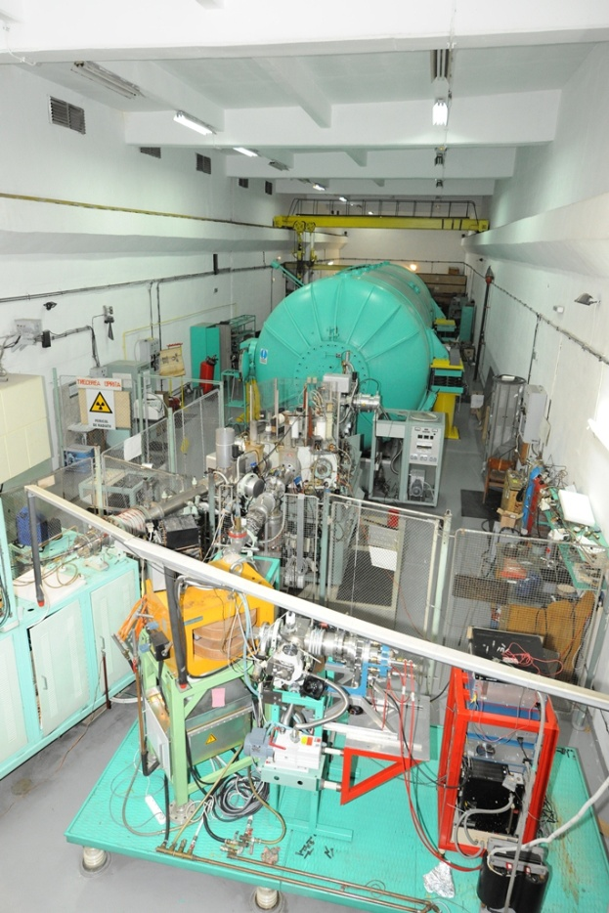
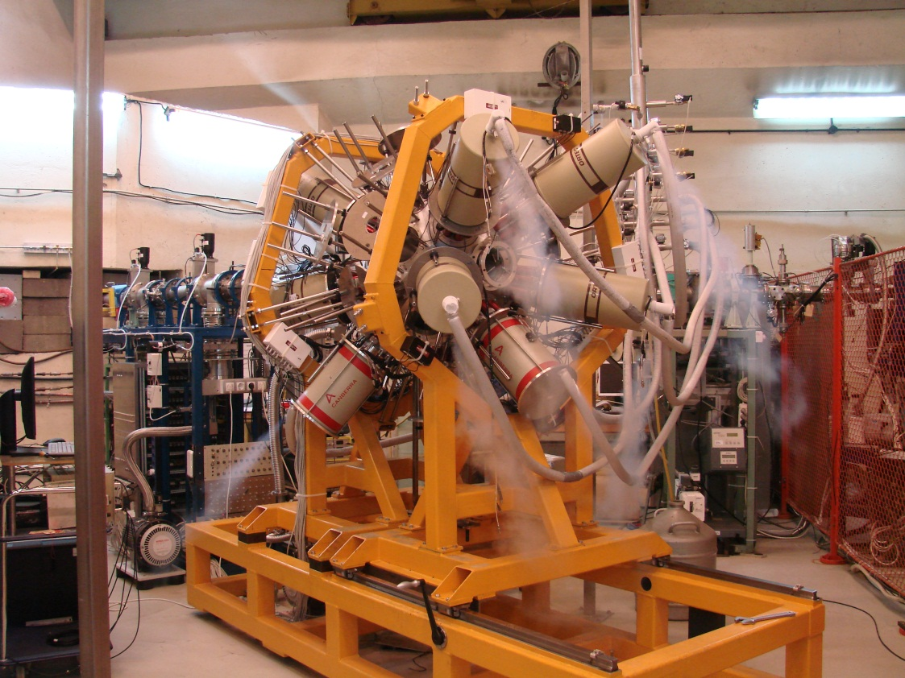
IFIN-HH 9 MV tandem and ROSPHERE

Slide 36
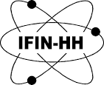
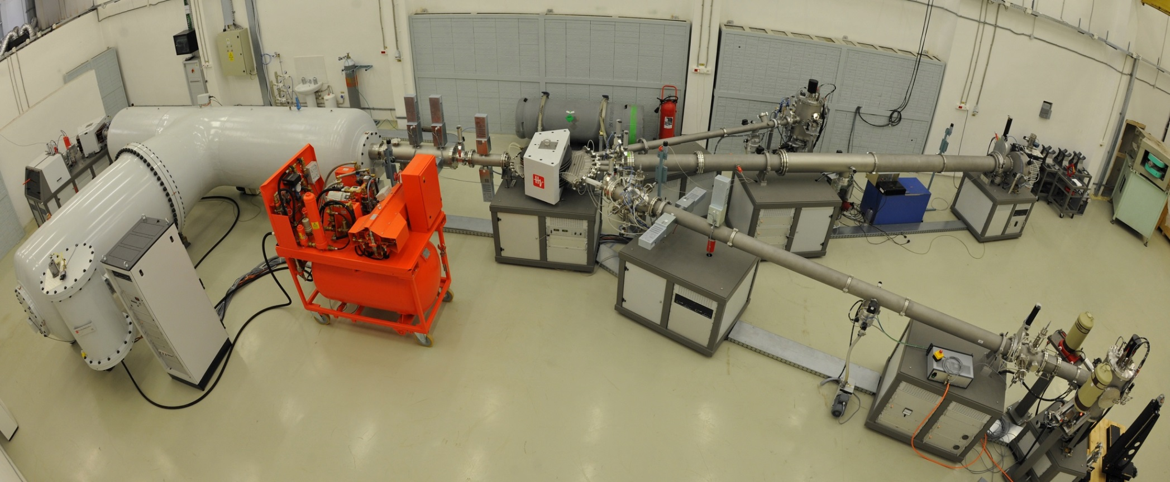
3 MV TandetronTM
I. Burducea et al., NIM B, vol. 359, 15: 12–19, 2015

Slide 37
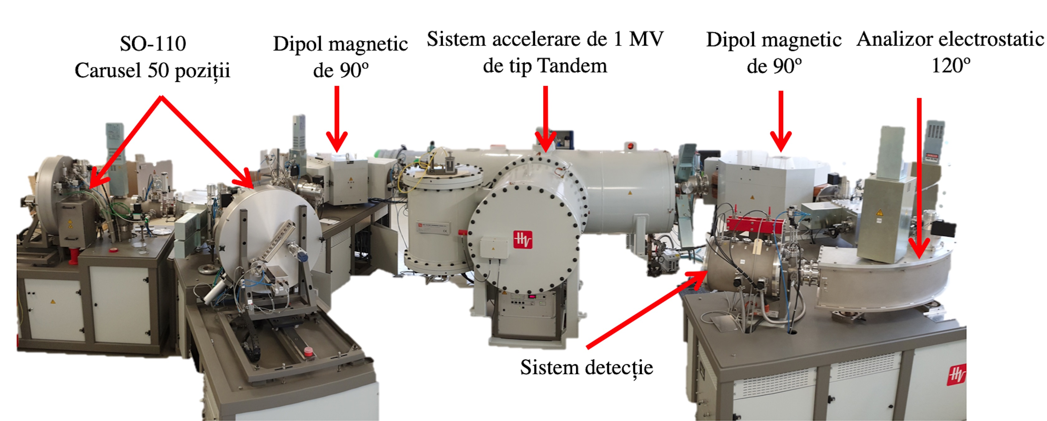
1 MV tandetron for AMS

Slide 38
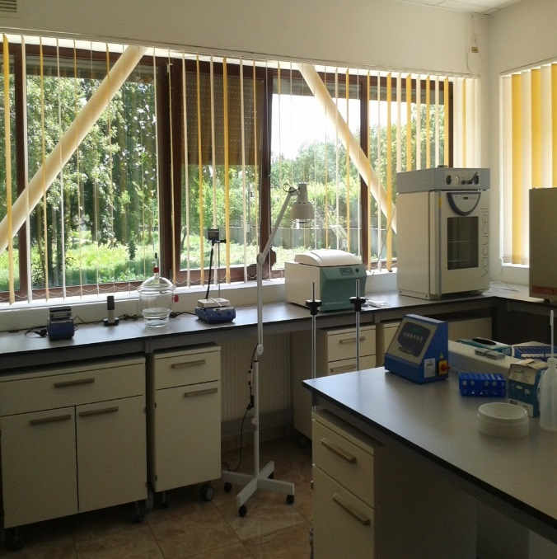
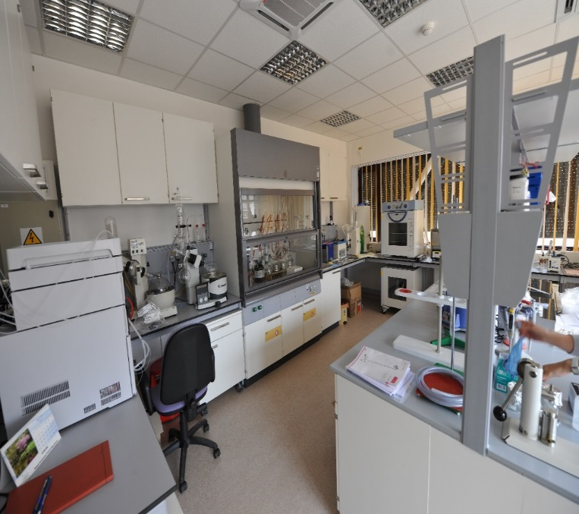
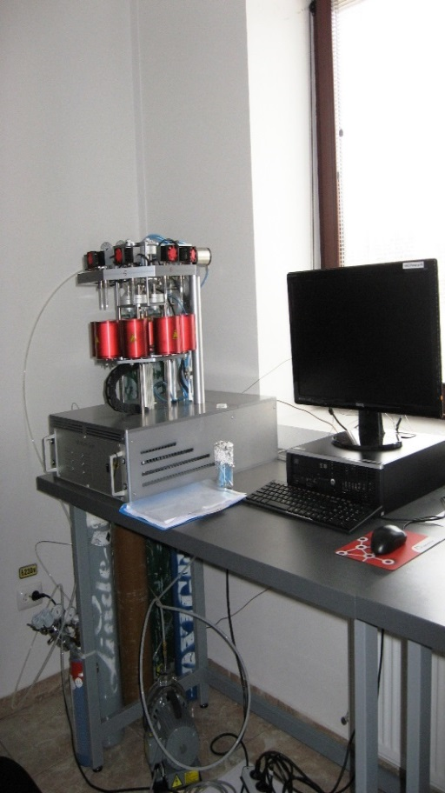







Sample preparation laboratories
& AMS measurements
Types of samples that can be dated via ¹⁴C:
Bones
Wood
Seeds
Corals
Shells
Sediments
Textiles
Mortars
Alloys
Water
AGE III - Automated
Graphitization System
¹⁴C spectra
C7 Standard (IAEA)
Age: 5645 ± 20 y (BP)
Measurement time: 20 min
¹⁴C/¹²C = 5.6E-13

Slide 39


Target labs
DFN
At ELI-NP

Slide 40

RIB facilities worldwide

Slide 41
Major RIB non-European facilities
RIBF at RIKEN, Wako, Japan – largest yet!
FRIB at MSU, East Lansing, MI, USA – newest!
Institute of Modern Physics, Lanzhou, China
HIAF, Huizhou, China – commissioned Dec. 2025
Center for Exotic Nuclear Studies , IBS, Daejeon, Korea (since 2024)
ANL CARIBU, IL, USA
MARS at TAMU, TX, USA
Notre Dame Twinsol, IN, USA
iThemba, S. Africa
…

Slide 42

RIBF at RIKEN

Slide 43


New: CENS Daejeon, S. Korea

Slide 44



HIAF of IMP, Lanzhou @ Huizhou, China (commissioned Dec. 2025)
for reactions I suggest:
RB stop and reaccel up to 3 MeV/u
n-rich
EoS studies
MNTR, n-rich

Slide 45


BTS23 at IFIN-HH: 3 lectures and 2 separate experiments at 2 accelerators

Slide 46


Sunday: visit to MicroBequerel lab
in the Slanic saltmine

Slide 47





BTS24 in Warsaw – social event
On Sunday students and supervisors visited the "Rancho pod Bocianem" where attractions awaited them:
a rope park and air gun shooting.
After having fun together, there was a barbecue and a bonfire, where international hits were sung with a guitar.

Slide 48





Basic Training School on Accelerator Applications
in Nuclear Physics 2025
Begoña Fernández on behalf of the organizing committee
University of Seville & Centro Nacional de Aceleradores (CNA)

Slide 49
Thank you!
Enjoy your stay!
Be aware of excitement, curiosity & work!

