Slide 1
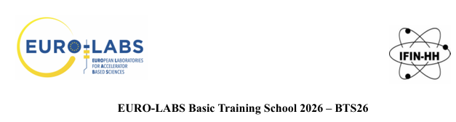


Experimental Nuclear Astrophysics: an introduction
G.L. Guardo
on behalf of the AsFiN group

Slide 2
Experimental Nuclear Astrophysics
Experimental nuclear astrophysics combines laboratory nuclear physics with astronomical observations to understand the origin of elements and stellar energy production

Slide 3

Experimental Nuclear Astrophysics
Experimental nuclear astrophysics combines laboratory nuclear physics with astronomical observations to understand the origin of elements and stellar energy production
Model
Experiments
Observations
Theory

Slide 4
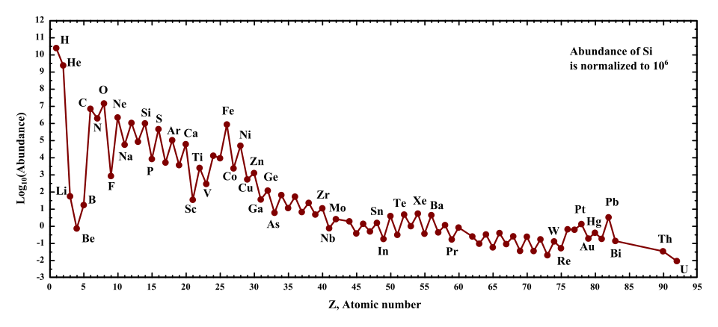
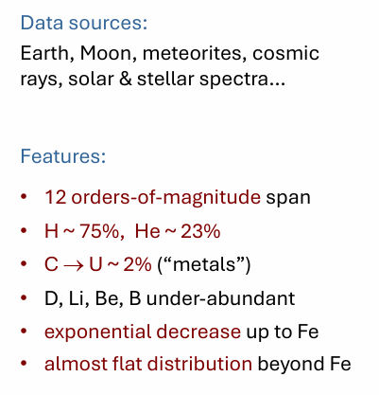
Cosmic Abundances of Elements

Slide 5
Cosmic Abundances of Elements

Slide 6
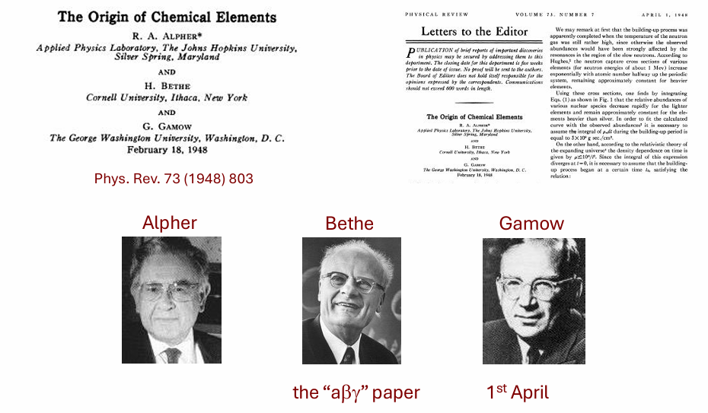
Origin of Elements

Slide 7
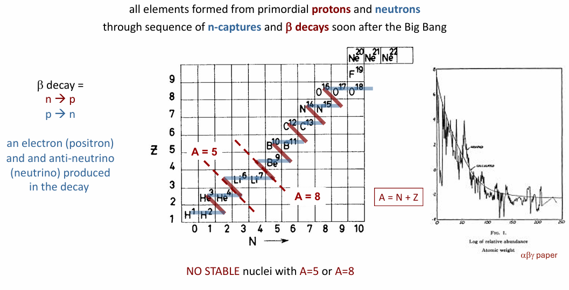
Origin of Elements

Slide 8
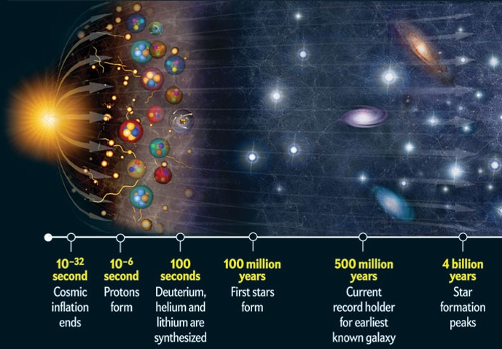
Big Bang Nucleosynthesis
For a time window of ≈ 200 – 1000 s after expansion began, corresponding to temperatures and densities of T ≈ 0.9 – 0.4 GK and 𝜌_{b} ≈ 2 × 10⁻⁵ – 2 × 10⁻⁶ g/cm³ the early universe passed through an epoch of nucleosynthesis. ²H, ³H, ³He, ⁴He, ⁷Li, and ⁷Be are formed (primordial or Big Bang Nucleosynthesis, BBN)

Slide 9
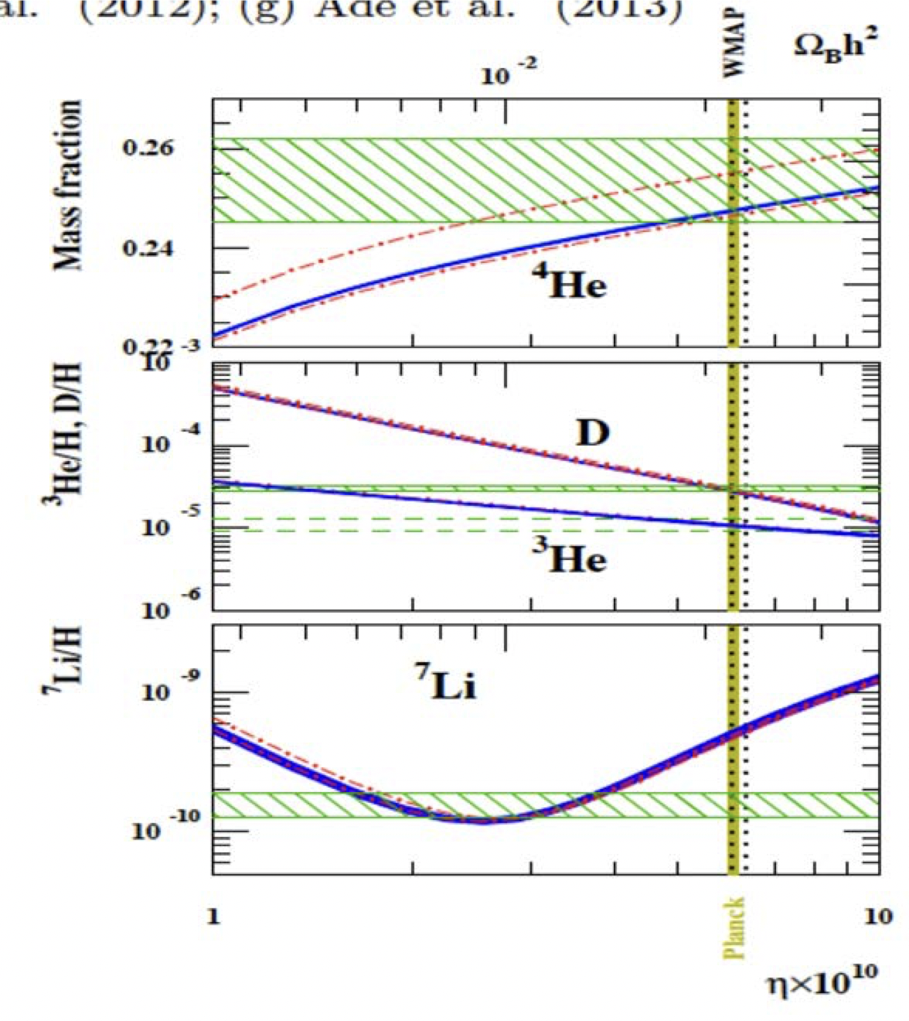
Big Bang Nucleosynthesis
Using as inputs:
-12 key nuclear cross sections
-the baryon-to-photon ratio (6.23+/- 0.17 from WMAP)
-the neutron lifetime
we can predict the abundances of d, He, Li relative to H
To check if these numbers from BBN hold we compare with abundance measurements in old parts of the Universe (metal poor halo stars, globular clusters)
1. p(n,γ)d
2. ²H(p,γ)³He
3. ²H(d,n)³He
4. ²H(d,p)³H
5. ³He(n,p)³H
6. ³H(d,n)⁴He
7. ³He(d,p)⁴He
8. ³He(α,γ)⁷Be
9. ³H(α,γ)7Li
10. ⁷Li(p,α)⁴He
11. ⁴He(d,γ)⁶Li
12. ⁶Li(p,α)³He
Cosmological Lithium problem!
For review see:
B. D. Fields, Ann. Rev. Nucl. Part. Sci. 61, 47 (2011)
R. H. Cyburt et al., Rev. Mod. Phys. 88, 015004 (2016)
S.Q. Hou et al, The Astrophysical Journal. 834 (2): 165 (2017)
C.A. Bertulani, J. Phys.: Conf. Ser. 1291 012002 (2019)

Slide 10
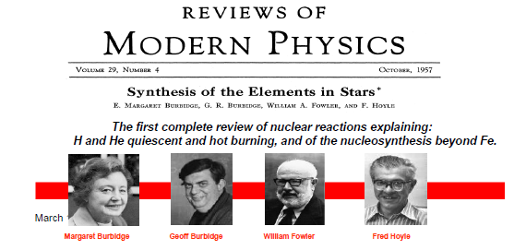
Stellar Nucleosynthesis
... Everything starts from the B²FH review paper of 1957,
the basis of the modern nuclear astrophysics
this work has been considered as the greatest gift of astrophysics to modern civilization
The elements composing everything from planets to life were forged inside earlier generations of stars!
Nuclear reactions responsible for both ENERGY PRODUCTION and CREATION OF ELEMENTS

Slide 11
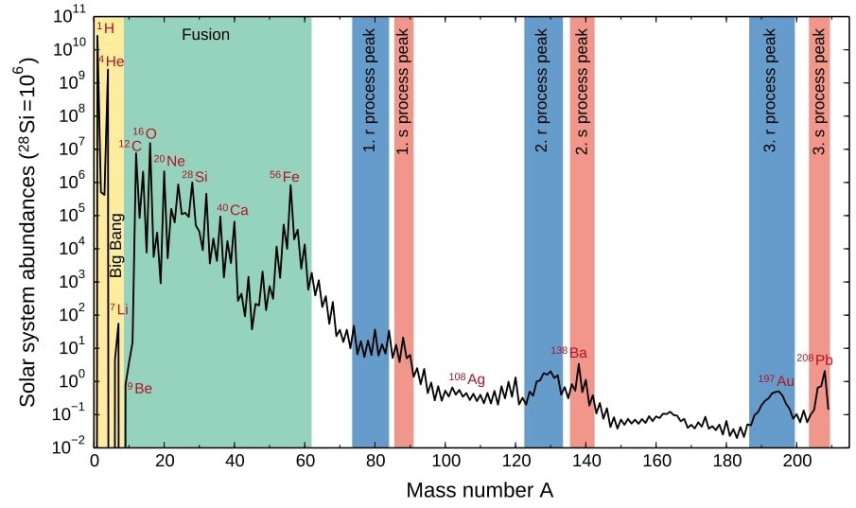
Stellar Nucleosynthesis
  Odd-even staggering of abundances
  Larger alpha-nuclei abundance
  Broad peak around ⁵⁶Fe
  ..

Slide 12
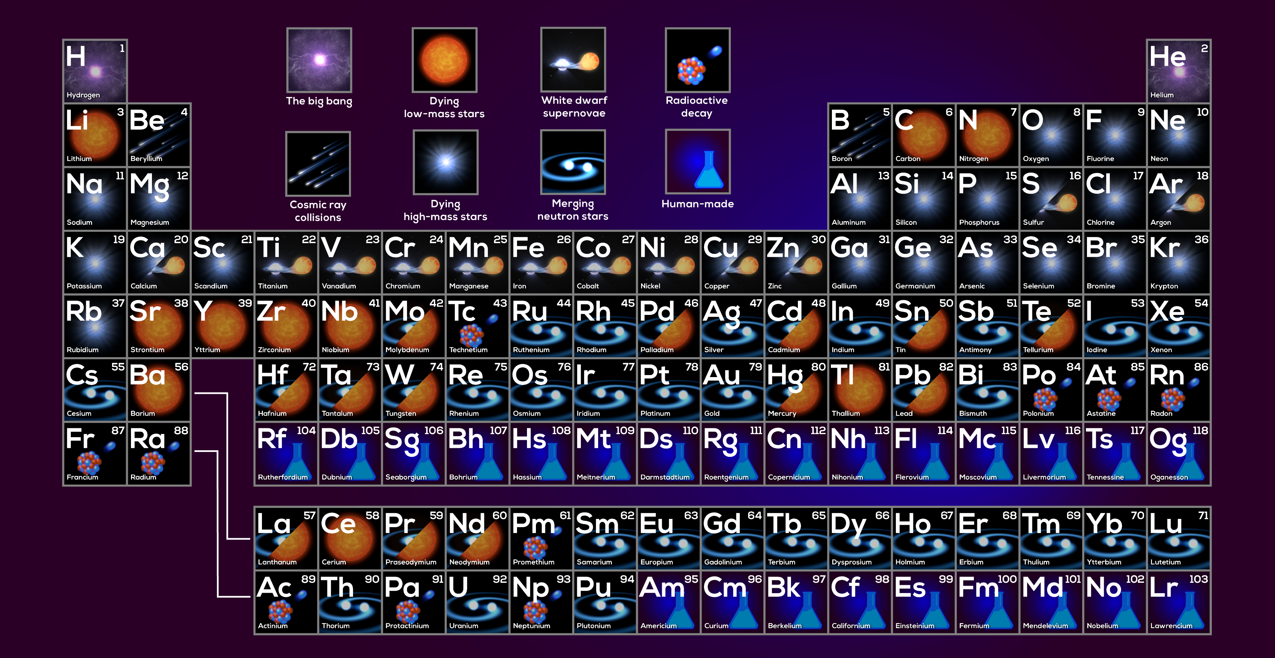
Origin of Elements

Slide 13
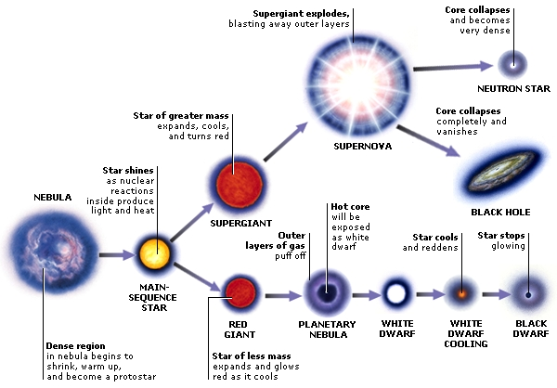
Stellar Nucleosynthesis

Slide 14
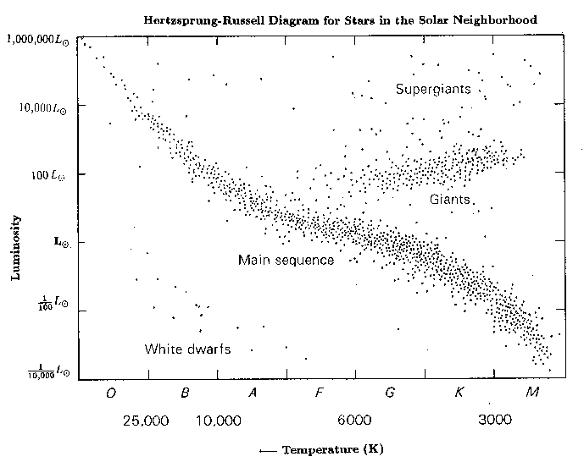
Stellar Nucleosynthesis

Slide 15
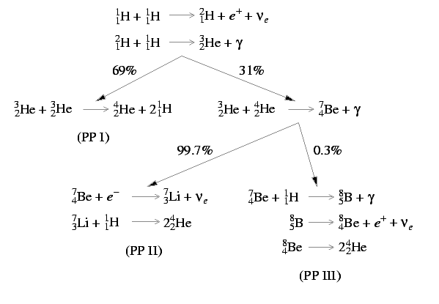
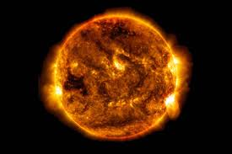
Life of a Star – pp chain

Slide 16
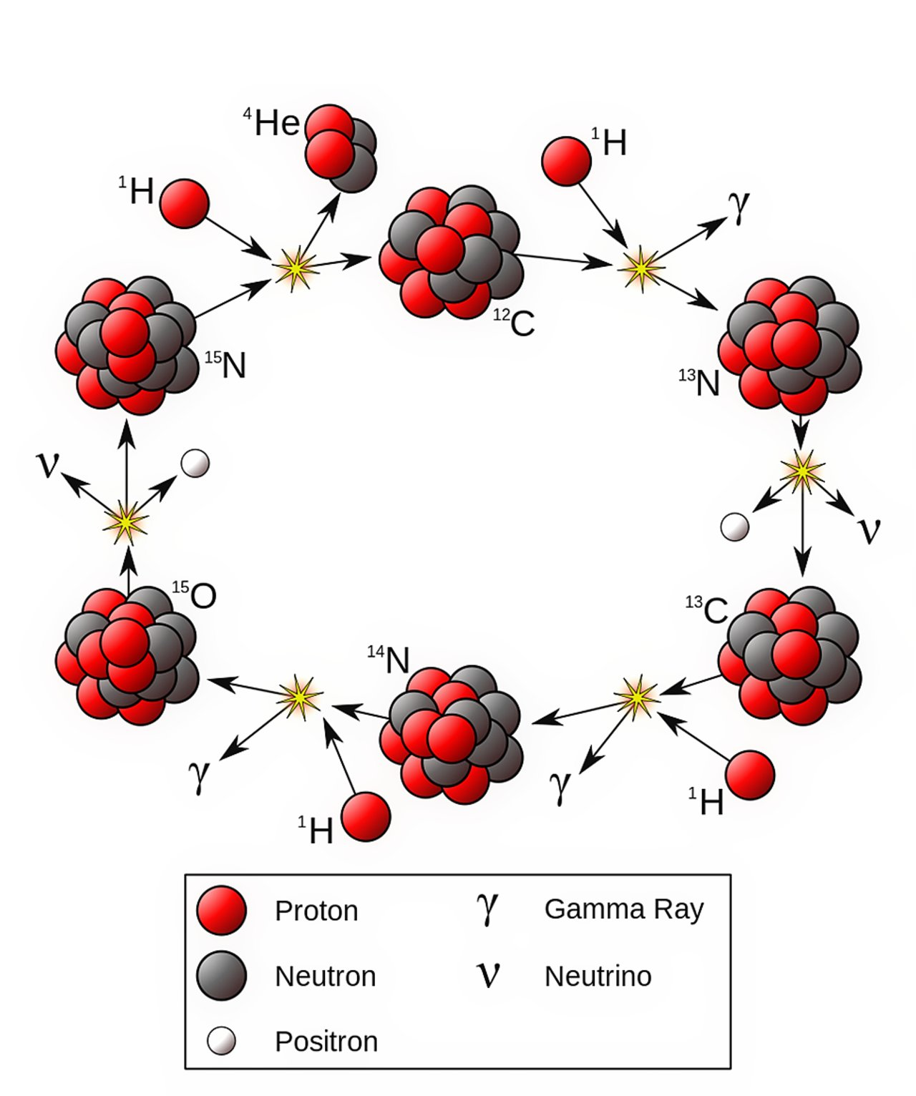
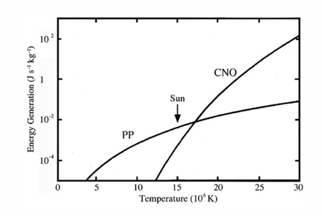
Life of a Star – CNO Cycle

Slide 17
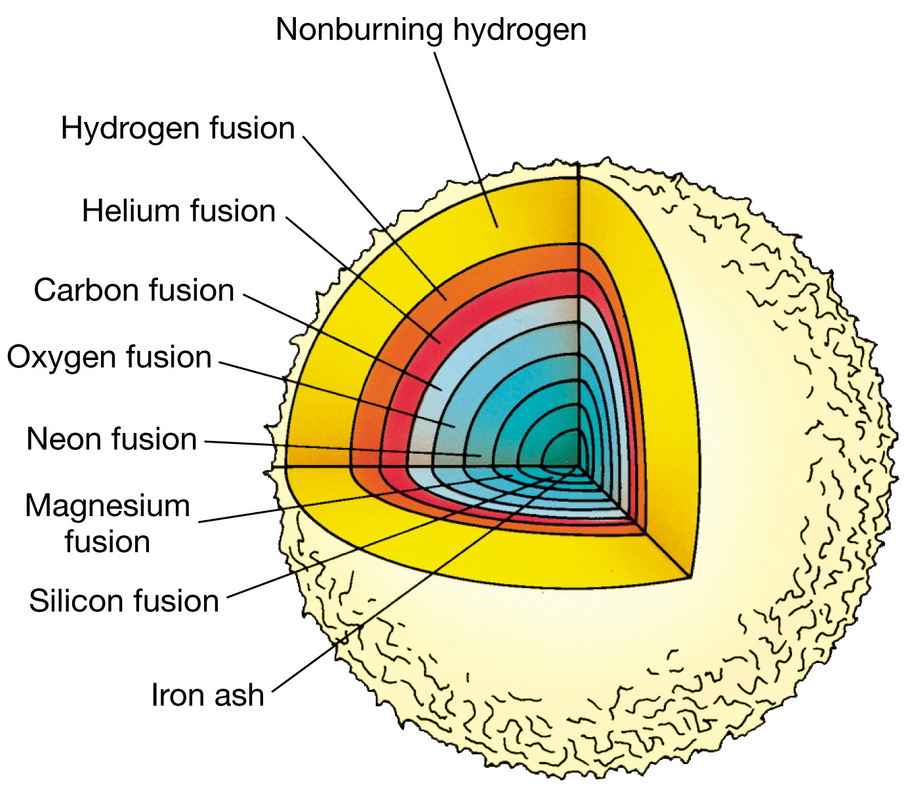
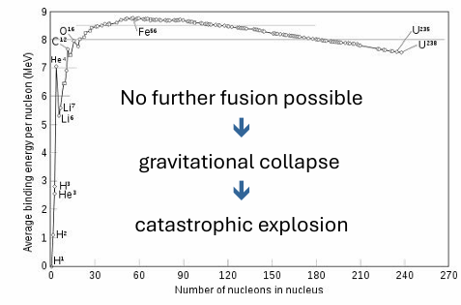
Life of a Star – Heavy Ion Synthesis
Helium Burning: A two-stage Process
  3α : α + α ⇔ ⁸Be* + α → ¹²C* → ¹²C
Carbon burning: ¹²C + ¹²C crucial phase in the nucleosynthesis of massive stars (> 8 M_{ʘ}), determines M_{up}, ignition trigger for superbursts and Type Ia supernovae

Slide 18
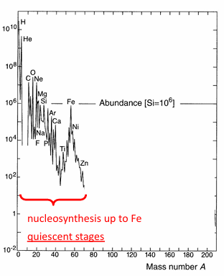
Life of a Star – Heavy Ion Synthesis

Slide 19
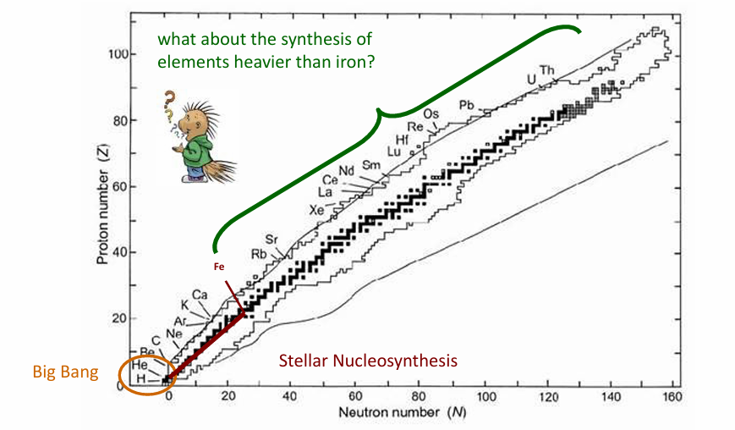
Life of a Star – Heavy Ion Synthesis

Slide 20
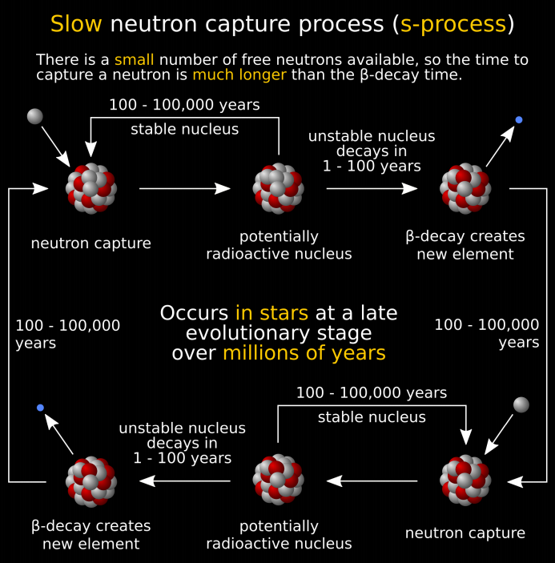
Life of a Star – Neutron Captures
Neutron sources:
¹³C(α, n) in low-mass AGB stars
²²Ne(α, n) in intermediate mass and massive
Low mass AGB stars < 3 M☼
Low temperature 10⁸ K
¹²C(p, γ)¹³N(β⁻)¹³C(α,n)
Flux 10⁸ n cm⁻³
Time scale 10⁵ y, A > 80
Intermediate mass AGB > 3 M ☼
Higher temperature 3 10⁸ K
¹⁴N(a, γ)¹⁸F(β⁺)¹⁸O(α,g)²²Ne(α,n)
Flux 10¹³ n cm⁻³
Time scale 10 y, A ≈ 60-80
n-capture time scales
(slow) s-process: 10³-10⁴ years

Slide 21
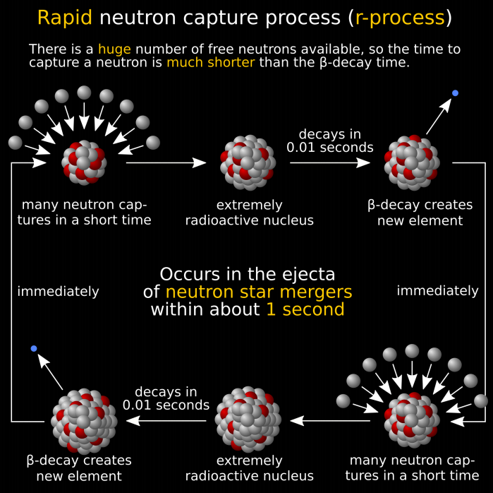
Life of a Star – Neutron Captures
Neutron sources:
core collapse supernovae (?)
neutron star mergers (?)
n-capture time scales
(rapid) r-process: 0.1-1.0 seconds
  Heavy elements formed by rapid neutron capture on seed nuclei
  High T required (T > 10⁹ K)
  High neutron density (n_{n} > 10²² cm⁻³)
  Flow along path near neutron drip line till (n,γ) = (γ,n)
  Neutron rich isotopes are unstable to beta decay
  After beta decay the new nucleus will have a new neutron drip line and in most cases be able to capture more neutrons.

Slide 22
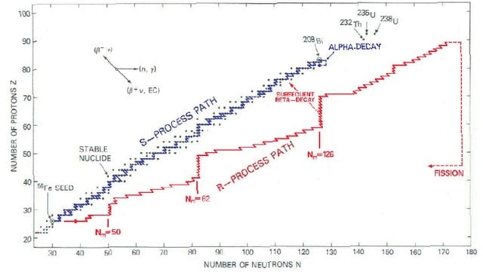
Life of a Star – Neutron Captures
To understand the abundance of elements in the universe it is important that we understand r-process.
Models are very sensitive to neutron capture cross sections and beta-decay properties, both of which can be measured in the laboratory by nuclear physicists.

Slide 23
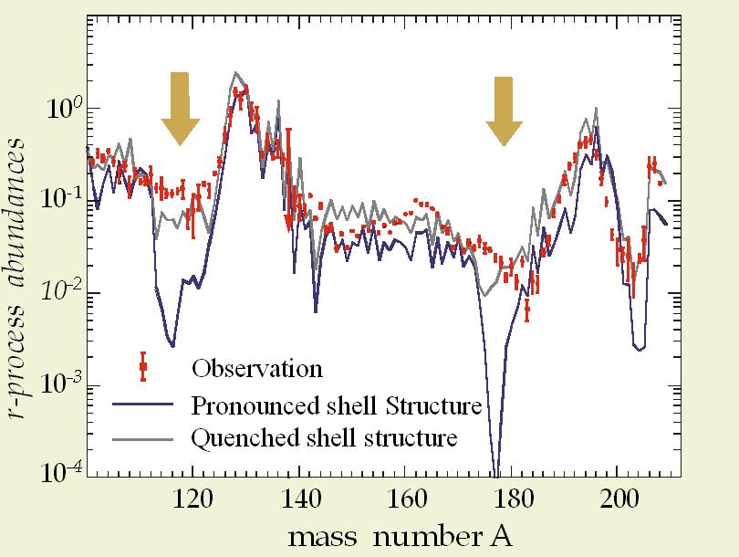
Life of a Star – Neutron Captures
Current models do not reproduce the observed abundance of elements in the universe
Challenges
The nuclei involved in r-process are very short-lived, however we can create radioactive ion beams of these short lived nuclei.
We cannot make a neutron target (free neutrons are unstable).

Slide 24
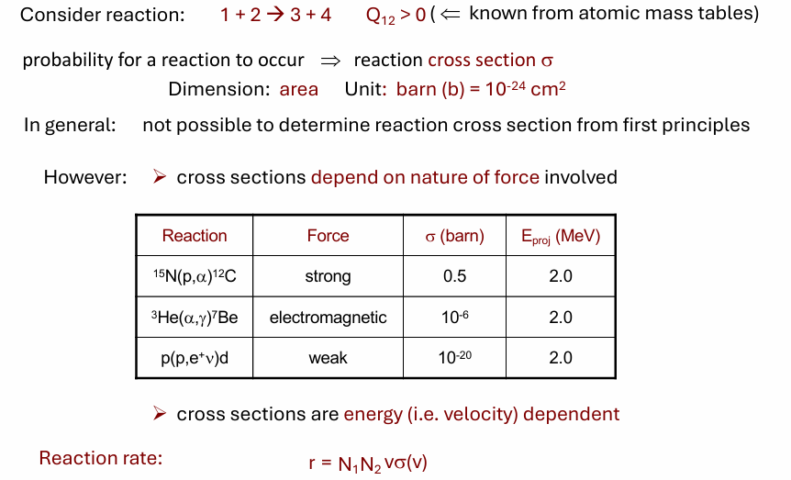

Nuclear Reactions
Stars are cosmic cauldrons (loosely quoting C. Rolfs) and they cook!

Slide 25
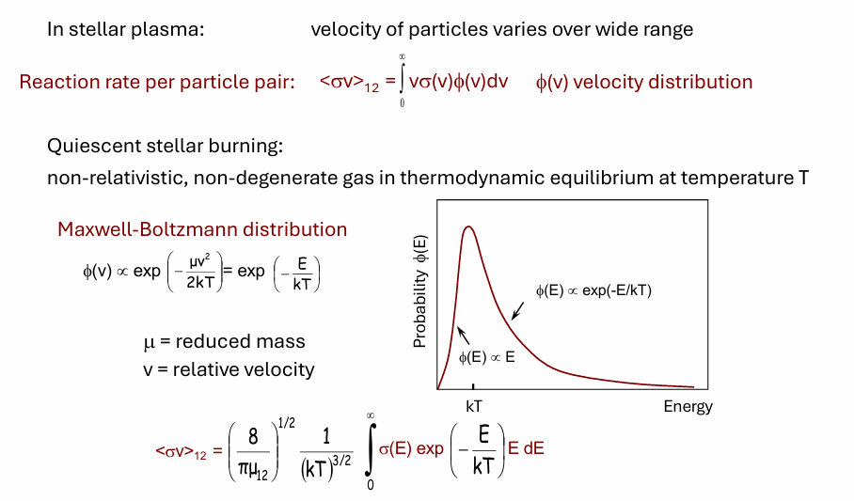
Reaction Rate
example:
Sun T ~ 15x10⁶ K ⇒ kT ~ 1 keV

Slide 26
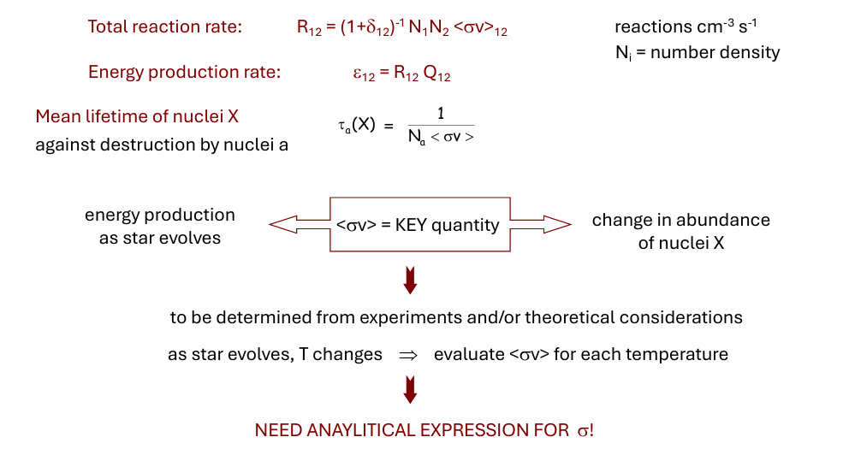
Reaction Rate

Slide 27
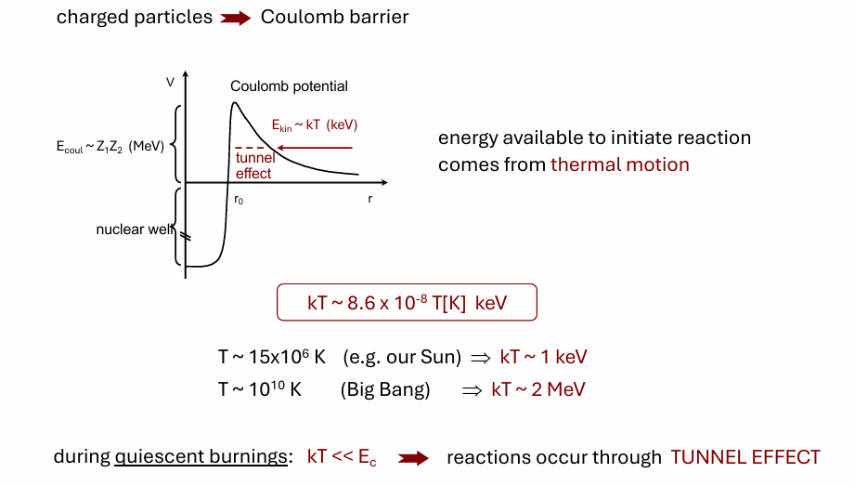
Charged Particle Nuclear Reactions

Slide 28
The Gamow Peak
The most effective energy region for thermonuclear reactions
(i.e. the energy region at which most of reactions occur).
Maxwell-Boltzmann
distribution
∝ exp(-E/kT)
tunneling through
Coulomb barrier
∝ exp(- )
E₀ ± ΔE₀/2
energy window of astrophysical interest
E₀ = f(Z₁, Z₂, T)
relative probability
Gamow peak
depends on the reaction and temperature
ΔE₀
Examples:
T ~ 15x10⁶ K
(T₆ = 15)
reaction | Coulomb barrier (MeV) | E₀ (keV) | area under Gamow peak ∝ <σv>
p + p | 0.182 | 5.9 | 7.0x10⁻⁶
α + ¹²C | 2.242 | 56 | 5.9x10⁻⁵⁶
¹⁶O + ¹⁶O | 10.349 | 237 | 2.5x10⁻²³⁷
kT
E₀
energy
STRONG sensitivity
to Coulomb barrier
separate stages: H-burning
He-burning
C/O-burning …

Slide 29
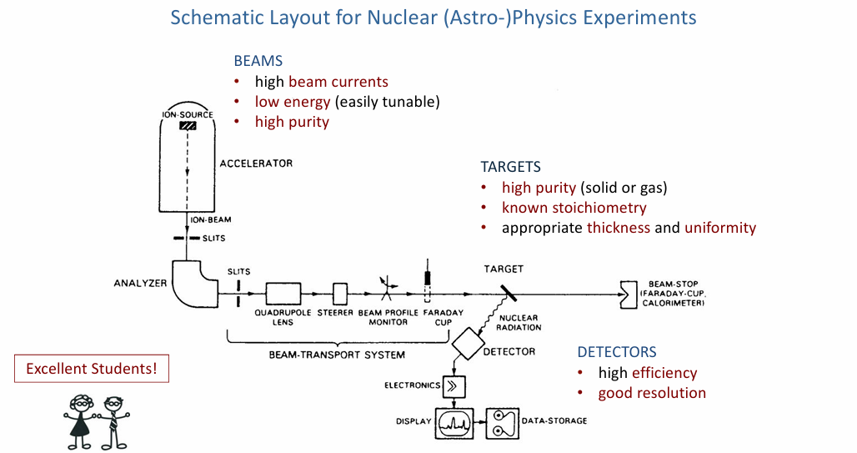
Direct Experiments

Slide 30

Direct Experiments
Very small cross section values reflect in a faint statistic;
Very low signal-to-noise ratio makes hard the investigation at astrophysical energies;
Instead of the cross section, the S(E)-factor is introduced
S-FACTOR
$$\frac{1}{E}$$
σ (E) = exp(-2πη) S(E)
S(E) = Eσ (E) exp(2πη)
S(E)
σ(E)
resonance
extrapolation
LINEAR
SCALE
direct measurement
LOG
SCALE
low-energy tail
of broad
resonance
non-resonant
non resonant
process
direct measurements
sub-threshold
resonance
⇓
E₀
E_{coul}
-E_{r}
0
E_{r}
interaction energy E
extrapolation
needed
Coulomb
barrier
DANGER OF EXTRAPOLATION !

Slide 31


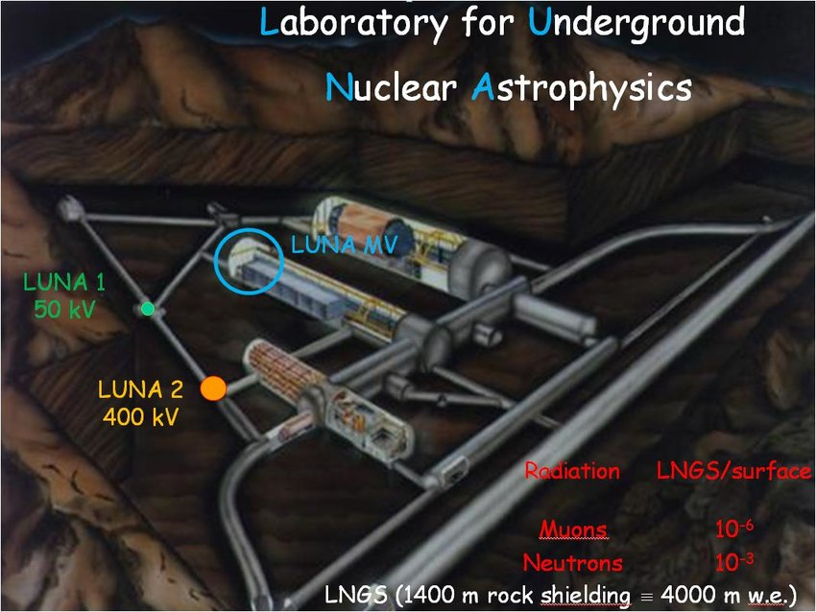
Direct Experiments
Several efforts have been made in the last years in order to improve the signal-to-noise ratio for low-energy cross section measurement.
Longer measurements
Higher beam currents
4π detectors
Pure targets
Underground laboratories

Slide 32
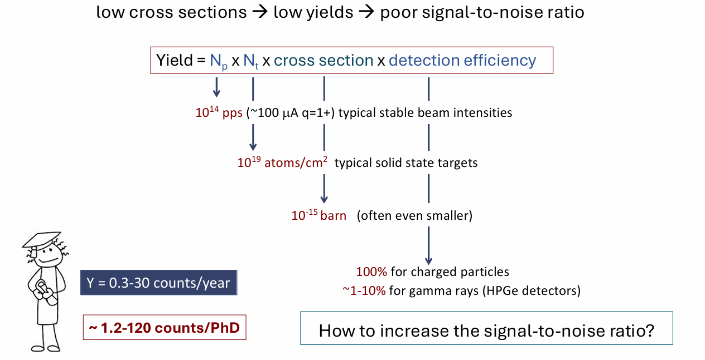
Direct Experiments

Slide 33
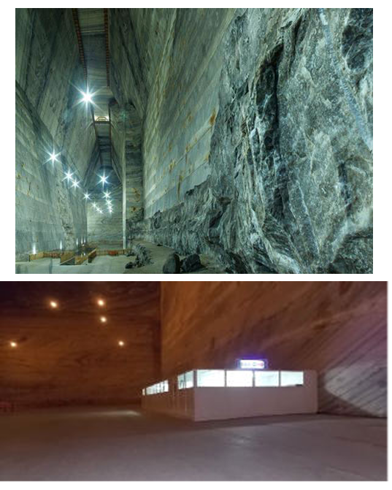
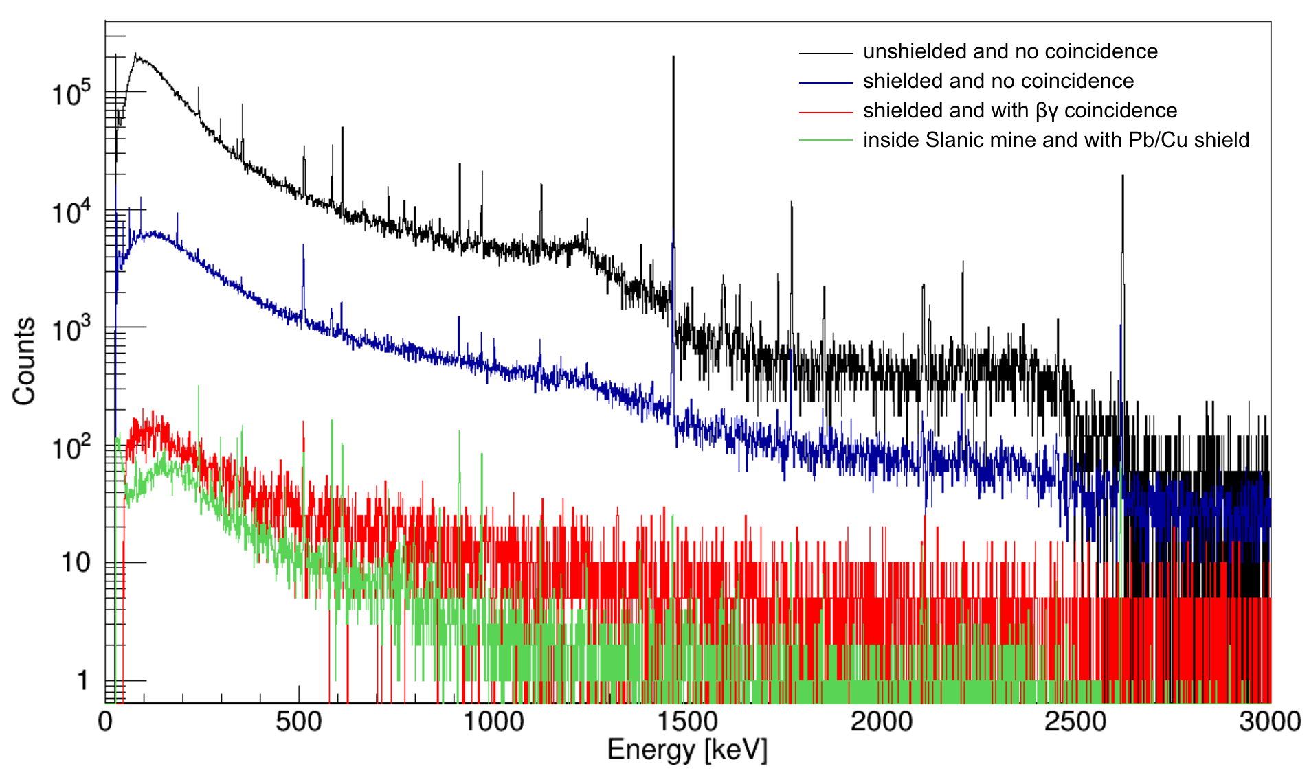
Underground Measurement
~ factor of 1000 background reduction

Slide 34

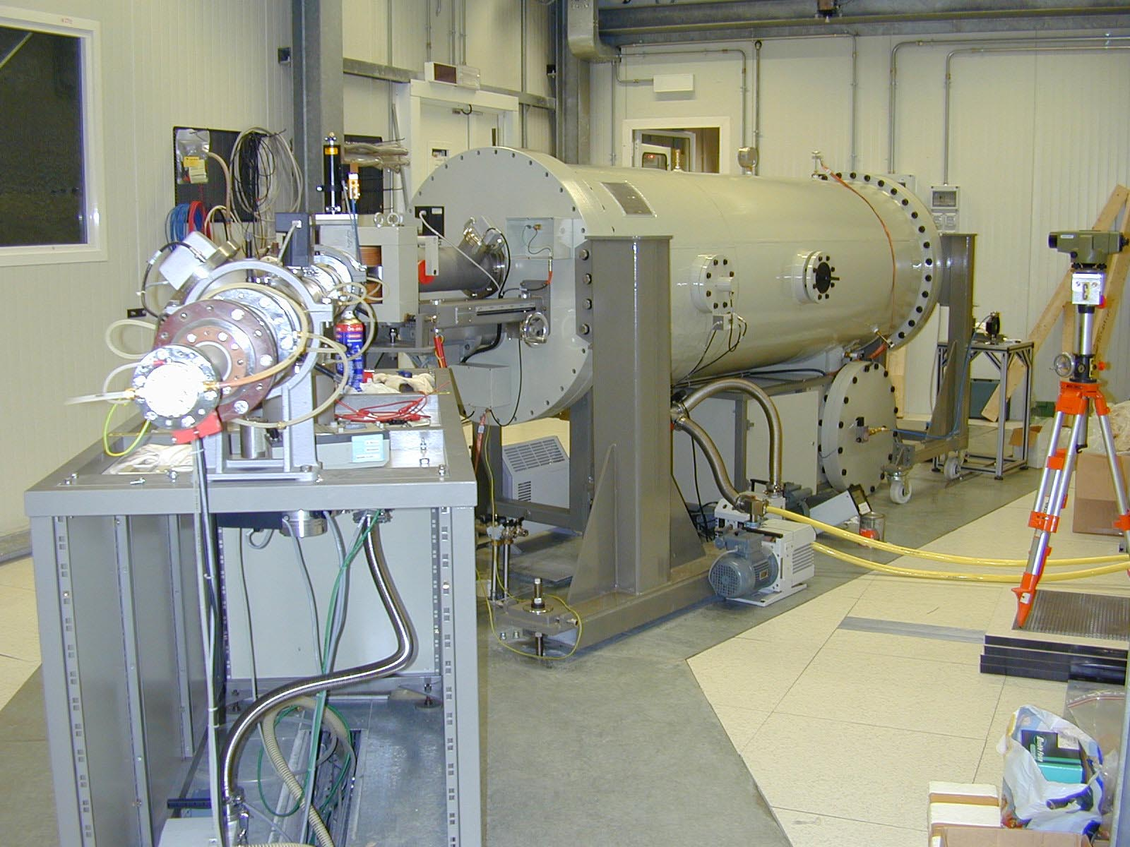
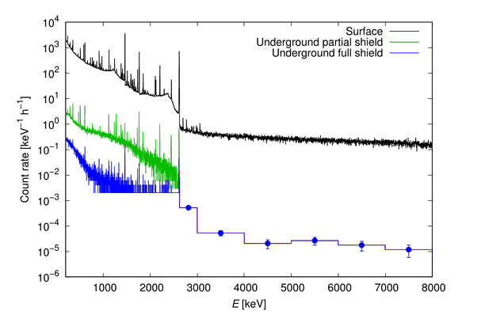
The LUNA Project
1400 m-rock thickness above the Laboratory represents a natural shield for cosmic ray flux → 10⁶ reduction factor
ideal location: underground + low concentration of U and Th
400 kV Accelerator : E _{beam} ≈ 50 – 400 keV
I _{max} ≈ 500 μA protons I _{max} ≈ 250 μA alphas
Energy spread ≈ 70 eV Long term stability ≈ 5eV/h

Slide 35
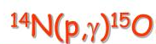
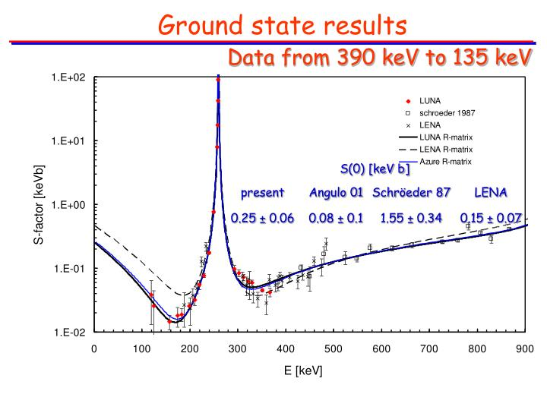
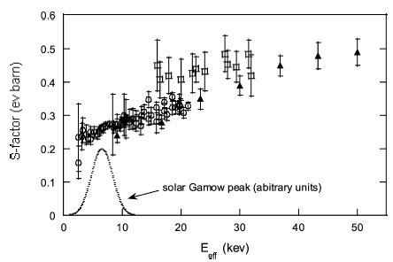
Some LUNA Results
d(p,γ)³He
@ lowest energy: σ ~ 9 pb → 50 counts/day

Slide 36
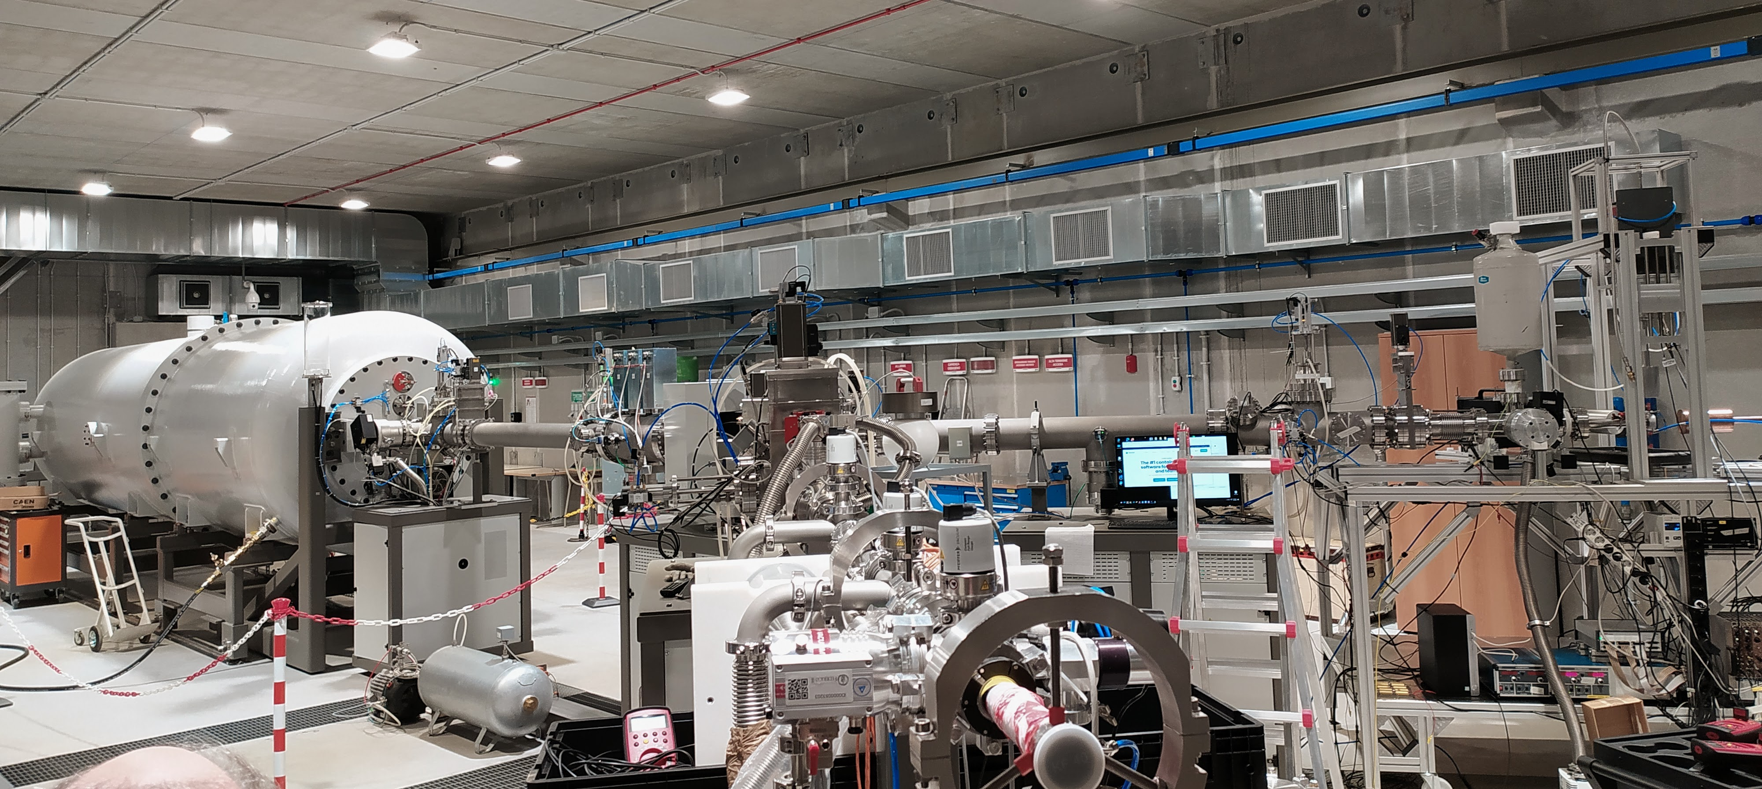
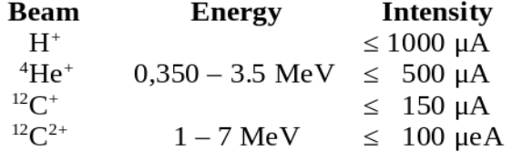
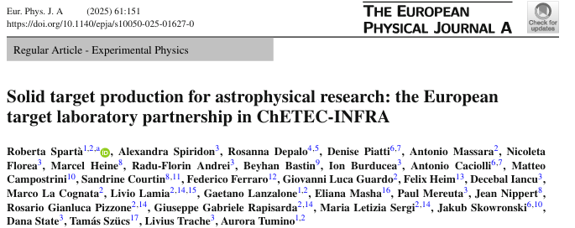
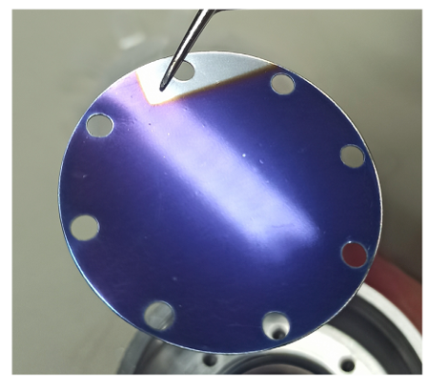
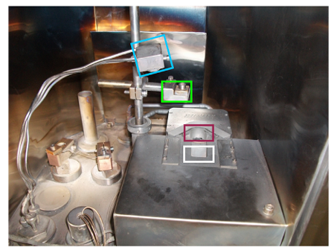
LUNA-MV Bellotti Facility
The new LUNA-MV accelerator has been recently commissioned. It will provide ion beams of H⁺, He⁺, C⁺ and C⁺⁺ using a terminal voltage as high as 3.5 MV with comparable beam currents. Budget over 5.3 M€

Slide 37
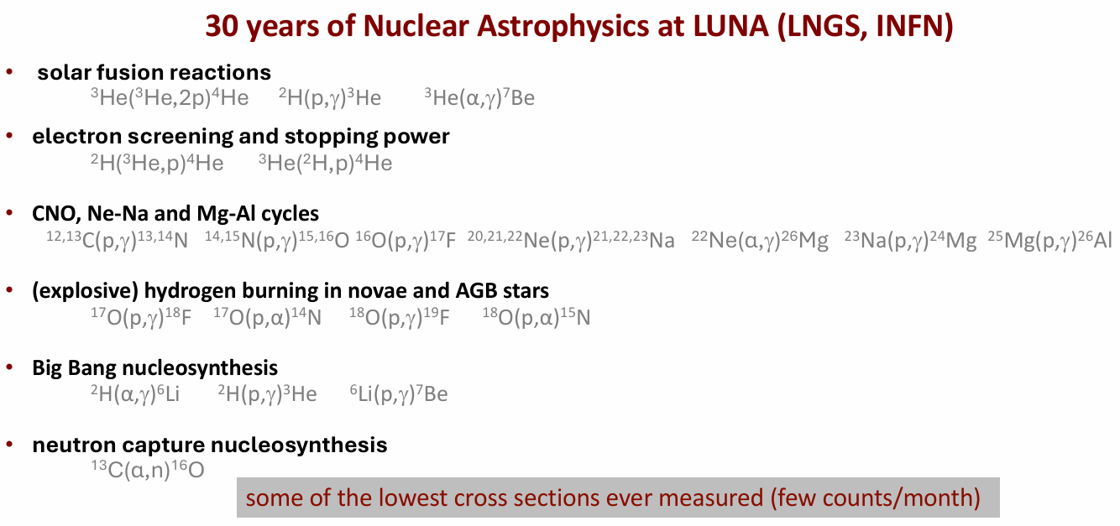
LUNA-MV Bellotti Facility

Slide 38
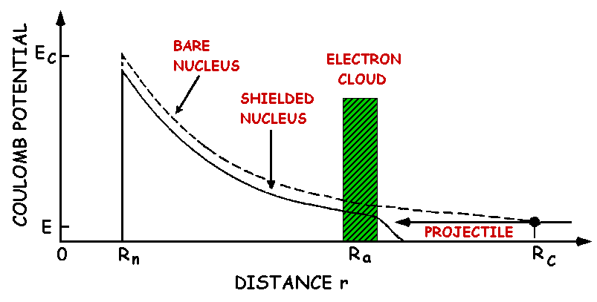
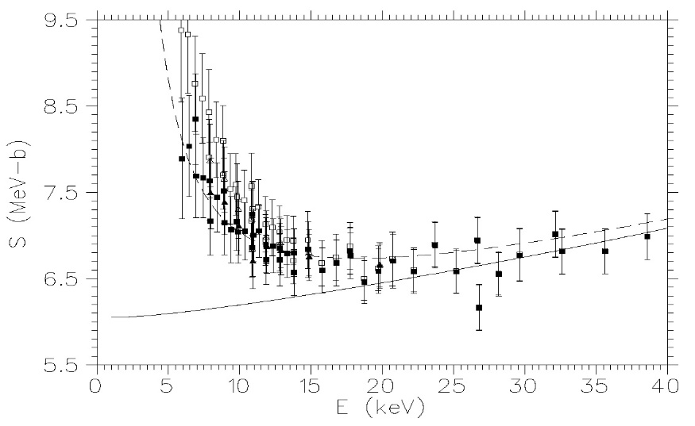
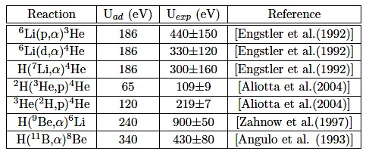
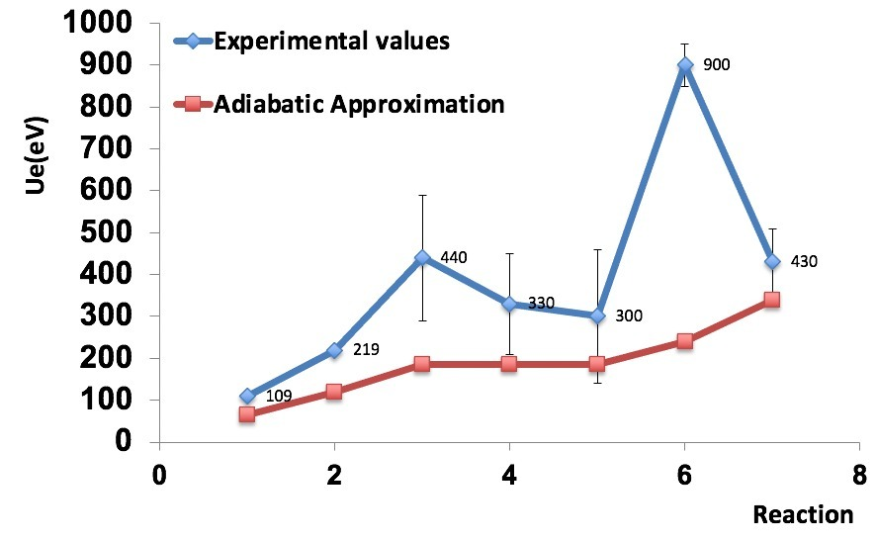
Electron Screening
Due to the electron cloud surrounding the interacting ions the projectile feels a reduced barrier
³He + ²H → p + ⁴He
S( E) (MeVb)
Theory.vs.Experiment→ Far to be understood…
Stellar Plasma

Slide 39
Indirect Methods
Beyond the extrapolation procedure, indirect and innovative experimental methods are highly demanded to address missing or incomplete aspects led by the complexity of nuclear reactions in stars.
The basic idea of using an indirect method in order to measure a cross section of interest for nuclear astrophysics is to overcome the experimental problems related to the low-energy regime typical of an astrophysical scenario using peculiar nuclear properties or dynamics that can provide information about the nuclear reaction of interest.
Among the others, the main indirect methods developed in the last decades are:
Trojan Horse Method
Asymptotic Normalization Coefficient
Coulomb Dissociation
Surrogate Reaction Method
Life-time measurements
Nuclear structure and spectroscopy measurements

Slide 40
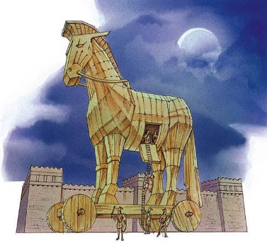
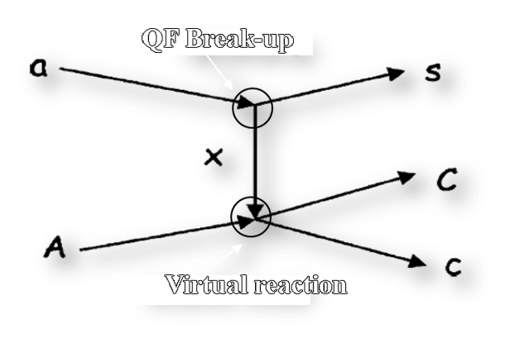
The Trojan Horse Method
The idea of the THM is to extract the cross section of an astrophysically relevant two-body reaction A+x→c+C at low energies from a suitable three-body reaction a+A→c+C+s
Quasi free kinematics is selected
only x - A interaction
s = spectator (p_{s}~0)
E_{A} > E_{Coul} →
NO coulomb suppression
NO electron screening
NO centrifugal barrier
THM Review paper→ Spitaleri C. et al., Prob. of Fund. Mod. Phys., 1991
Tumino A. et al., An. Rev. Nuc. and Part. Sci. 2021

Slide 41

Theoretical Approach
The TH-nucleus is chosen because of:
  its large amplitude in the a=x⊕s cluster configuration;
  its relatively low-binding energy;
  Its known x-s momentum distribution |Φ(p_{S})|² in a.
$$E_{Ax}=\frac{m_{x}}{m_{x}+m_{A}}E_{A}−B_{xs}$$
B_{x-s} plays a key role in compensating for the beam energy thanks to the x-s intercluster motion inside a, it is possible to span an energy range of several hundreds of keV with only one beam energy
In the Plane Wave Impulse Approximation (PWIA) the cross section of the three body reaction can be factrorized as:
Three body measured cross section
Calculated kinematical factor
Fourier trasform for the x-s intercluster motion
Astrophysically relevant two body cross section

Slide 42
THM Cross Section
Virtual nature of x particle → A+x interaction is off–energy shell
Cross section of the bare nucleus but NO absolute value → normalization to direct data available at higher energies
Standard R-Matrix approach cannot be applied to extract the resonance parameters → Modified R-Matrix is introduced instead
where:
M_{i} (p_{xa}R_{xa}) describes the transfer amplitude for the QF-process;
γ_{xa} and γ_{Cc} represents the reduced partial widths for the resonant excited states that are the same of the direct measurements
La Cognata et al., ApJ, 777, 143, 2013

Slide 43
Results of THM
In the last 30 years the THM has been applied to several reaction of astrophysical interest in different scenario, ranging from BBN to Novae Explosion.
Variuos TH nucleus has been used, such as:
d, ³He, ⁶Li, ⁹Be, ¹⁴N, ¹⁶O, ²⁰Ne
In order to study proton-induced, alpha-induced, neutron-induced and heavy particle-induced reactions
Perfect method for study neutron-induced reaction cross sections with radioactive ion beams!!!!

Slide 44
Results of THM
Three open channels:
¹⁹F(p,α₀)¹⁶O
¹⁹F(p,α_{π})¹⁶O
¹⁹F(p,α_{γ})¹⁶O

Slide 45

Results of THM
FACTOR up to 5 in reaction rate!

Slide 46
Results of THM
THM successfully applied to RIBs
Experiment in CNS RIKEN and Texas A&M

Slide 47


Results of THM
Application of THM with RIBs and neutron induced reactions
Hou et al. (2015)
Kawabata et al. (2017)
Lamia et al. (2017)
BELICOS (preliminary)
ENDF/B-VII
Barbagallo et al. (2016)

Slide 48
Results of THM
Blue => hindrance
Red => Caughland & Fowler 1988
Black => Godbey 2019

Slide 49
Conclusions on THM
PROS CONS
A - Measurement of the bare-nucleus cross section σ_{b} (or the S_{b}(E) ) at Gamow energy for reactions involving charged particles and neutrons. No extrapolation needed
B - Measurement of the excitation function in a relatively short time, since the typical order of magnitude for the three- body cross- section at those higher energies is mb;
C - One of the few ways to measure the electron screening effect in comparison with direct data;
D - Application to the radioactive beam measurements.
A - Preliminary study of quasi-free mechanism and tests of validity are necessary. Presence of different 3-body reaction mechanisms (Sequential Decay-Quasi-Free)
B - No absolute cross section is measurable: the excitation functions at energies above/below Coulomb barrier must be known from direct measurements;
C - Measurements with high angular and energy resolutions are needed;
D - Theoretical analysis is needed: PWIA, MPWBA..
TH Method is complementary to direct measurements as well as other indirect methods.

Slide 50
Take Home Points
A - ASFIN has a long history on Indirect Methods for Astrophysics with different approach and several outstanding results over the years;
B - This expertise covered various astrophysics scenarios, giving new cross section values at Gamow energy;
C - Open the path to the application with radioactive beam measurements;
D - Multi indirect method research for approaching the same problem;
E – New detectors and approach are under development to face new quests in multimessenger era
Method complementary to direct measurements (Multi Diagnostic Experiments)

Slide 51

Photodissociation Process in NA
In evolved stars, high photon densities are present, making it possible to dissociate stable seed nuclei the photon energies being as large as many MeV.
For the first time high intensity (3∙10⁸ γ/s) high resolution (<10⁻³) will be available, making it possible to measure photodissociation reactions of astrophysics importance (HIGS, NEW SUBARU, ELI-NP??)
Big Bang Nucleosinthesys and Li-problem
⁷Li(γ,t)⁴He
Si-burning in stars and presupernova phase
²⁴Mg(γ,α)²⁰Ne
²⁸Si(γ,p)²⁷Al
p-process (production of proton rich nuclei)
⁹⁶Ru(γ,α)⁹²Mo
⁷⁴Se(γ,p)⁷³As

Slide 52

Astrophysical Scenarios
Typical temperatures of plasmas experiencing nuclear burning range from 10⁷ K for hydrostatic hydrogen burning to 10¹⁰ K or more in explosive events, such as supernovae or neutron star mergers.
Photodisintegration reactions only significantly contribute when the plasma temperature is sufficiently high to have an appreciable number of photons (given by a Planck radiation distribution) at energies exceeding the energy required to separate neutrons, protons, and/or α particles from a nucleus.
Forward and reverse reactions are always competing in a stellar plasma and thus photodisintegrations have to be at the same level or faster than capture reactions in order to affect nucleosynthesis. Since the number of captures per second and volume (the capture rate) not only scales with temperature but also with plasma density, the threshold temperature at which photodisintegrations cannot be neglected is higher for denser plasmas. On the other hand, photons require less energy when the particle separation energies are small.

Slide 53


Laser Compton Backscattering
Laser photons are boosted into the MeV regime, which is the interesting range for nuclear physics experiments, when scattered off ultrarelativistic electrons with energies of several hundreds of MeV. By a proper collimation system, the scattered photons at very backward angles can be selected resulting in an almost monoenergetic photon beam, that can be tuned by varying the electron or laser photon energy.

Slide 54

LCB vs Bremsstrahlung
Continuos spectra of γ energies
Need a tag system
(Almost) mono-energetic γ beams
Need a laser-electron interaction
system

Slide 55



New Facilities for Gamma Beams

Slide 56

NA Experiments with Gamma Beams
  Features of NA Experiment:
  Gamma energies around 10 MeV are typically necessary
  Particles are emitted with energies ranging from hundreds keV up to few MeV
  Typical cross section should be very low
  ~3·10⁴ events per day expected at 11 MeV
A SSD array is very flexible as it can be used to measure photodissociation on many nuclei, including noble gases (using a gas cell) and long lived unstable nuclei (such as ⁷Be, ¹⁴C or ²⁶Al)
Requirements:
Large area coverage
Two or three particles at most are emitted per reaction event
Low detection threshold
No PSD or DE techniques are viable for particle ID
High energy and angular resolution for kinematical particle ID

Slide 57

MC Simulation: the GROOT code
Estimate the gamma-induced e.m. background
Estimate the full background of photonuclear reactions and the detector’s resolution effect
Optimization of the detector geometry
Estimate the event rate (provided that we have reliable cross-section calculations) or calculate the minimum cross-section we can measure because of the background
Based on GEANT4 tracking + ROOT event generator engine
D. Lattuada et al. EPJ Web of Conf. 165, 01034 (2017)

Slide 58

Extreme Light Infrastructure
Silicon Strip Array
Characteristics:
Wide angular range coverage
Low energy threshold
Compactness
Angular resolution better than 0.5 cm
Energy resolution better than 1%
Kinematical identification of outgoing particle
Barrel configuration:
3 rings of 12 position sensitive X3 silicon-strip detectors by Micron
2 end cap detectors made up of 4 QQQ3 DSSSD by Micron
>550 channels readout with standard/digital electronics
Perfectly suited for nuclear astrophysical studies!!
G. L. Guardo et al. EPJ Web of Conf. 165, 01026 (2017)

Slide 59
Large High-resolution
Array of Silicon for Astrophysics
Characteristics:
Wide angular range coverage
Low energy threshold
Compactness
High energy resolution
Angular resolution allows for PID

Slide 60
Direct Experiments
with Gamma Beam
The ⁷Li(γ,t) reaction
Astrophysical Motivation
Alpha captures in mirror reactions like ³He(α,γ)⁷Be e ³H(α,γ)⁷Li are fundamental for the evaluation of the primordial abundances of the ⁷Li.
Ab-initio calculations and experimental data show discordances
Dohet-Eraly et al, PLB 757, 430 (2016)

Slide 61

Direct Experiments
with Gamma Beam
The ⁷Li(γ,t) reaction
Experimental setup
D₂O cell
EJ315
¹⁹⁷Au foil
Lead Shieding
HPGe
EJ301D
Lead Shieding
SIDAR chamber
E_{γ} = 4.4 – 10 MeV provided by HIGS facility
1.2 cm collimator defines beam spot
LiF target on mylar(180 μg/cm²)
SIDAR array from ORNL(lamp-shade)
12 YY1 detectors (200 ch)
two lamp-shades of YY1: 300, 500, 1000 μm
Standard electronic read-out (mesytec preamp + amp + caen adc)

Slide 62




Direct Experiments
with Gamma Beam
The ⁷Li(γ,t) reaction
Data taking
tritons
1000
300
500
300
alphas

Slide 63



Direct Experiments
with Gamma Beam
The ⁷Li(γ,t) reaction
Beam diagnostic
HPGe & collimator for Compton
¹⁹⁷Au activation above 8 MeV
d(γ,n)p w/ EJ301D & EJ315
EJ315
γ beam
¹⁹⁷Au foil
D₂0
beam intensity w/ EJ315
beam intensity w/ paddle detector
scaled to Au-197 activation
good agreement 4.5-10 MeV
EJ301D

Slide 64





Direct Experiments
with Gamma Beam
The ⁷Li(γ,t) reaction
Activation Method

Slide 65


Direct Experiments
with Gamma Beam
The ⁷Li(γ,t) reaction
Results

Slide 66
Direct Experiments
with Gamma Beam
The ⁷Li(γ,t) reaction
Results

Slide 67

Laser induced reaction for nuclear astrophysics
An effective approach to improve our knowledge on fusion reactions in stars can be to mimic the stellar conditions by generating a controlled laboratory plasma with thermodynamical status not too different from the stellar conditions.
The advent of novel techniques in laser amplification on one hand opened the way to the the implementation of high-power high-intensity lasers in many facilities around the world and on the other it forced a steep development on the diagnostics side, de facto unlocking the feasibility of new paradigms of research.

Slide 68
Nuclear Astrophysics with laser beams
The most common scenario on laser-ion acceleration relies on focusing a high intensity laser pulse into a target made of the species of interest. Depending on the intensity and on the surface density of the target, different acceleration mechanisms are involved. The most studied scenario today relies on the Target Normal Sheath Acceleration mechanism originated by high-intensity laser pulses focused on thin targets.
These methods will open the way for a new approach to study Nuclear Astrophysics Reaction such as:
deuterium- deuterium
deuterium-³He
proton-lithium
proton-boron
¹²C-¹²C
¹⁶O-¹⁶O
and much more….

Slide 69
Coulomb Explosion paradigma
The interaction of ultra-short laser pulses with an expanding gas mixture at controlled temperature and pressure inside a vacuum chamber causes the formation of plasmas with multi-keV temperature. These energies overlap with the typical temperatures of stellar environments where thermonuclear reactions occur, thus making this paradigm a perfect scenario for nuclear astrophysics research.

Slide 70

Electron Screening in Plasma
Relatively small enhancements due to electron screening at energies E/U = 100 could cause significant errors in the extrapolation to lower energies, if the cross section curve is forced to follow the trend of the enhanced cross sections without correcting for screening
The whole effect of screening in this case (U₀<<E_{max}) is then that the reaction rate with screening
⟨ ^{σ v} ⟩accelerator ≠ ⟨ ^{σ v} ⟩ plasma ≈ ⟨ ^{σ v} ⟩stars ≠ ⟨^{σ v} ⟩bare

Slide 71



Electro Magnetic Pulse
The charge separation and target polarization under the action of a laser pulse produce an electromagnetic pulse.

Slide 72

Deuterium-deuterium Fusion

Slide 73
Energy definition in CE
Ideal Maxwellian distribution
Energy spectrum from the MCP
kT ~ 1.9 keV

Slide 74





Energy definition in CE
slow ions
x-rays
keV ions
photopeak

Slide 75


Experimental Preparation
the number of fusion displays the power law dependence from the critical temperature with the critical exponent close to χ thus dominated by the surface term
the number of fusion reaches the maximum for T~T_{c}

Slide 76




Target Characterization
GROOT 10.1051/epjconf/201716501034

Slide 77



Experimental Setup
n
d
p
n & p → scintillators, diamond, CR39
Deuteron spectrum → MCP, FC, diamond, CR39
Gas and plasma diagnostics → interferometry, CCD, previous Rayleigh scattering measurements

Slide 78


Experimental Setup
neutron
n
d
p
photopeak
A star in the lab!!

Slide 79


Data taking
Over 3000 shots, with T control between kT~1 keV and kT~40 keV

Slide 80



Results

Slide 81




Towards C-C Fusion
Online Thomson Parabola Spectrometer with MCP-readout developed in collaboration with ELI-NP (D. Doria et al.) and GIST, for CH₄ test.
H⁺
D⁺
C^{+?}

Slide 82



Versatile Array for Laser-induced
Astrophysics Research
Science-driven, portable, cost-efficient
cryo-cooled supersonic nozzle
compact interaction chamber
neutron ToF detectors (plastic/liquid scintillators)
charged particle ToF detectors (SiC/CVD diamond detectors + FCs)
2 TPS
(CR39 for checks/normalization)

Slide 83


Do not Trust me

Slide 84


Collaborations
Cyclotron Institute,Texas A&M,US: R. Tribble, V. Goldber Texas A&M Commerce US: C. Bertulani
Florida State University US: I. Wiedenhofer
Notre Dame University US: M. Wiescher, M. Couder
C.N.S. Riken, Wako, Japan: S. Kubono, H. Yamaguchi, S. Hayaka University of Taskent: B. Irgaziev, R. Yarmukhanmedov
CIAE, Beijing, China: S. Zhou, C. Li, Q. Wen
Nuclear Physics Institute, ASCR, Rez, Czech Rep.: V. Kroha, V. Burjan, J. Mrazek
Nipne IFIN Bucharest: L. Trache
ELI-NP Bucharest: C. Matei, D. Balabanski Atomki, Debrecen, Hungary: G. Kiss
CSNSM, Orsay, France : A. Coc , F. Hammache, N. De Sereville
University of Catalunya: J. Jose
Rudjer Boskovic Institute Zagreb Croatia: N. Soic, M. Milin
GIST, Gwangju, South Korea: W. Bang
@Catania: A. Bonasera, S. Cherubini, G. D’Agata, A. Di Pietro, P. Figuera, S. Gammino, G.L. Guardo, M. Gulino, M. La Cognata, L. Lamia, D. Lattuada, A.A. Oliva, R.G. Pizzone, G.G. Rapisarda, S. Romano, D. Santonocito, M.L. Sergi, R. Spartà, C. Spitaleri, A. Tumino
@Napoli M. La Commara @Padova M. Mazzocco, S. Pigliapoco, A. Togni
@Perugia S. Palmerini, M. Limongi, A. Chieffi, M.C. Nucci

Slide 85



Slide 86

Thank you for your attention

