Slide 1
BTS26 - Vacuserv
Vacuum presentation and Experiments
Prezentat de Mircea Lupas

Slide 2
Who are we and what do we do
- Family business founded in 1991
- 3 Employees with a combined experience of over 50 Years
- We make Vacuum happend ☺
- We offer System counselling, System upgrading, System retrofitting
- Leak testing, calibration services, on-site repair

Slide 3
How do we do it
- We work with top-notch companies
- Busch-Pfeiffer / Edwards
- Entire Vacuum range for pumps, Off the shelf and custom chambers, Off the shelf and custom components, vacuum measurement.
- VAT Valves
- Leading Valve manufacturer, Custom Edge Welded Bellows.
- Scia Systems
- Manufacturer of Precise surface processing equipment.
- Other companies on a case-by-case basis

Slide 4
Experiments

Slide 5
What is vacuum?
- Basically nothing
- There are different types of vaccum and ways to do it
- Rough Vacuum, Low Vacuum, High Vacuum , UHV
- Mechanical pumps, “thermal“, Turbo Pumps

Slide 6
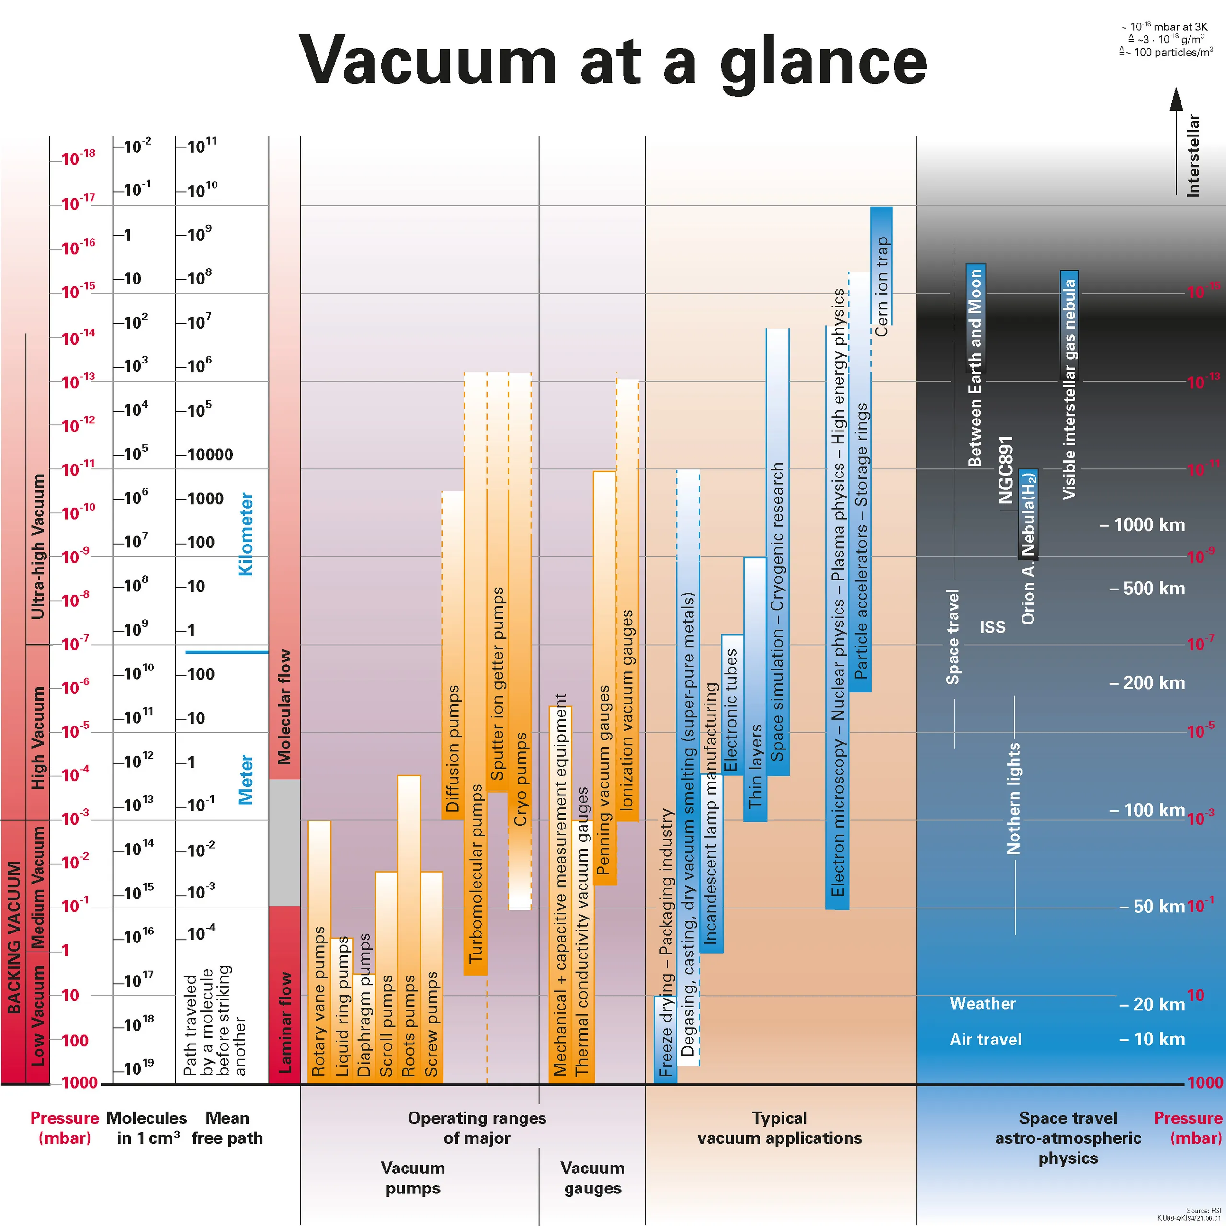

Slide 7
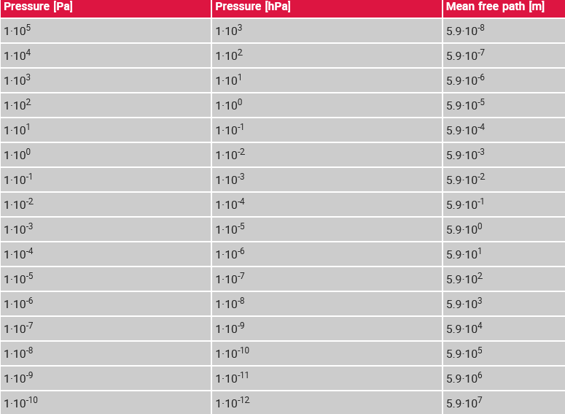
Mean Free path
Average distance between collision of 2 molecules
If at atmospheric pressure 1 molecule takes around 59 nm to hit another molecule, at E-8 mbar it will take around 5.9 km to hit another molecule
In our Experiments, the Mean free Path is aprox. 0.59 mm.

Slide 8
Magdeburg hemispheres
Made in 1654 by Otto von Guericke to demonstrate the concept of athmospheric pressure.
Wanted to demonstrate the first vacuum pump
51 cm in diameter, 16 horses tried to pull them apart.
Can you beat 16 Horses?

Slide 9
Types of vacuum- Termic
Fire Triangle– HeaT, Oxigen, Fuel
Charles Law– The Volume of a given mass of gass is directly proportional to its absolute temperature, provided the pressure remains constant

Slide 10

Objects n vacuum
What happens with a ballon under vacuum?
Boyle’s Law –> $P_{1}V_{1}=P_{2}V_{2}$
What happens with Shaving cream under vacuum?

Slide 11
Water in vacuum
Can Water survive in Outer space?
What does it mean to freeze / Boil / condensate? When does this happen??
What happens to water in vacuum?
What happens to the temperature of water in vacuum?

Slide 12
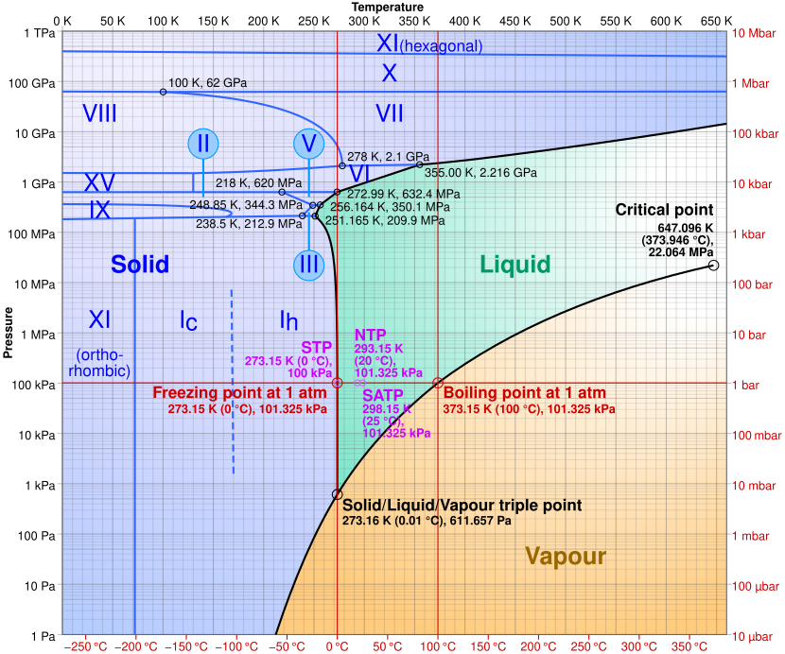
Tripoint of Water

Slide 13
Water is expected to boil at 20 mbar when temperature is at 20 °C
This is why you can’t Boil an Egg on mount Everest. The water does not reach 100 °C
aprox 330 mBar on Mount Everest -> Boiling point at around 70 °C

Slide 14
Sound in vacuum
In space nobody hears you scream
Sound needs a medium to travel. There are “no” molecules in a vacuum, therefore no sound.

Slide 15
Sweets in Vacuum
What happends to a marshmellow in Vacuum?
Similar to Freeze-Drying – See strawberries, bananas.

Slide 16
That’s it. Questions?

