Slide 1

BTS26 - Yellow
HPGe
Friday, May 22nd, 2026

Slide 2
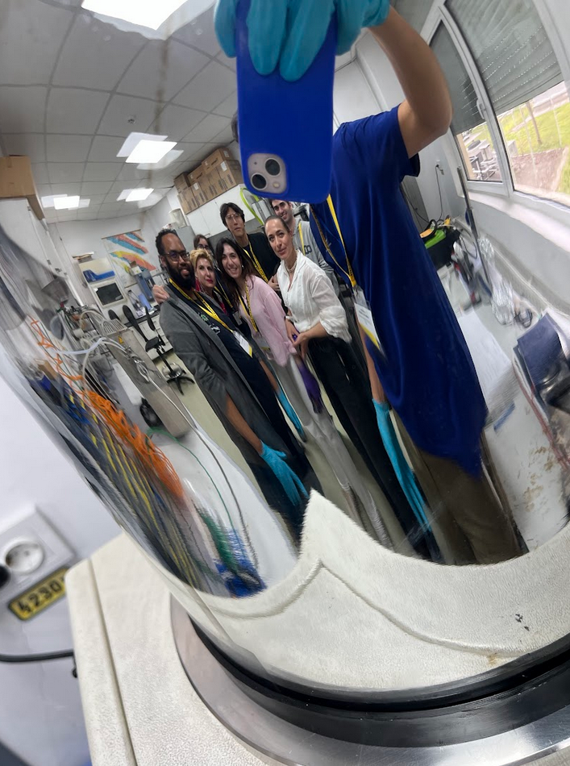
The team 😎 🇵🇹 Ana Sofia Sousa
🇪🇸 Cayetano Soneira Landín
🇷🇴 Cristina Adriana Humă
🇵🇹 Diogo Pereira
🇿🇦 Manfred Jaftha
🇬🇧 Wenxuan Zheng
🇬🇷 Zoi Bari

Slide 3
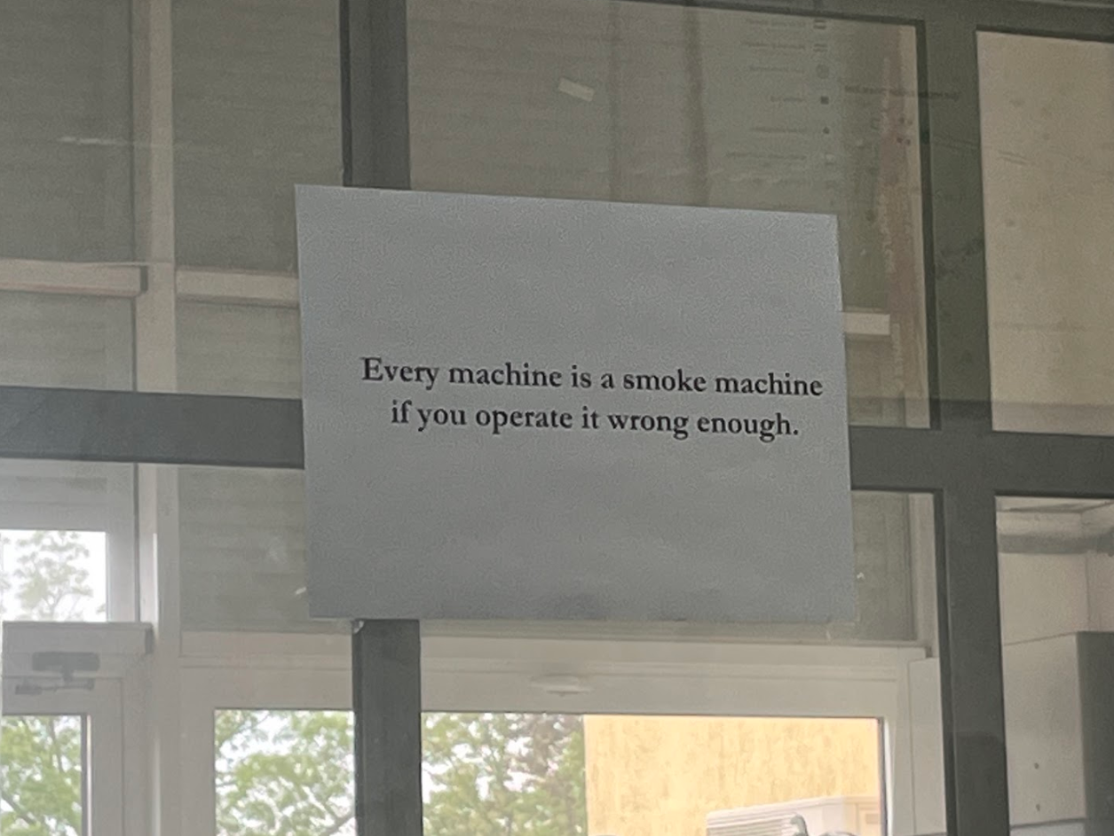
Main takeaways:

Slide 4
Target laboratory
pressing, evaporating, rolling

Slide 5
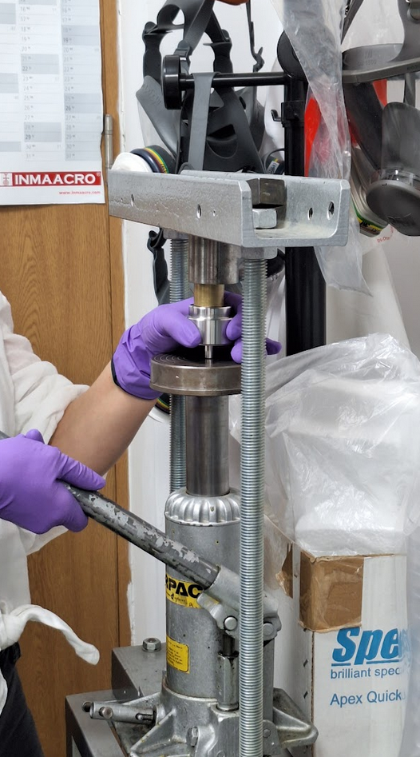
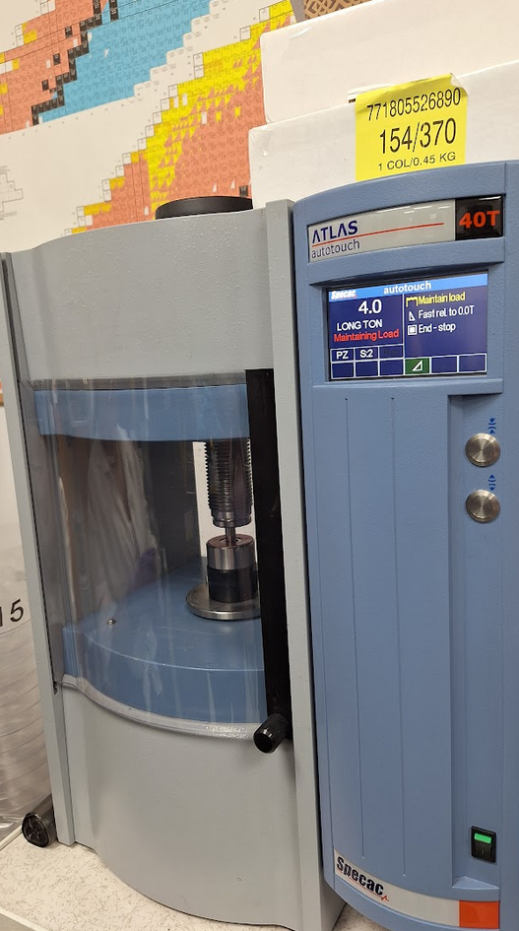
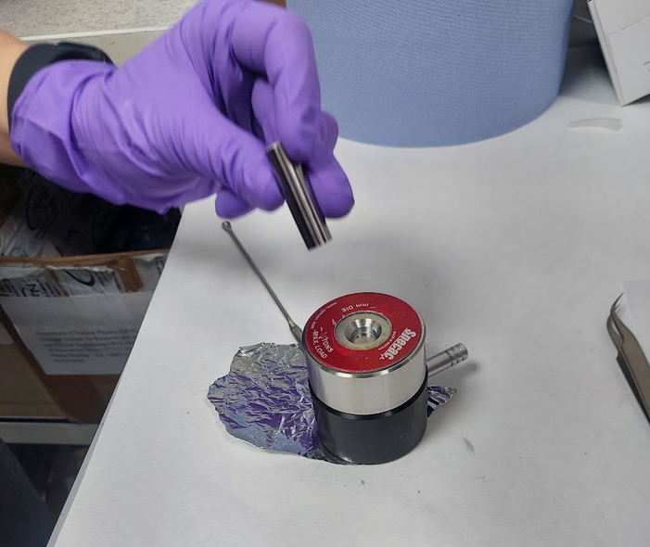
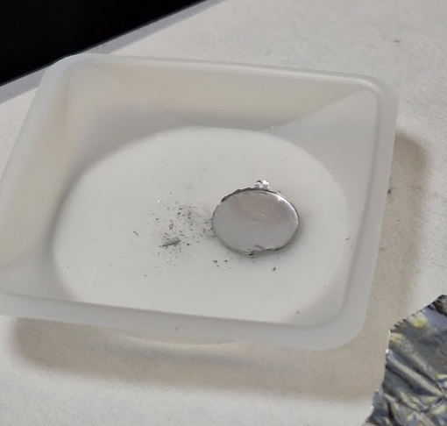
Pressed powder
Aluminum in the press

Slide 6
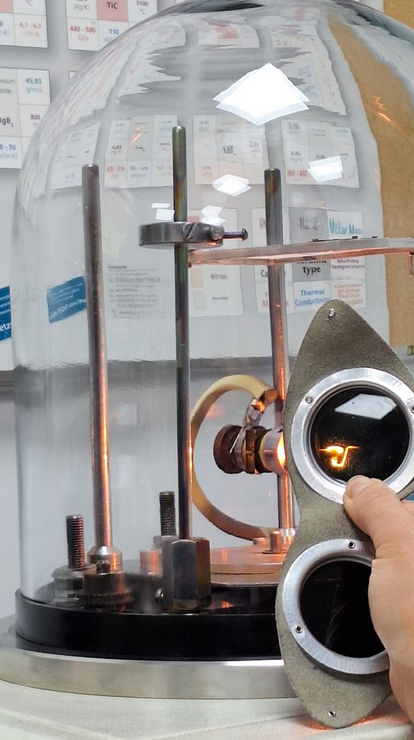
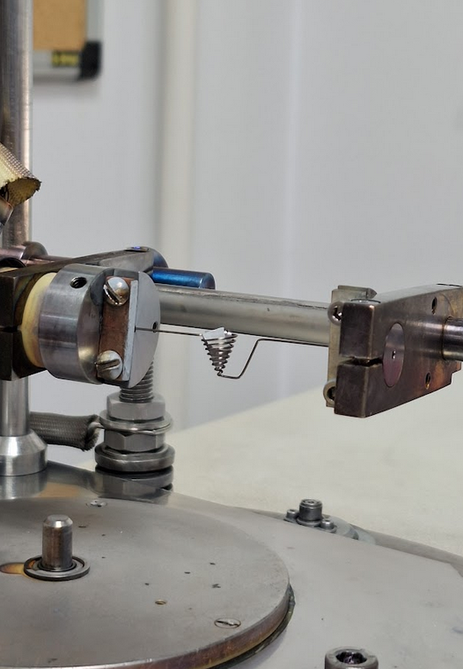
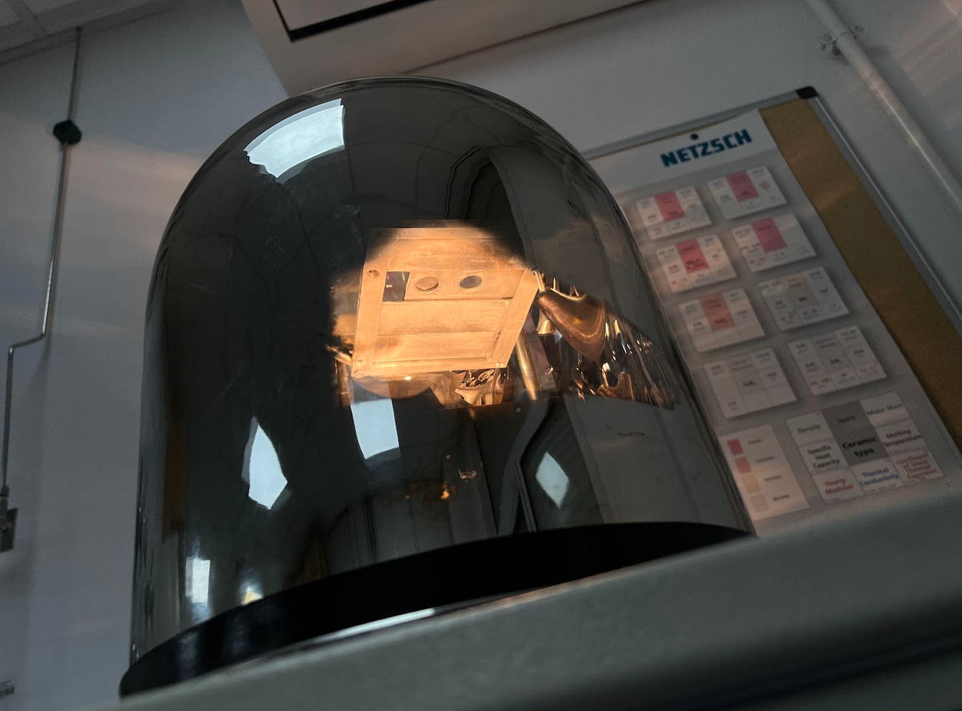
1. Evaporation
Aluminum on Tantalum + glass
Step 1: evaporation and deposition
Target: Aluminum on Tantalum

Slide 7
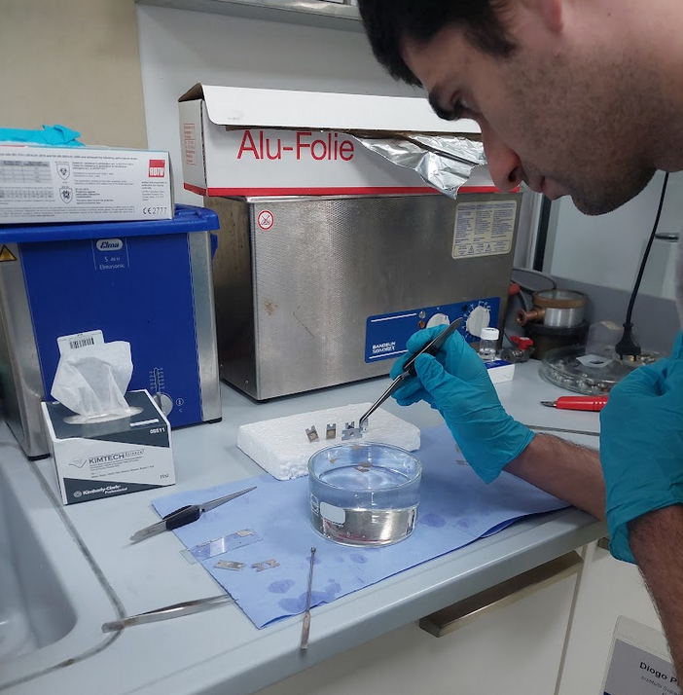
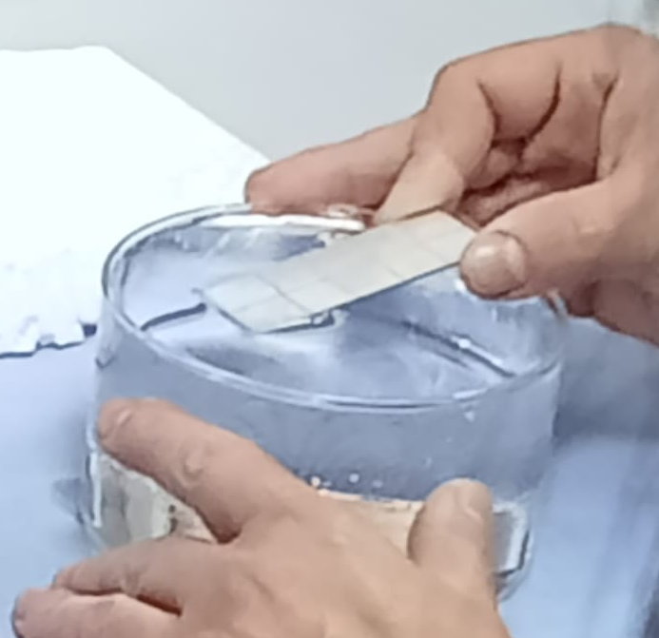
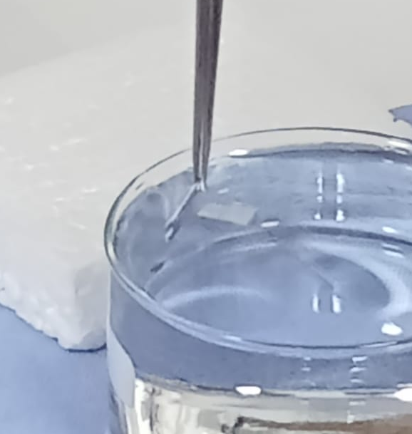
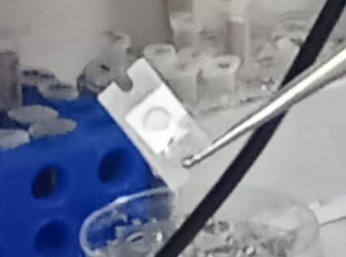
Step 2. Release into holder
Target:
Self-sustaining
Aluminum

Slide 8
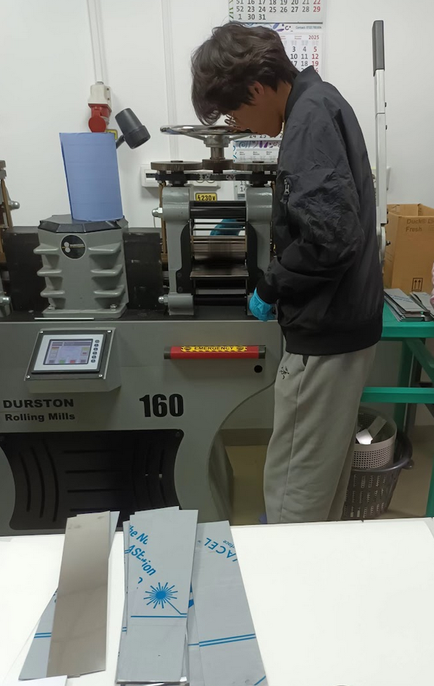
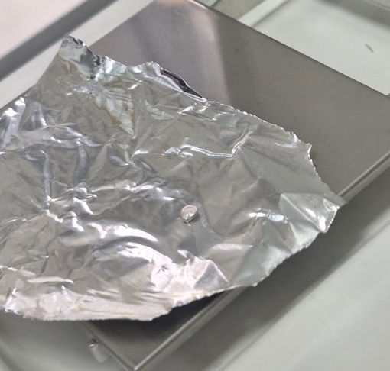
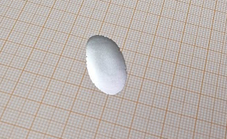
2. Rolling press
Ductile materials
Hands on:
Silver target
Area = 272 mm²
Weight = 105.1 mg
Thickness = 36.8 μm

Slide 9
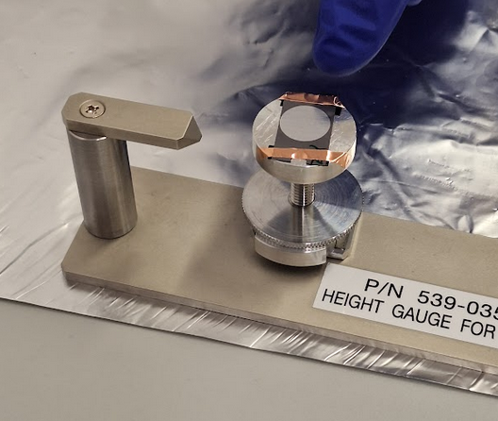
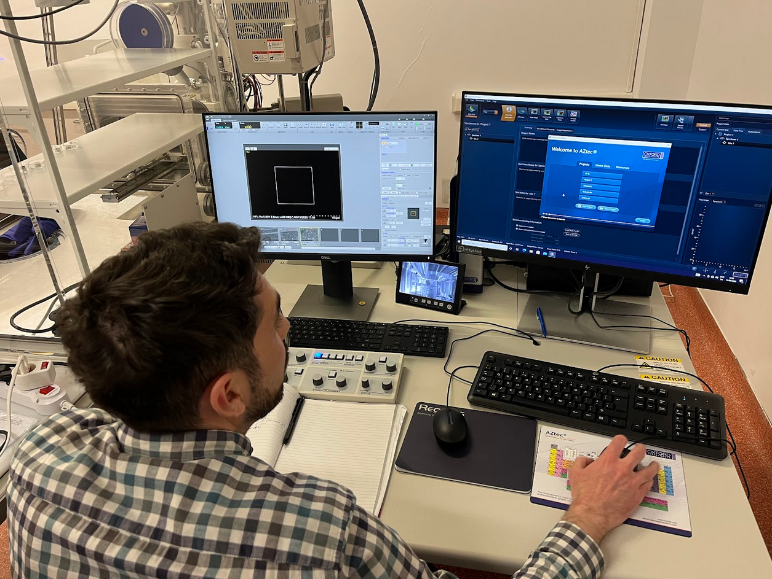
Characterization
Scanning Electron Microscopy

Slide 10
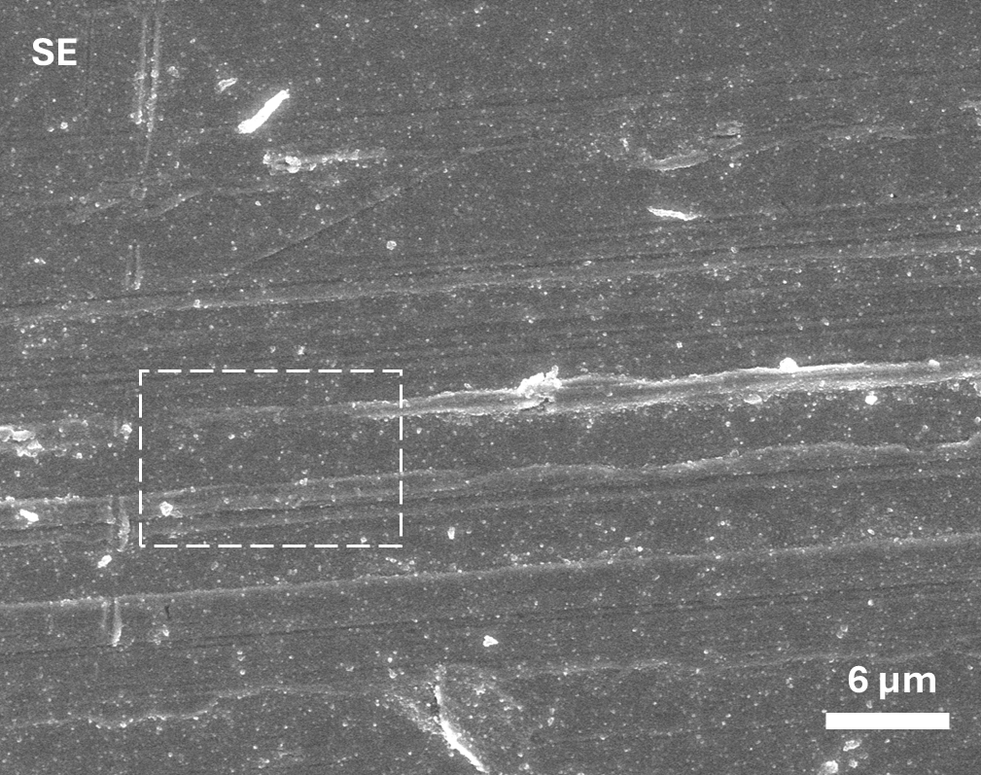
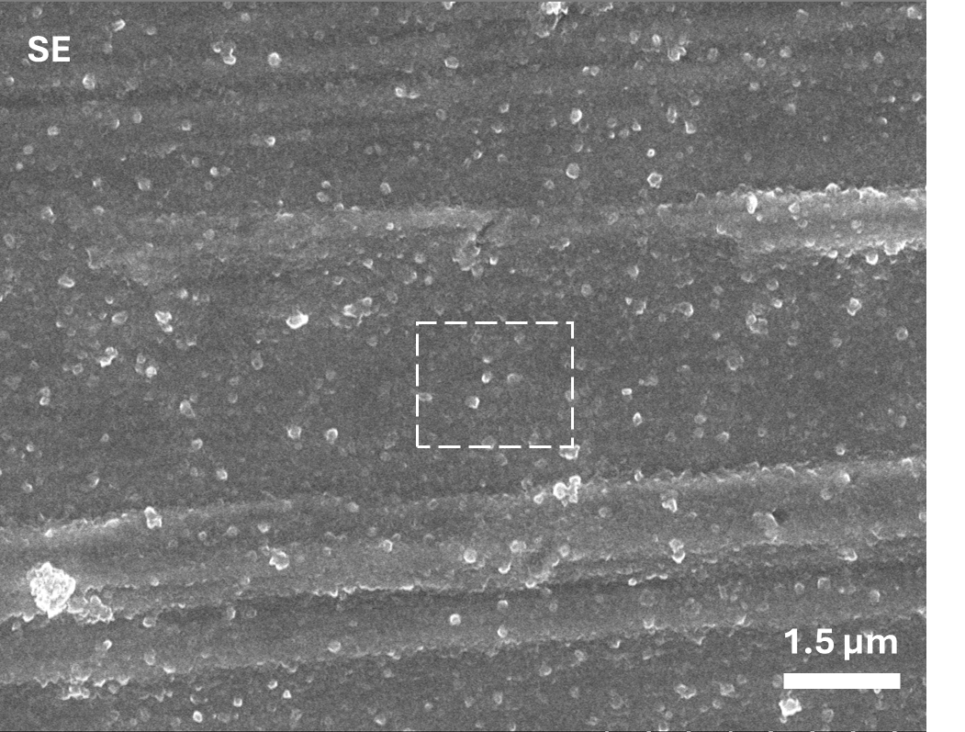
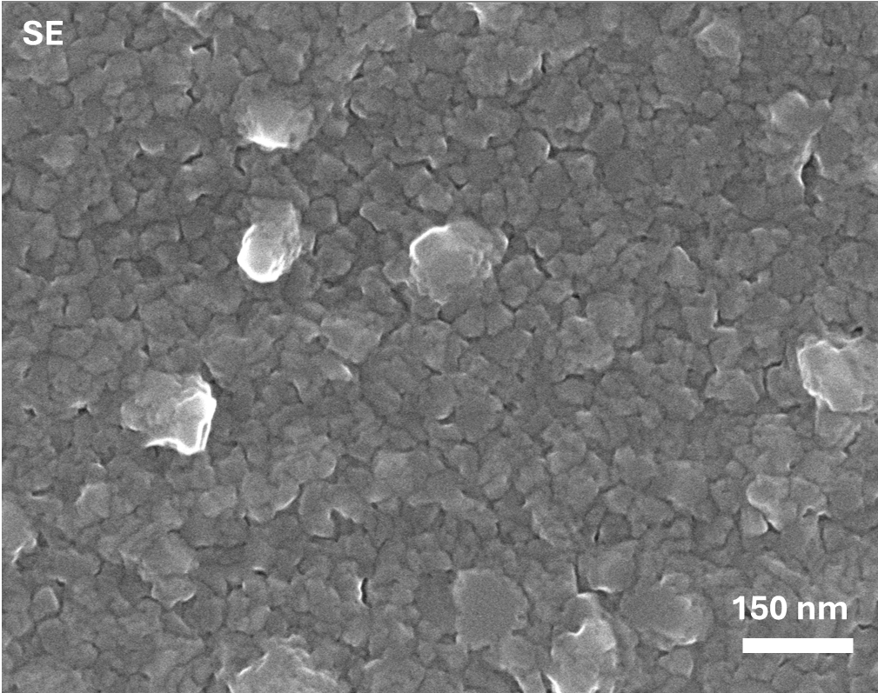
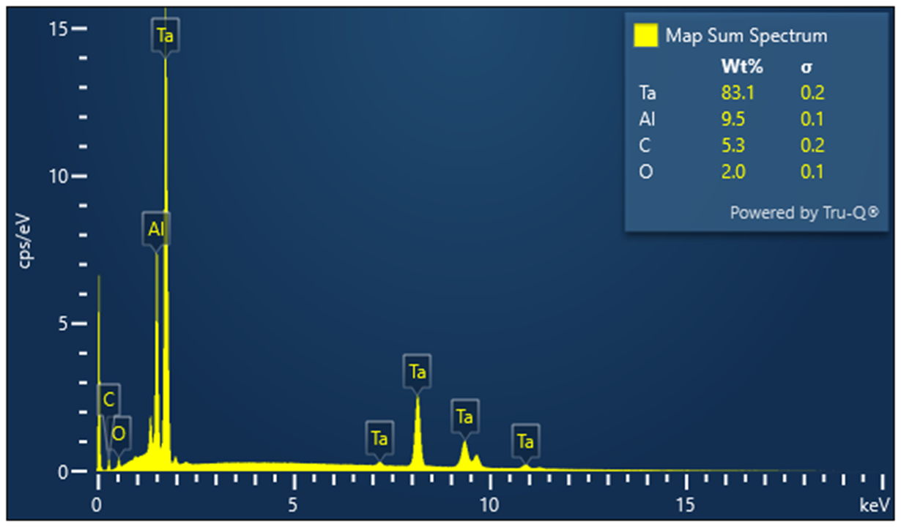
Imperfections due to fast deposition
Zoom in
Our self-made target
Real targets require careful, precise treatment!

Slide 11
3 MV visit and data analysis
Rutherford Backscattering Spectrometry and activation

Slide 12
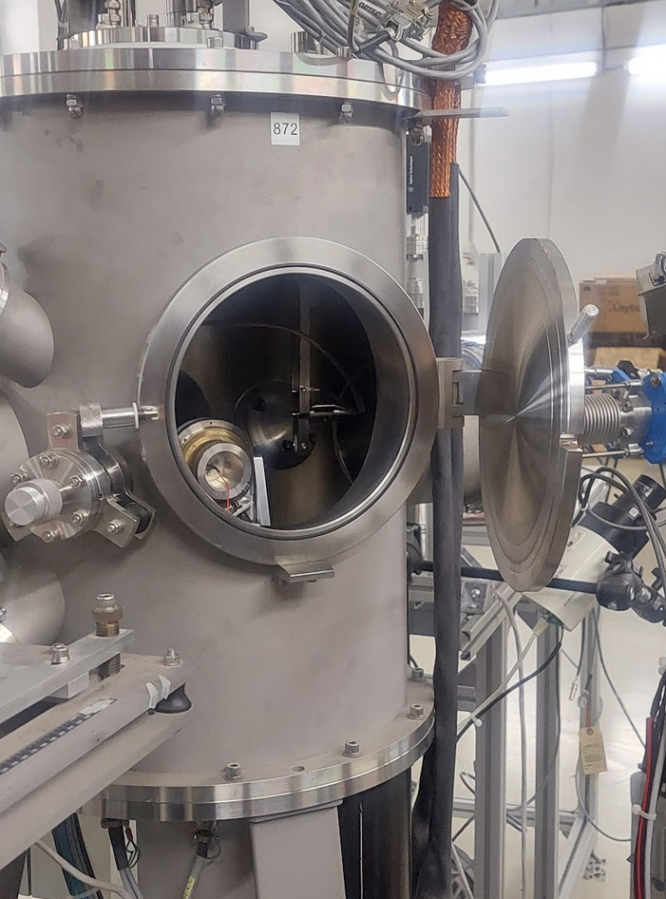
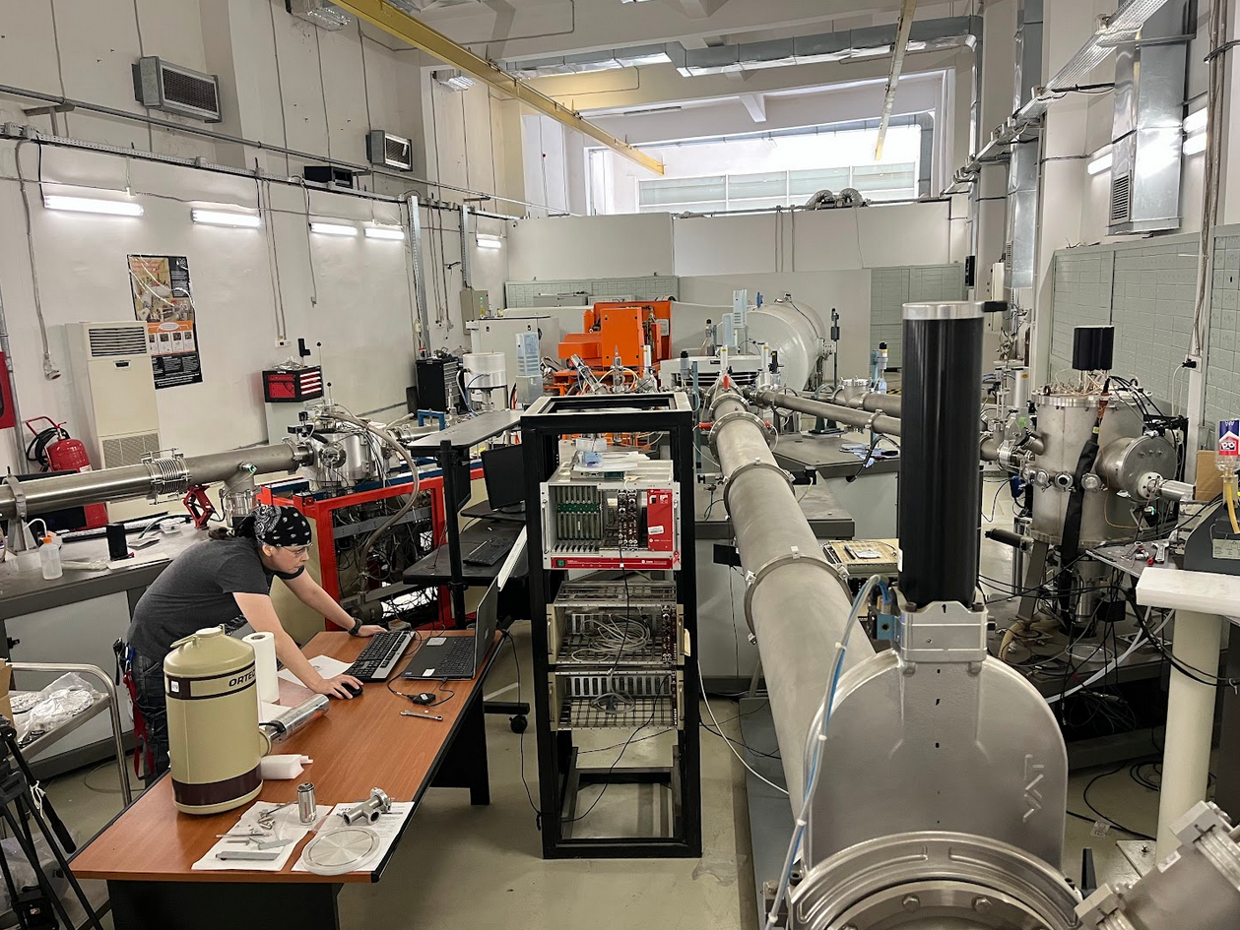

Slide 13
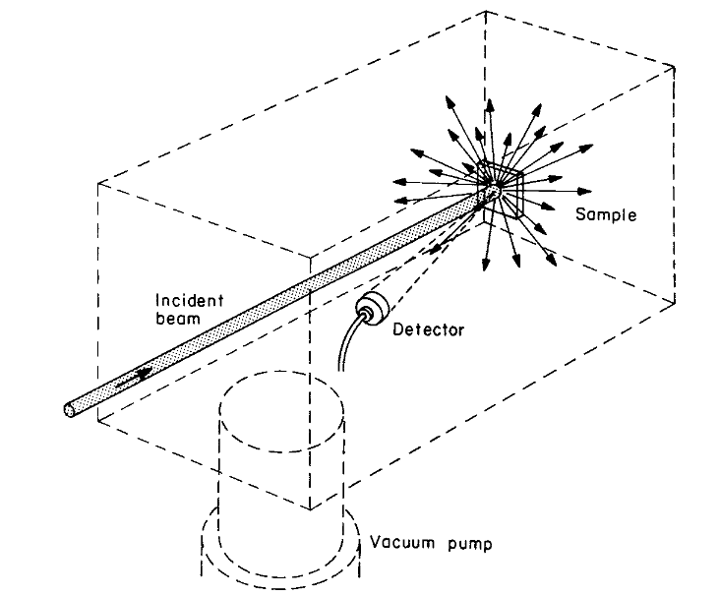
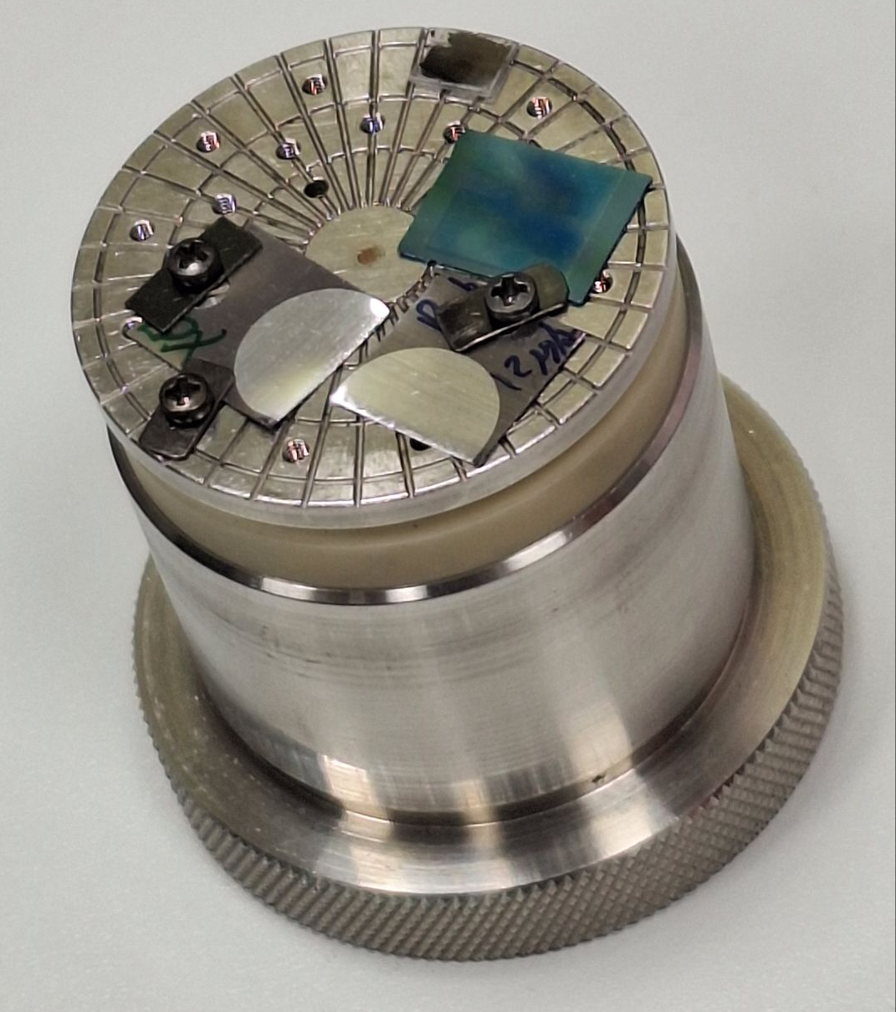
Rutherford Backscattering Spectrometry (RBS)
Incidence: 7°
Detector: 165°
Energy: 2 MeV
Samples: Al on Ta
Calibration sample
C
Au
Co
Fe
SiO₂
Si

Slide 14
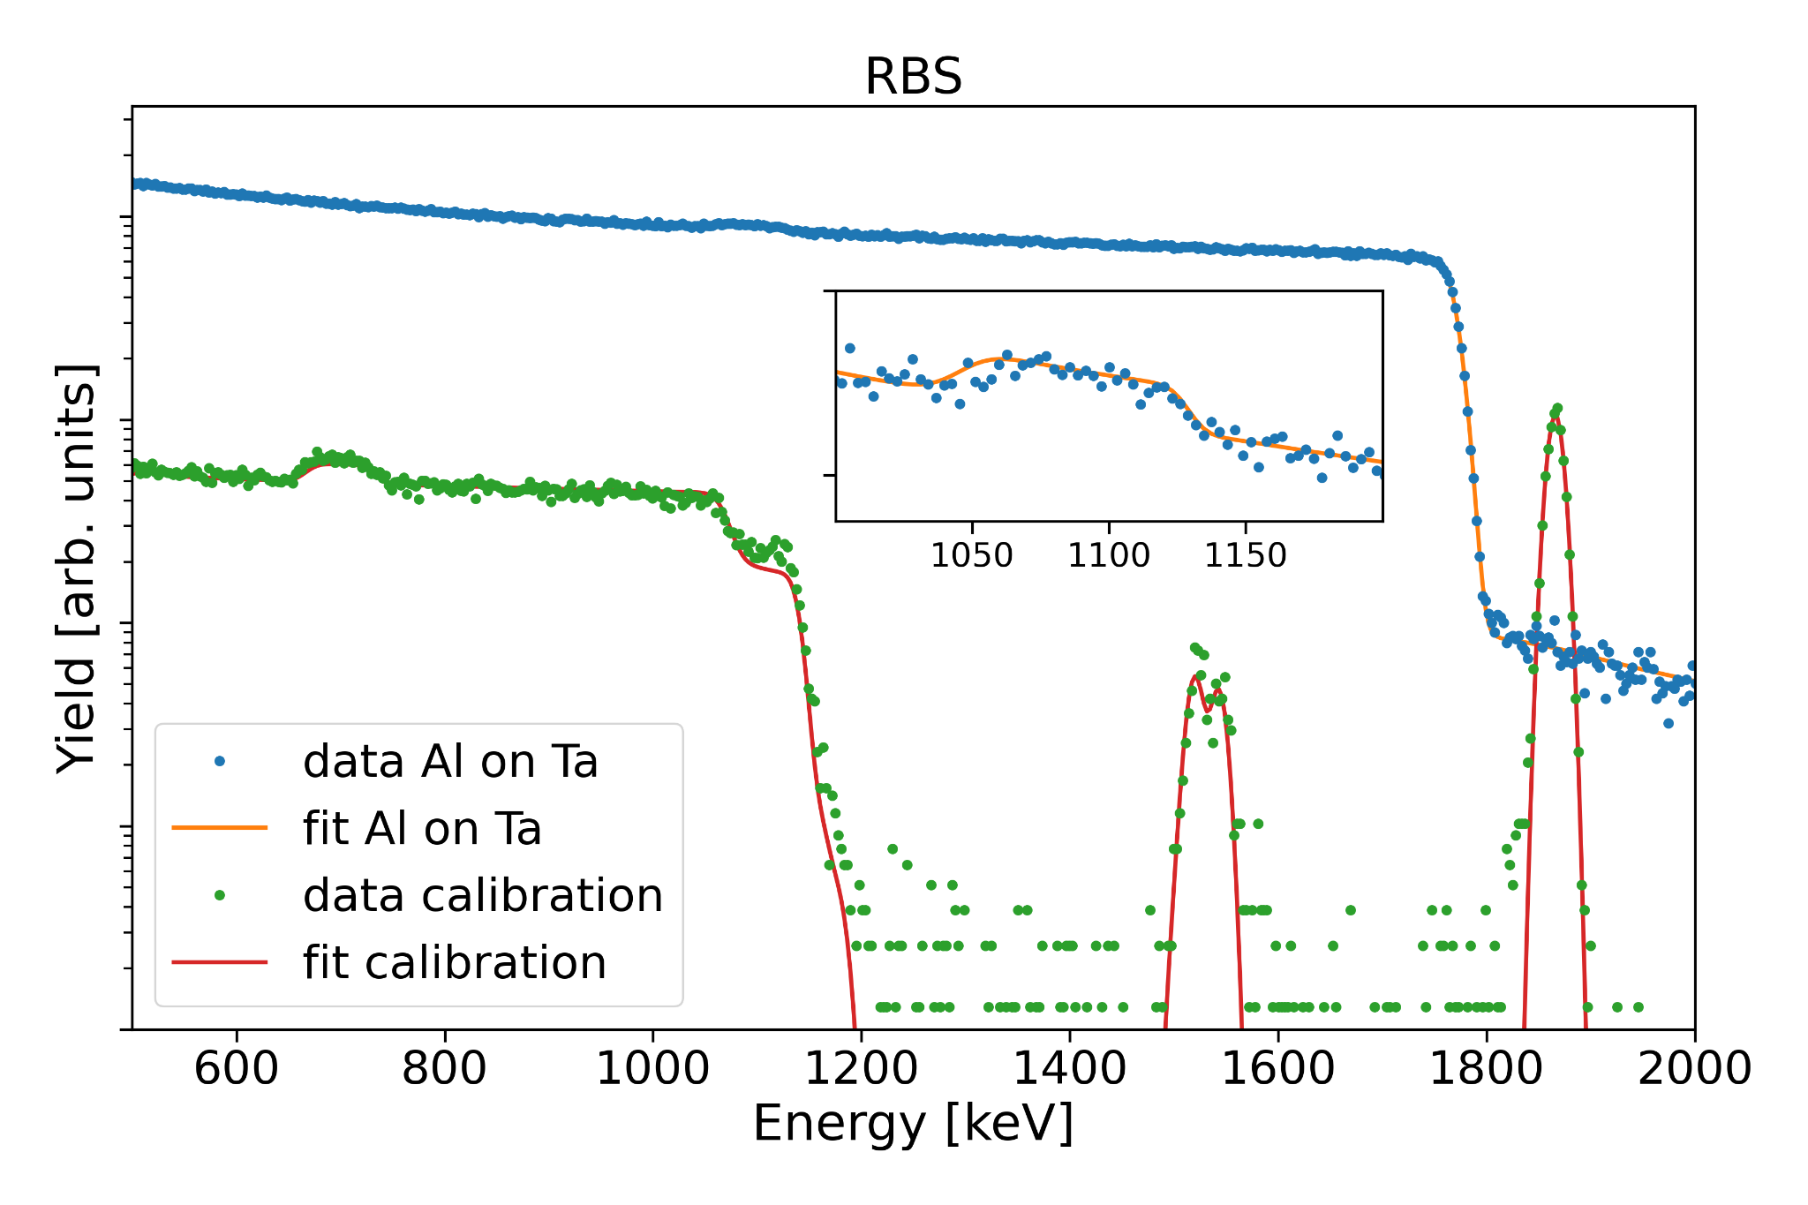
RBS results
Al
Ta
Main results:
thickness of Al is 1045 TFU
Assuming atomic density of 6.0266·10²² atoms/cm³:
173 nm
Au
O
Si
Fe
Co

Slide 15
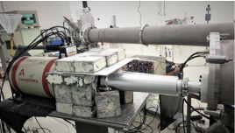
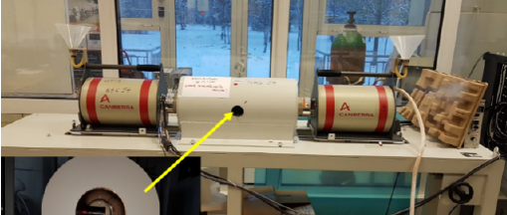
Activation Measurement of the case ¹³C + ¹²C
The experiment utilized the 3MV Tandetron
HPGe detector in-beam of 100% relative efficiency
Target: ^{nat}C (98.93%¹²C, 1.07% ¹³C)
Off-line measurements in BEGA staion

Slide 16
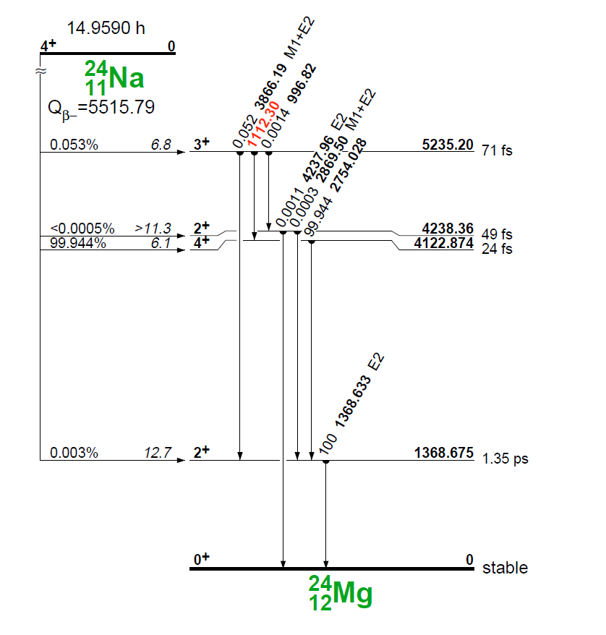
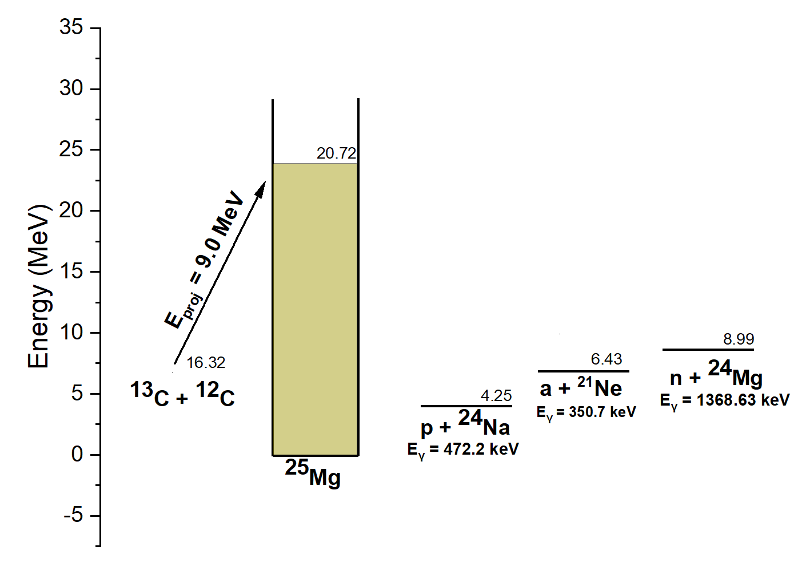
Gamma-rays of Interest
Prompt gamma-rays
De-activation

Slide 17
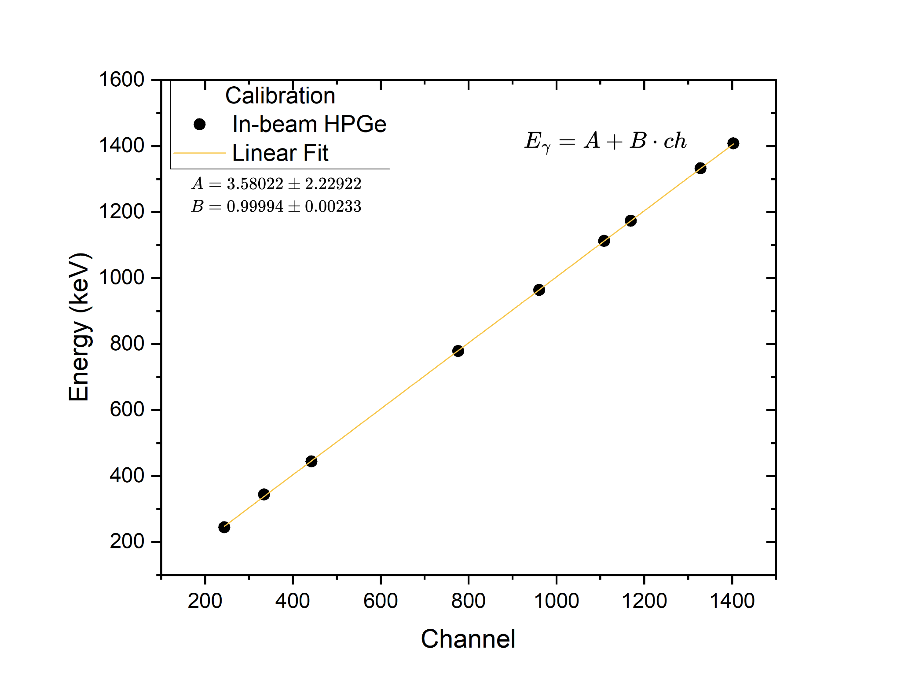
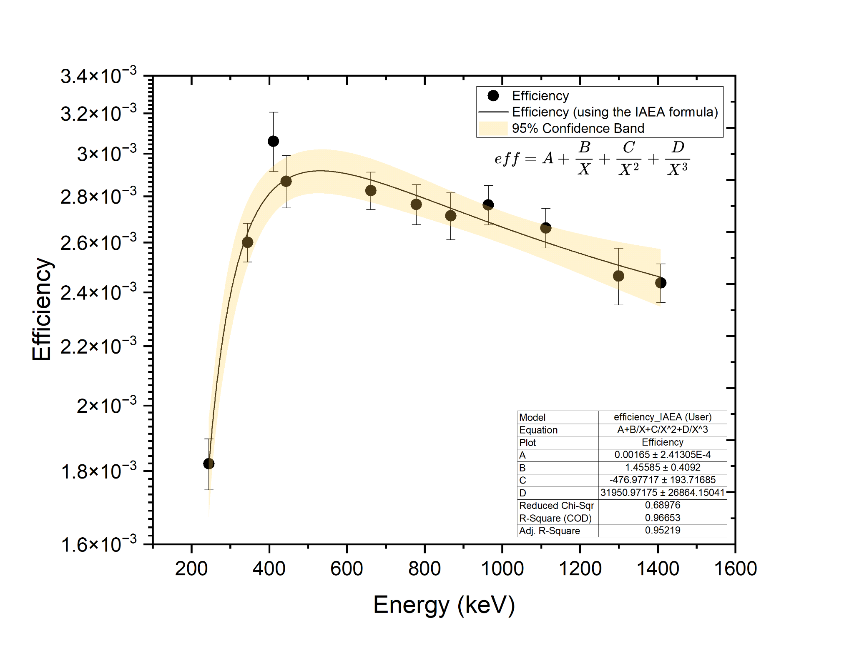
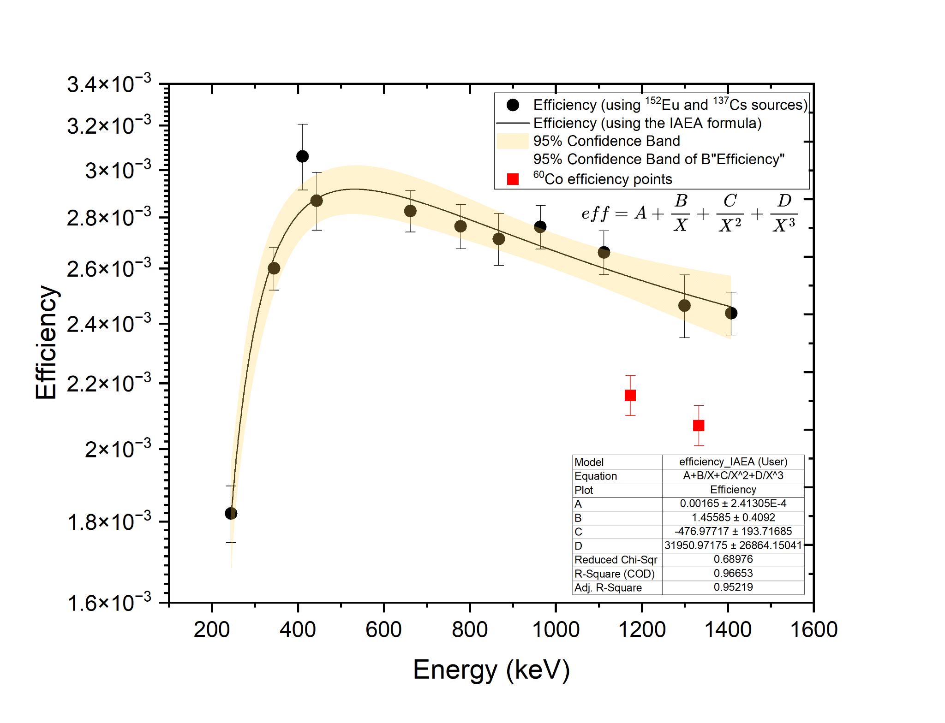

In-beam detector calibration and efficiency
¹⁵²Eu, ¹³⁷Cs, ⁶⁰Co calibrated sources were used for the efficiency calculation

Slide 18
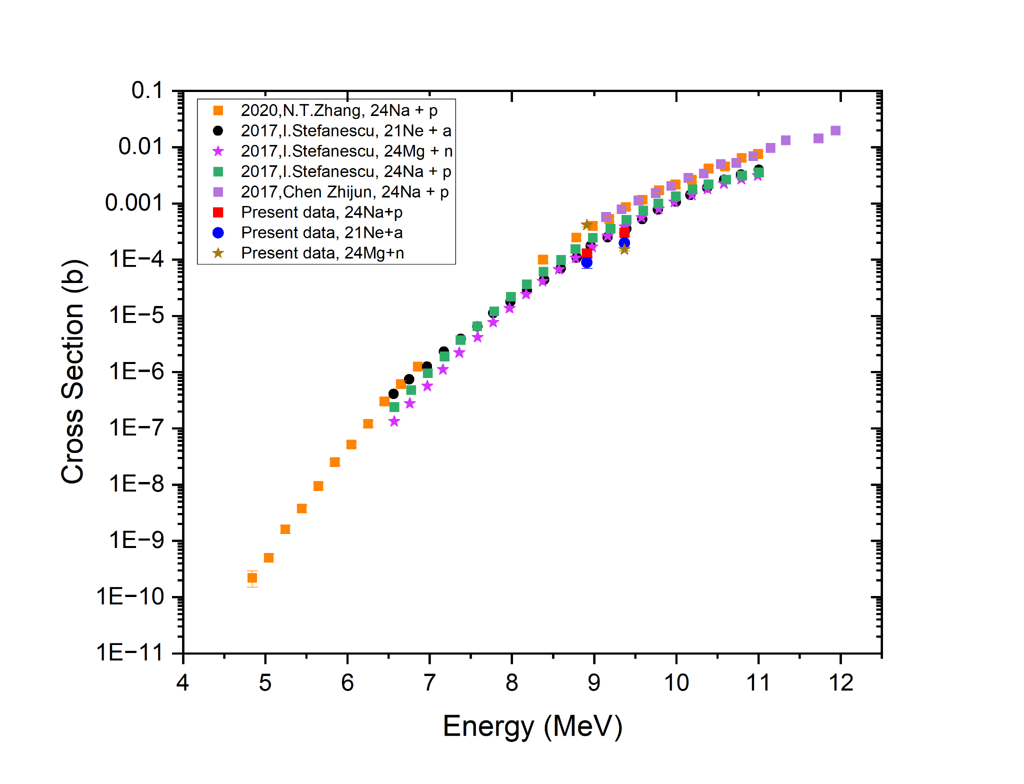
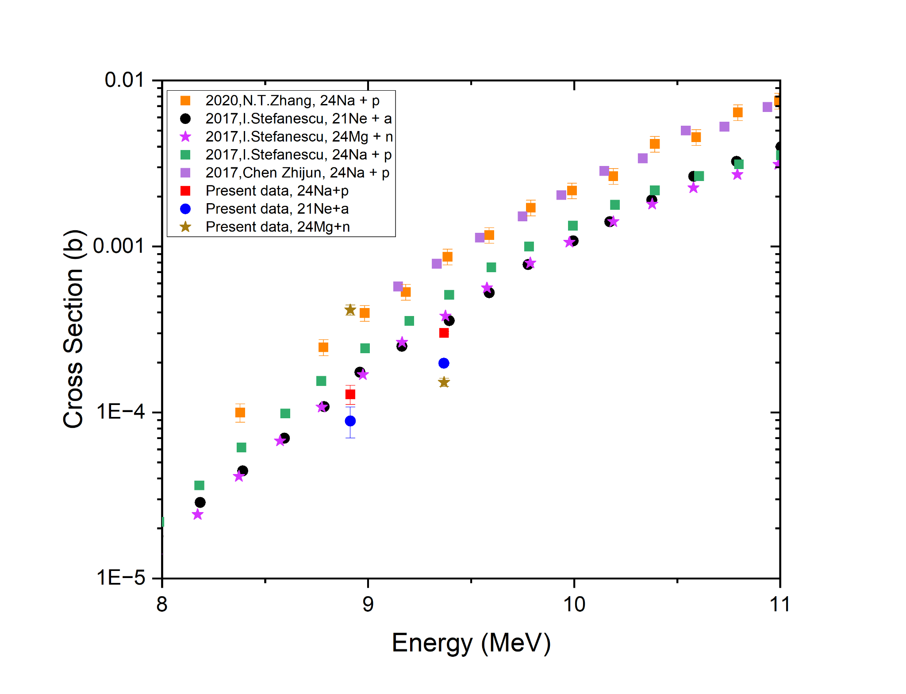

Cross Section Results - Prompt Measurements at E_{eff} = 8.9 and 9.4 MeV

Slide 19
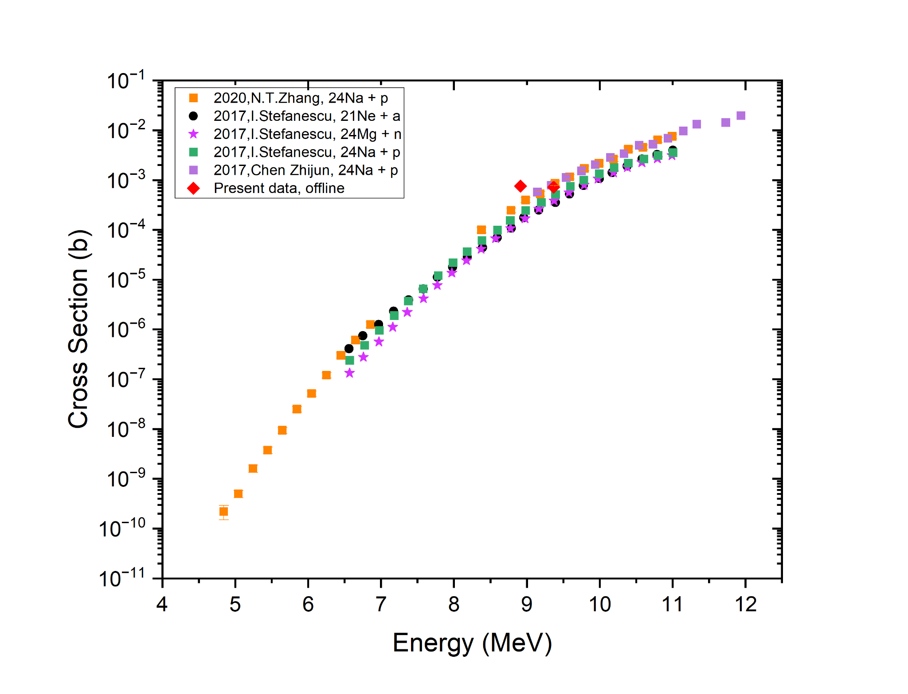
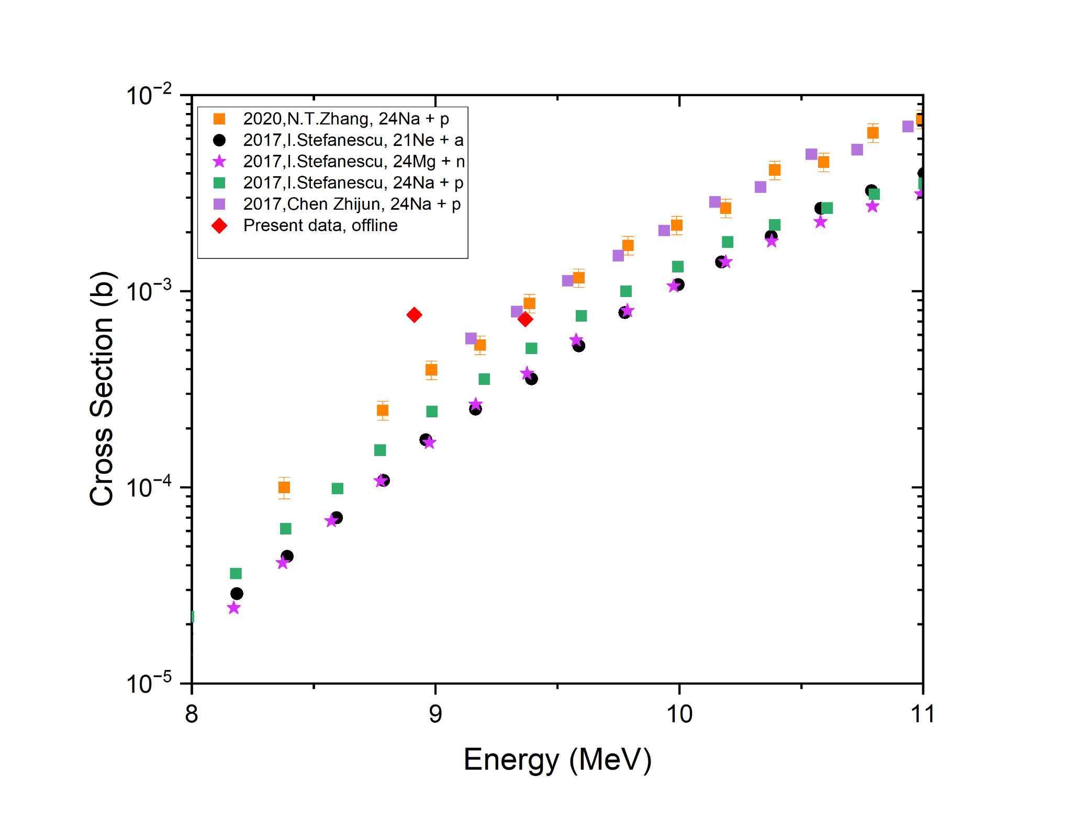
Cross Section Results - Decay Measurements 8.9 and 9.4 MeV

Slide 20
Visit to the Slanic Mine
and IFIN-HH low background laboratory

Slide 21
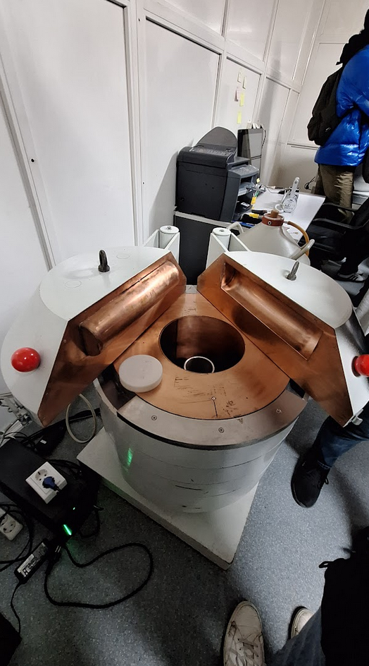

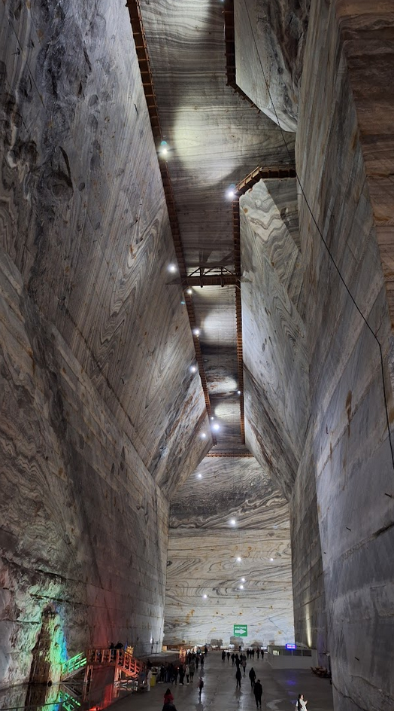
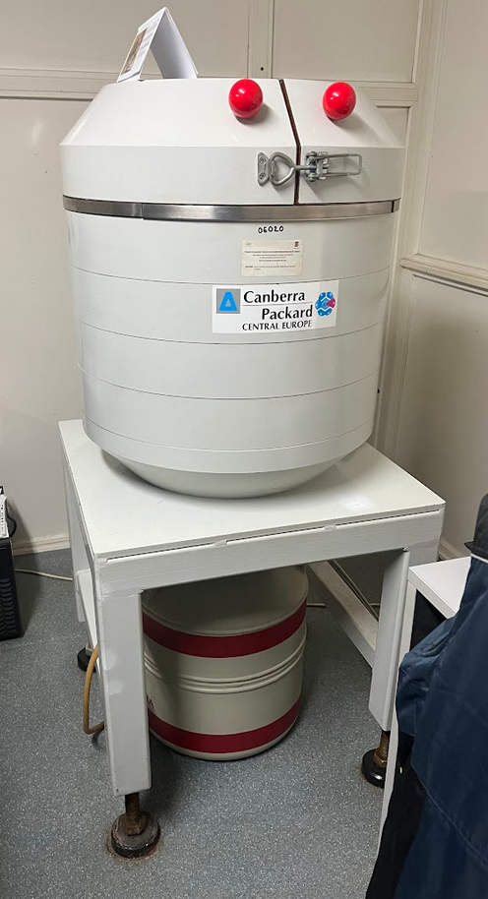
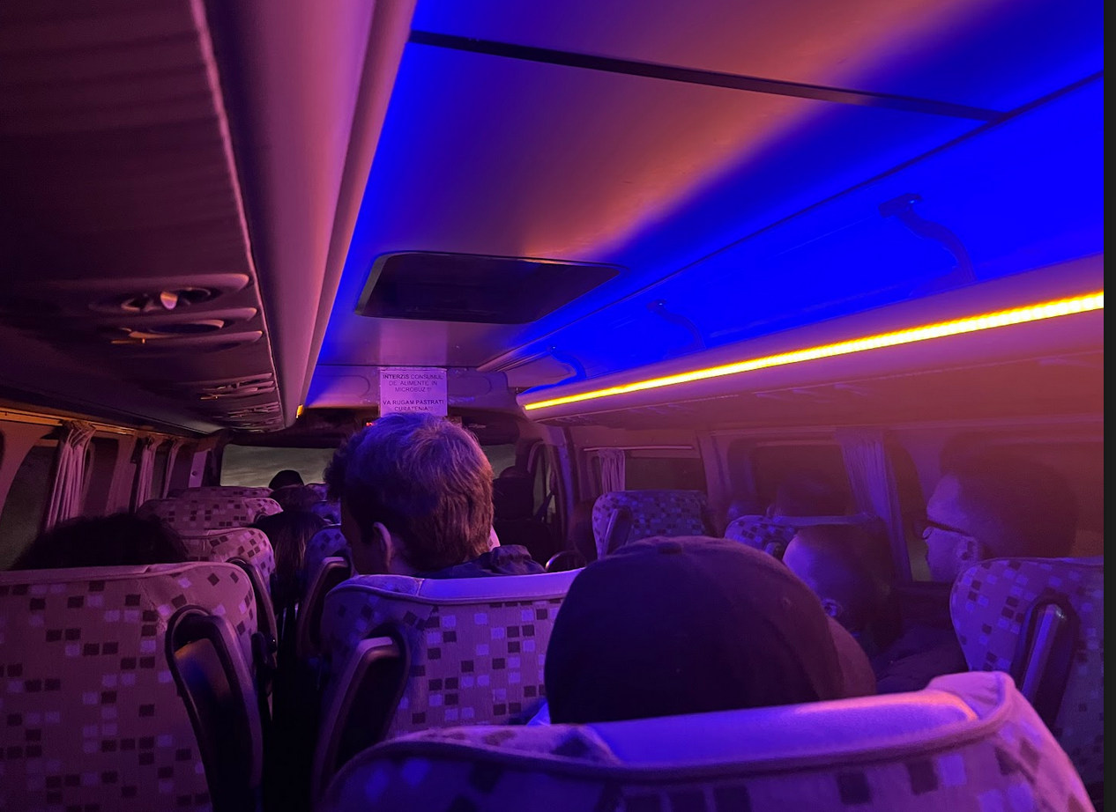
Salt mine: trip and μBq lab

Slide 22
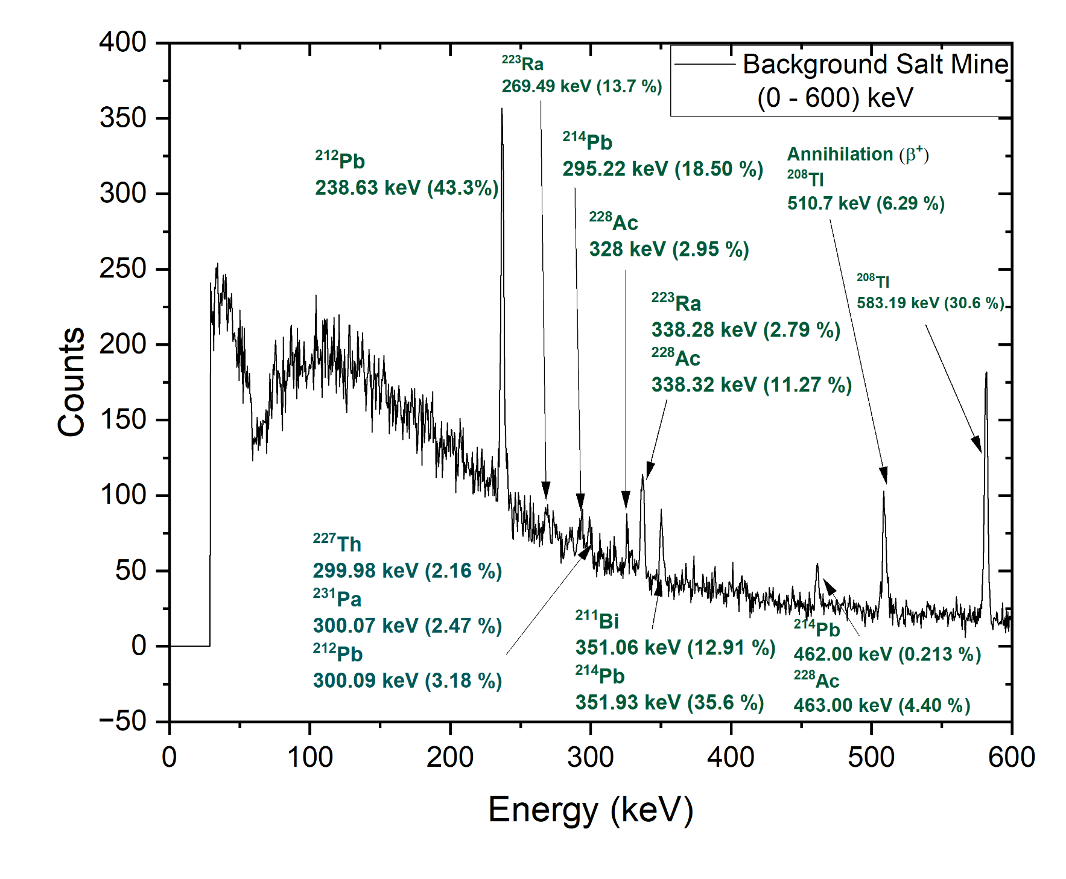
Salt mine HPGe background at lower energies

Slide 23
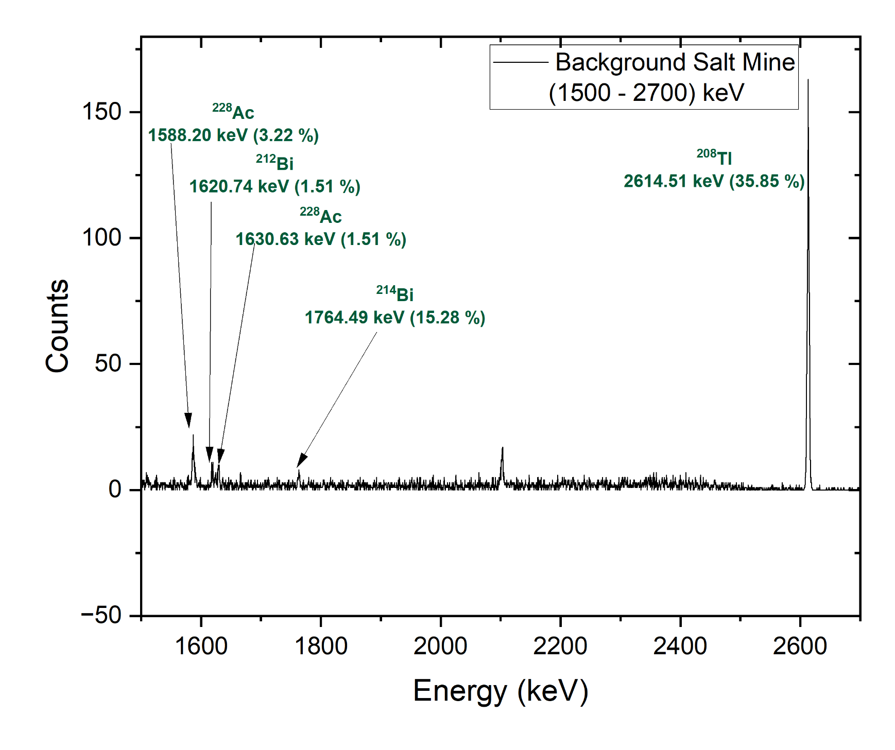
Salt mine HPGe background at medium energies

Slide 24
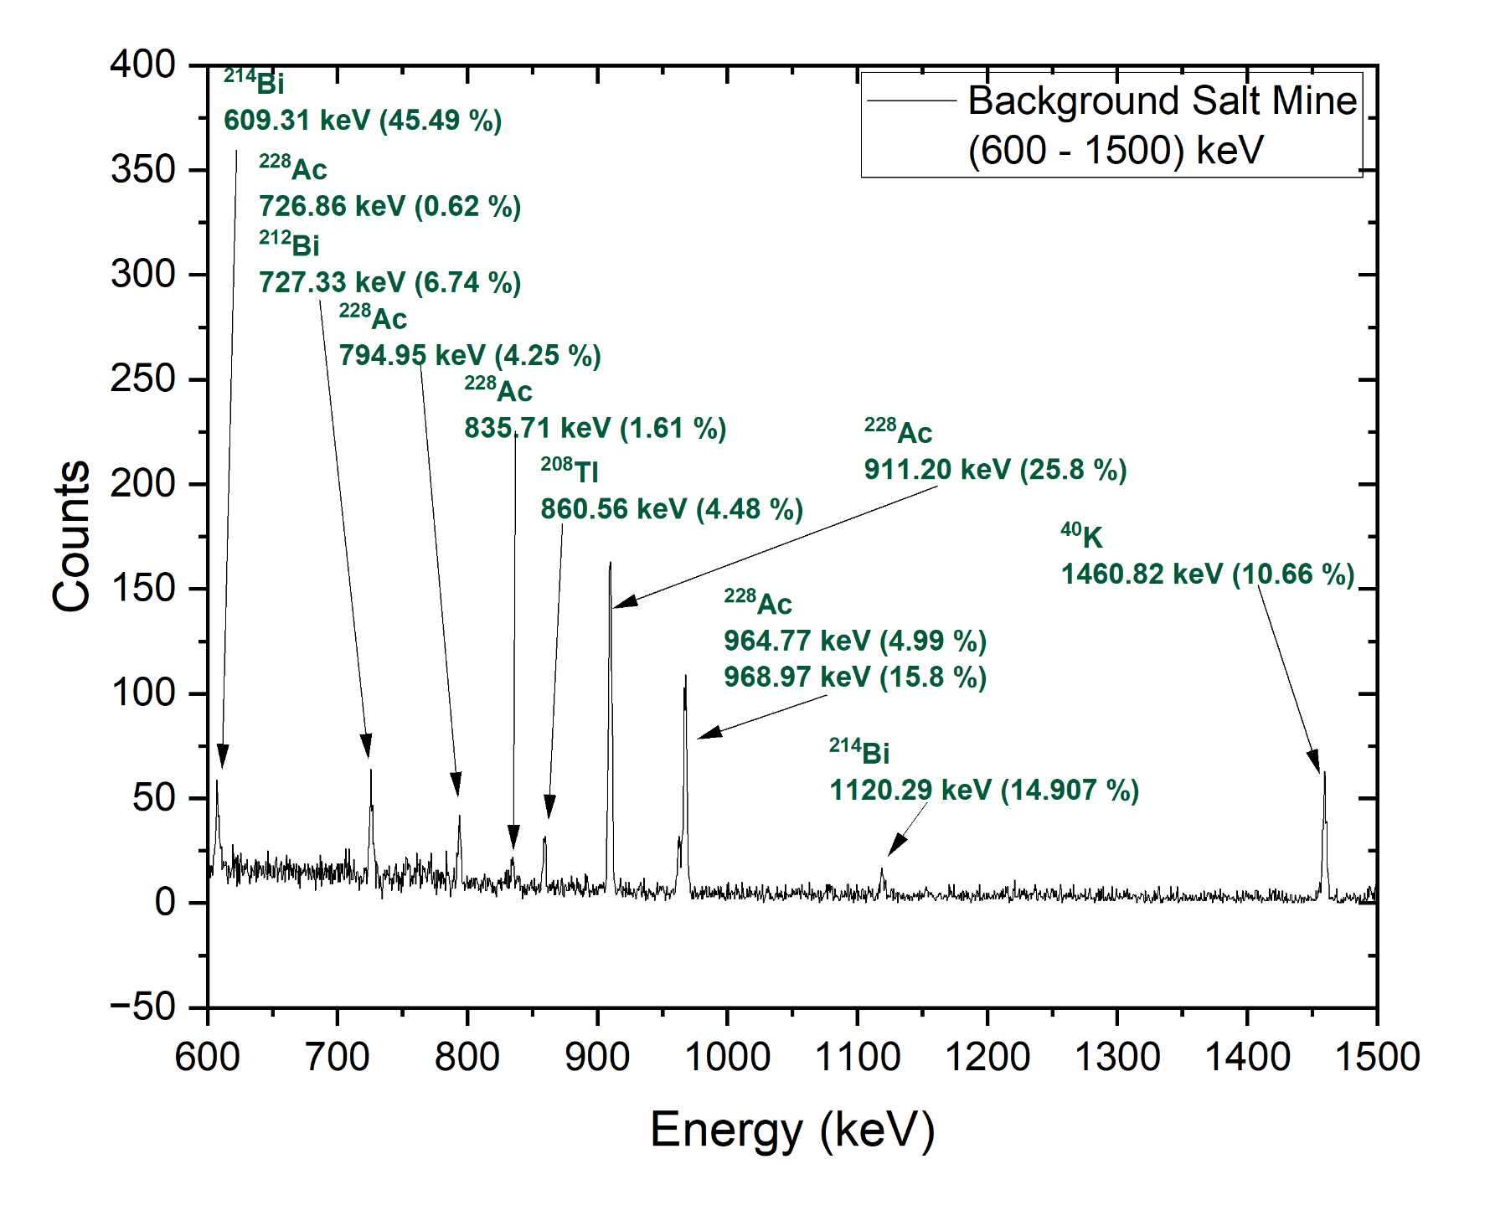
Salt mine HPGe background at higher energies

Slide 25
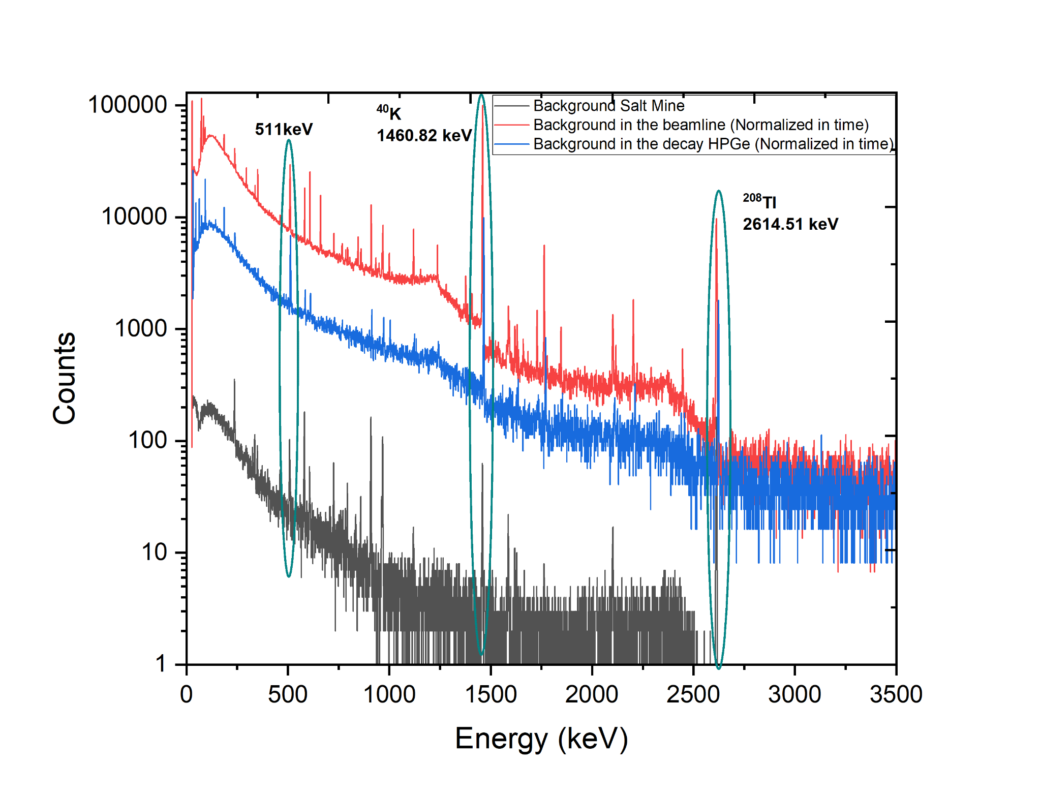
Comparison of Background spectra from different detectors

Slide 26
Hands on @ 1 MV acc.
Case Studies: ¹⁰Be and ¹⁴C dating

Slide 27
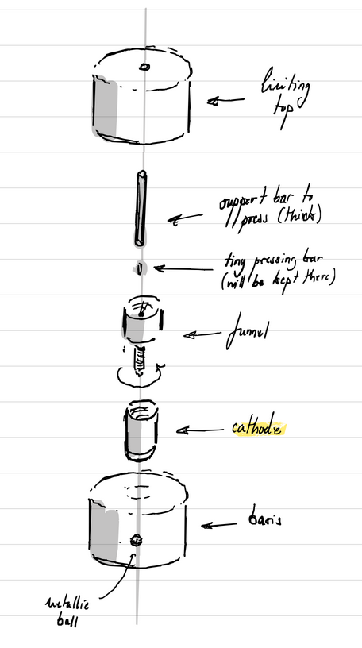
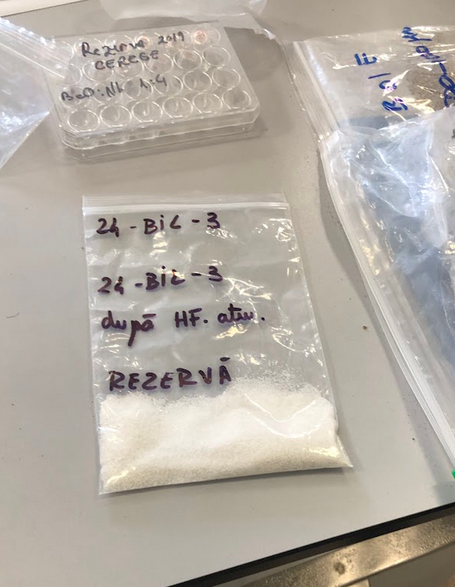
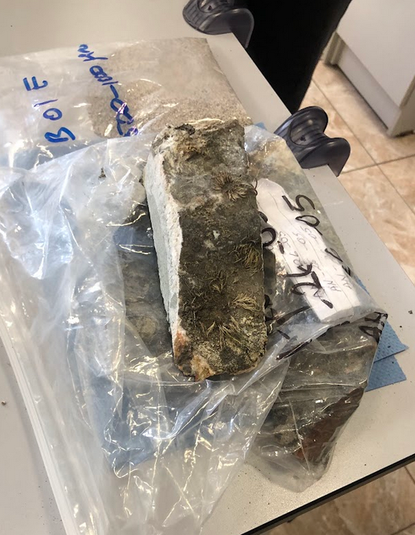
Preparing rock samples for AMS - Beryllium

Slide 28
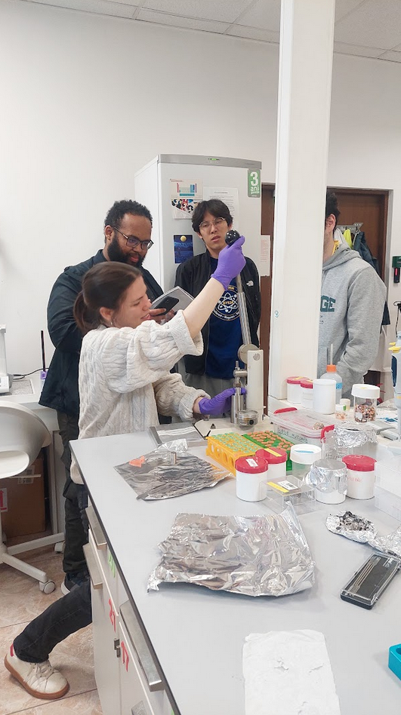


Preparing rock samples for AMS - Beryllium

Slide 29


Preparing OXA II calibration for AMS

Slide 30
1 MV dating ¹⁴C
Radiocarbon determination
BP: Before Present
Calibration curve
“¹⁴C age”
“Real age”
Calibrated date
calBC: calendar Before Christ

Slide 31



1 MV dating 14C
Typical carbon samples:
Charcoal / charred wood / charred seeds
Bone collagen
Organic residue or textile/fiber
Carbonate material, such as shell

Slide 32

AMS ¹⁰Be samples

Slide 33

AMS ¹⁰Be samples
VD5B | 17.3 ± 1.1 ka
CARW 1 | 11.11 ± 0.75 ka
VD4A | 17.5 ± 1.1 ka
FUND CAP B | 11.35 ± 0.76 ka
POD2 | 17.89 ± 0.98 ka
POD PPAL EST | 15.92 ± 0.88 ka
FUND CAP A | 11.6 ± 2.0 ka

Slide 34


AMS ¹⁰Be samples

Slide 35
9 MV Tandetron
Visit and data analysis

Slide 36


Slide 37


2 out of the 7 lines
Neutron spectrometer
ROSPHERE
Fast-timing
Doppler Shift
and more

Slide 38

ROSPHERE
4He + 108Cd
25 MeV
Our analysis
γγ counts
1 keV bins for histogram
2 keV bins for coincidence match
HPGe 10 vs HPGe 12

Slide 39
IRASM Multipurpose Irradiation Facility visit

Slide 40



Cherenkov light from ⁶⁰Co source

Slide 41
Hadronic Physics Department visit

Slide 42



Resistive Plate Chambers
Transition Radiation Detectors
Multiwire Proportional Chambers

Slide 43
ELI-NP visit

Slide 44



Laser experimental area
Control room

Slide 45


S-band accelerator structures for the VEGA LINAC

Slide 46


Lectures
EURO-LABS, Vacuserc, Nuclear Astrophysics

Slide 47


DUROCERN
visit

Slide 48



Lectures
Overview of AMS, CANBERRA-PACKARD HPGe

Slide 49
Lectures
DAQ analysis

Slide 50



Pulse Shape Discrimination (PSD) analysis

Slide 51

PSD analysis

Slide 52

Papanași workshop

Slide 53

Old accelerator building

Slide 54

Thank YOU for a great school!

