Slide 1


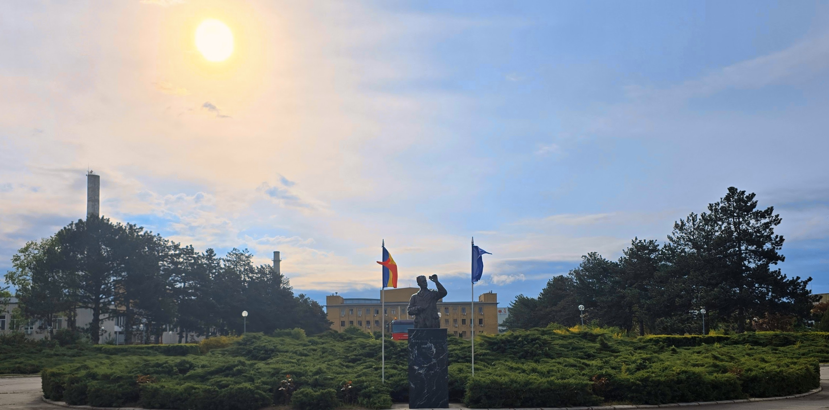
Basic Training School ​
IFIN-HH 2026 ​
Blue Team
May 11-23,2026, Bucharest-Magurele (Romania)

Slide 2
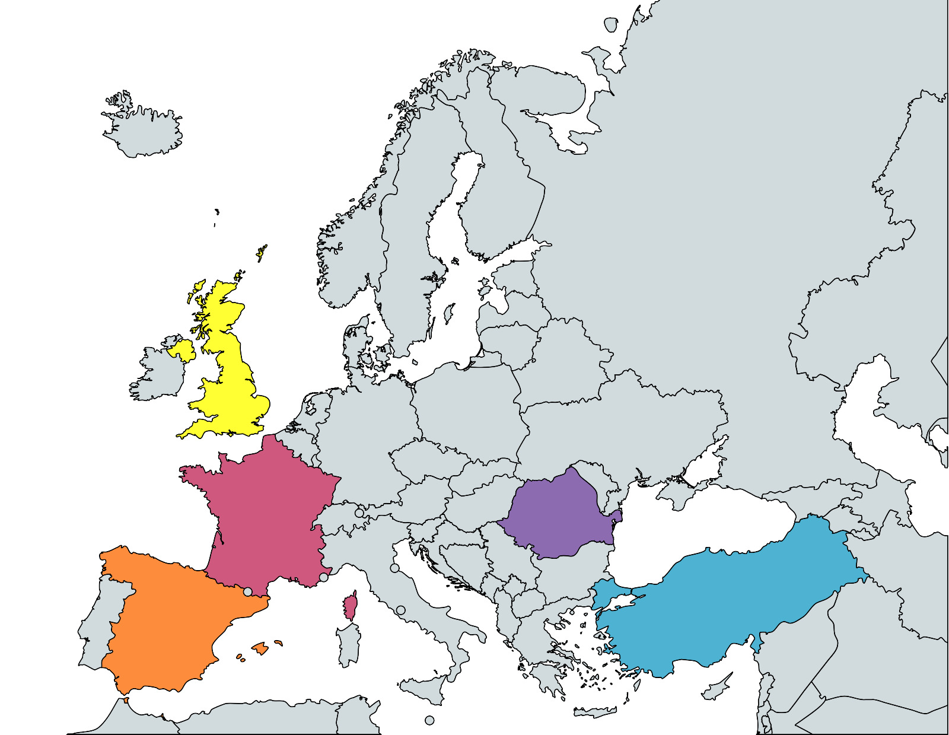
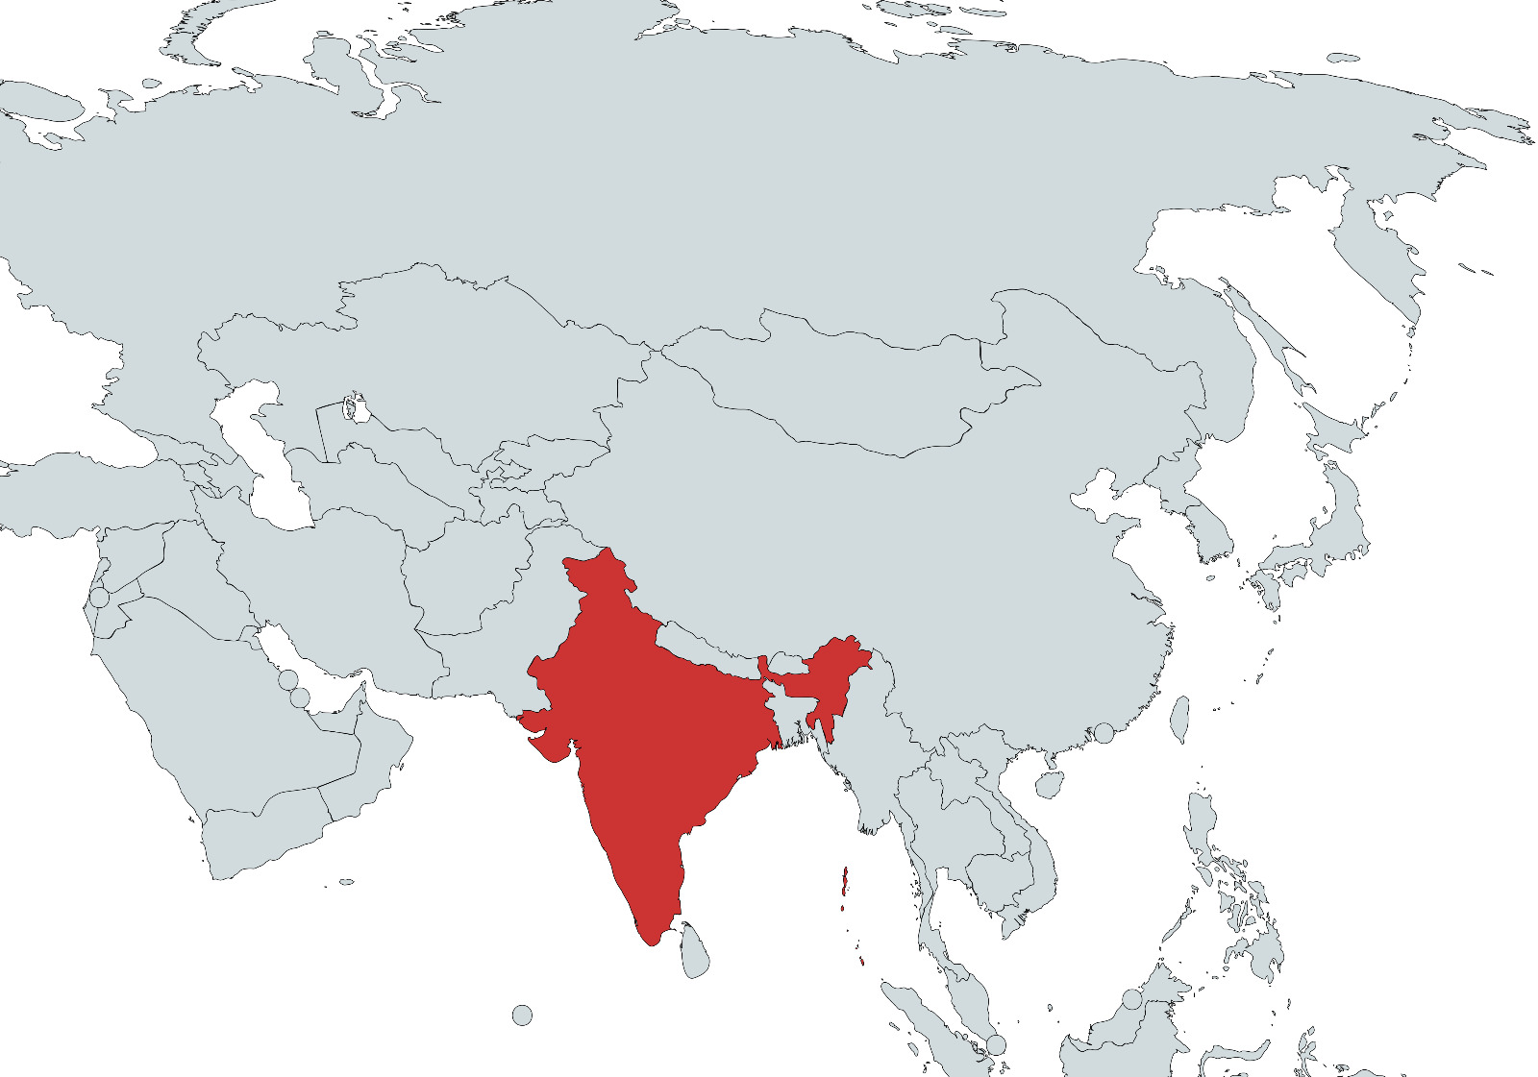
Our Team
PhD student from UK
Master student from France
Research assistant from Turkey
Master student from Spain
High School and Bachelor students from Romania
PhD student from India

Slide 3
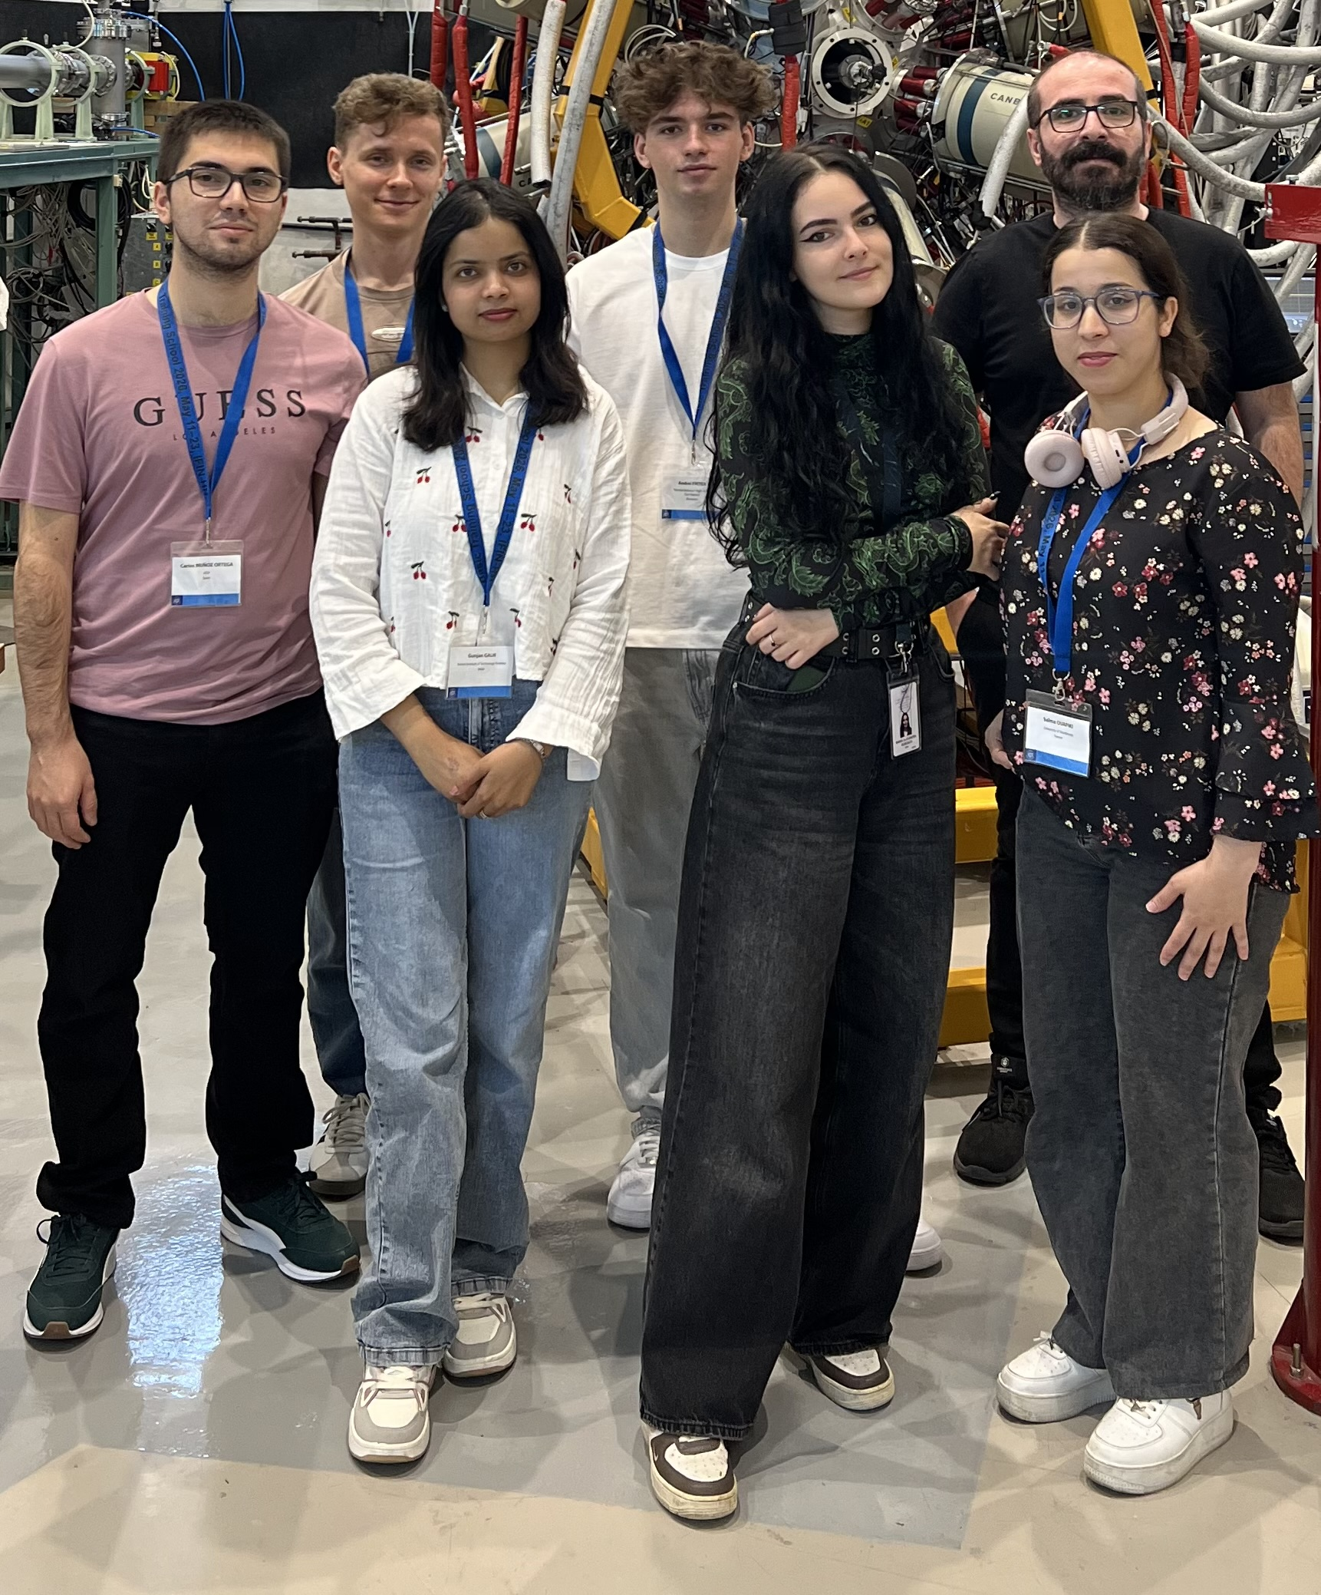

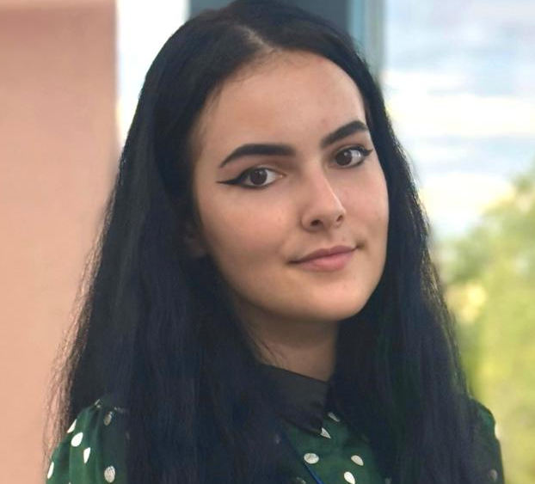
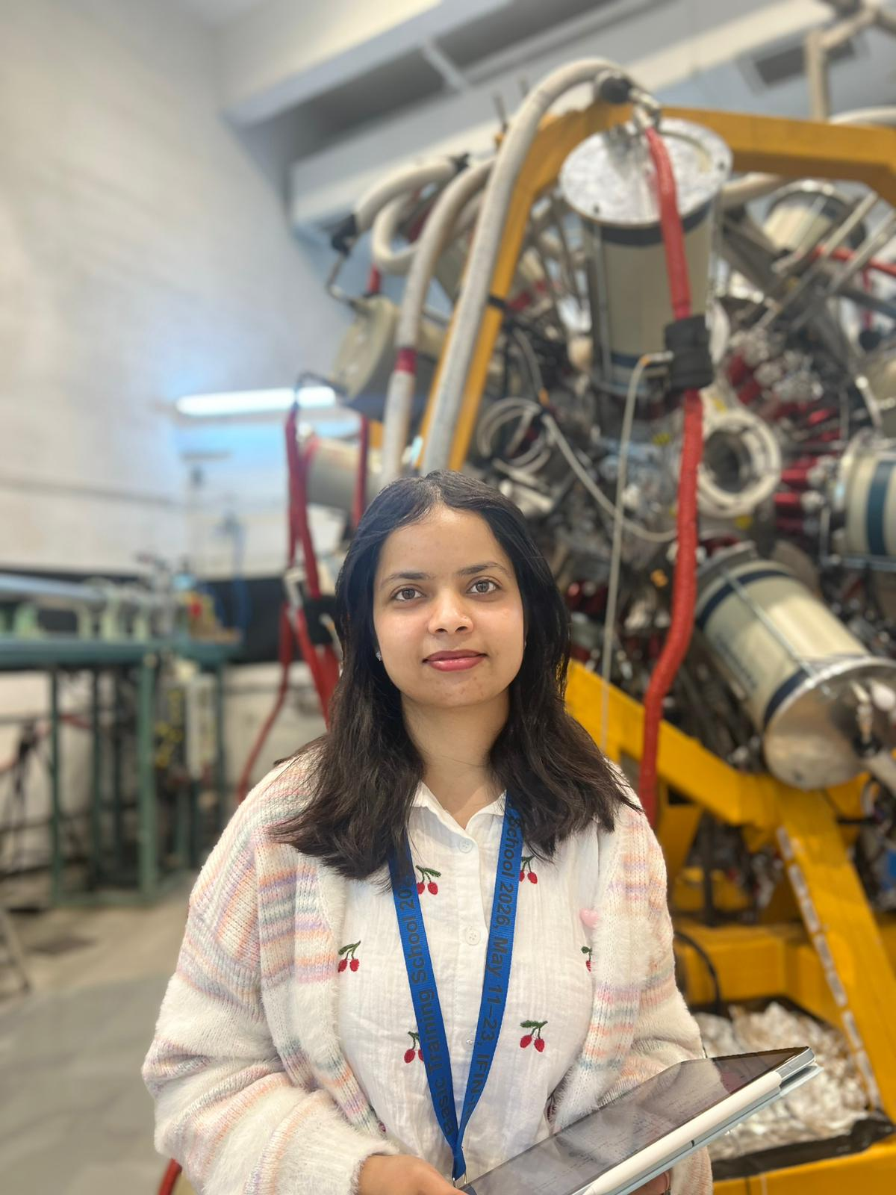
Our Team
SALMA OUAFIKI
Faculty of Physics, University of Strasbourg , Radiations physics, Detector, Instrumentation and Imaging.
Boboacă Maria Alexandra
Faculty of Physics, University of Bucharest, Physics-Informatics
Gunjan Gaur
Indian Institute of Technology Roorkee,
Gamma Spectroscopy in 208Pb region
.

Slide 4

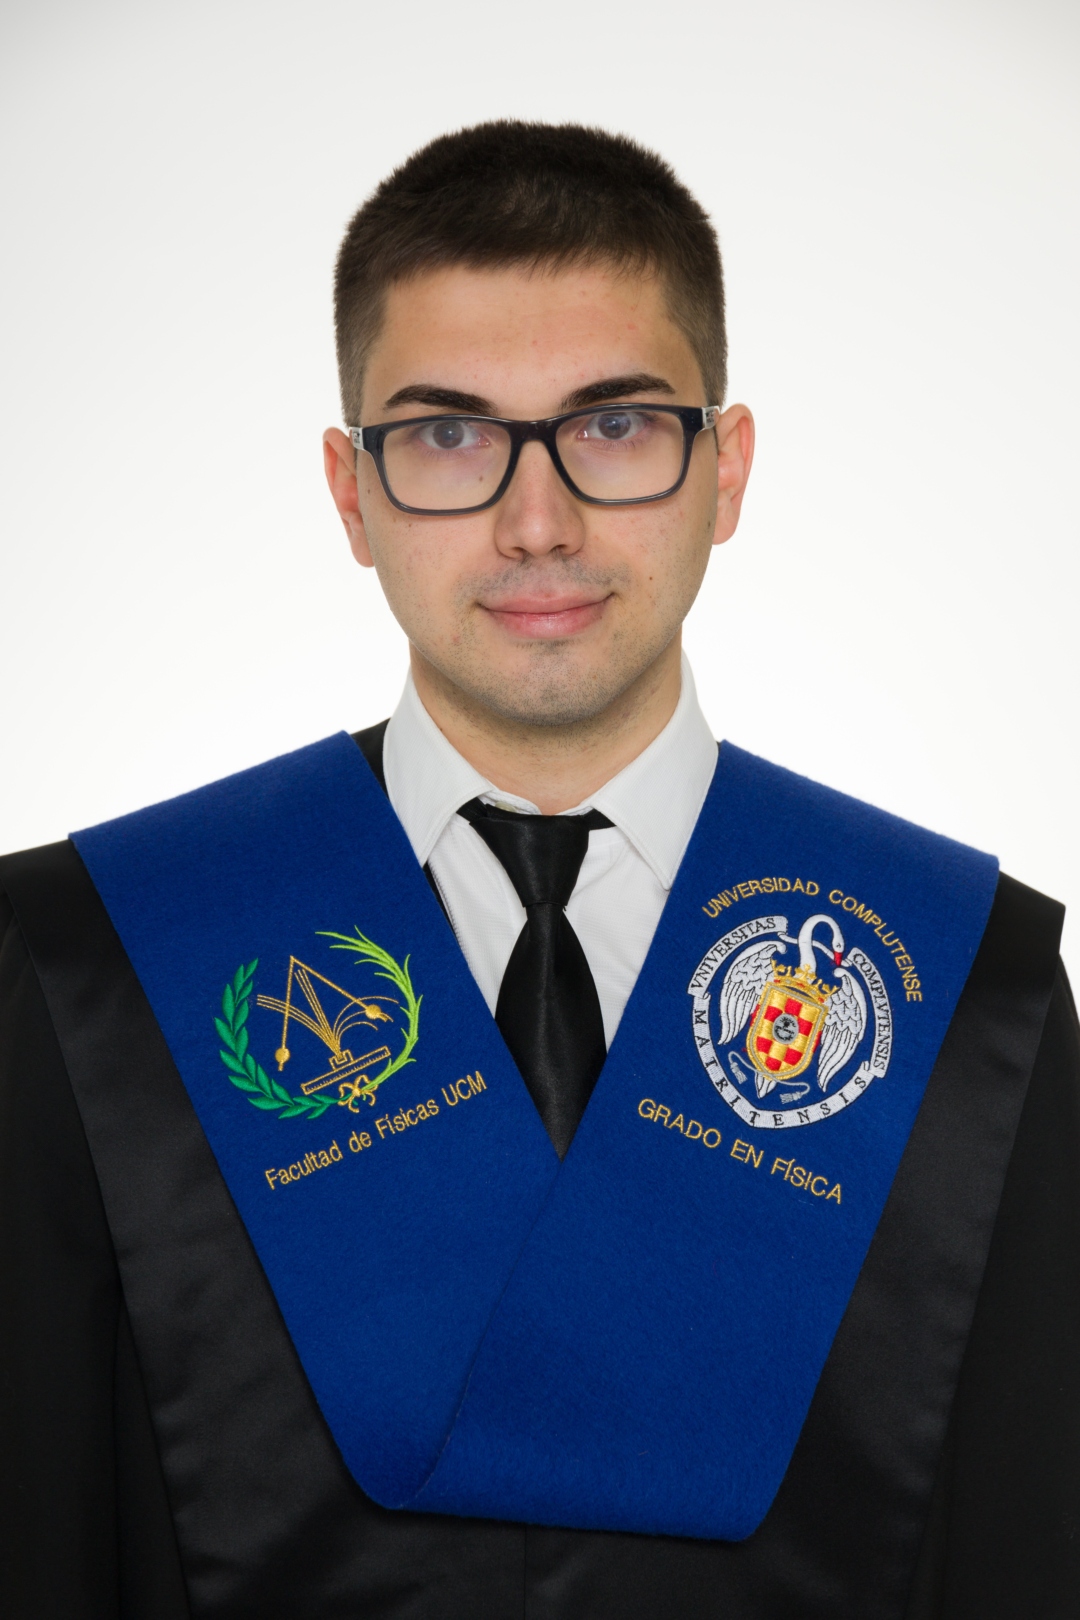
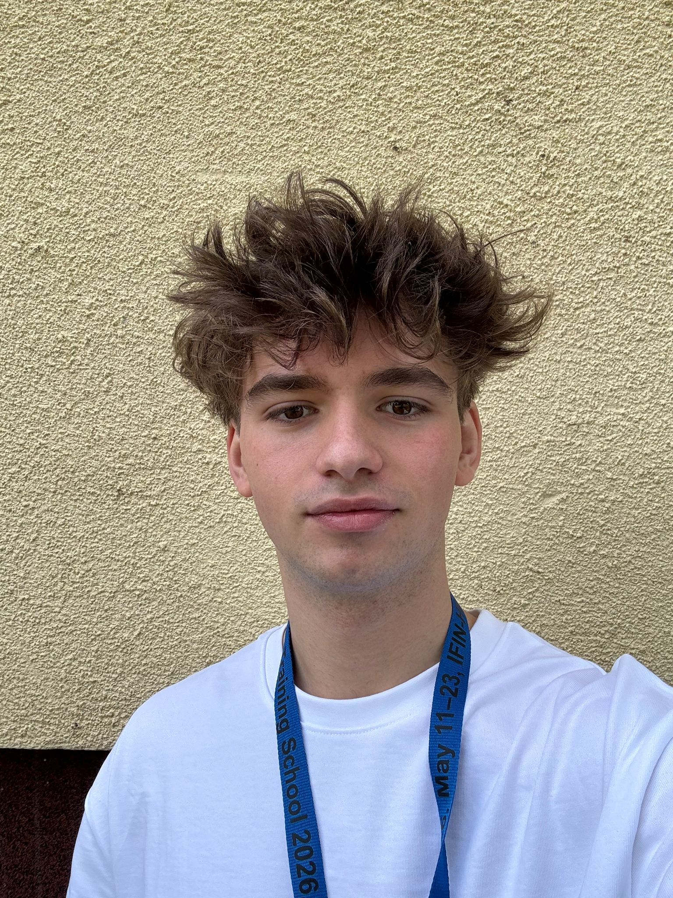

Our Team
Emre IREN
Mimar Sinan Fine Arts University, İstanbul Turkey
Carlos Muñoz Ortega
Complutense university of Madrid, Spain,Nuclear Physics
Andrei Fritea
"Nicolae Balcescu" High School, Cluj-Napoca, Romania
Michał Włodarczyk,
The University of Manchester

Slide 5
WHAT HAVE WE DONE?
Visit to 9MV, 3MV and 1MV tandetrons -Accelerator Mass Spectrometry
Visit to hadron physics department
Visit to ELI NP
Visit Durocern at IFA Magurele
Presentation about nuclear physics for astrophysics, AMS, and Detectors
Sample preparation
Target preparation
RBS experiments at 3MV
Trip to Slanic-Prahova
Activation experiments at 3MV
Experiment at 9MV Data analysist

Slide 6
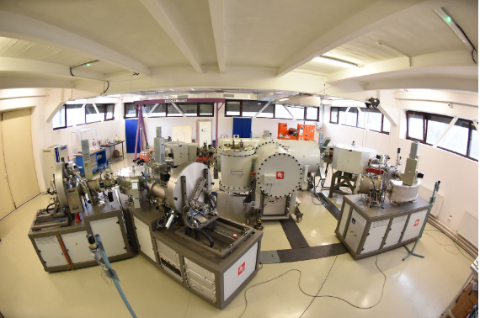
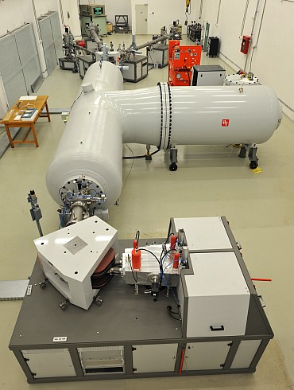
Facilities
1MV Tandetron
3MV Tandetron

Slide 7
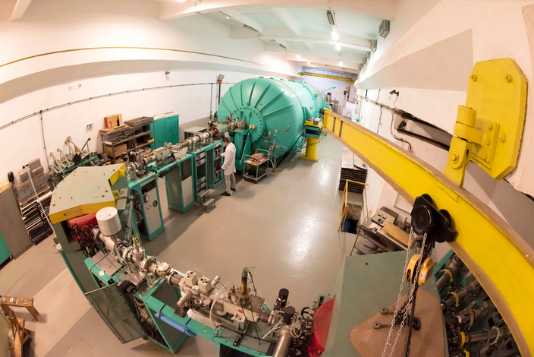
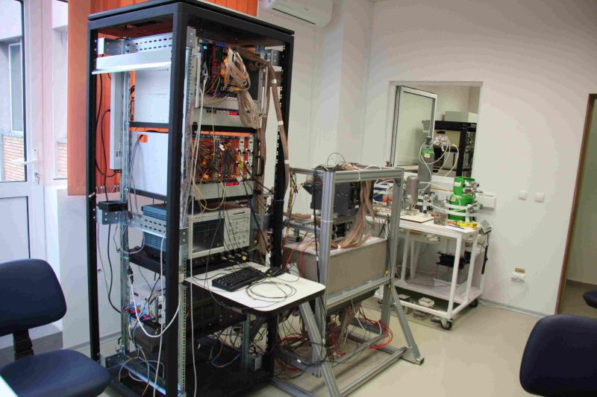
Facilities
hadron physics department
9MV Tandetron
Hadron Physics Department

Slide 8
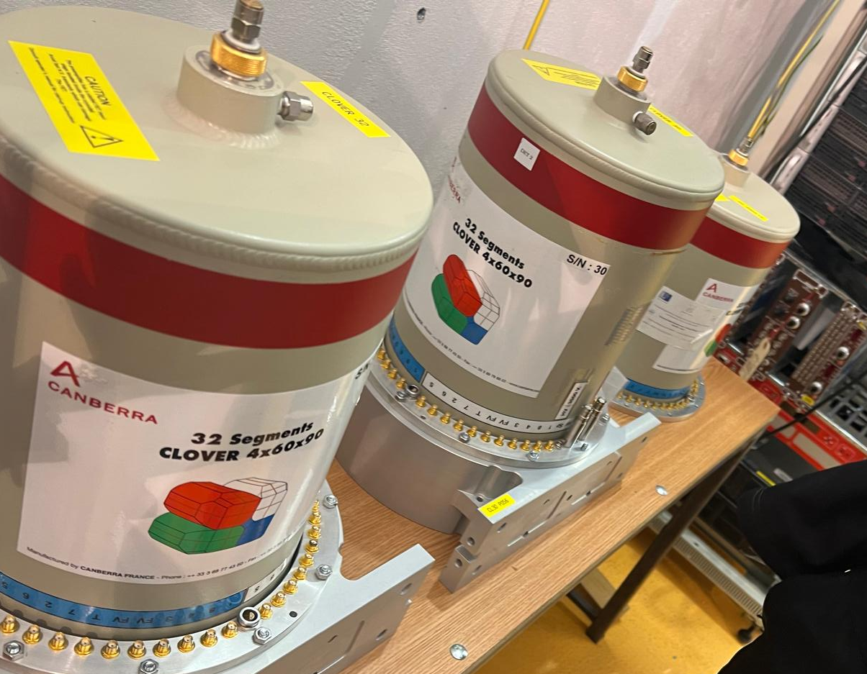
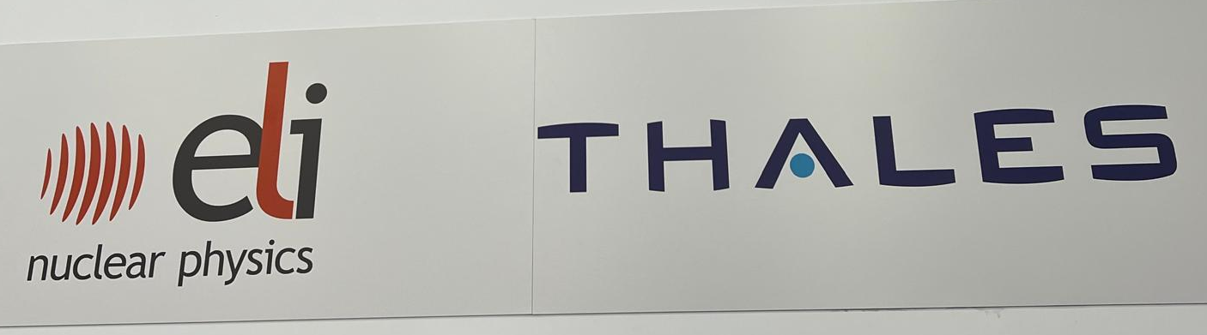
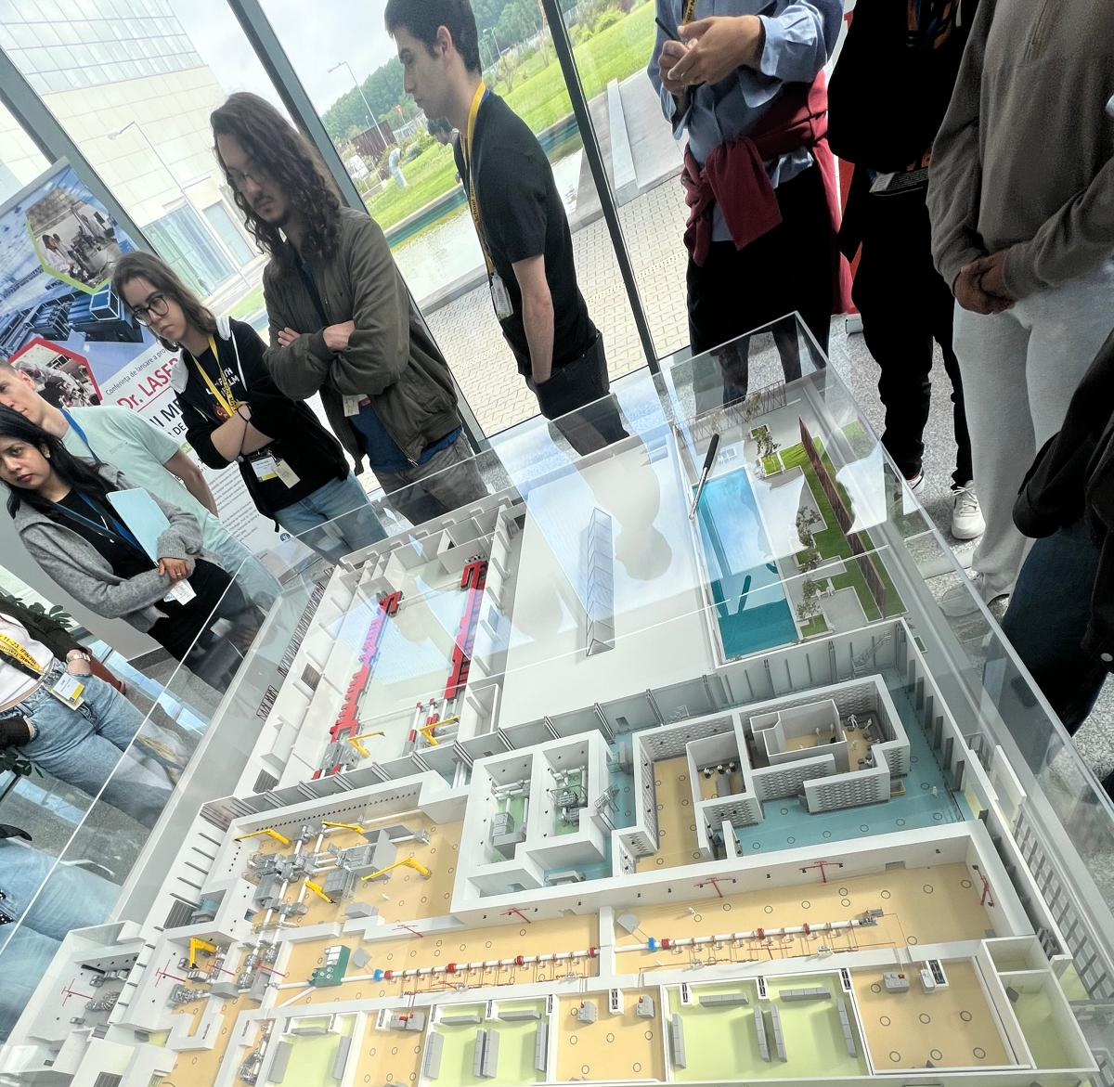
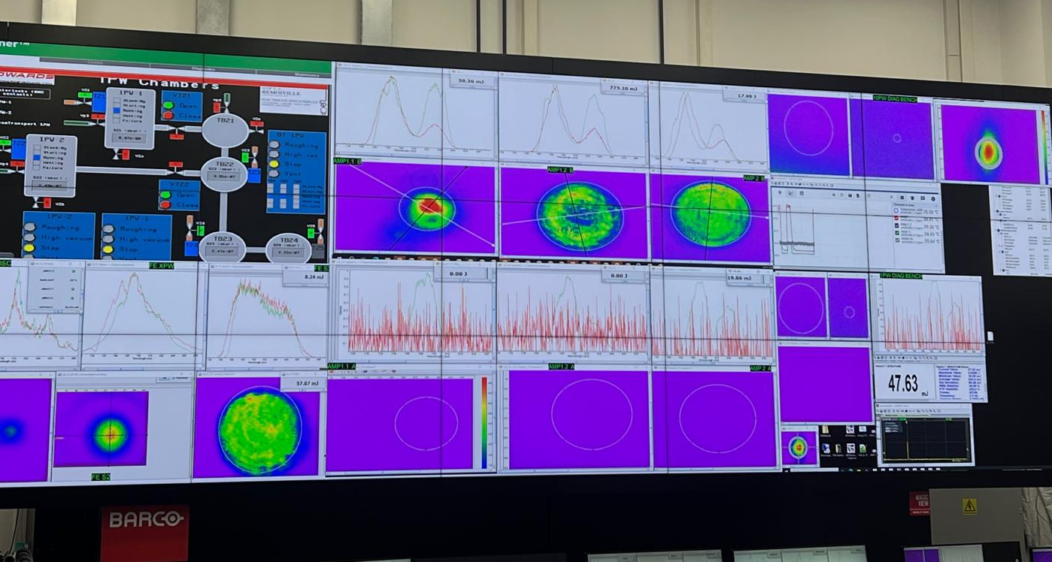
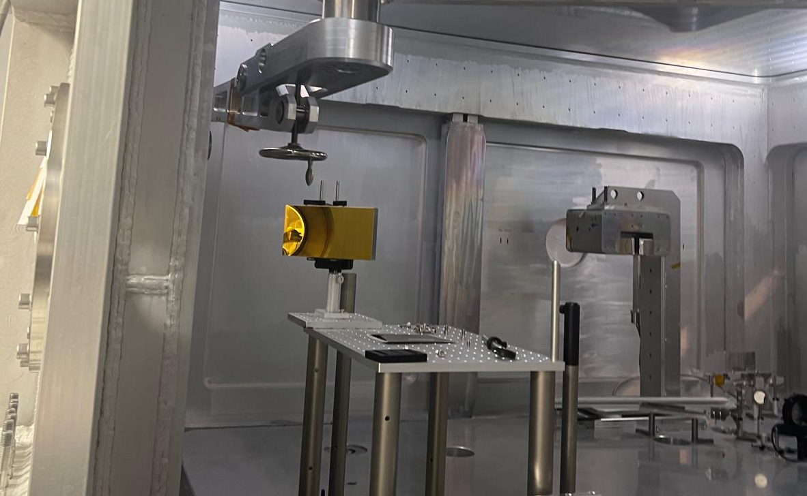
ELI-NP

Slide 9
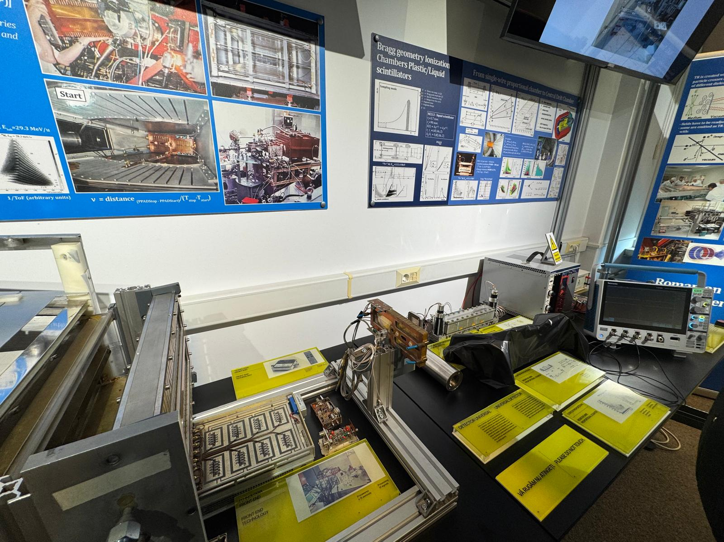
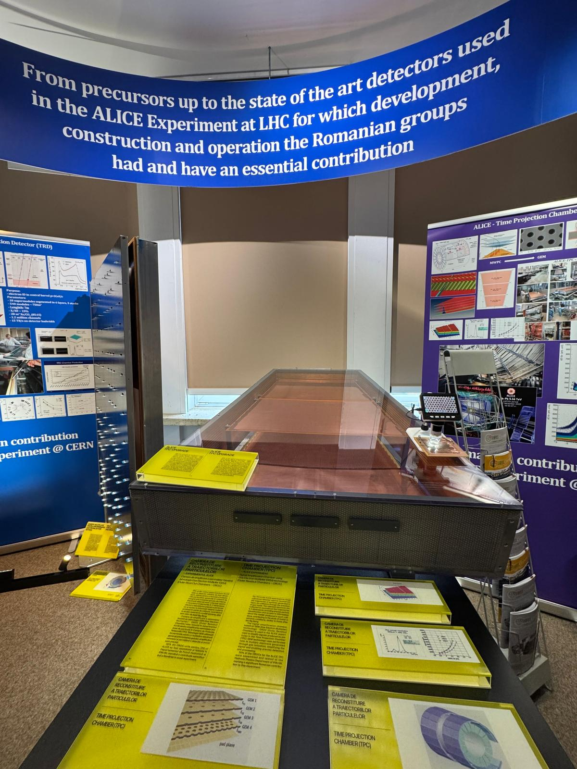
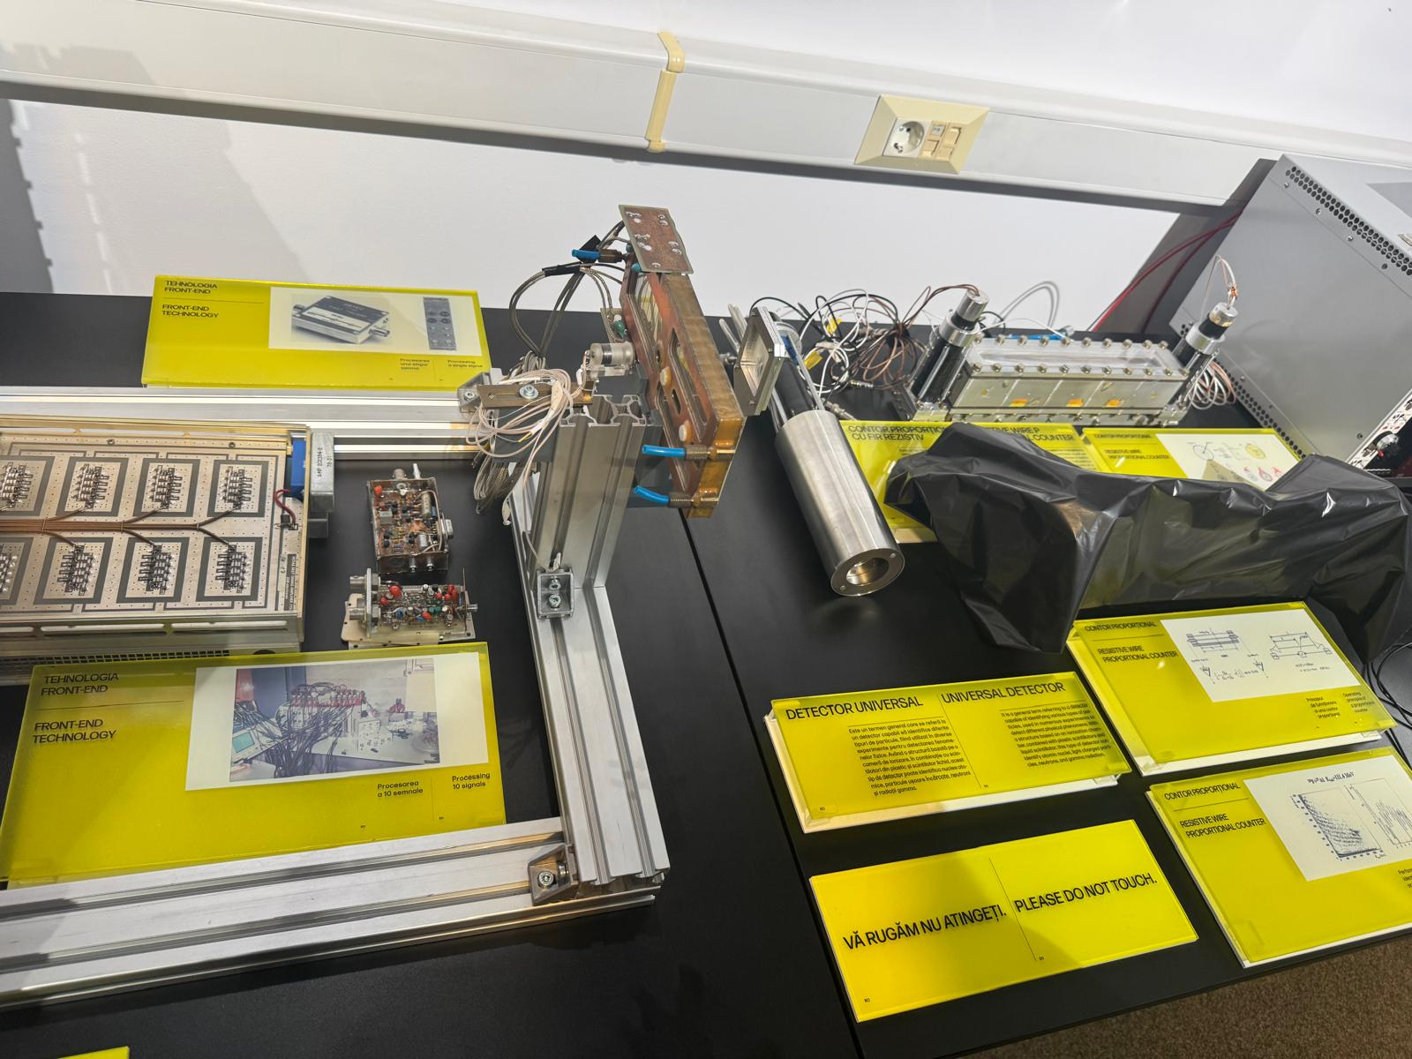
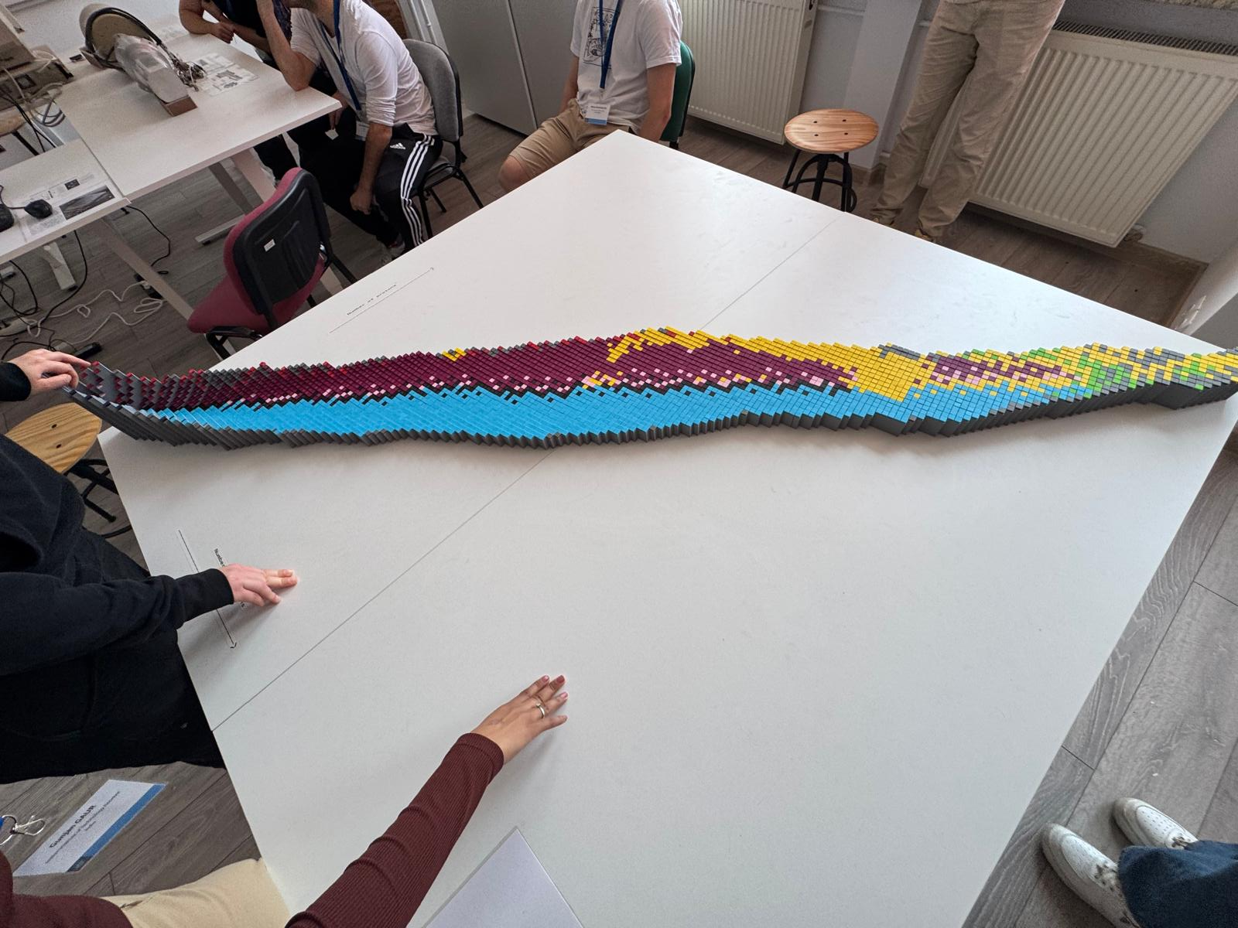
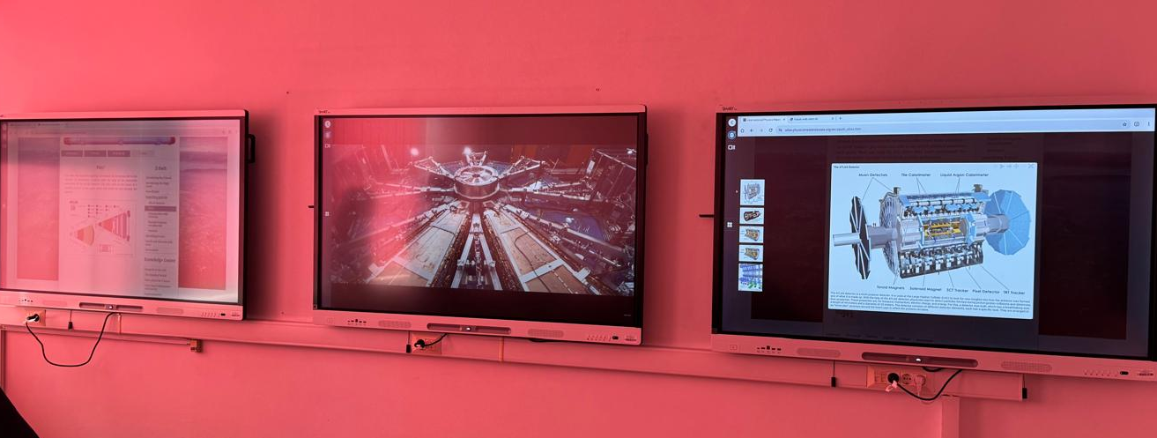
DUROCERN

Slide 10
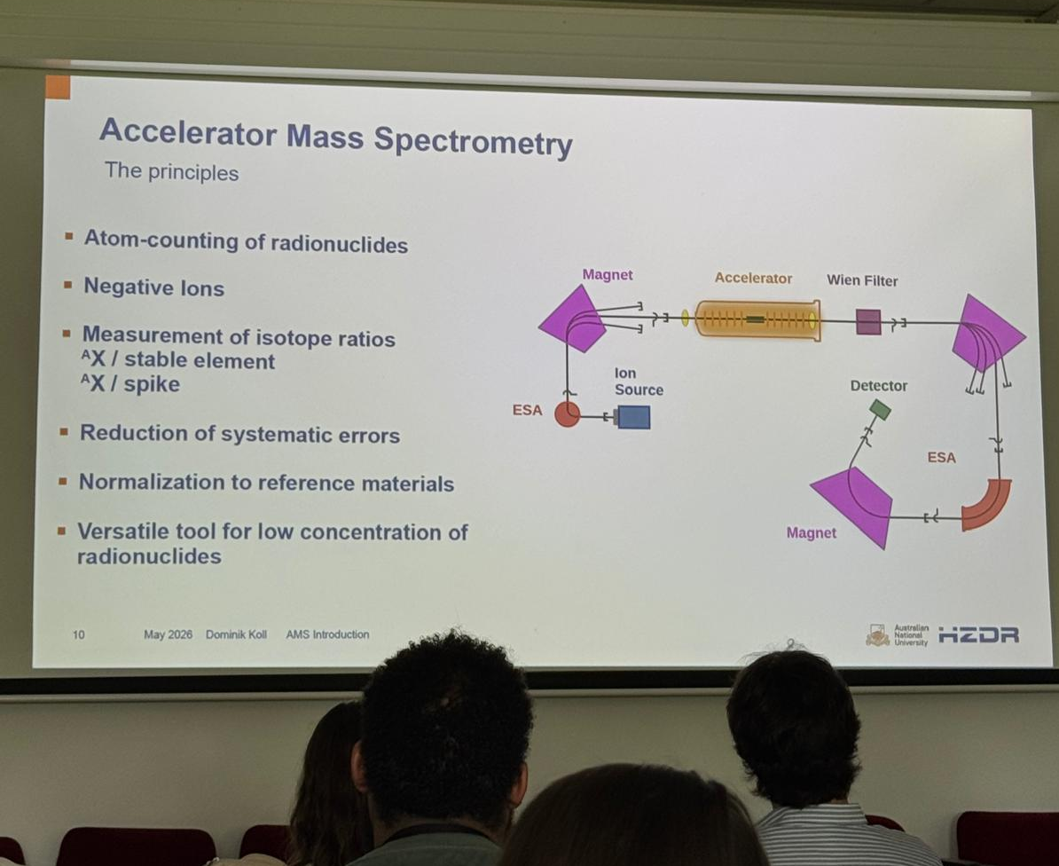
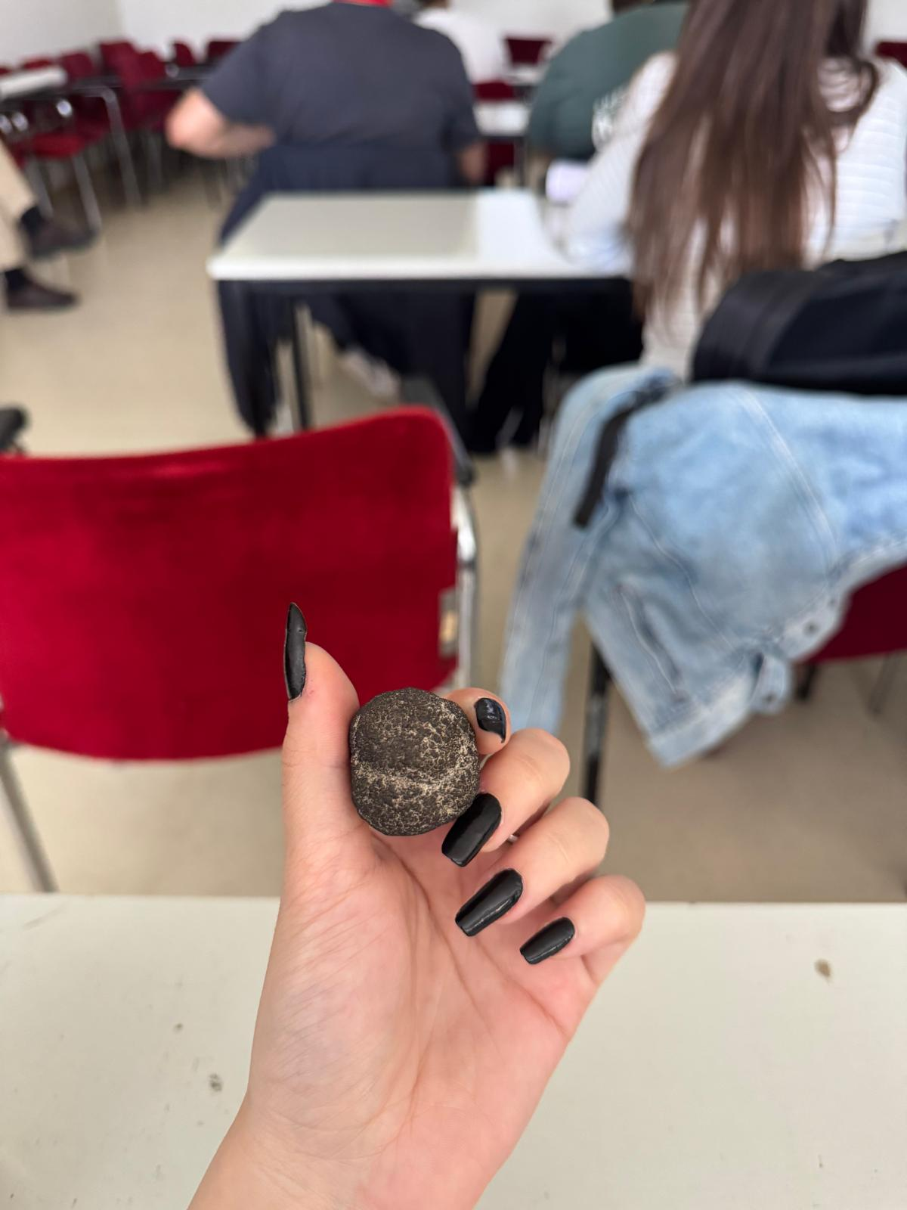
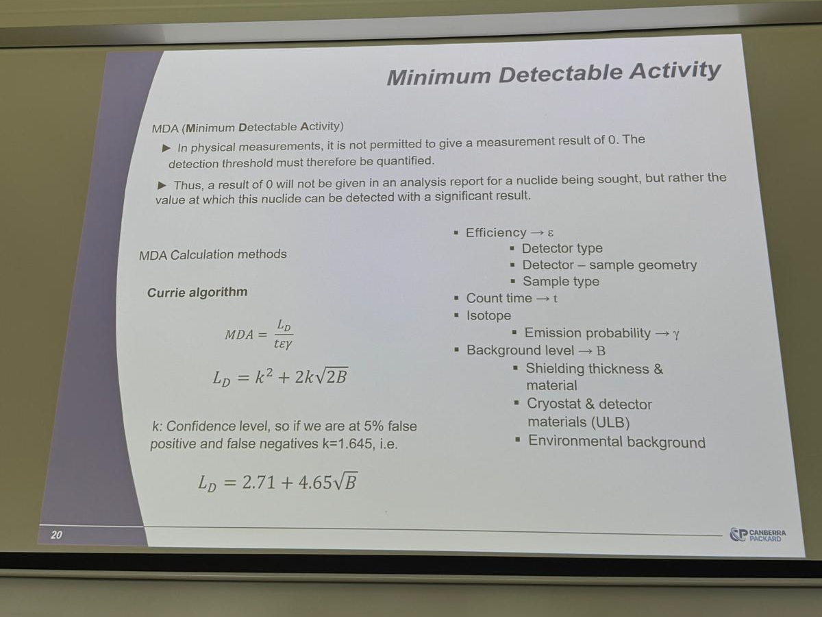
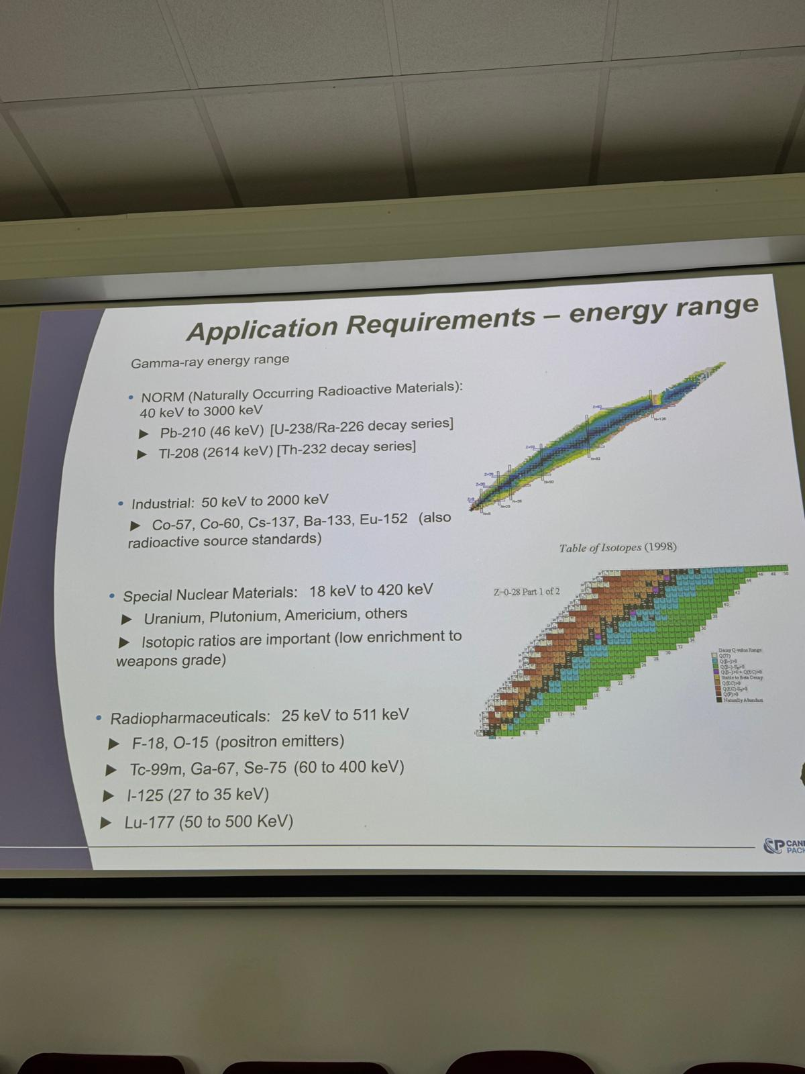
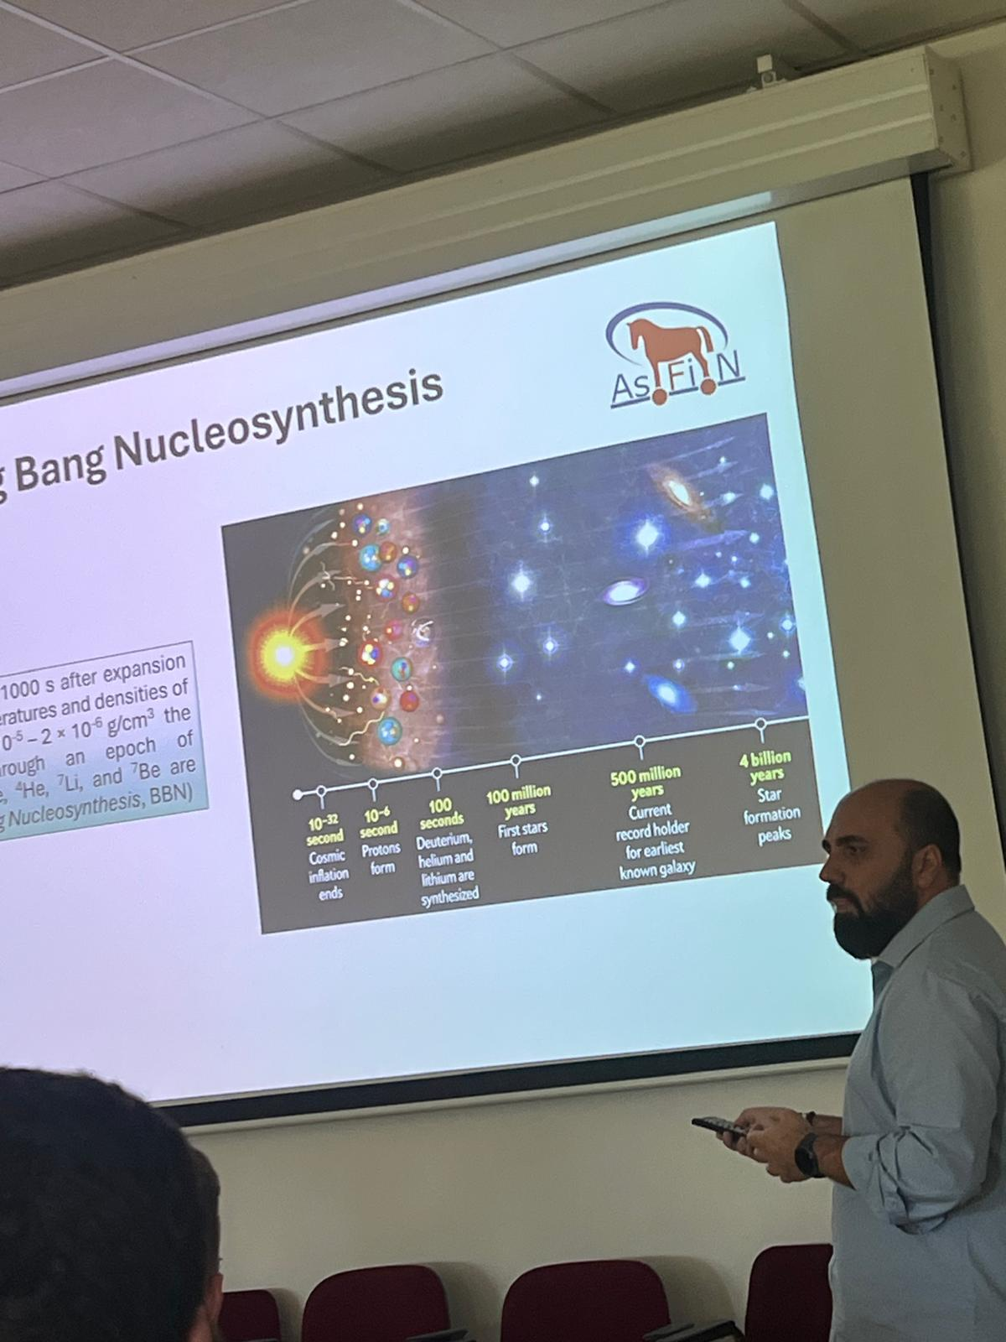
Some presentations

Slide 11
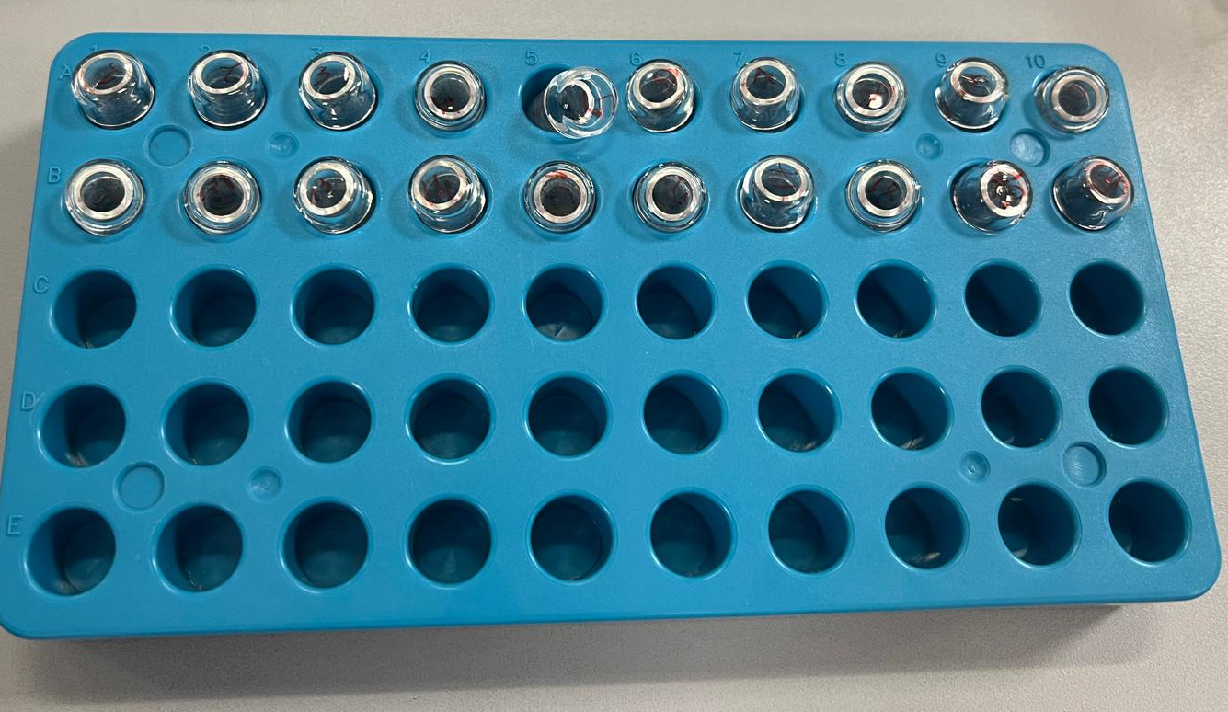
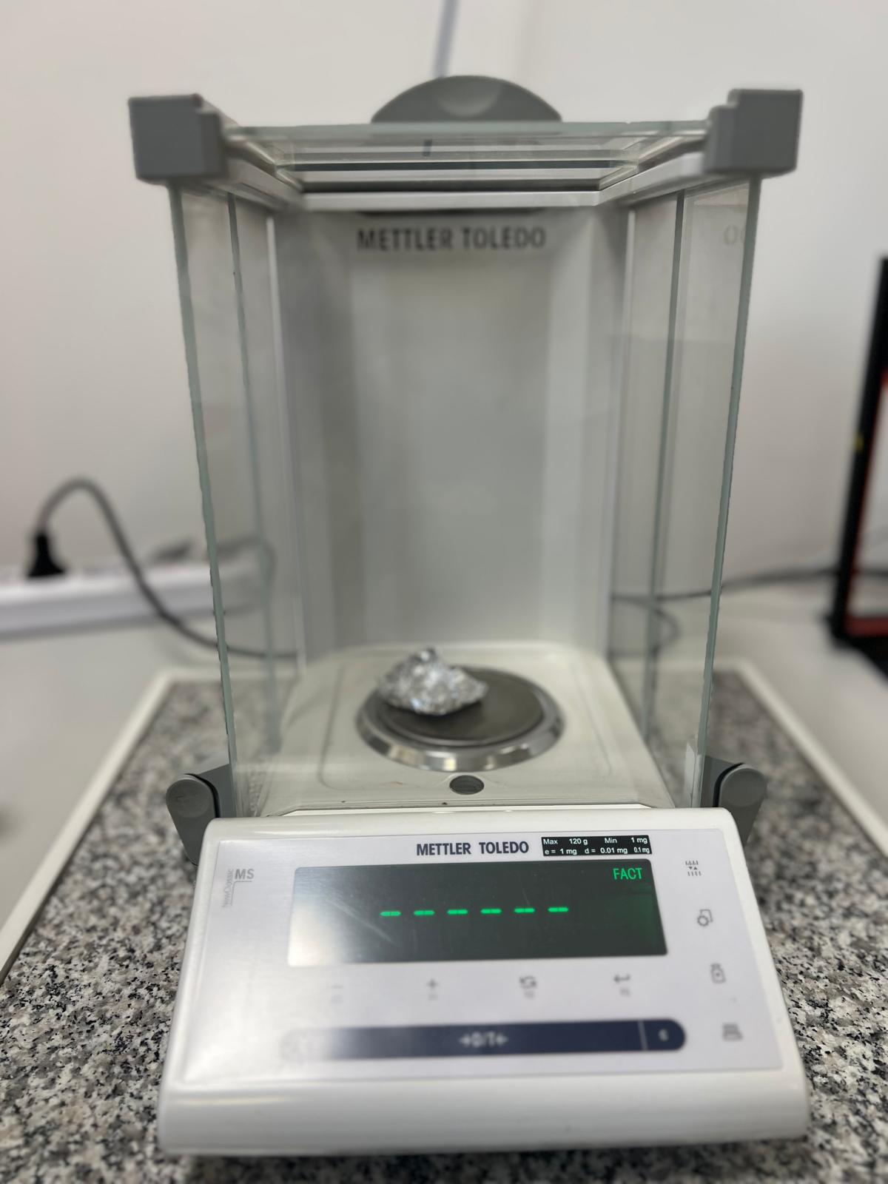
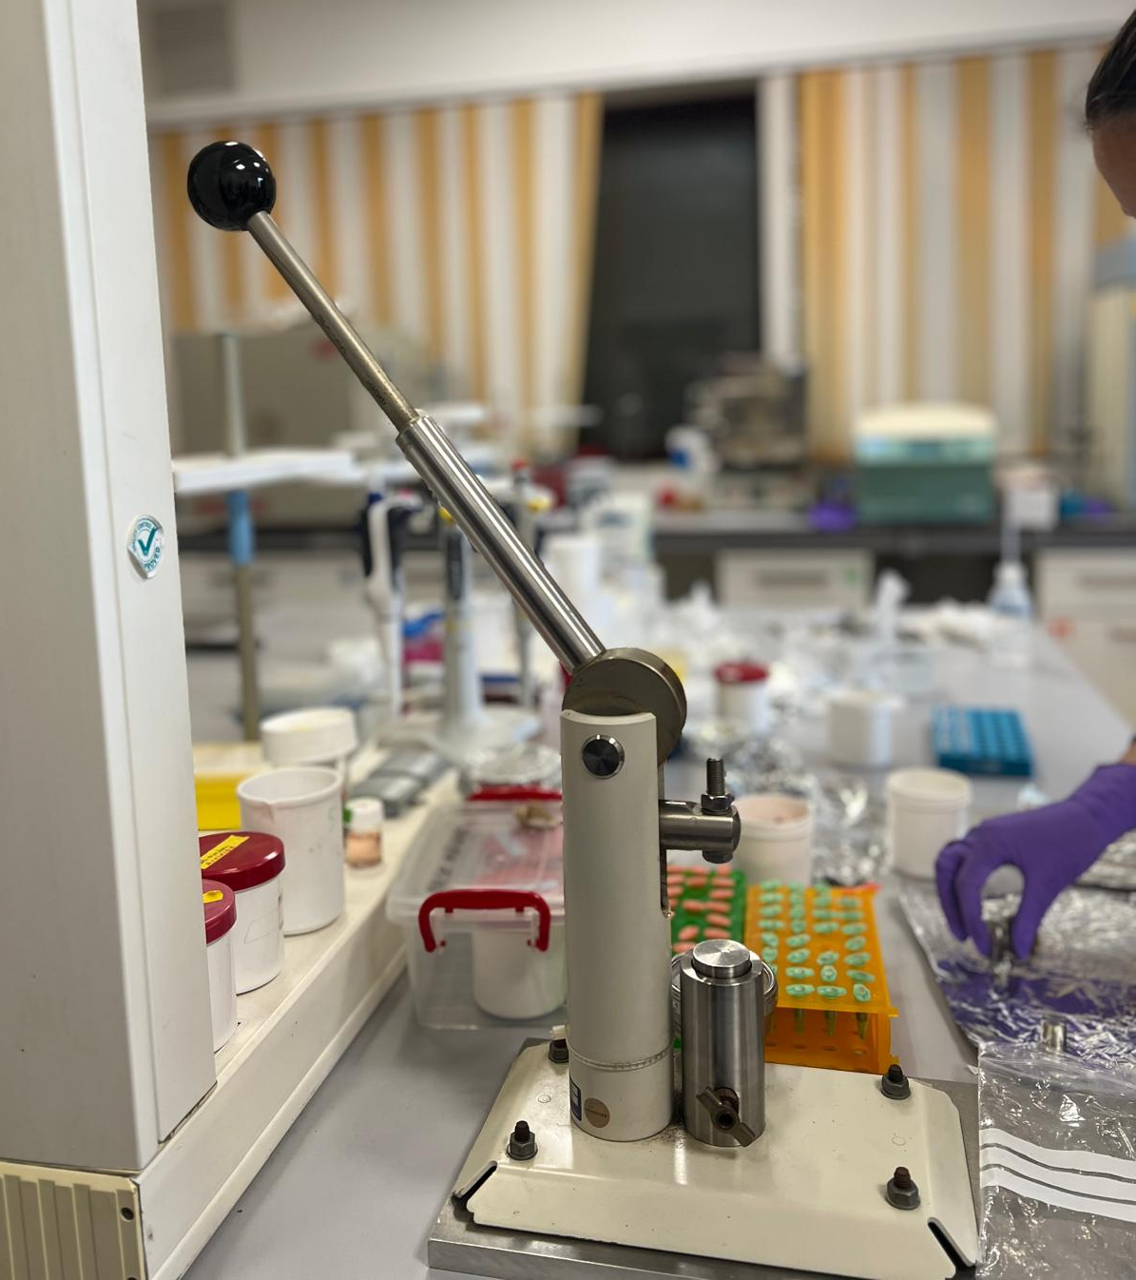
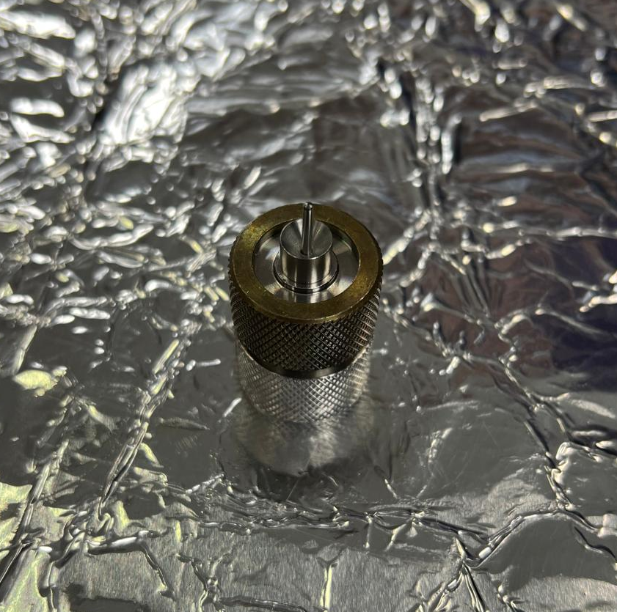
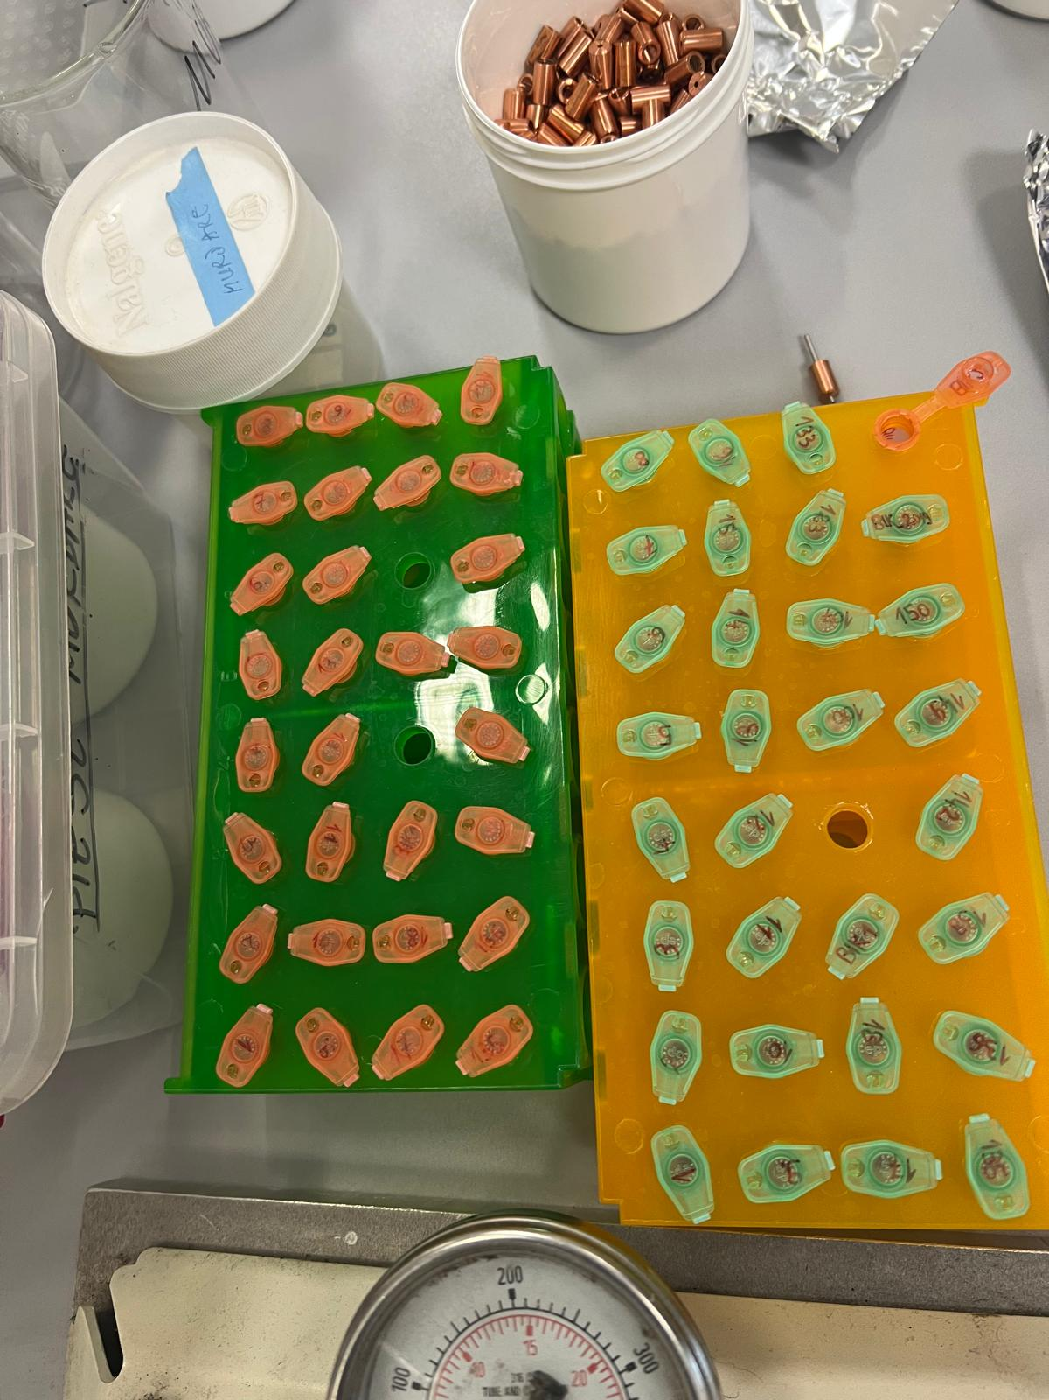
Sample preparation
Samples
Materials

Slide 12
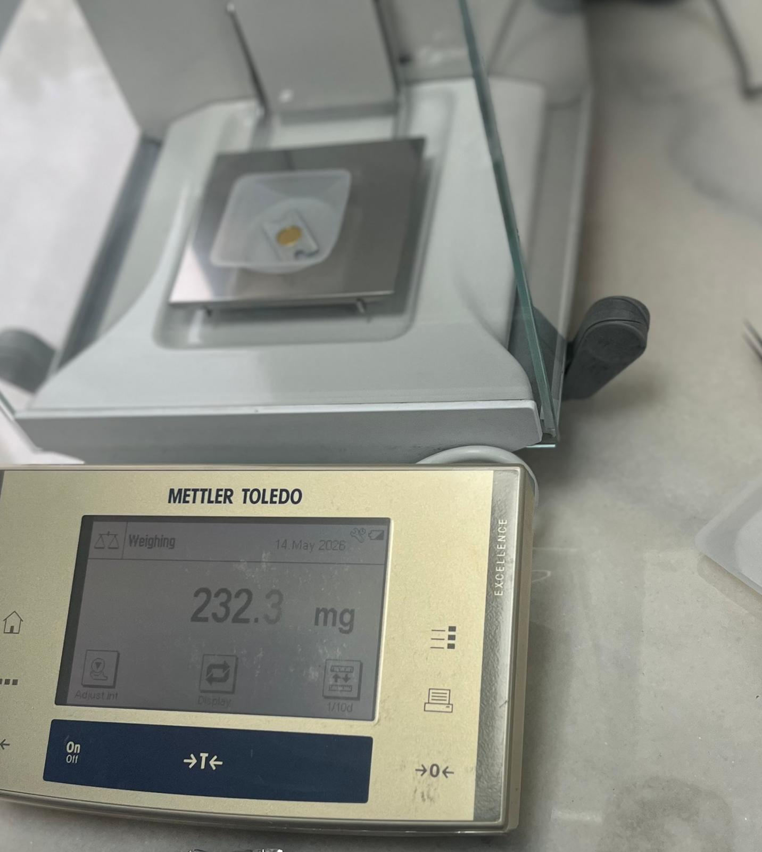
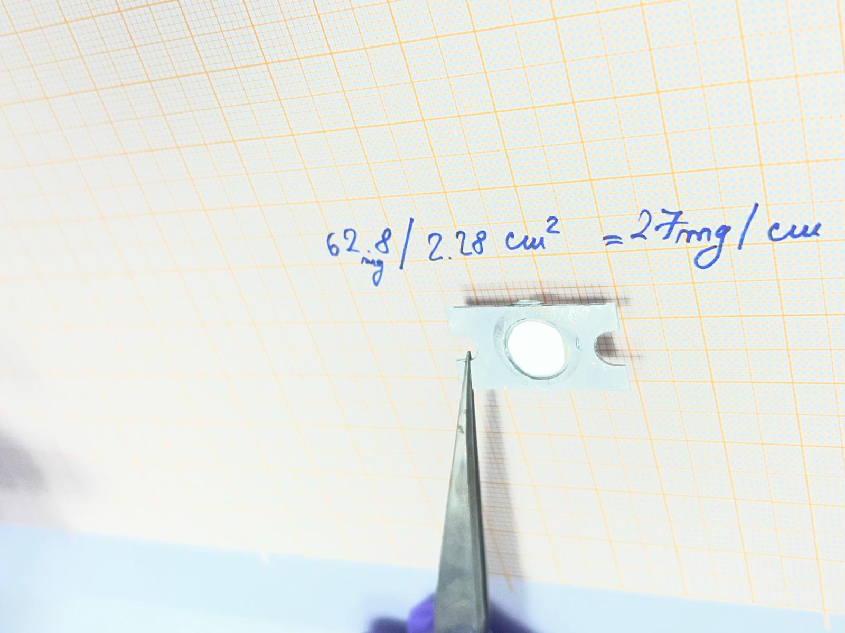
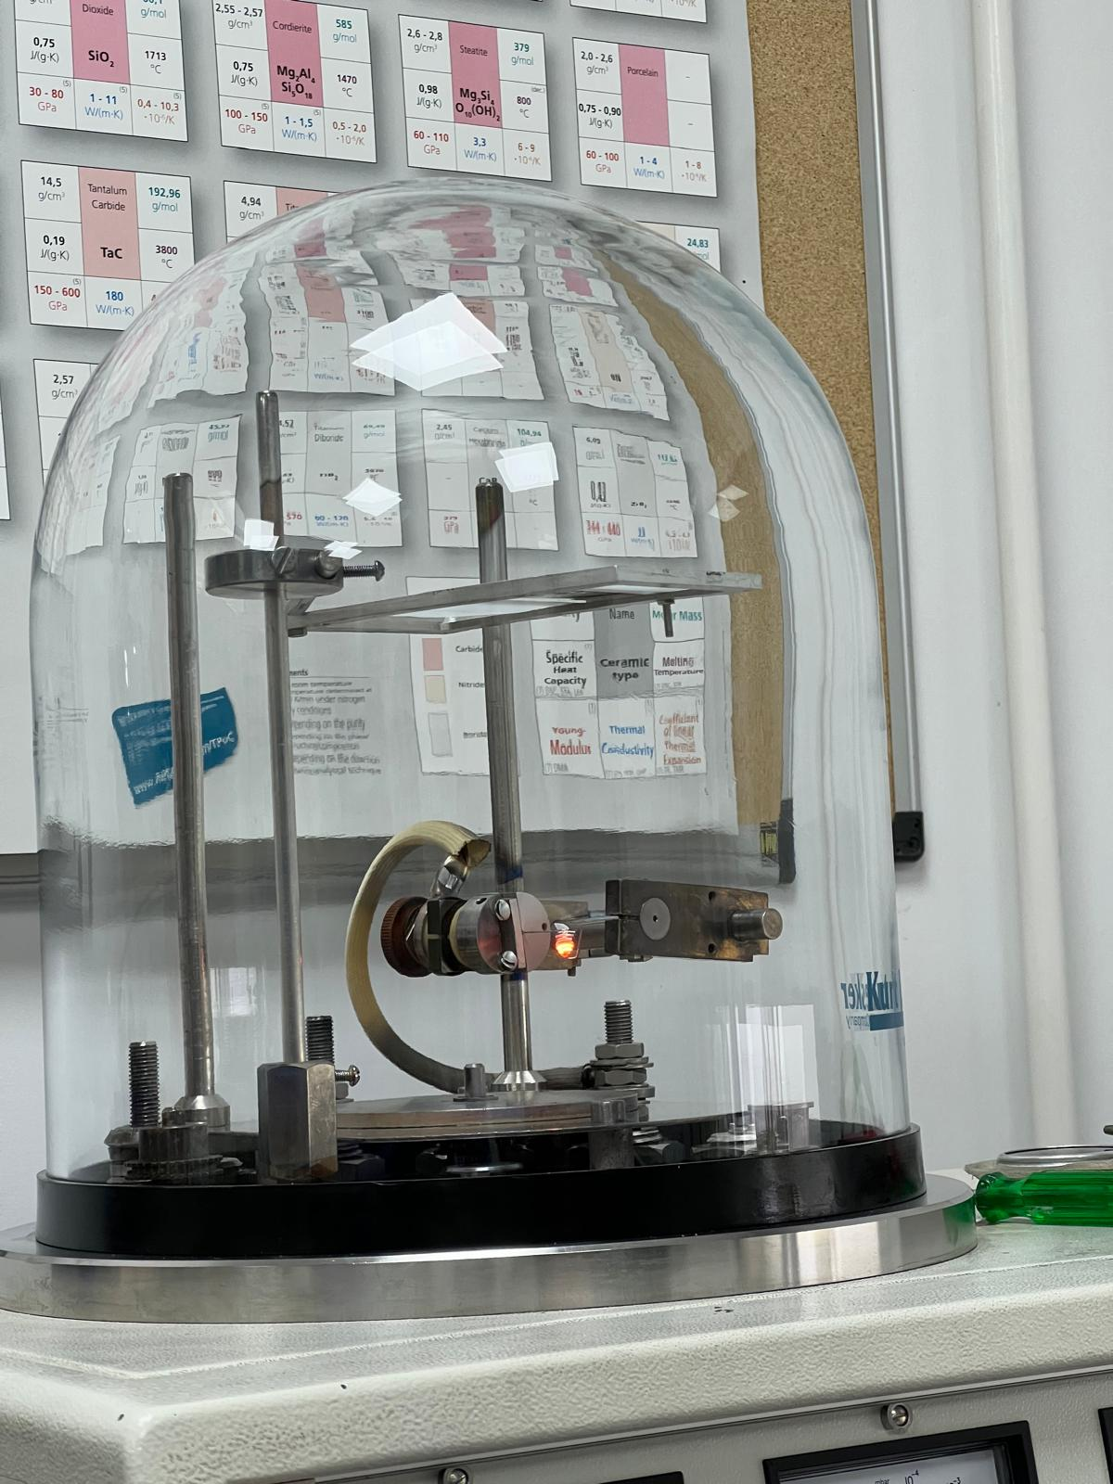
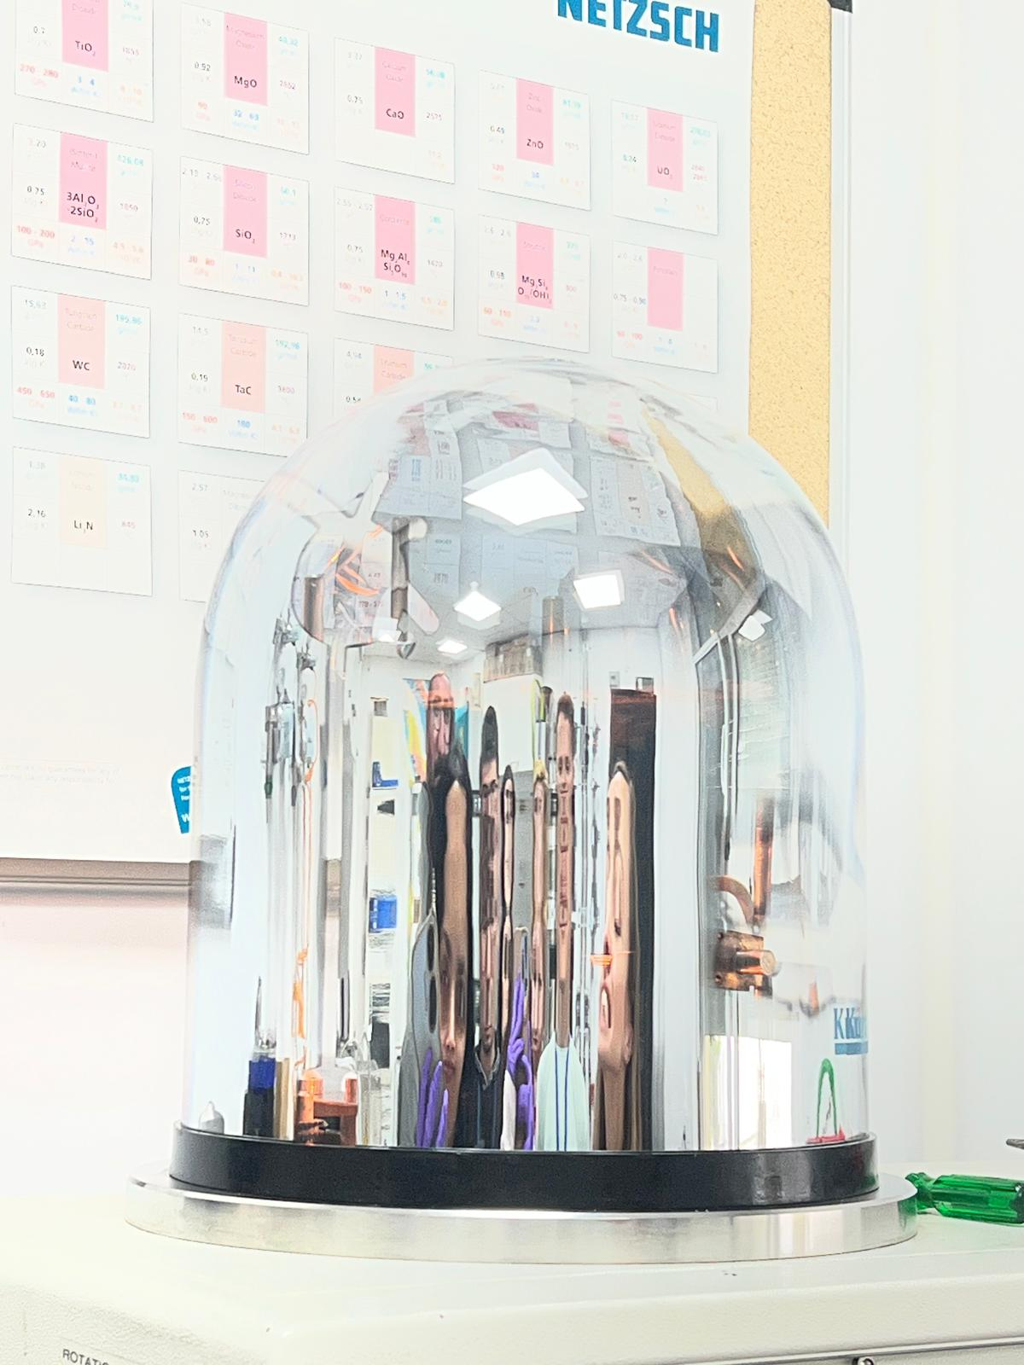
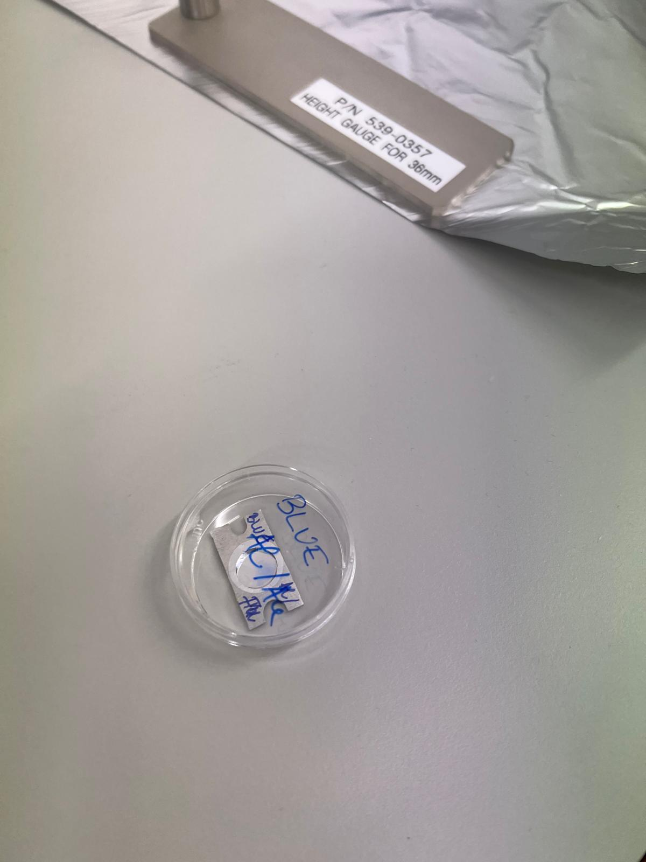
Target Preparation
1
Manufacturing techniques
5
Cold rolling
Resistive Evaporation
2
3
4

Slide 13
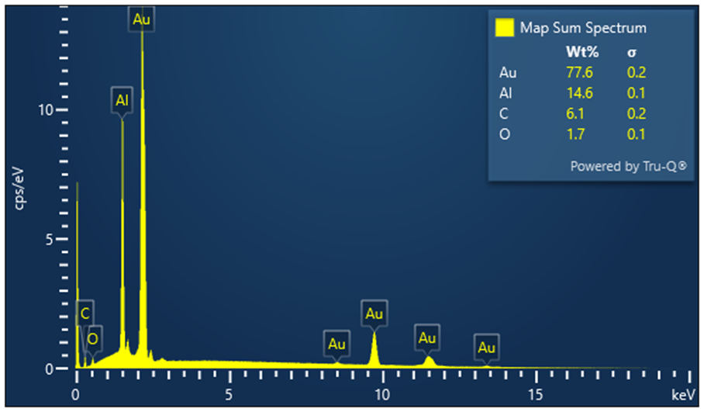
Target Quality Assurance
Scanning electron microscopy
Surface uniformity
Target contamination

Slide 14
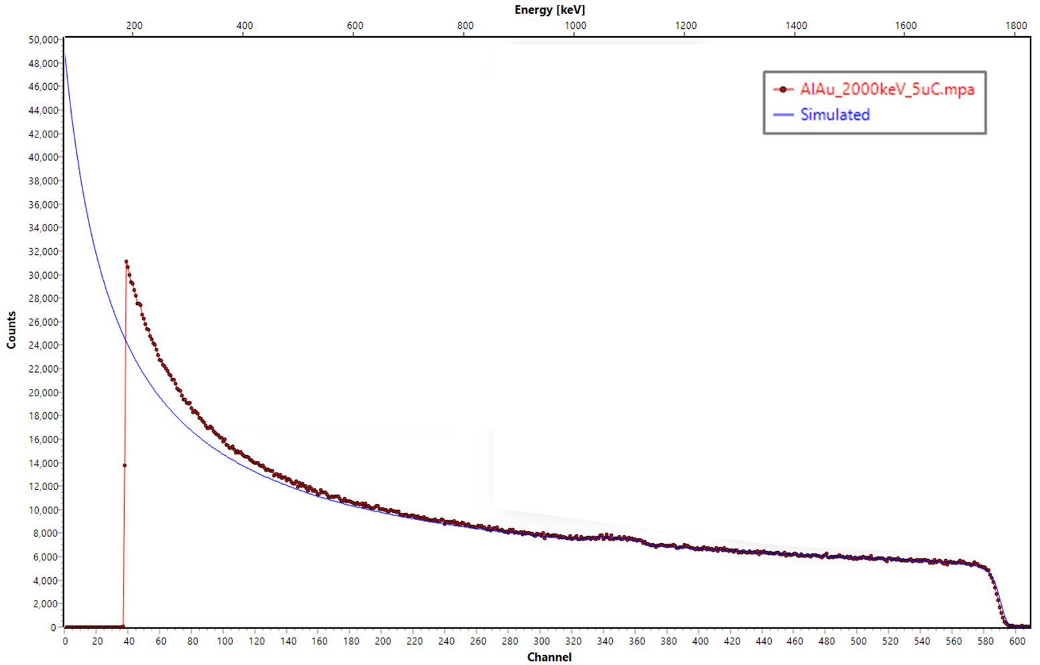
Target Quality Assurance
Rutherford's backscattering spectrometry
Technique pioneered in Manchester!
Target thickness of 1025 ± 25 TFU

Slide 15
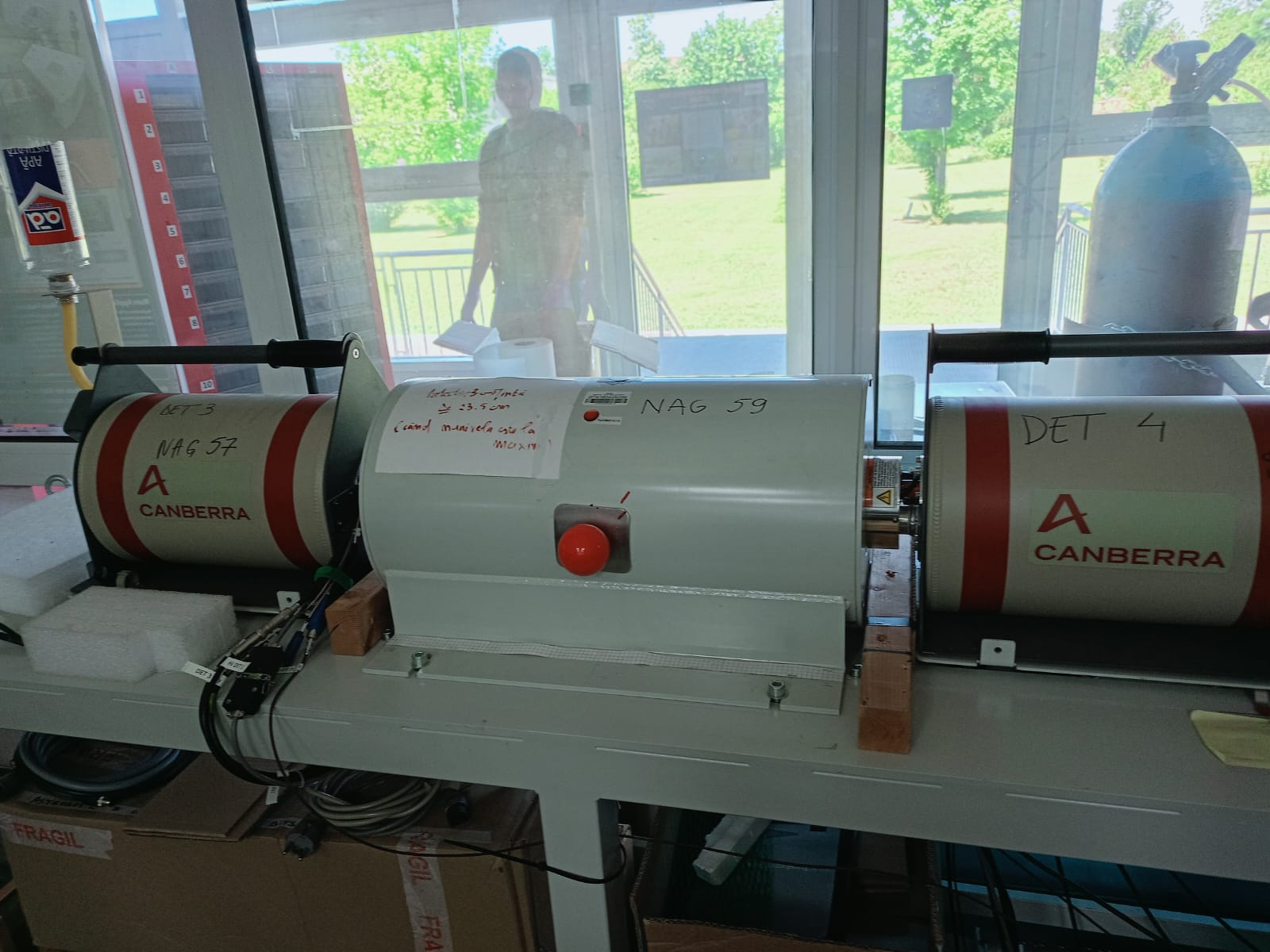
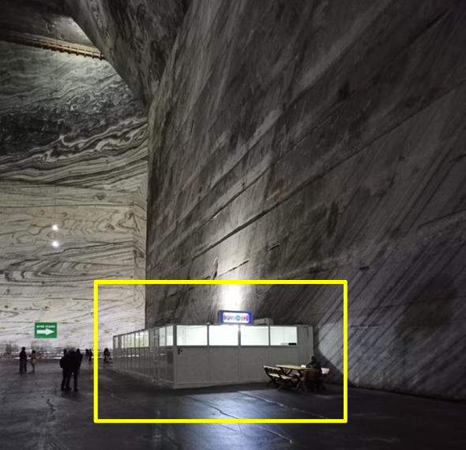
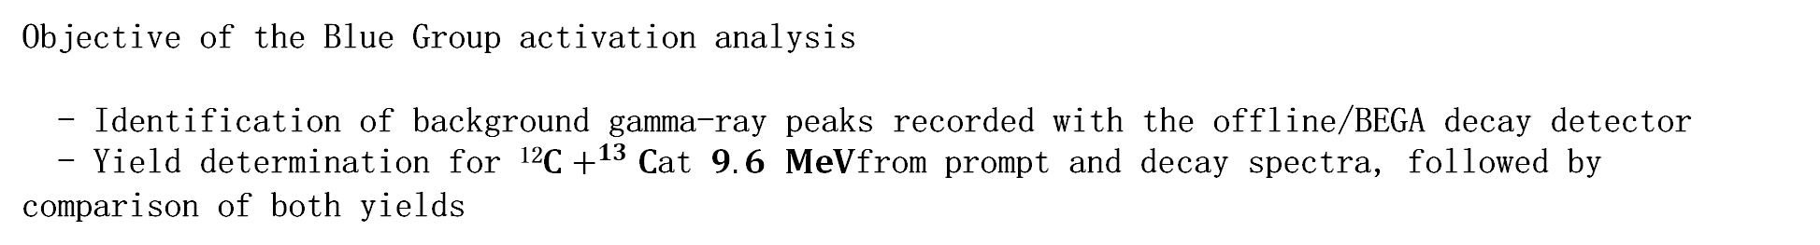
Activation experiment and background analysis at 3 MV Tandetron
Objective of the Blue Group activation analysis
- Identification of background gamma-ray peaks recorded with the offline/BEGA decay detector
- Yield determination for ¹²$C+^{13}C$at $9.6 MeV$from prompt and decay spectra, followed by comparison of both yields
Beam: ¹³C @ 9.6MeV
Target: ¹²C
Charge state: 3⁺
Irradiation time: ≈ 30min
BEGA
µBq Lab(Slanic salt mine)

Slide 16

Background spectrum recorded with BEGA
Main observations
• Several natural background peaks are visible in the BEGA spectrum.
• The spectrum is dominated by natural environmental background from ⁴⁰$K$, ²³⁸U and ²³²Th decay-chain daughters, and the 511 keV annihilation peak.

Slide 17
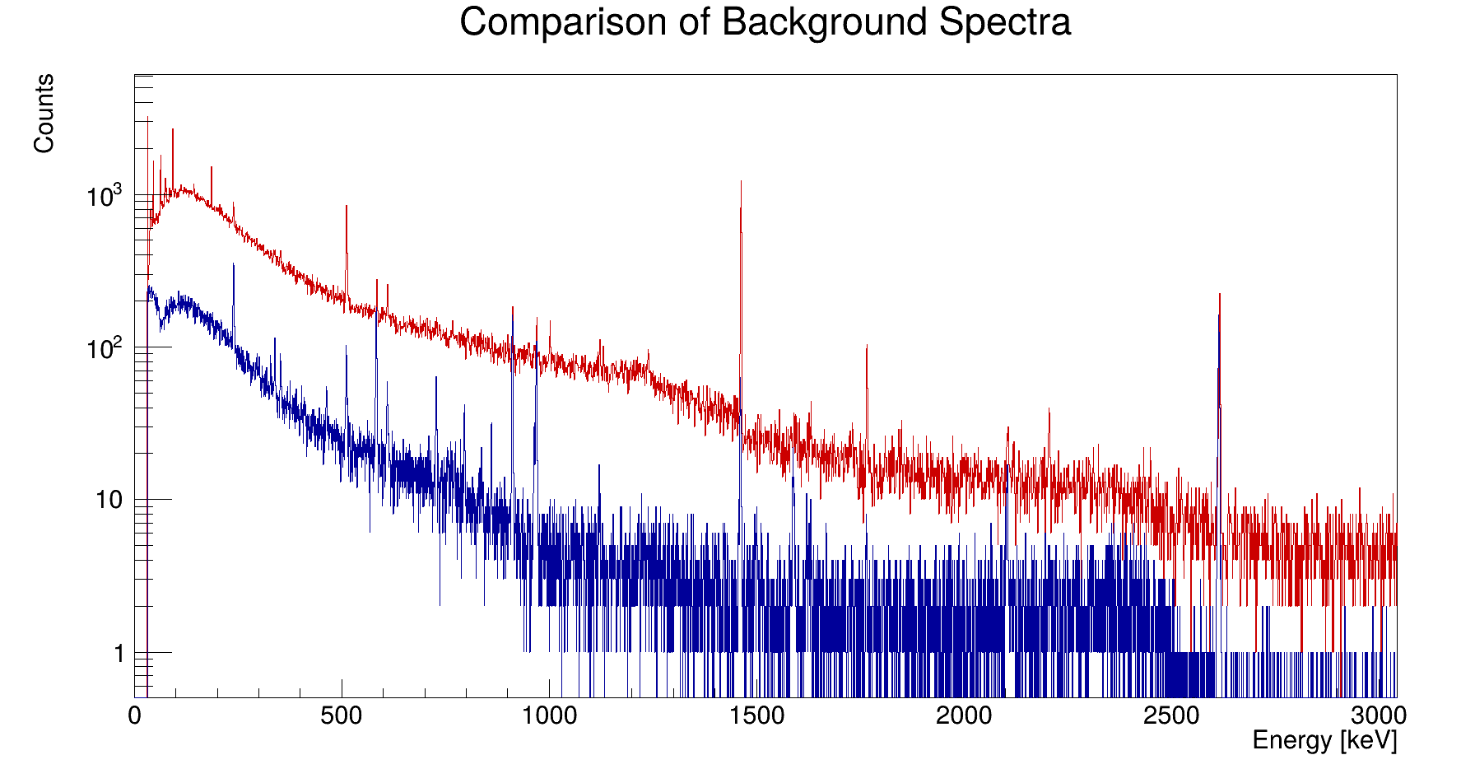
Above ground and underground comparison
Top is above ground and bottom is underground.
The natural radioactivity is reduced for measurements in the underground laboratory (bottom spectrum).
Calibration for underground:
E = 0.8976 + 0.5318Ch

Slide 18
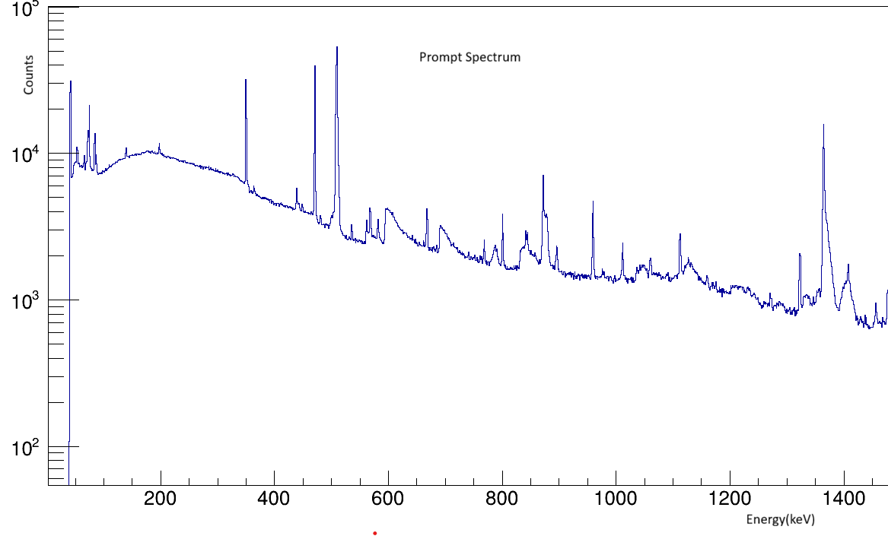
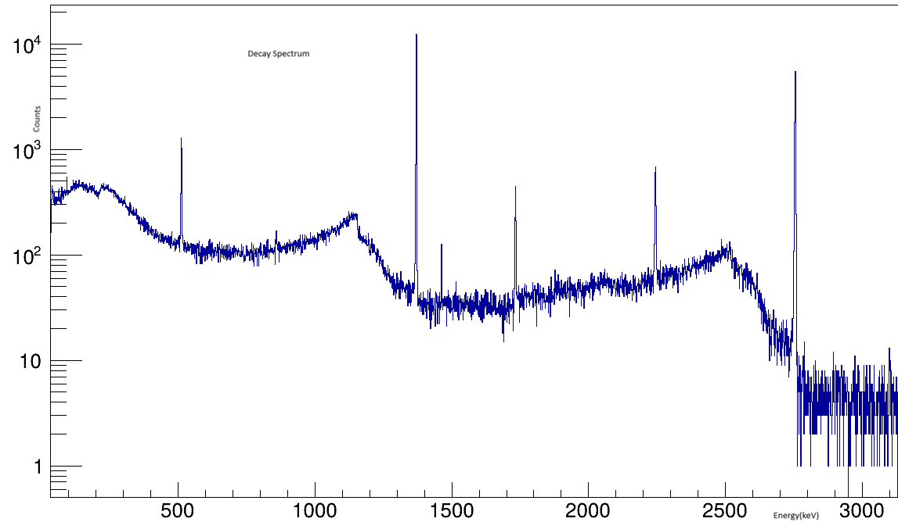
3MV Yield Measurement​ 12C-13C
v
Prompt Spectrum
Decay Spectrum

Slide 19
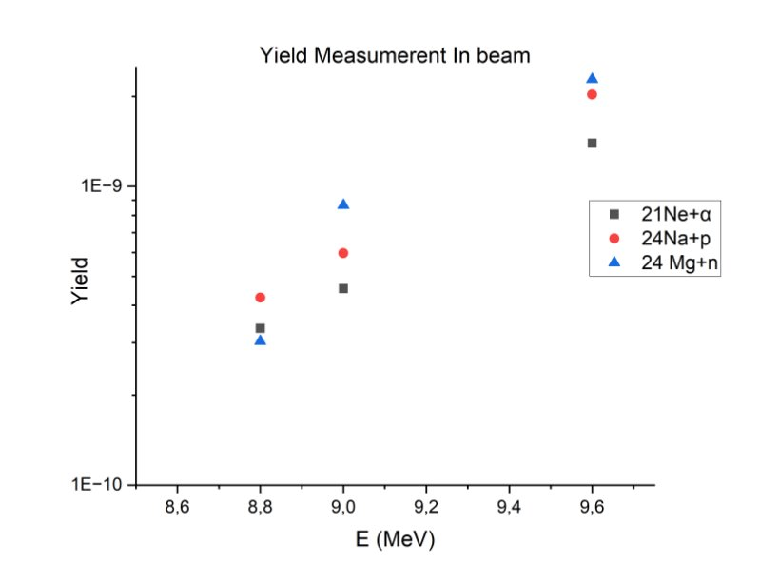
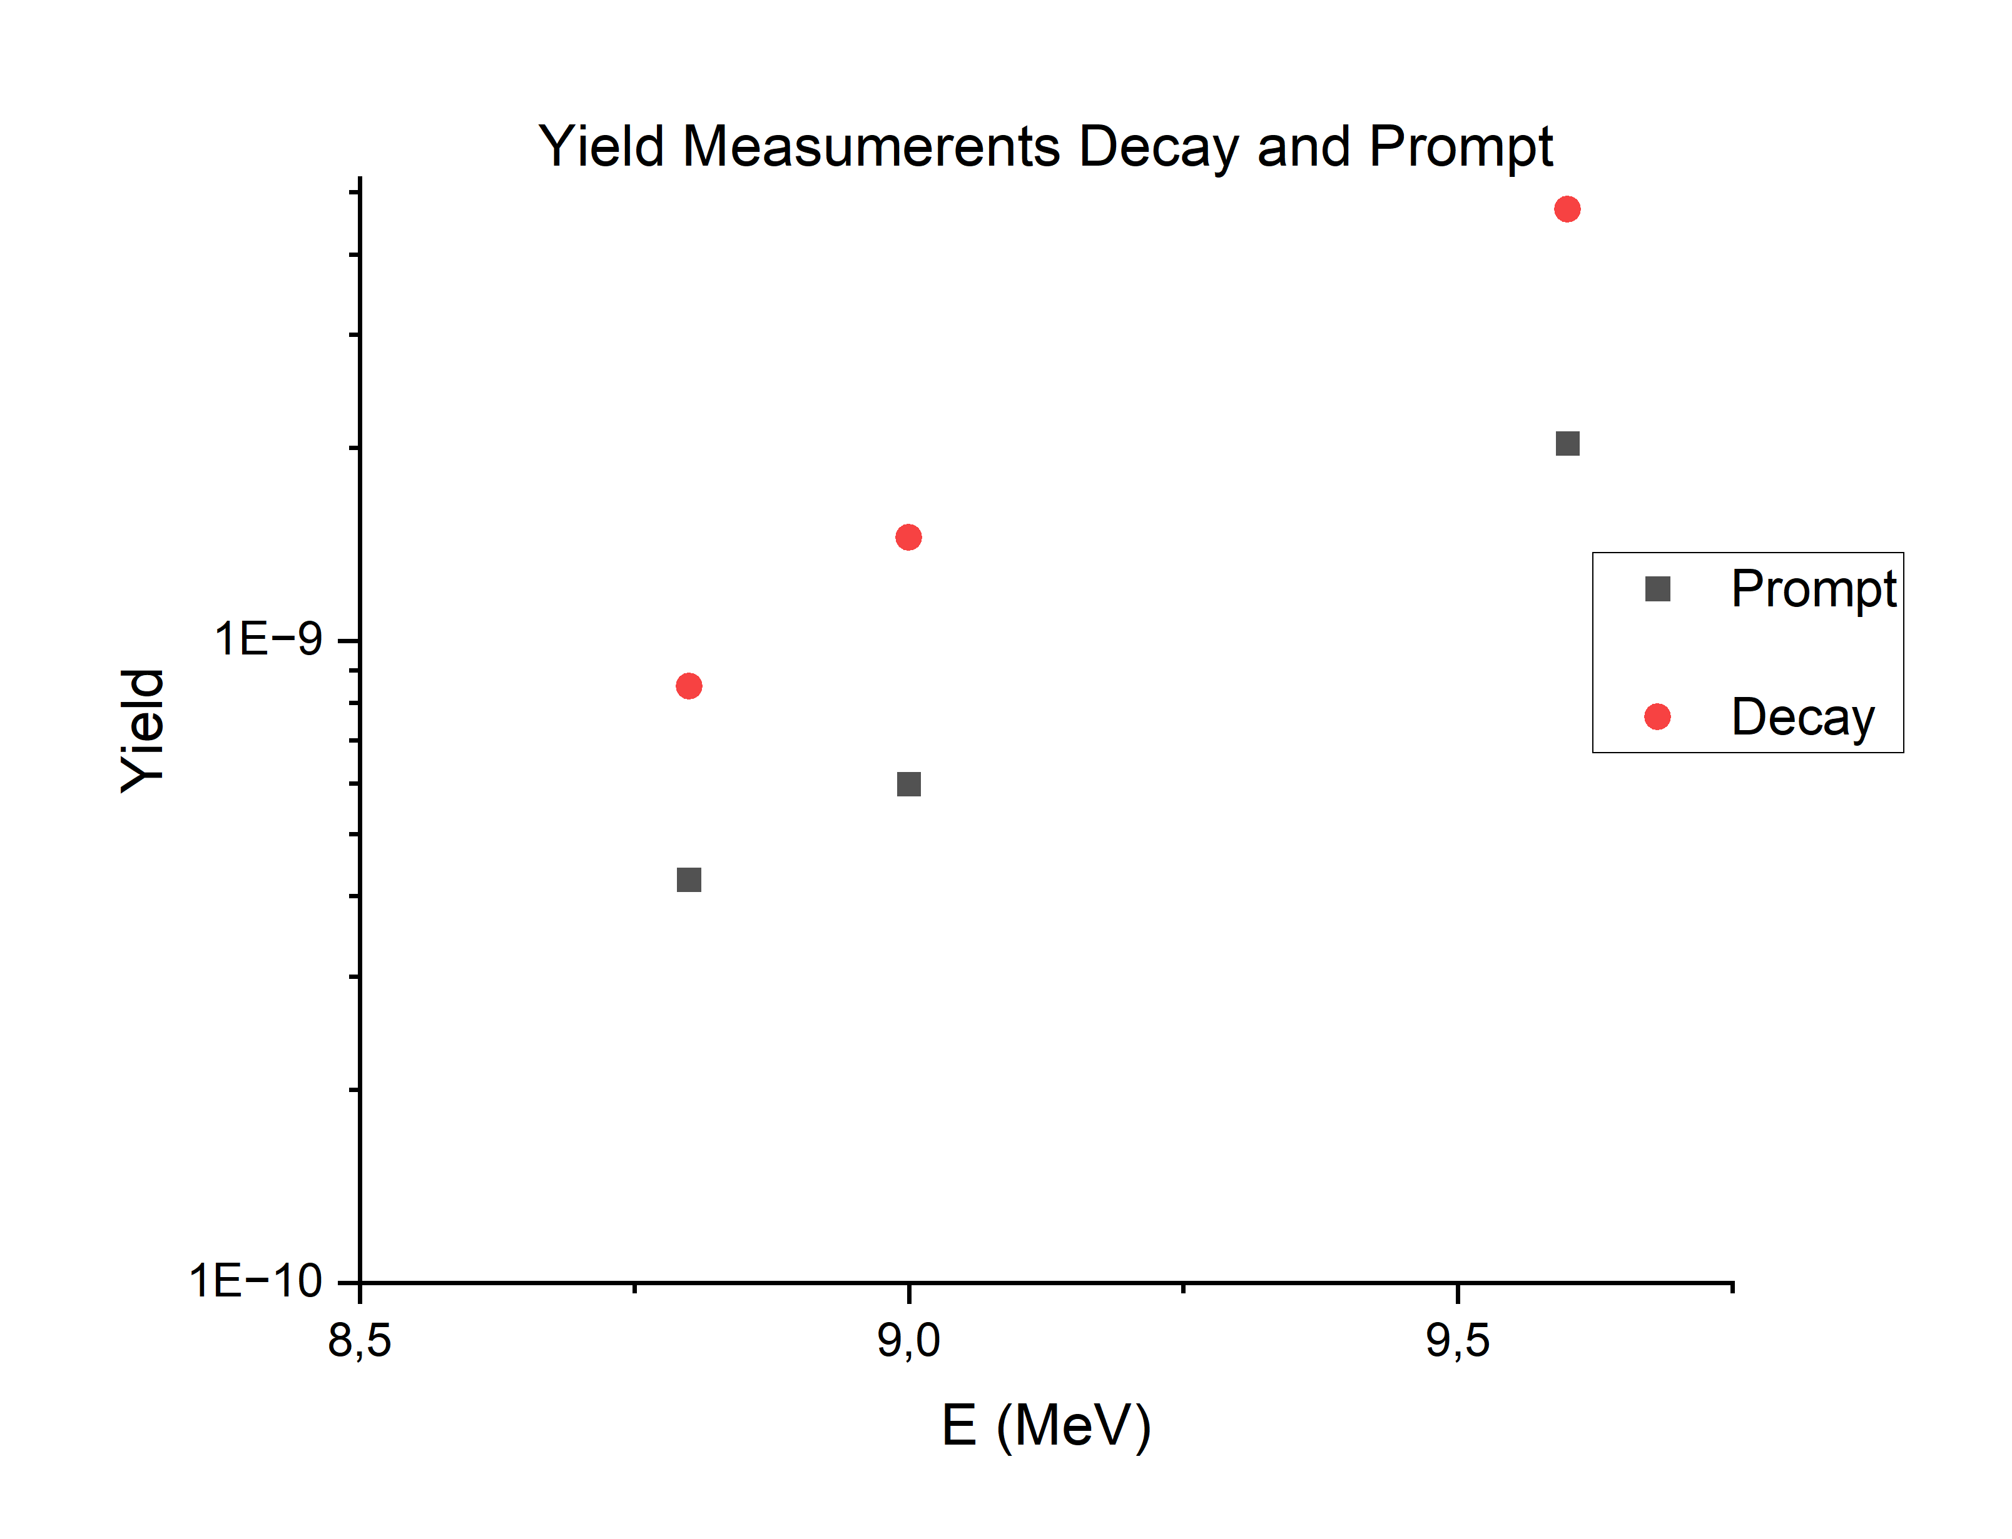
3MV Yield Measurement​12C-13C

Slide 20
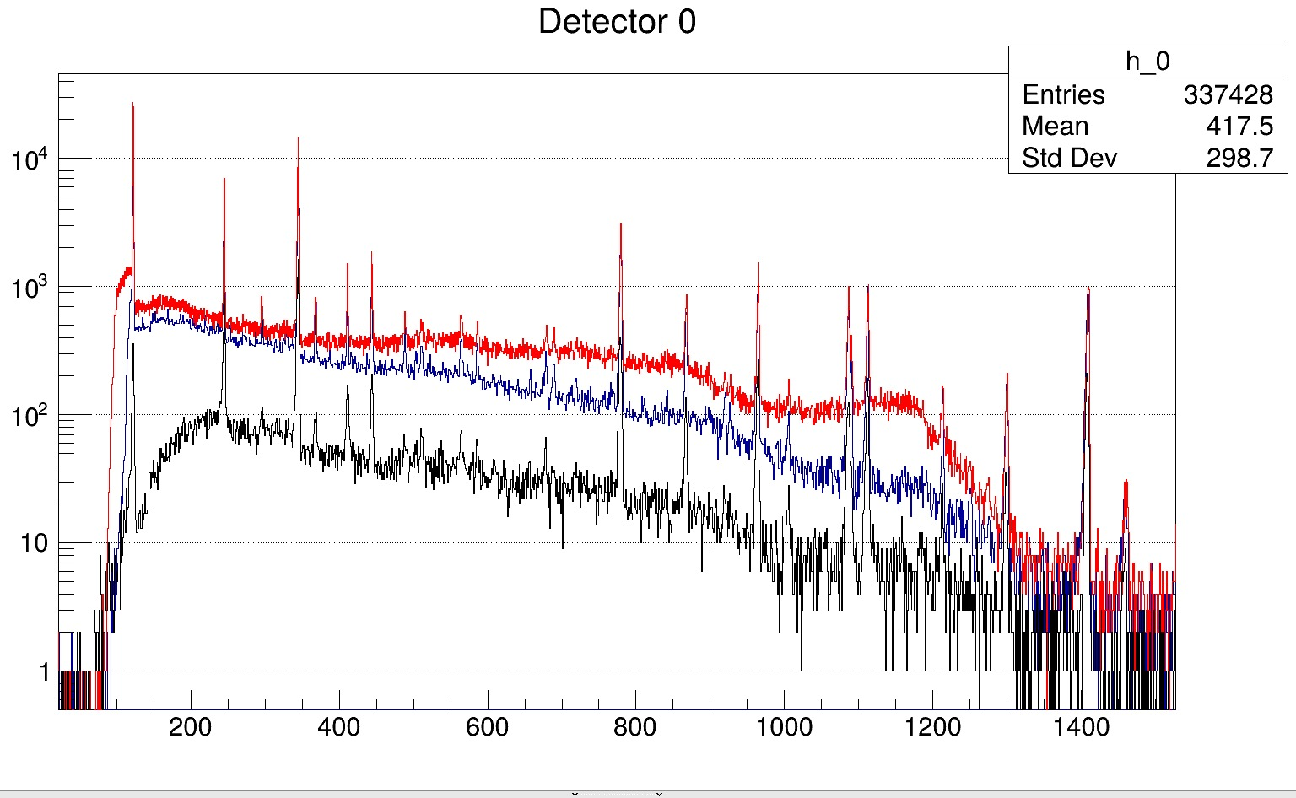
9MV Experiment
⁴He + ¹⁰⁸Cd ➡ ¹¹²Sn*
Beam Energy: 24MeV
Beam Current: 1.5nA
¹⁵²Eu is used for calibration.
The energy calibration for
each detector was fitted
using the quadratic relation:
Eγ = a Ch² + b Ch + c
where Ch is the channel numb
-er and Eγ is the calibrated
gamma-ray energy in keV.

Slide 21
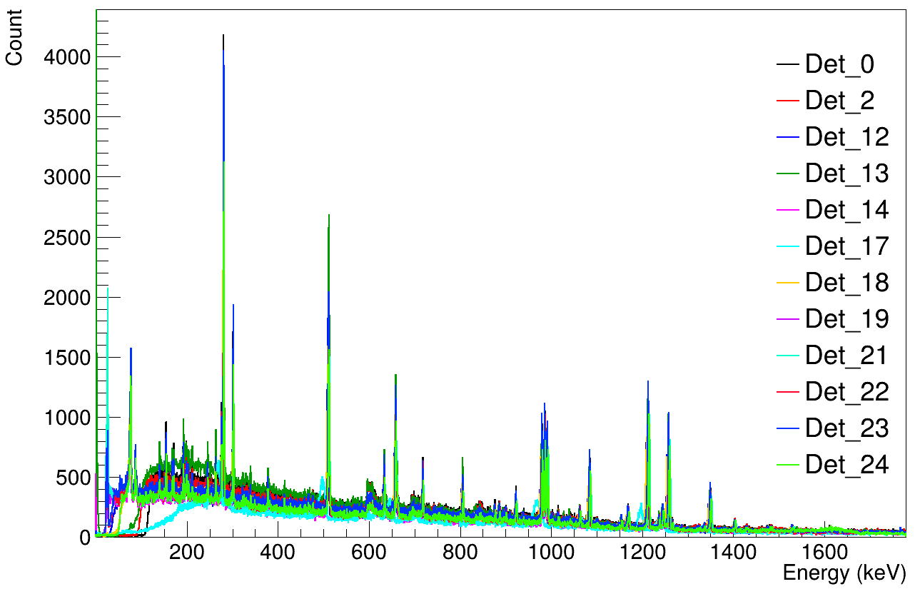
9MV Experiment
⁴He + ¹⁰⁸Cd ➡ ¹¹²Sn*
Beam Energy: 24MeV
Beam Current: 1.5nA
¹⁵²Eu is used for calibration.
The energy calibration for
each detector was fitted
Using the quadratic relation:
Eγ = a Ch² + b Ch + c
where Ch is the channel numb
-er and Eγ is the calibrated
gamma-ray energy in keV.

Slide 22

Conti..
Detector | a | b | c
0 | -2.44E-08 | 0.197655 | 0.193614
2 | -2.53E-08 | 0.182096 | 0.211962
4 | -2.44E-08 | 0.197655 | 0.193614
10 | -3.46E-08 | 0.197837 | 0.106803
12 | -4.72E-08 | 0.193704 | -0.12427
13 | 1.45E-07 | 0.449258 | 0.2779
14 | -2.42E-08 | 0.171554 | 0.104743
17 | -6.46E-10 | 0.150806 | -48.2009
18 | -3.88E-08 | 0.195091 | 0.07031
19 | -2.19E-08 | 0.194128 | 0.099186
20 | 2.09E-09 | 0.196685 | 0.255466
21 | -2.58E-08 | 0.149106 | -0.00146
22 | -1.49E-08 | 0.152863 | 0.14157
23 | -3.15E-09 | 0.192228 | 0.180371
24 | -1.19E-08 | 0.150242 | 0.260446

Slide 23

Conti..
Calibration residuals measure the difference between the known gamma-ray energy and the calibrated energy obtained from each detector channel.
They show individual errors by calculating measured values minus true values.
A perfect calibration has residuals slightly scattered near zero.
In HPGe calibration, they verify precise energy and efficiency curves.
They help detect electronic system drifts and coincidence summing problems.
For 2D detector matrices, residuals quickly expose unaligned channels.

Slide 24





Thank You

Slide 26

Backup

