Slide 1

EURO-LABS
Basic Training School 2026
11-23 May 2026, Bucharest-Măgurele, Romania
Green Group Report

Slide 2
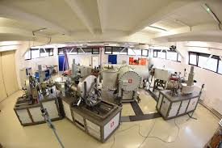

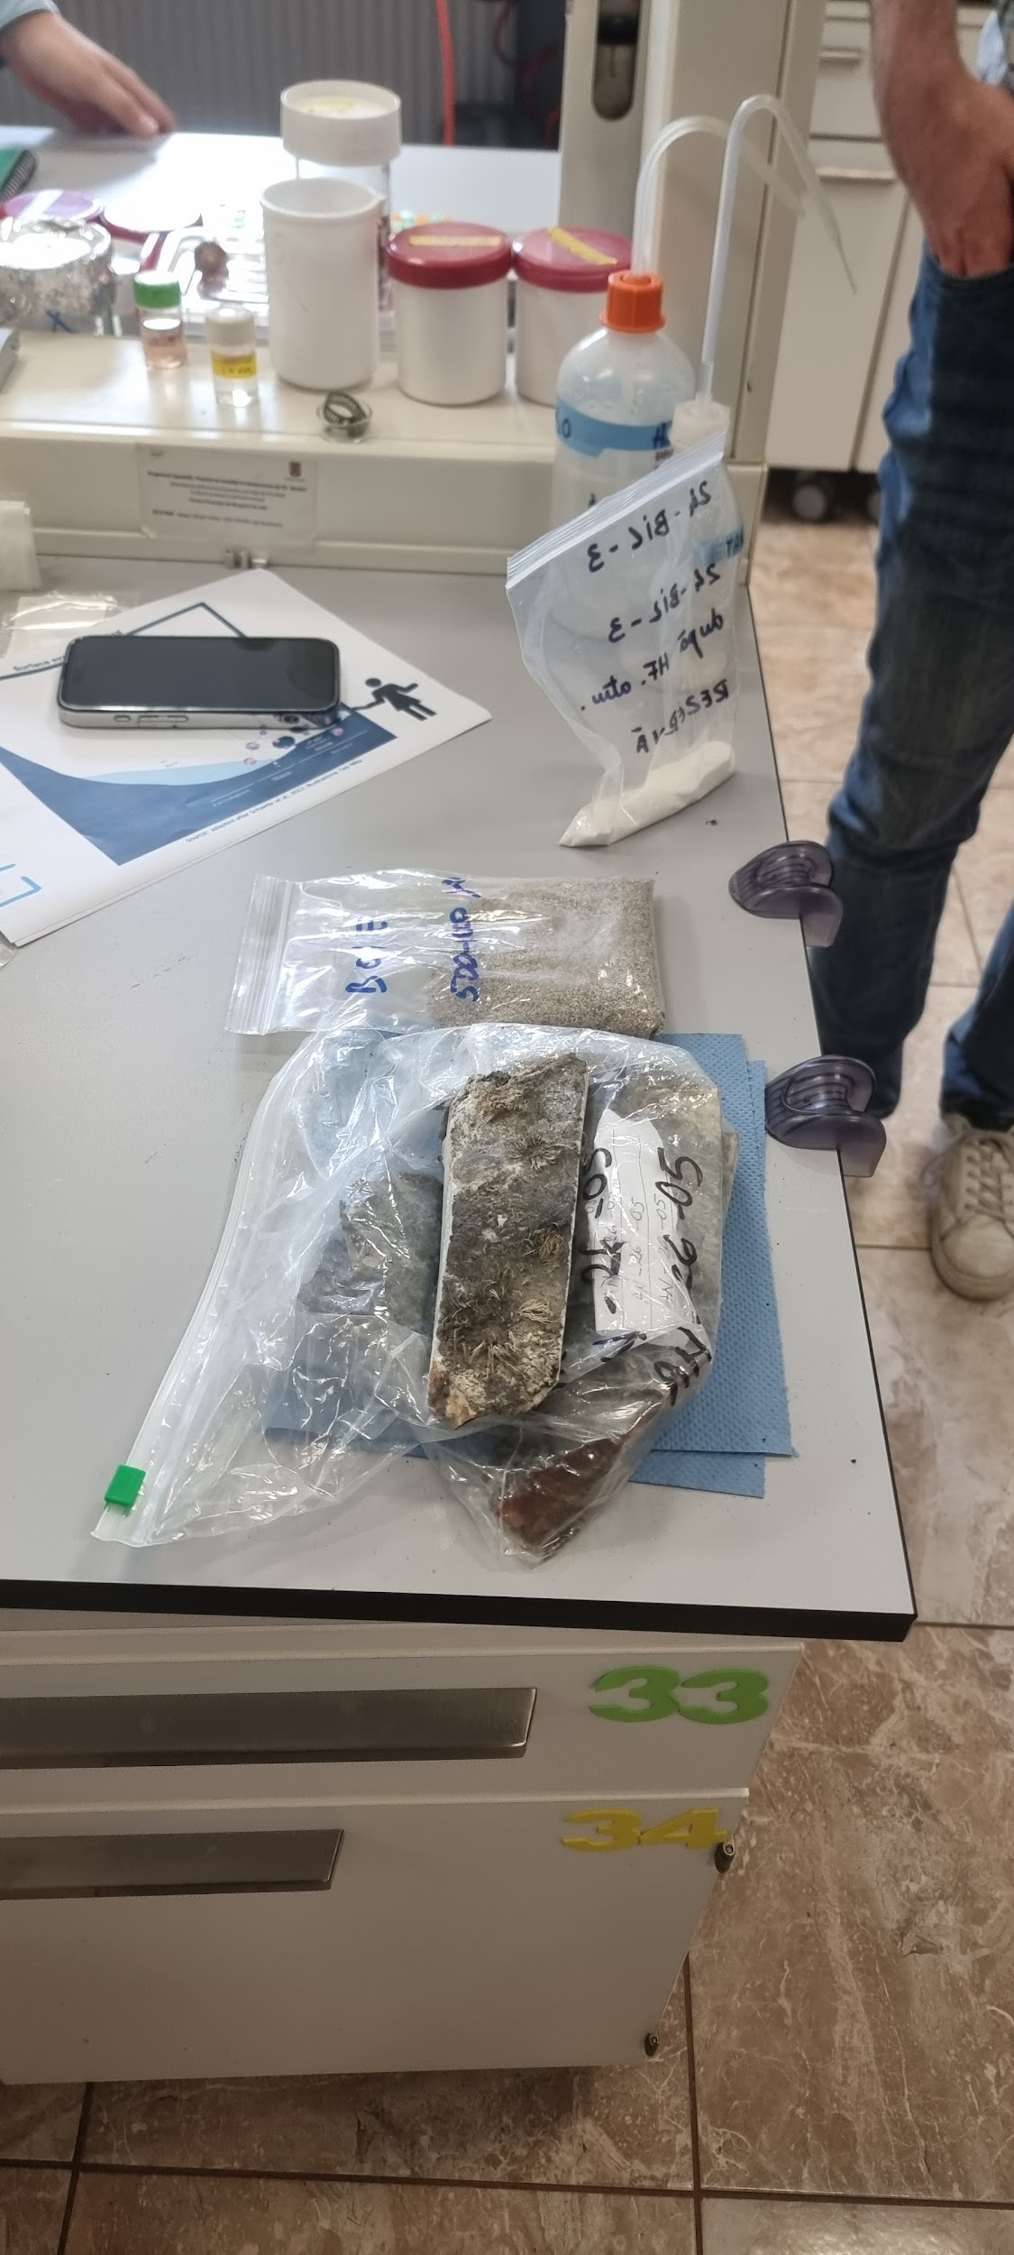

Accelerator Mass Spectroscopy
At the 1 MV accelerator

Slide 3
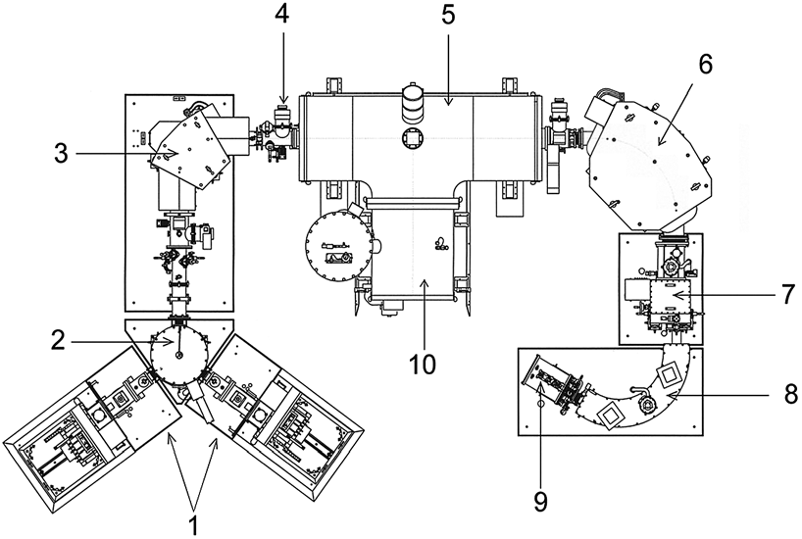
What is AMS?

Slide 4


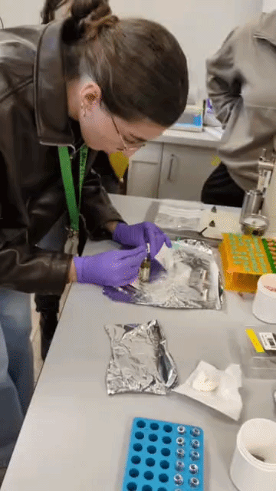
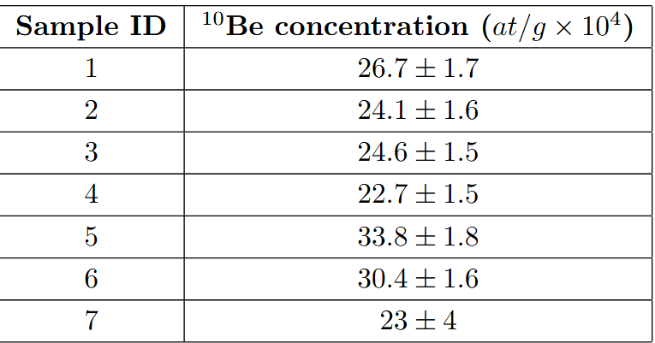
AMS for dating
Goal → Exposure Age
Field Data + 10Be nuclide concentration
10Be nuclide concentration? → AMS

Slide 5
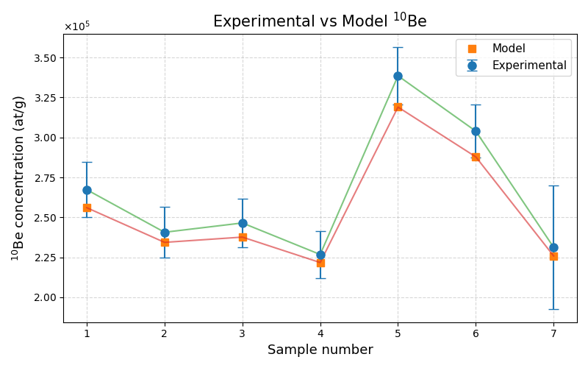
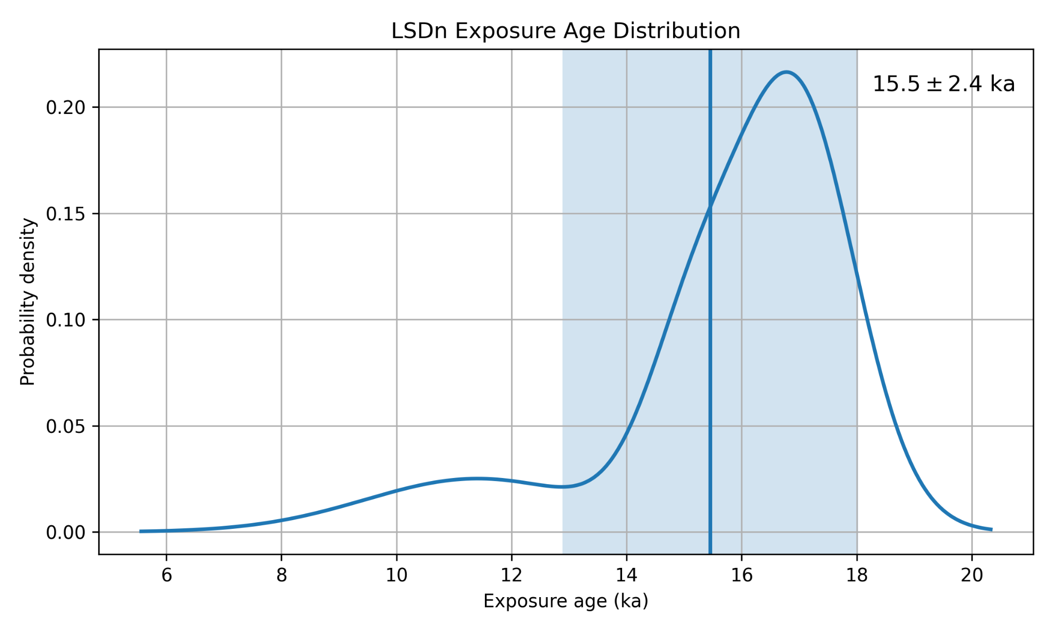
AMS for dating
The kernel density estimate (KDE) plot shows the distribution of calculated cosmogenic ¹⁰Be exposure ages for the seven analyzed samples.

Slide 6

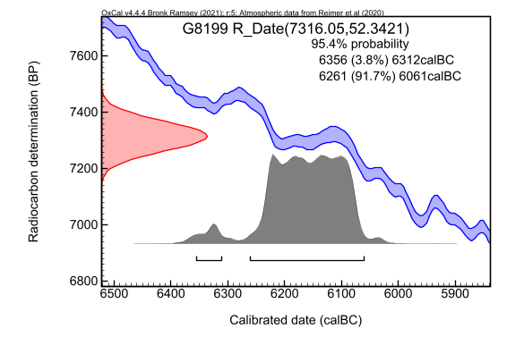
AMS for dating

Slide 7
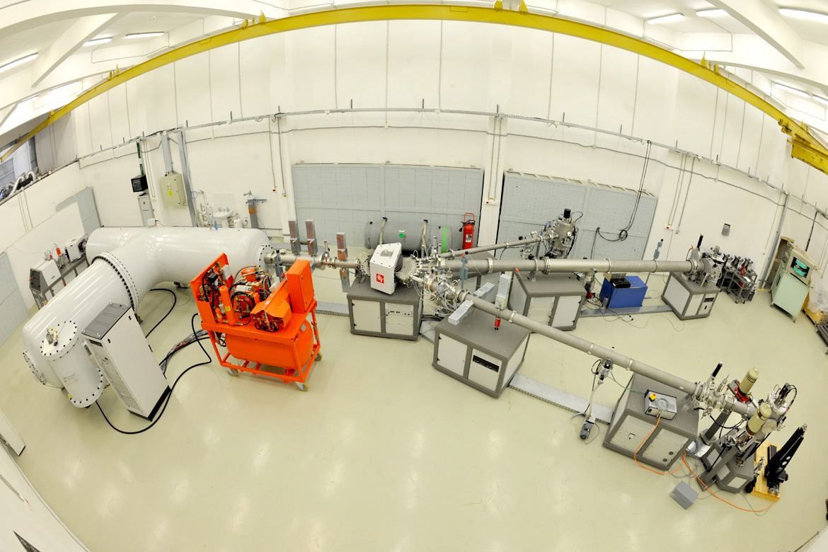
RBS @ 3MV
Aluminium target

Slide 8
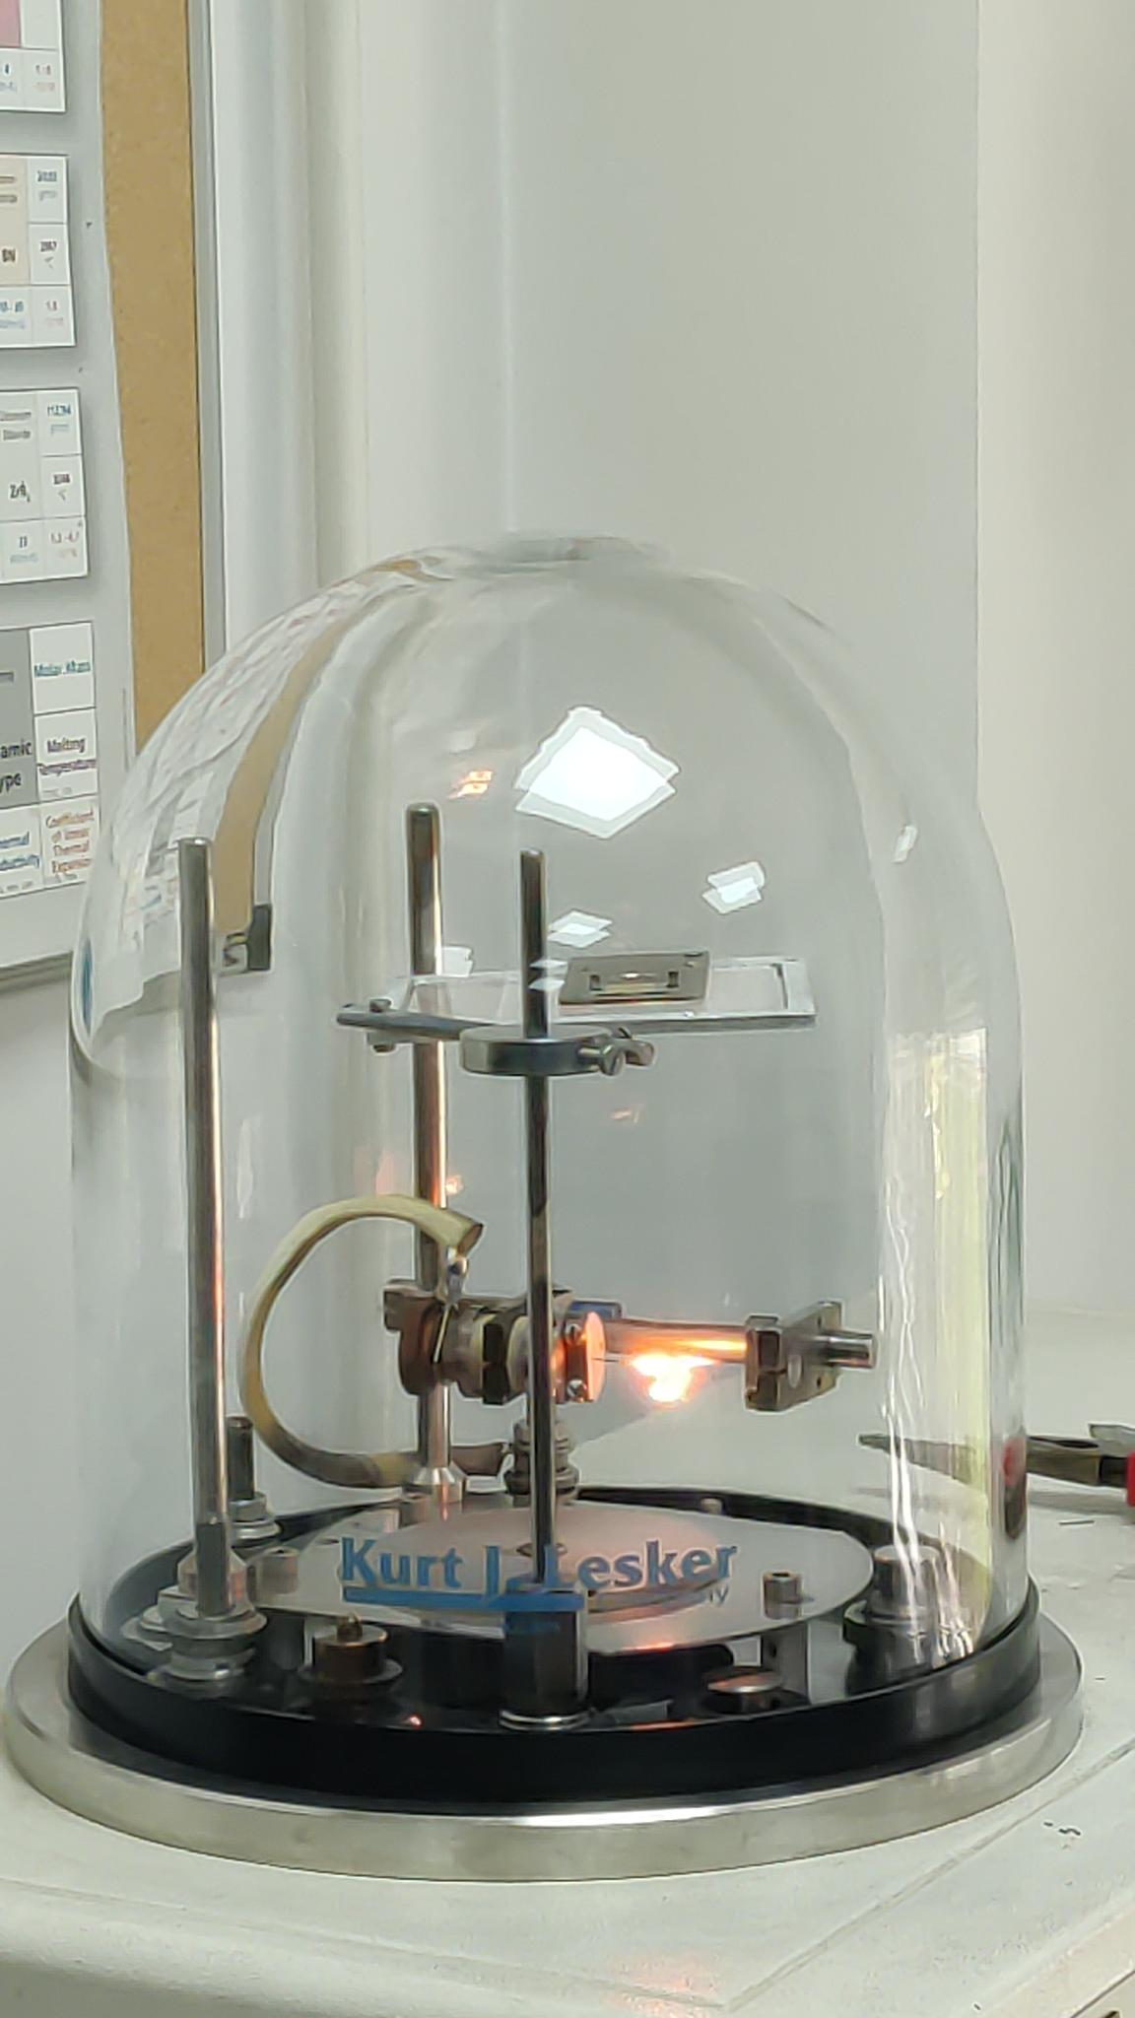
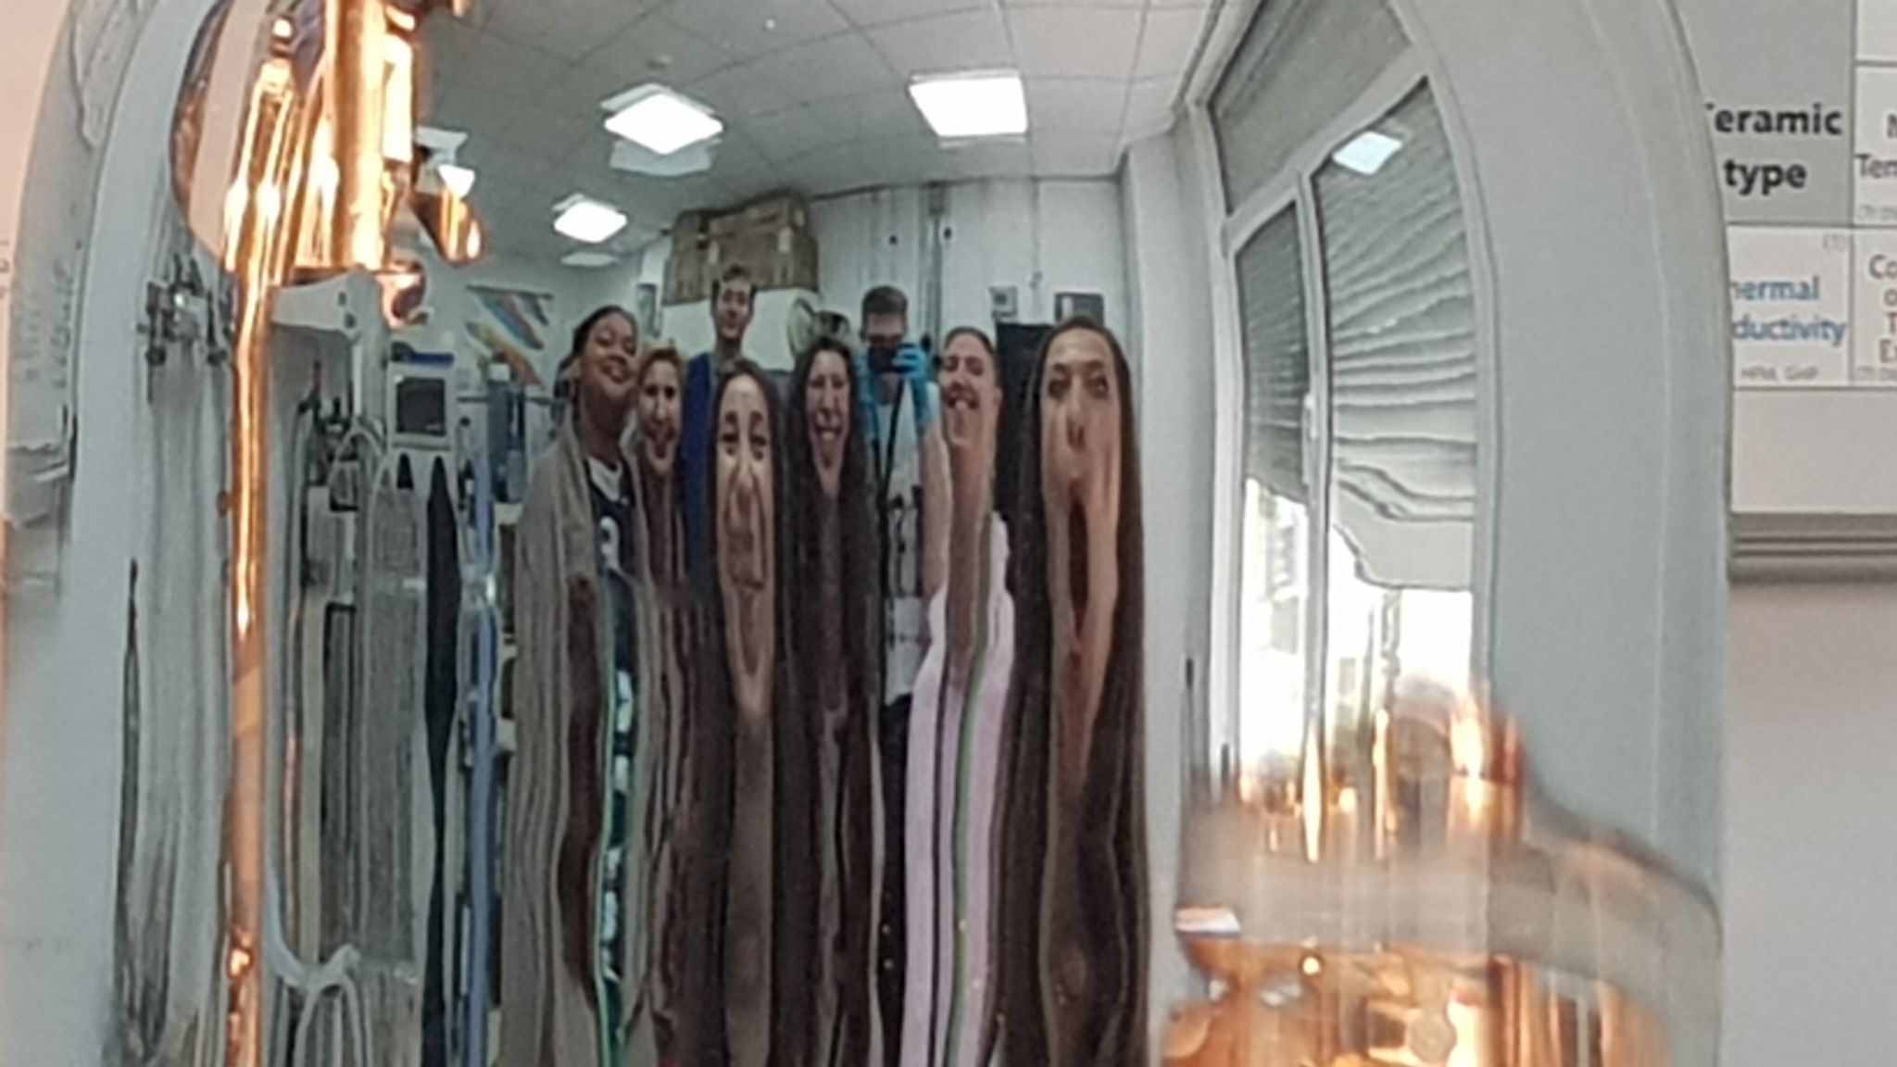
Target preparation
Al on Au substrate
Vacuum evaporation technique

Slide 9
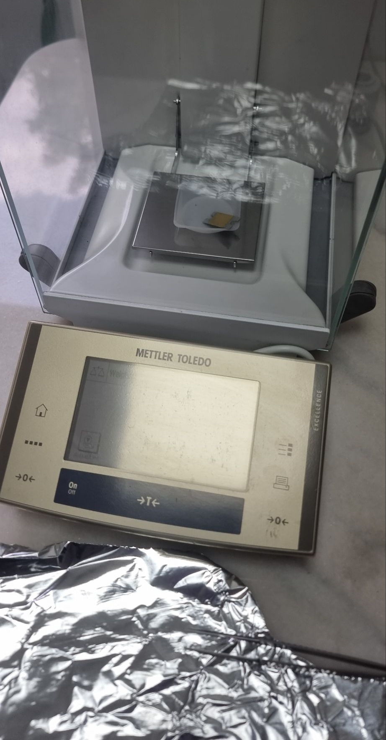
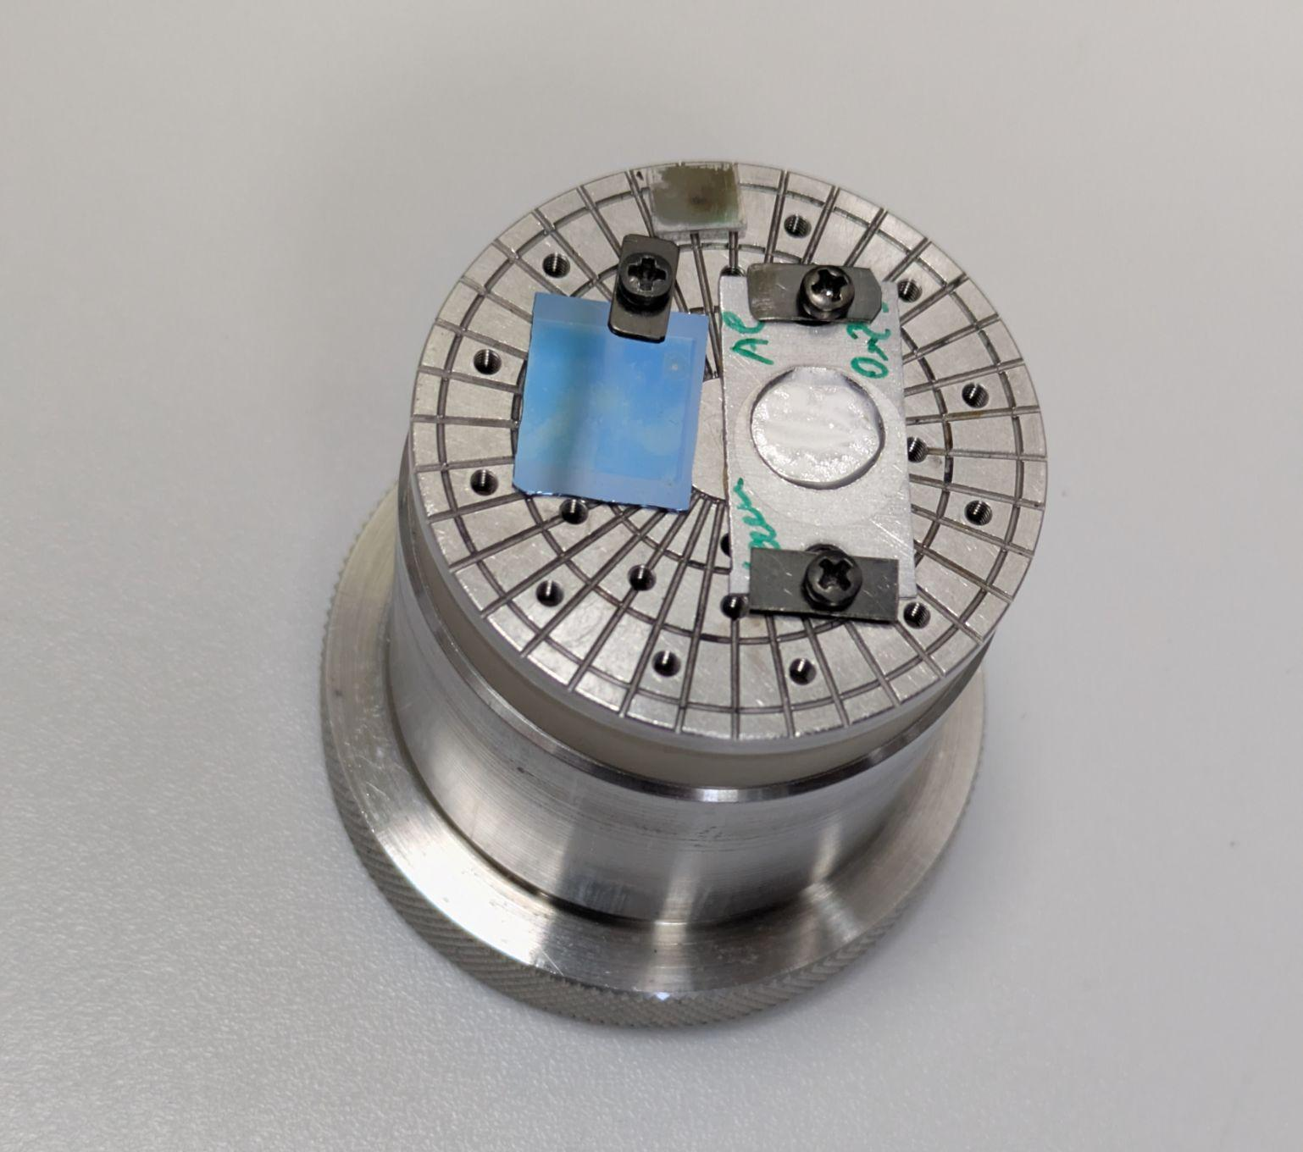
Resulting sample

Slide 10

Resulting sample
???

Slide 11
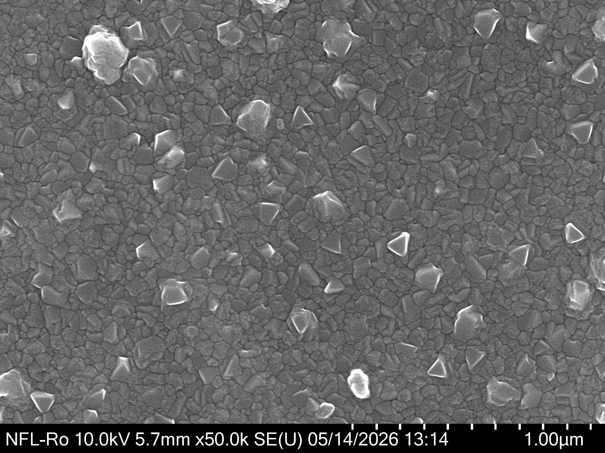
Resulting sample

Slide 12
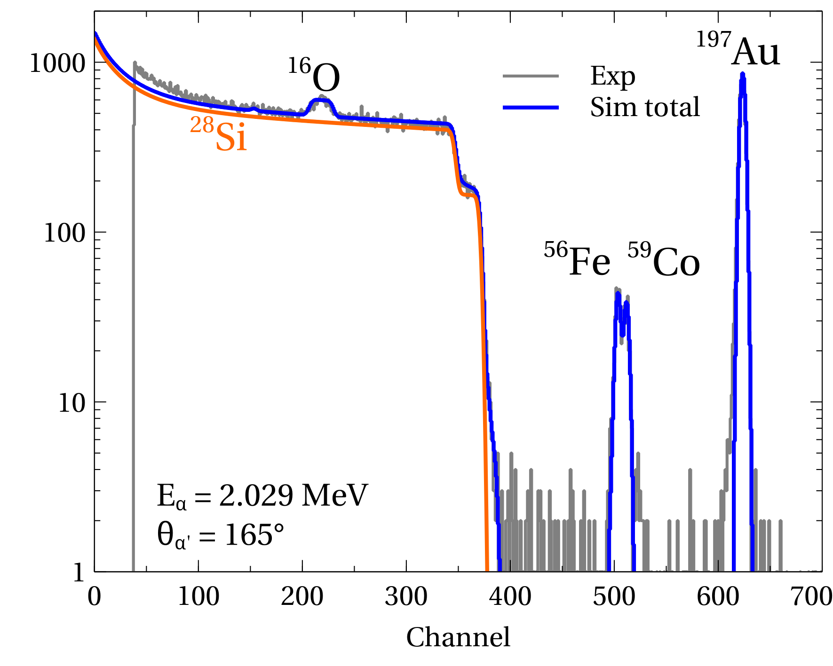
RBS
Layered reference sample
-> Energy calibration

Slide 13
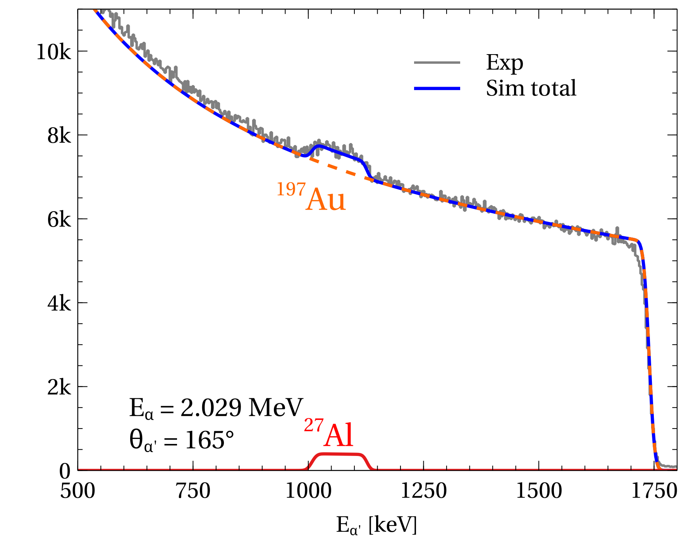
Al+Au - results
Fit -> Al thickness:
1524 tfu (= 68.30 𝜇g/cm²)
or: 25.31 𝜇m

Slide 14
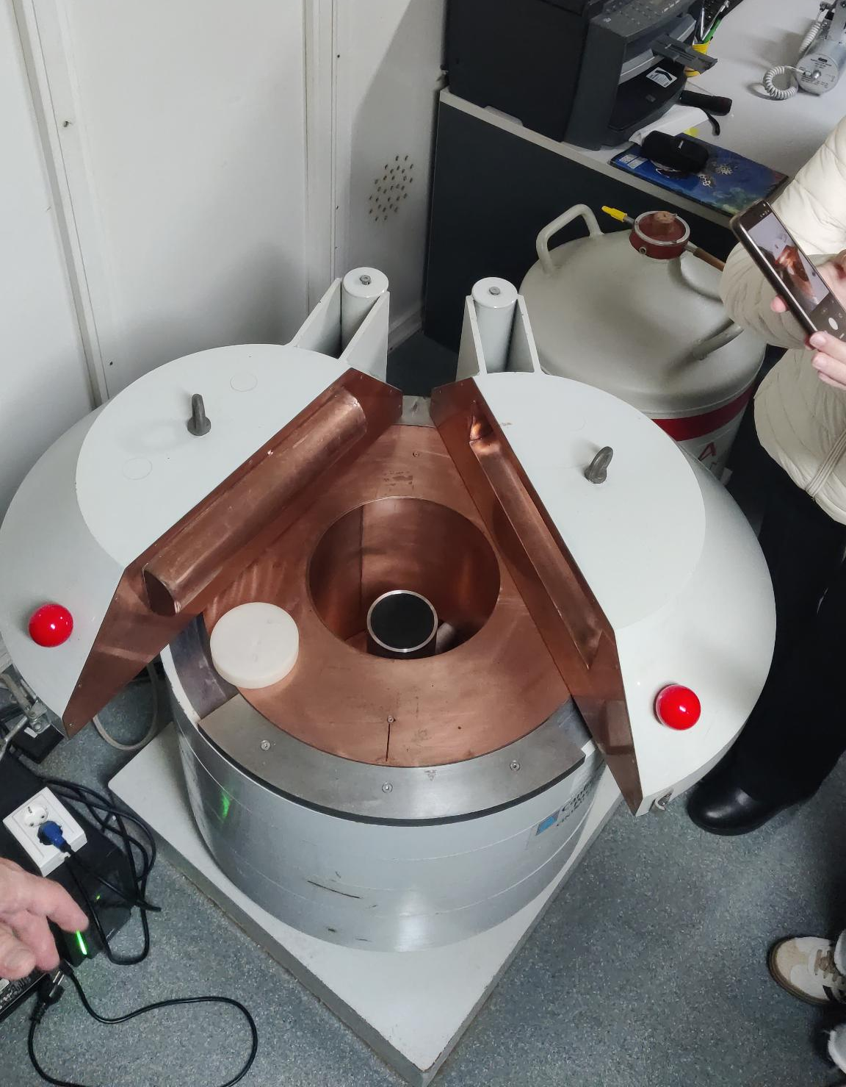
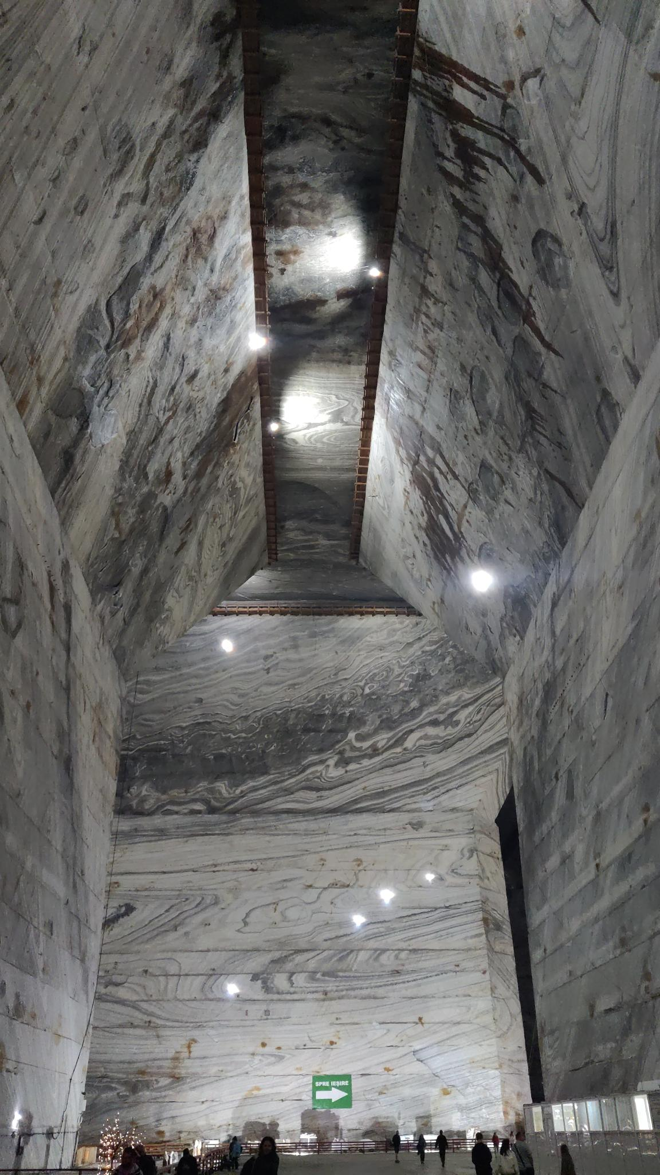
Low background at Slanic salt mine
Pb, Cu, Al shielding

Slide 15
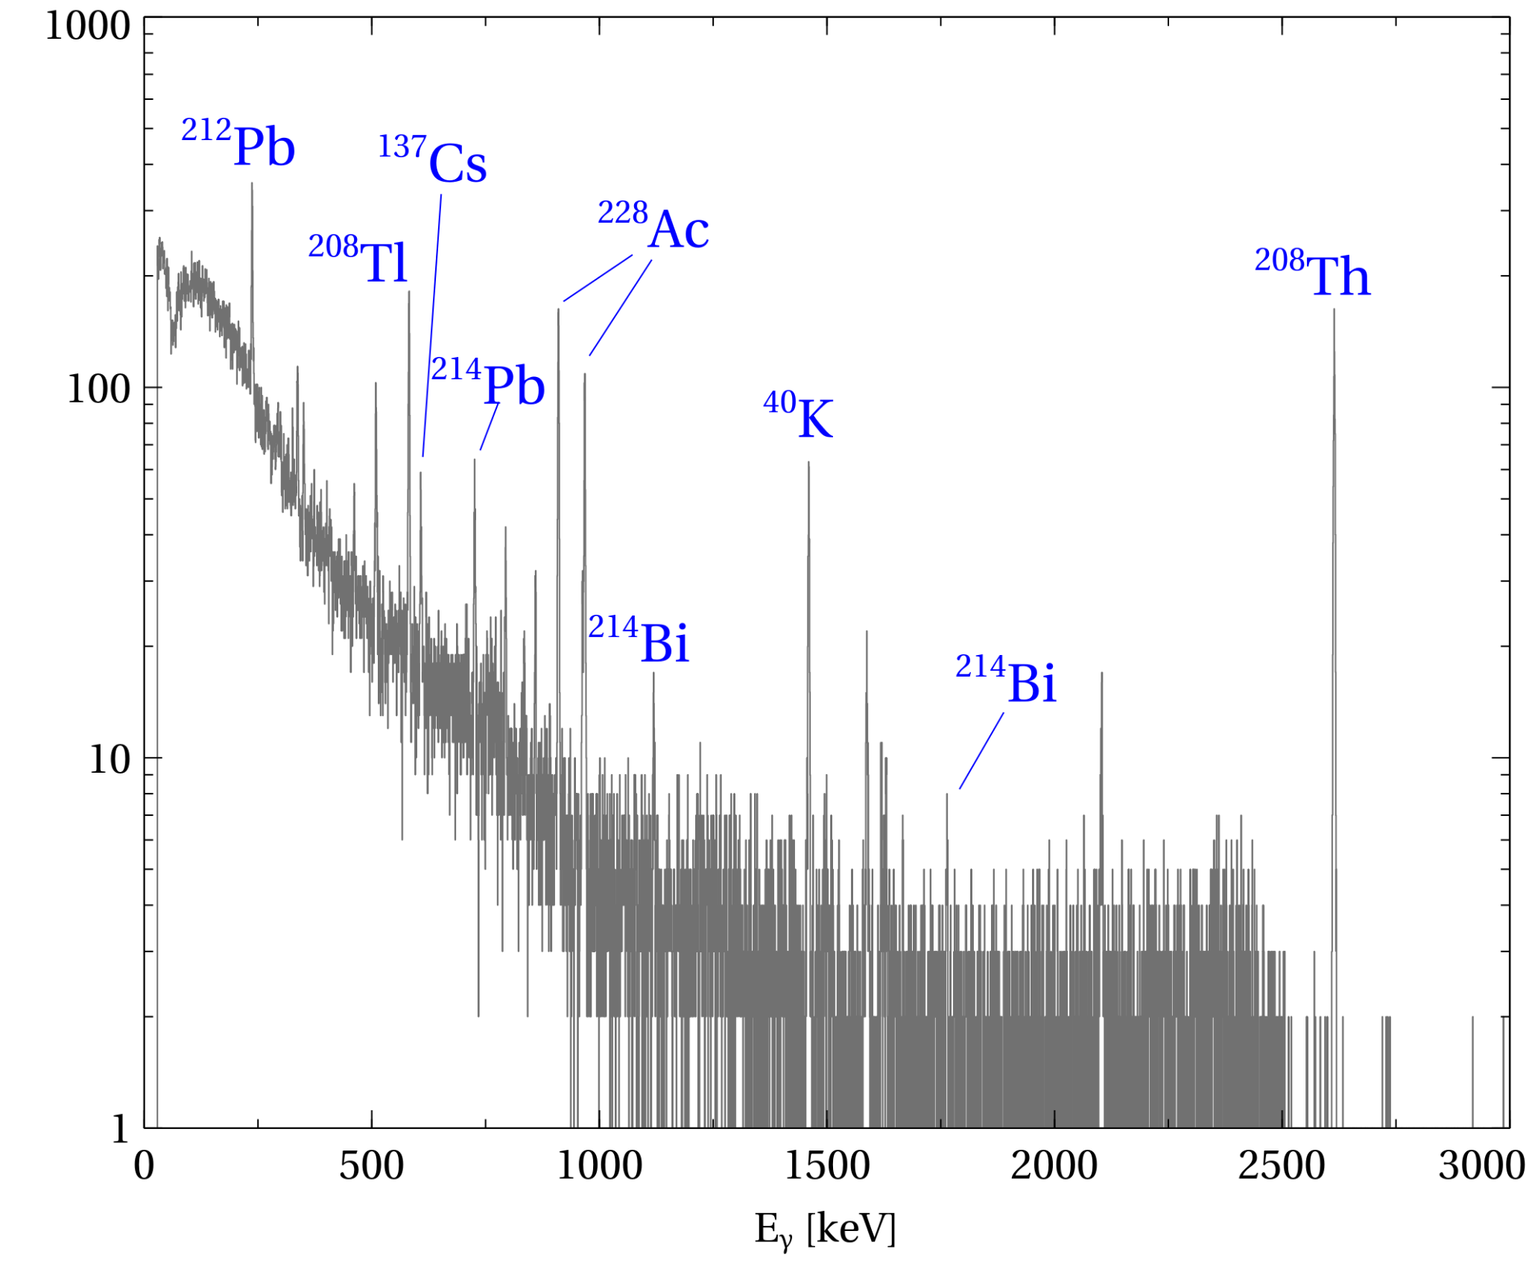
Low background at Slanic salt mine

Slide 16
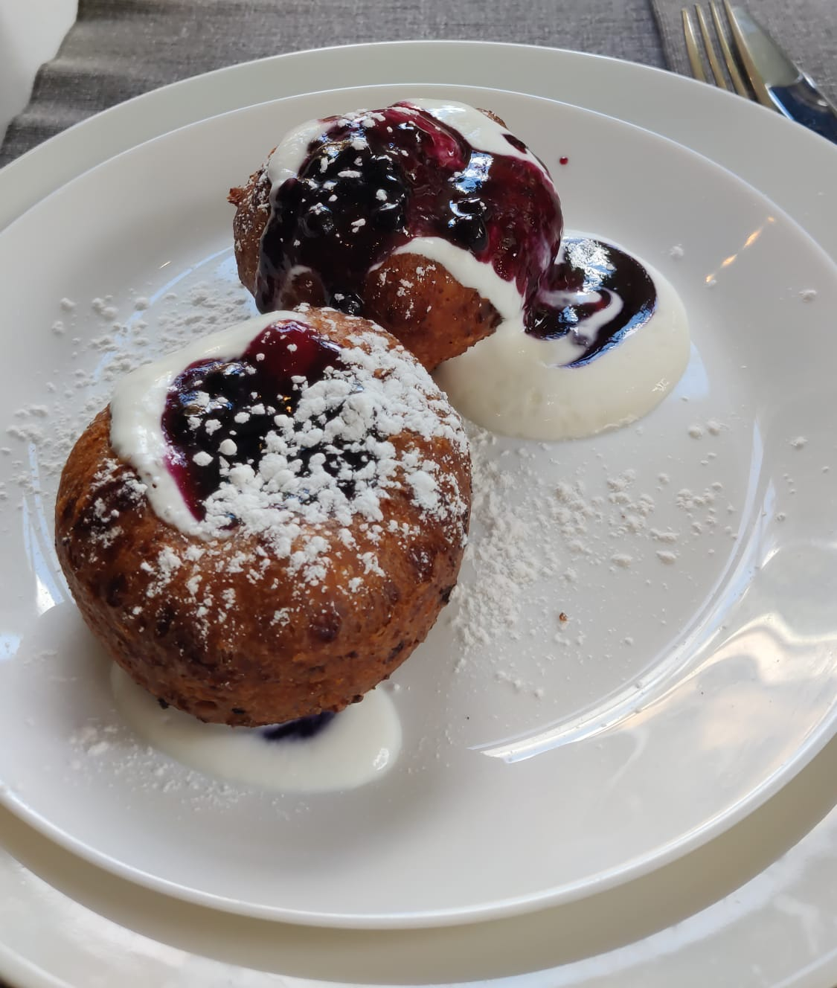
Papanași

Slide 17
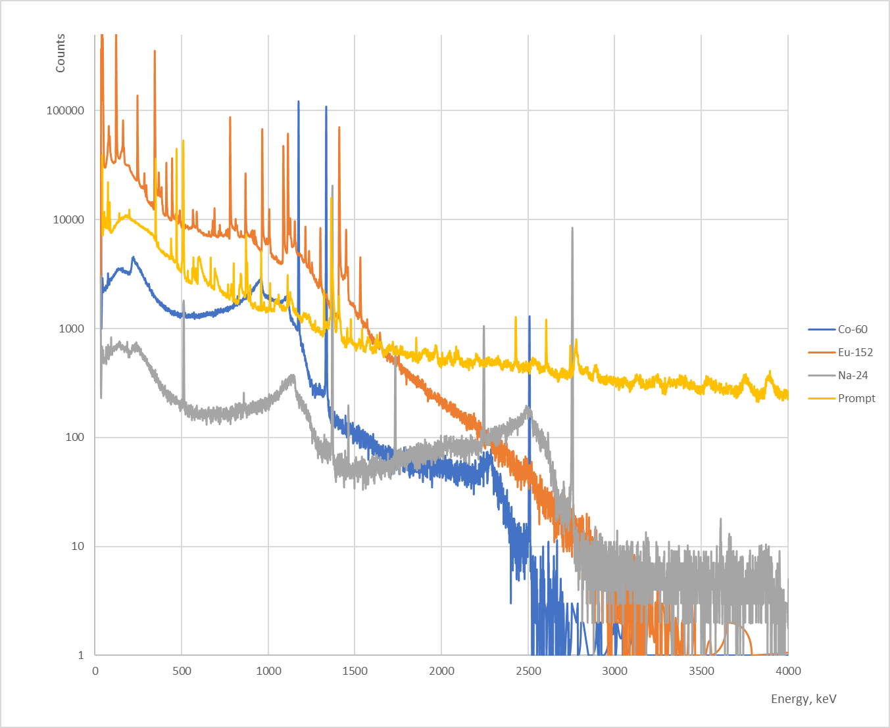
Calibration spectra of Co-60, Eu-152
Post-irradiation spectrum of Na-24
Prompt gamma spectrum

Slide 18
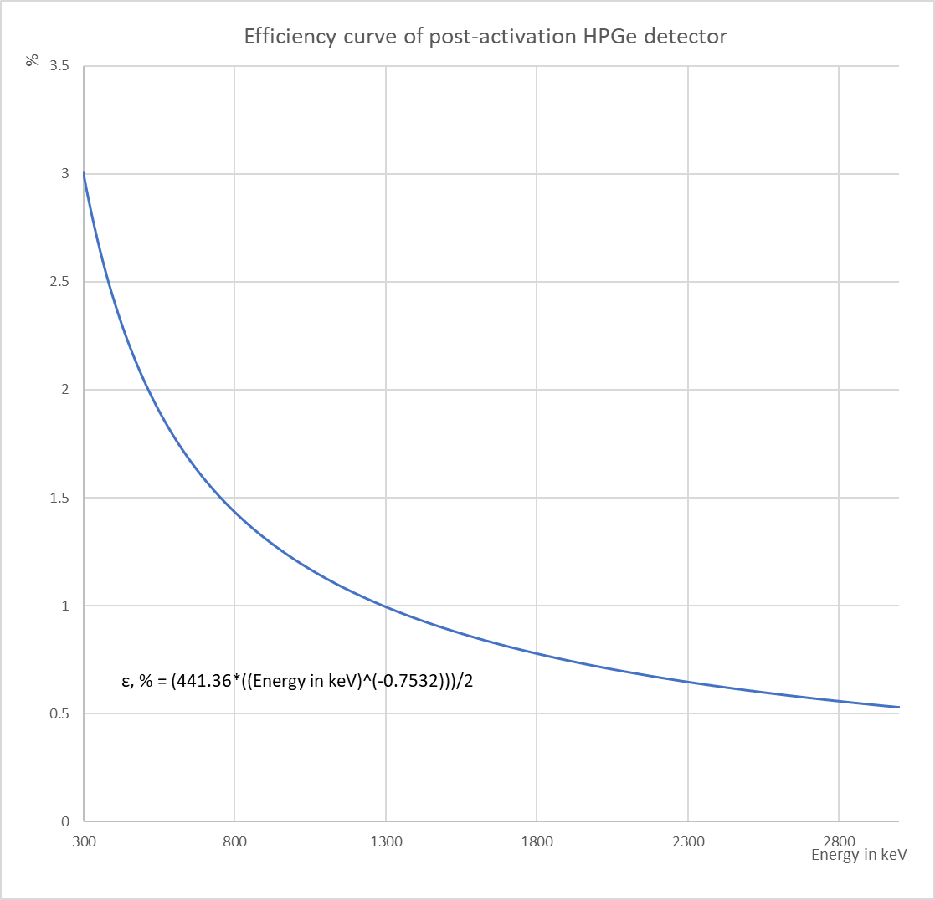

Slide 19
10 MeV ¹³C + ¹²C results
²⁴Na activation yield: 5338837 nuclei
(Product of ²⁴Mg + n channel): 4980142 nuclei
(Product of ²⁴Na + p channel): 3231877 nuclei
(Product of ²¹Ne + 𝛼 channel): 1817565 nuclei
Total of 3.917*(10^15) ¹³C projectiles during irradiation
1.362*(10^-9) ²⁴Na nuclei/¹³C projectile deactivation method
1.271*(10^-9) ²⁴Mg + n nuclei /¹³C projectile (prompt gamma method)
8.250*(10^-10) ²⁴Na + p nuclei /¹³C projectile (prompt gamma method)
4.640*(10^-10) ²¹Ne + 𝛼 nuclei /¹³C projectile (prompt gamma method)

Slide 20
10 MeV ¹³C + ¹²C result interpretation
A significant difference of 65% was achieved by deactivation and prompt gamma method comparison in the yield calculation of ²⁴Na. The difference can only partially be explained by not exactly knowing the excited state population of ²⁴Na during the reaction.
Sample transportation time (from the irradiation chamber to the deactivation detector) was unknown at the time of the calculation. No transportation delay was assumed, but realistically, at least some decays were wasted during it, so the real yield of ²⁴Na nuclei for deactivation measurement can only be higher.
A significant efficiency difference of around one order of magnitude between in-chamber and deactivation detectors was obtained during cooperation between the groups. The mentioned parameter still needs calculation methodology refinement and/or error correction.

Slide 21
10 MeV C13 + C12 reaction Na-24 yield comparison
Some exit channels:
→²⁴Mg + n (E_{𝛾}= 1368.63 keV)
→²⁴Na + p (E_{𝛾}= 472.2 keV)
→²¹Ne + 𝛼 (E_{𝛾}= 350.7 keV)

Slide 22
10 MeV C13 + C12 reaction Na-24 yield comparison
Some exit channels:
→²⁴Mg + n (E_{𝛾}= 1368.63 keV)
→²⁴Na + p (E_{𝛾}= 472.2 keV) compare to ²⁴Na activation result
→²¹Ne + 𝛼 (E_{𝛾}= 350.7 keV)

Slide 23
24Na + p Thick Target Cross Sections
Transition (Energy range) | Δx (mg/cm²) | Nt, 10¹⁸ (nuclei/cm²) | ΔY, 10⁻9 | Cross section σ (cm²), 10⁻²⁸ | Error in σ (cm²), 10⁻³⁰ | Effective Energy
Green → Blue | 0.062 | 3.124 | 1.239 | 3.967 | 7.545 | 9.80 MeV
Blue → Yellow | 0.093 | 4.653 | 1.363 | 2.929 | 5.065 | 9.30 MeV
Yellow → Red | 0.029 | 1.499 | 1.740 | 1.161 | 15.29 | 8.90 MeV

Slide 24
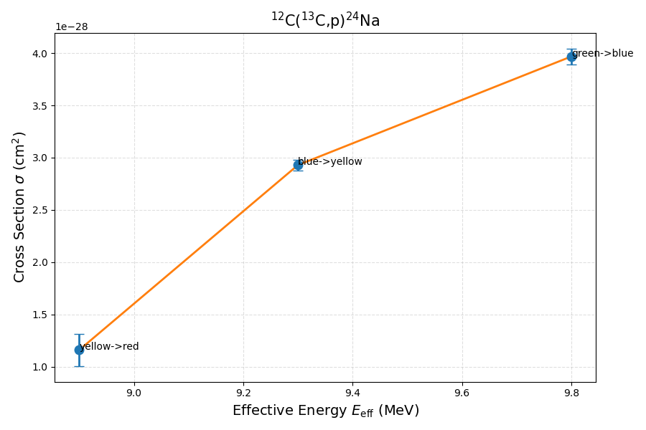
24Na + p Thick Target Cross Sections
Transition (Energy range) | Δx (mg/cm²) | Nt, 10¹⁸ (nuclei/cm²) | ΔY, 10⁻9 | Cross section σ (cm²), 10⁻²⁸ | Error in σ (cm²), 10⁻³⁰ | Effective Energy
Green → Blue | 0.062 | 3.124 | 1.239 | 3.967 | 7.545 | 9.80 MeV
Blue → Yellow | 0.093 | 4.653 | 1.363 | 2.929 | 5.065 | 9.30 MeV
Yellow → Red | 0.029 | 1.499 | 1.740 | 1.161 | 15.29 | 8.90 MeV

Slide 25
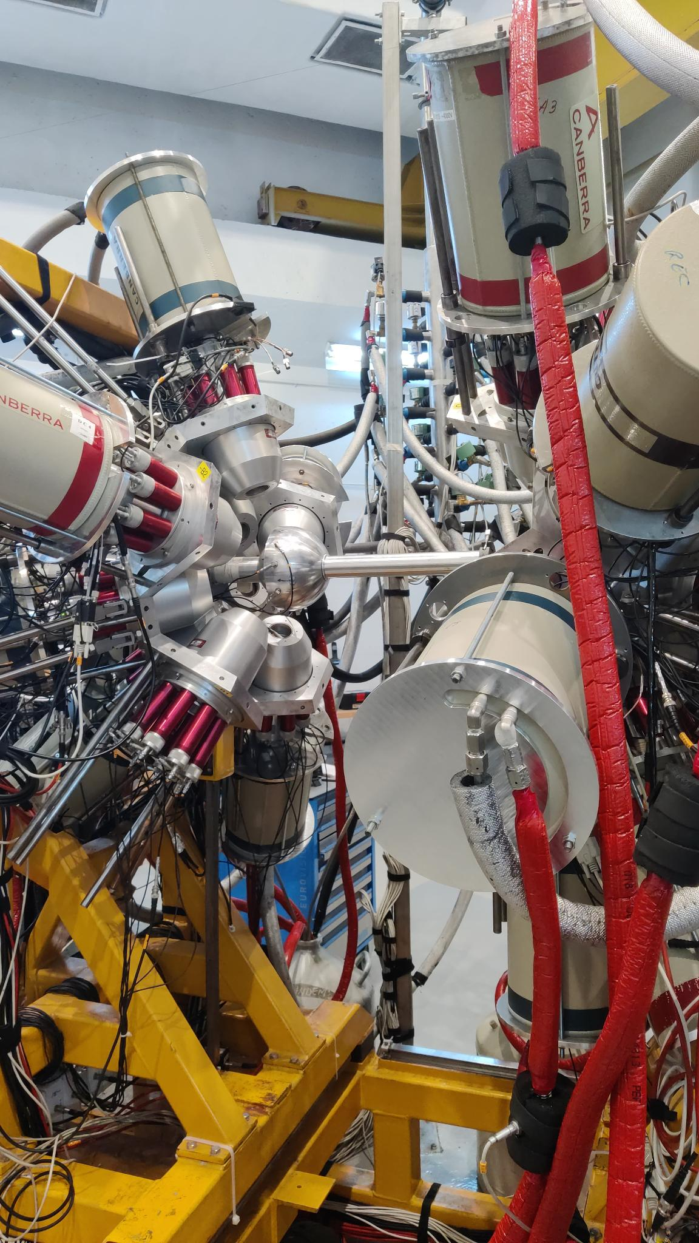
9 MV Experiment
¹⁰⁸Cd + 𝛼(24 MeV)
  prompt gammas from Sn
Rosphere: 𝛾-𝛾 coincidences
  Calibrate spectra
  Construct 𝛾-𝛾 matrix
  Infer lifetimes from doppler shifts

Slide 26


9 MV Experiment
¹⁰⁸Cd + 𝛼(24 MeV)
  prompt gammas from Sn
Rosphere: 𝛾-𝛾 coincidences
  Calibrate spectra
  Construct 𝛾-𝛾 matrix
  Infer lifetimes from doppler shifts
We did not have time
to do this…

Slide 27
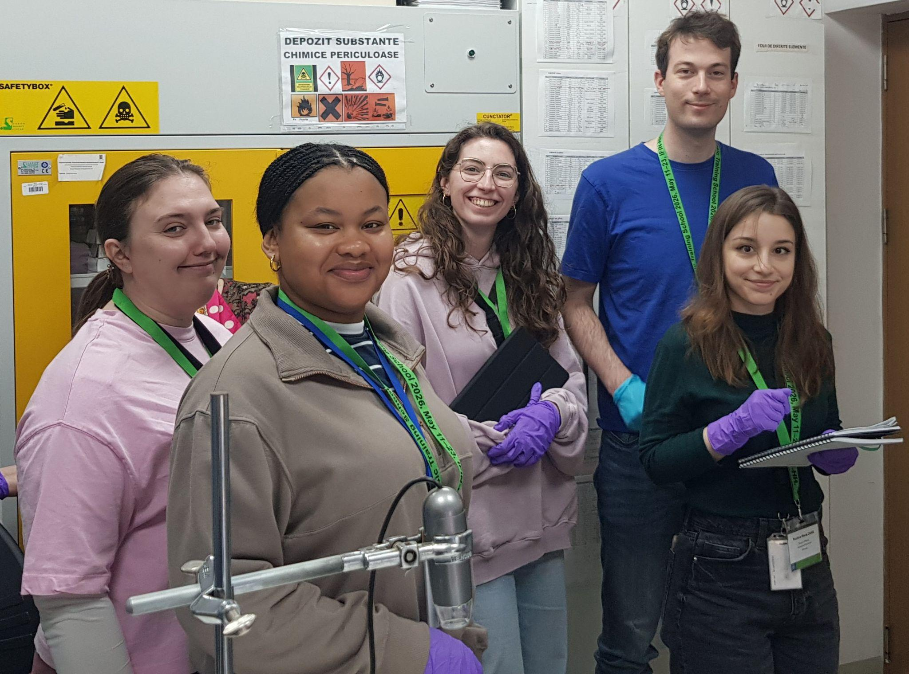
A word of appreciation
All members of the green team sincerely thank the IFIN-HH team for organizing such a memorable and beneficial event. We thank all the professors, supervisors, and lab employees for their tireless work and favorable approach to all the participants and this event in general. The green team expresses gratitude to all of you. We look forward to further cooperation.

Slide 28

Thank You!

Slide 29
Mg24+n 1368kev | energy | Y | Yerr | X mg/cm2
green | 10 Mev |  |  | 1.6027
blue | 9.6 Mev | 1.55e-09 | 7.62e-12 | 1.5404
yellow | 9.0 Mev | 8.65e-10 | 3.82e-11 | 1.4476
red | 8.8 Mev | 3.03e-10 | 4.84e-12 | 1.4177
na24 | energy | Y | Yerr | X mg/cm2
green | 10 MeV | 2.3е-0.9 | 2.23e-11 | 1.6027
blue | 9.6 MeV | 1.9608e-09 | 7.62e-12 | 1.5404
yellow | 9.0 MeV | 5.98e-10 | 2.23e-11 | 1.4476
red | 8.8 MeV | 4.24e-10 | 5.298 | 1.4177

Slide 30
24Na + p Thick Target Cross Sections
Transition (Energy range) | Effective Energy (MeV) | Δx (mg/cm²) | nt (nuclei/cm²) | ΔY | Cross section σ (cm²) | Error in σ (cm²)
Green → Blue (10.0 → 9.6 MeV) | 9.80 | 0.06230 | 3.124 × 10¹⁸ | 1.239 × 10⁻⁹ | 3.967 × 10⁻²⁸ | 7.545 × 10⁻³⁰
Blue → Yellow (9.6 → 9.0 MeV) | 9.30 | 0.09280 | 4.653 × 10¹⁸ | 1.363 × 10⁻⁹ | 2.929 × 10⁻²⁸ | 5.065 × 10⁻³⁰
Yellow → Red (9.0 → 8.8 MeV) | 8.90 | 0.02990 | 1.499 × 10¹⁸ | 1.740 × 10⁻¹⁰ | 1.161 × 10⁻²⁸ | 1.529 × 10⁻²⁹

